Slide 1
Stochasticity vs. Noise in Malaria Studies & Simulation
David L Smith, smitdave@uw.edu
Professor of Global Health
19 Apr 2017
Infectious Disease Modeling Symposium, Seattle, WA

Slide 2
How to build, fit, & interpret models
Biological & environmental mechanisms / processes in individuals
These processes & interactions among individuals generate patterns in populations
Even though the world is really stochastic / random
The expectation is what tends to matter most
Theory is usually based on simple concepts & deterministic models of the expectation
Models / theory & constrained opportunity drive development of metrics
The metrics play a central role in the design of studies
Constrained by questions & available evidence
Develop a model that 1) fits; but that is 2) as “simple as possible, but no simpler.”

Slide 3
Stochasticity: mechanism or noise?
Demographic stochasticity can sustain oscillations that are damped in the analogous deterministic model

Slide 4
Stochasticity: mechanism or noise?

Slide 5
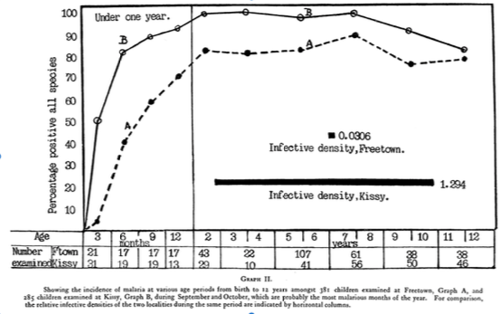
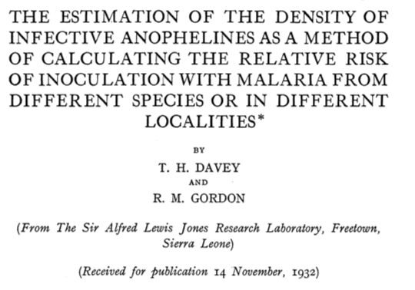
Standard Measures of Malaria Tell Different Stories about Malaria Transmission

Slide 6
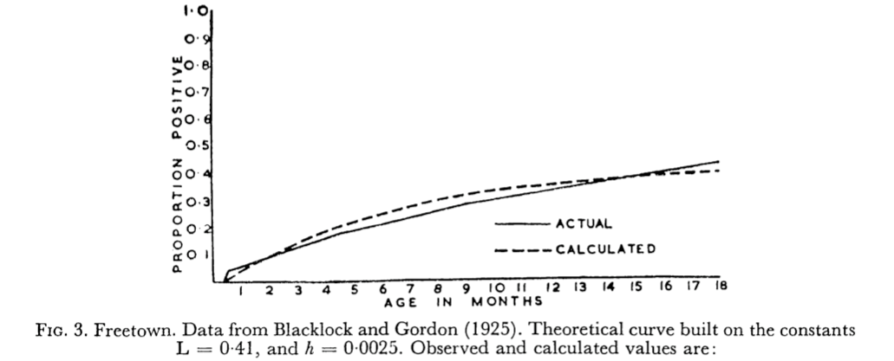
Macdonald Fit Simple Curves to These (and other) Data

Slide 7
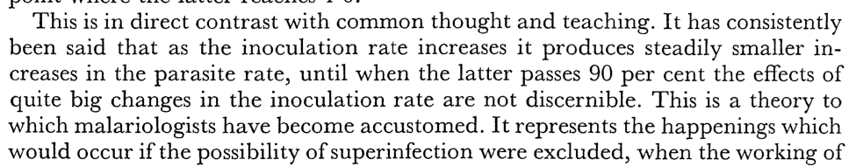
…& asked why there was such a large discrepancy between mosquito counts & infection rates

Slide 8
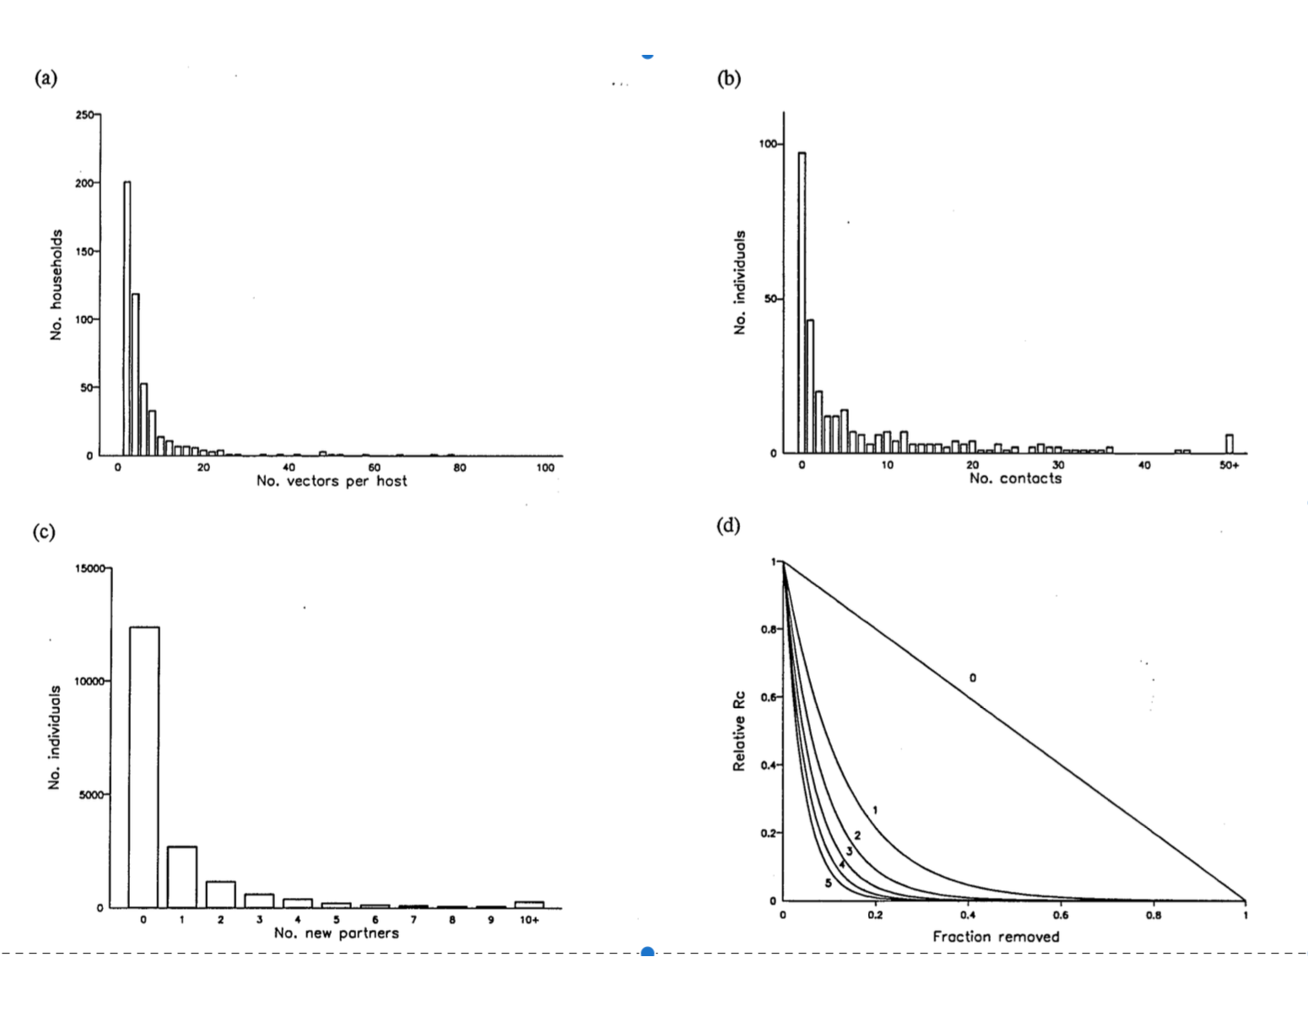
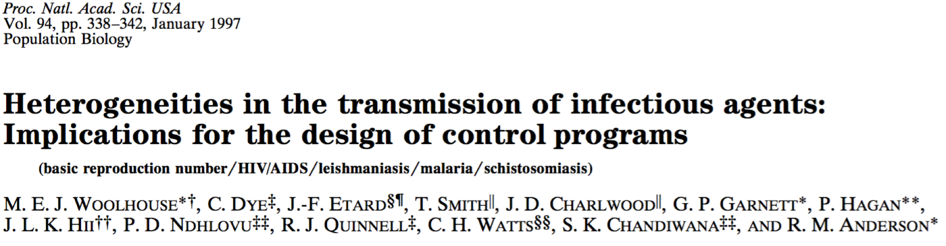
Frailty (Heterogeneous Biting) /
Proportional Mixing
Targeting Malaria
Malaria
Schistosomiasis
STD

Slide 9
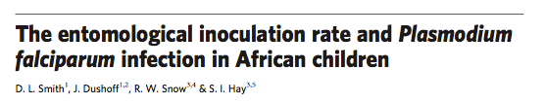
Heterogeneous Biting & Scaling Relationships
EIR vs. PR

Slide 10
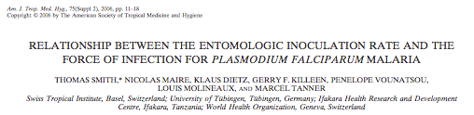
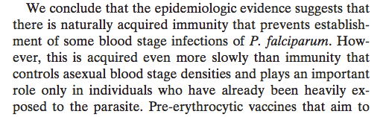

Slide 11
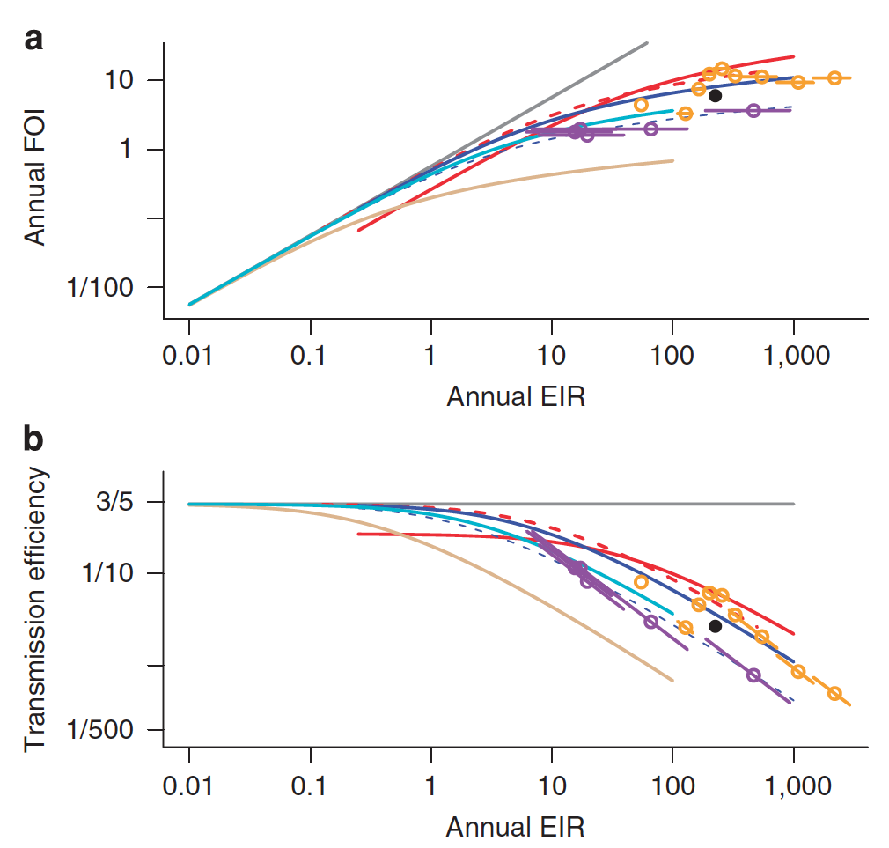
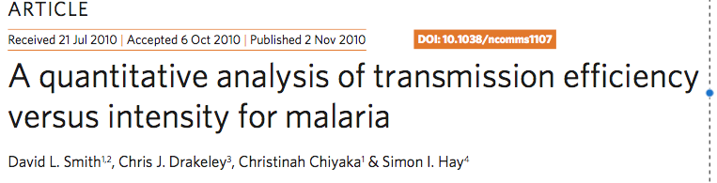
Heterogeneous Biting & Scaling Relationships
EIR vs. FOI

Slide 12
PRISM Study in UGANDA
Power Laws for Counts Data
Three study sites in Uganda
~100 households in each study site
One night each month of mosquito counts using a CDC Light Trap
Study
  Grant Dorsey et al. (UCSF)
  Moses Kamya et al. (IDRC, Uganda)
Analysis
  Su Kang, Donal Bisanzio (Oxford)
  Laura Cooper (Princeton / Cambridge)
  Isabel Rodriguez Barraquer, Bryan Greenhouse (UCSF)

Slide 13
PRISM Study in UGANDA
Power Laws for Counts Data
Why is there a power-law relationship?
Does it matter for malaria transmission?
Does it affect the accuracy of measures of malaria?
Does it affect the conclusions of analysis based on malaria transmission models?

Slide 14
Causes of Heterogeneity
Household Biting Propensities
Seasonality
Amplification
2.2 in Jinja
2.5 in Kanungu
1.5 in Tororo
Residual Error

Slide 15
PRISM Study in UGANDA
Power Laws for Counts Data
In linked studies of the same households, we conducted detailed epidemiological studies
  Passive reporting of malaria fever from outstanding medical care
  Active sampling at the household scheduled every three months
This is not what I expected to see if “heterogeneous biting” was the cause of “inefficient transmission”

Slide 16
Retracting last year’s talk
By that moron Professor David L Smith

Slide 17
Inefficient Transmission
Simulated 14-day Attacks per 100 people
Simulated study to estimate FOI from the Attack Rate
EFFECT SIZES:
heterogeneous biting: 1.3-1.6
unexplained:
10-20

Slide 18
What’s the right answer?
From that genius Professor David L Smith

Slide 19
Causes of Heterogeneity

Slide 20
Inefficient Transmission
Simulated 14-day Attacks per 100 people
Simulated FOI

Slide 21
Summary
Environmental noise, seasonality, and household heterogeneity were quantified using mosquito counts data from three study sites in Uganda
When that pattern was used to simulate a study:
  Environmental noise and seasonality caused transmission to be highly inefficient through highly temporally aggregated bites
  The magnitude of environmental noise scaled with overall transmission intensity
  The effect size was of the right magnitude to explain most of the inefficiency in transmission observed across study sites
  This pattern was consistent with other studies linking EIR & FOI
Environmental noise is a sufficient cause for MOST of the inefficient transmission in these three study sites in Uganda
“Heterogeneous biting” propensities are probably not the cause

Slide 22
Conclusions
Insect counts, in particular mosquito counts, tend to be modeled well with negative binomial distributions, and they tend to follow power laws
Environmental noise is probably an underlying cause of these power law relationships
Environmental noise is, therefore, likely to be a sufficient cause of ”inefficient transmission” across the spectrum of malaria transmission intensity
The causes of this “environmental noise” and (in particular) the things that make it different in different contexts are of great interest
It is perilous to treat ”stochasticity” as ”noise” in making the translation from evidence to process to policy

