Slide 1
Data (to fund) Science
Wellcome Data labs
Nick Sorros, 17 April 2019

Slide 2
Agenda
Intro to Wellcome
Policy tool
Other tools
ML next steps
Take away points
Notes:
Intro to Wellcome that will set up the context

Slide 3
Intro to Wellcome

Slide 4
Me 👨🏻‍💻
MSc Advanced Computing at Imperial college
Data scientist for 5 years
Startups like Conversocial, 6tribes and Seedrs
Communities such as PyData and DataKind
Senior data scientist in Wellcome Data labs

Slide 5
Wellcome
23.2B investment portfolio (2nd biggest foundation in the world)
2nd biggest funder of research in the UK after UKRI
Funded 1.1B in 2017 across 939 awards
We fund basic science with a focus on infections diseases and genomics
Also operate a museum, fund public engagement work and do policy

Slide 6
Data labs
“Inform Wellcome decision making”
👨🏻‍💻
Senior data scientist
👨🏻‍💻
Senior data engineer
👩🏾‍💻
Partnership manager
👩🏻‍💻
Senior Tableau analyst
👨🏻‍💻
Senior data engineer
👩🏻‍💻
Data
scientist
👨🏻‍💻
Data
scientist
👨🏻‍💻
Data
scientist
👨🏻‍💻
Software engineer
👩🏻‍💻
User
researcher
👨🏻‍💻
Tableau analyst
👩🏼‍💻
Data
engineer
Data science
Software engineering
Strategy
& UX
Analytics
Notes:
Three main teams
Analytics
Software engineers
Data scientists
But also a user researcher and partnership manager

Slide 7
Mission
To improve health for everyone by helping great ideas to thrive

Slide 8
Ambition 1
Our understanding of science and health is transformed by research

Slide 9
Ambition 3
Knowledge and discoveries are shared, accessed and used in a manner that maximizes health benefit

Slide 10
Policy tool

Slide 11
Ambition 7
Health is improved through
changes in policy and practices

Slide 12
Indicators
Health is improved through changes in policy and practices
Policy and practice are informed by research and researchers
Number of policy cases that reference WT funded research
Number of grantees involved in policy activities
Decision makers take up Wellcome’s position on policy and practice
Number of Wellcome direct interventions aimed to influence policy

Slide 13
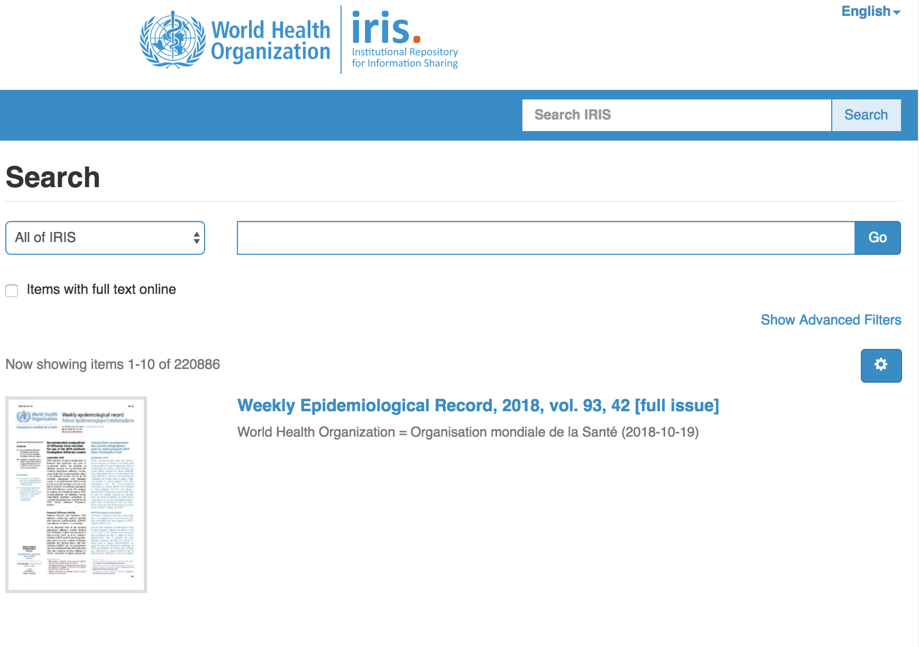
Manual approach
220.886
Notes:
Manual approach is infeasible from the get go

Slide 14
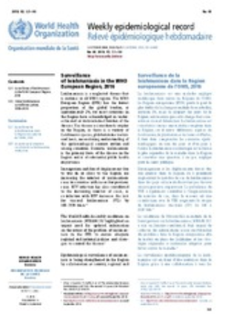
Automatic approach
WSF
NICE
Gov.uk
Uber
EPMC
Machine learning
Notes:
Pipeline
Scrape pdfs from policy organizations
Find references if any
Split references section into individual references
Parse individual references to extract title, journal, author etc
At the same time we pull publications from external providers such as Uber or EPMC
And finally match them together using titles
These matched references end up in our data warehouse
And finally to Tableua so business people can access them

Slide 15
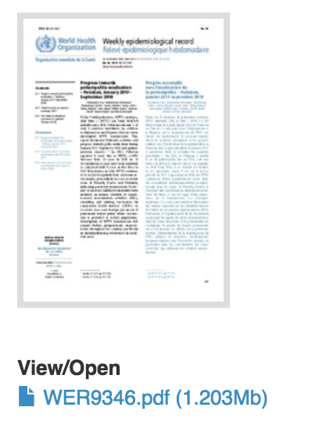
Scrape
Notes:
The idea is
Empty search
Go to all pages
Go to all documents
Download pdf
We use
Scrapy
Weekly

Slide 16
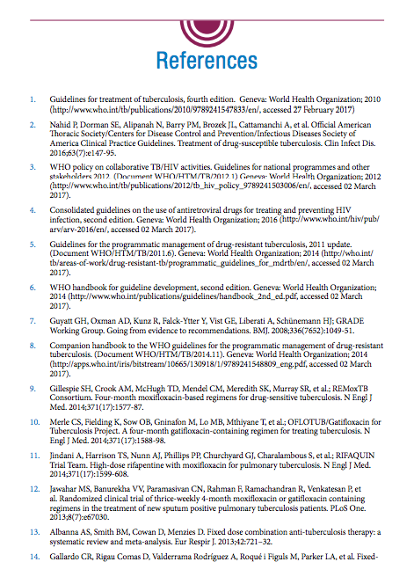
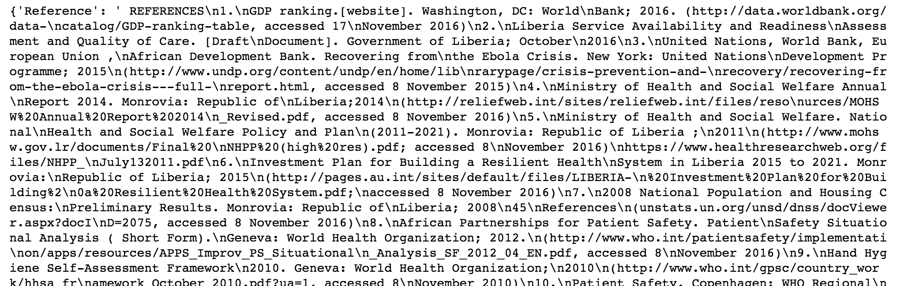
Find
Notes:
The idea is
Split document to headers
Look for header titles like References, Bibliography etc

Slide 17
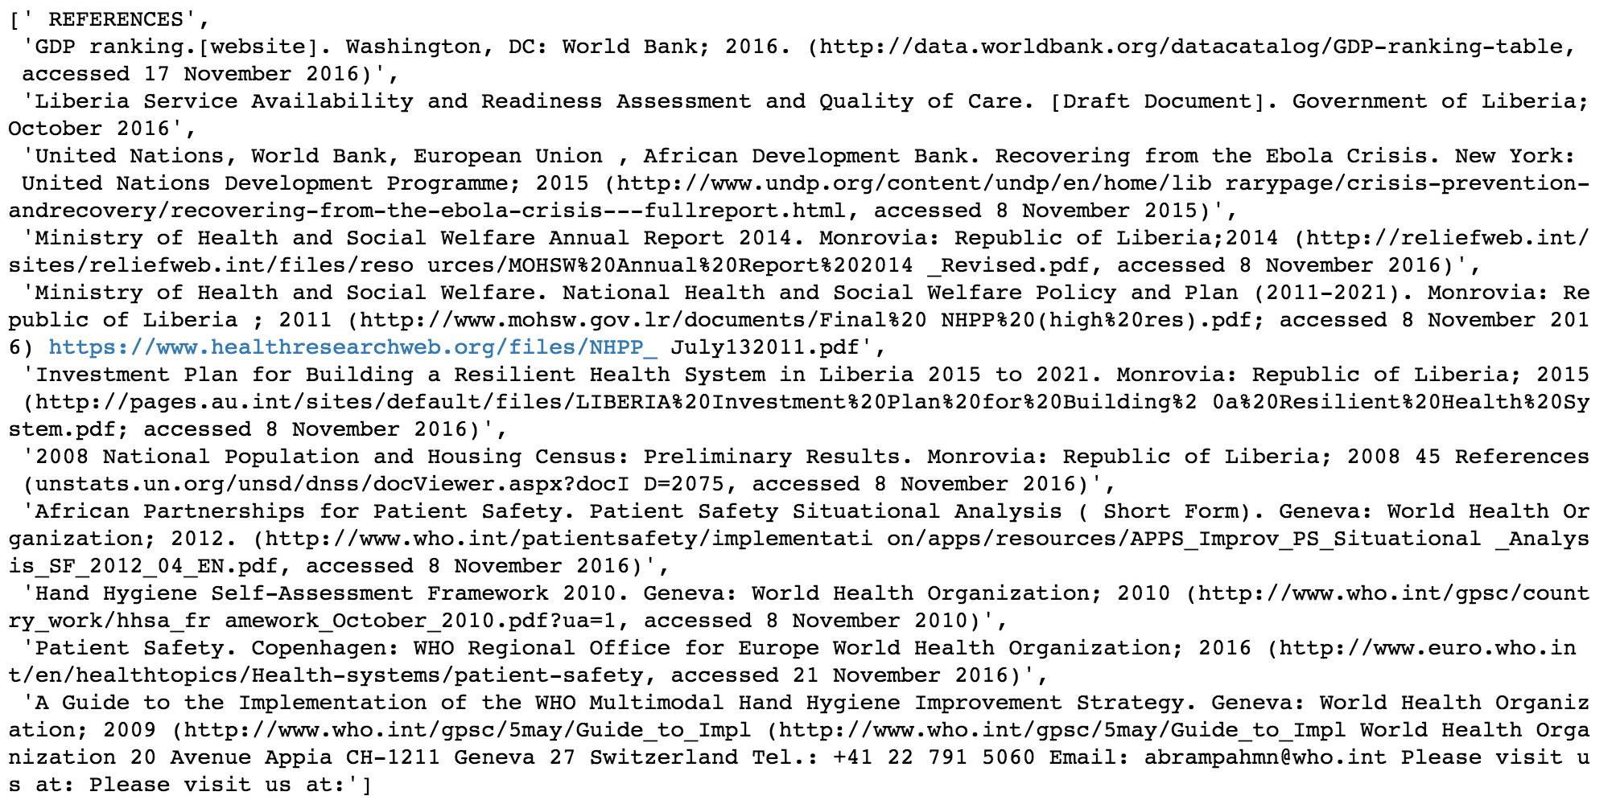
Split
Notes:
We split using a custom regex that utlises the common structure of references
Numbered
Bullet points
Tabs before

Slide 18
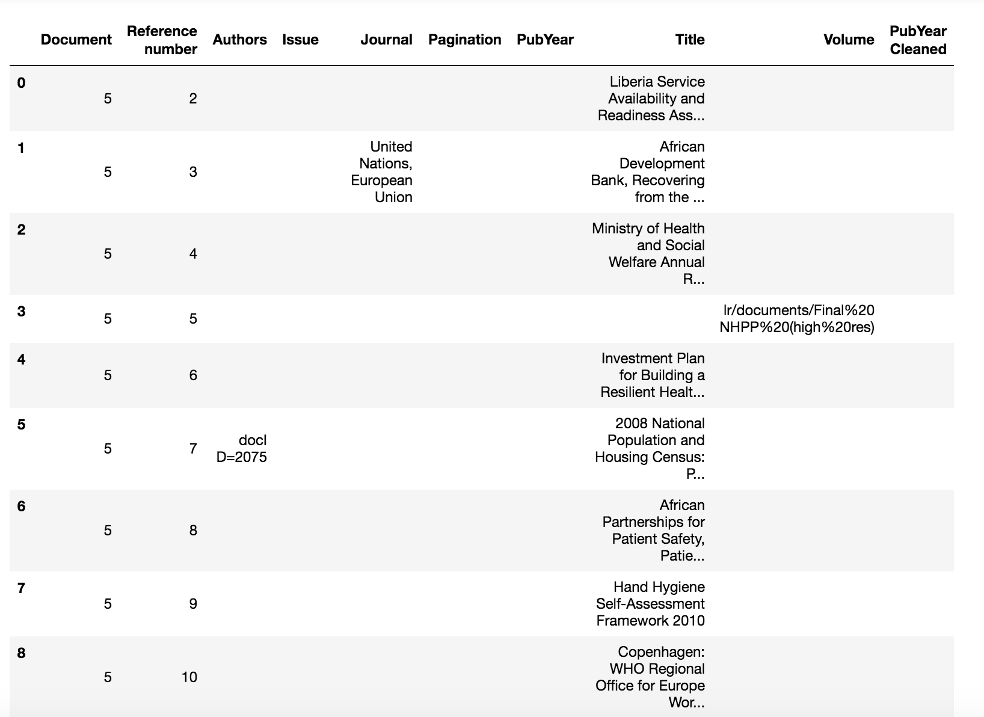
Parse
Notes:
Parsing is a three step process
Split reference string into tokens. We split by comma, full stop, exclamation mark etc.
Predict tokens using a Naïve Bayes model and a bag of word representation
Combine tokens with same category together

Slide 19
Match
Predicted authors | Predicted title | Predicted journal
Hong Chau TT, Hoang Mai HT | Timing of initiation of antiretroviral therapy in human immunodeficiency virus (HIV)-associated tuberculosis meningitis
Rahman A, Rwagatare P | Grand challenges: integrating maternal mental health into maternal and child health programmes | PLoS Med
Dimensions title
Timing of Initiation of Antiretroviral Therapy in Human Immunodeficiency Virus (HIV) - Associated Tuberculous Meningitis
Notes:
Finally we use the predicted title to match with our database of publications using a tf-idf approach and cosine similarity along with a manual tweaked threshold

Slide 20
Accuracy
Find
Split
Parse
Match
85%
57%
87%
96%
Notes:
Find. FP of references section (how many are indeed true)
Split. Percentage of documents that our error between actual and predicted is less than 30%
Parse. Accuracy for title
Match. Sample 100 true reference matches and constructed4 a dataset with 1 and second closest match as true and false

Slide 21
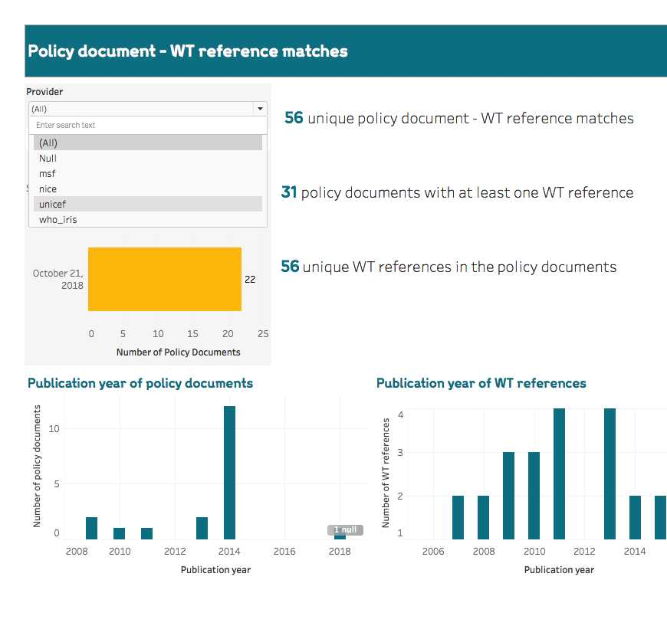
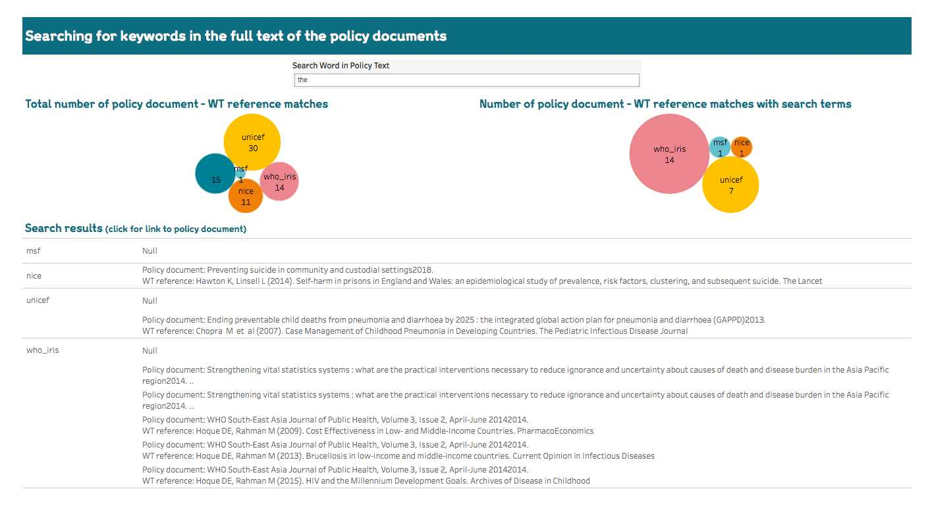
Dashboard
Notes:
Interactive dashboards that allows the user
To view how many publication end in which policy organizations
Search for specific keywords in the policy documents

Slide 22
Volume
Organisation | Documents | WT References
Gov.uk | 102.903
Parliament | 18.744
WHO | 7.484 | 867
NICE | 289 | 5
Unicef | 189 | 33
MSF | 69 | 1
Notes:
Gov.uk and the parliament are
newly scraped source hence no WT references yet.
This slides proves not only that the
scale of the problem is beyond reach for a manual approach
but also how even taking a sample would be hard

Slide 23
Internal interest
Science team (RC2H review)
Policy team (Board of governors report)
Central team (Horizon scanning)
Notes:
Has been used to
Collect evidence of policy impact for one of our science schemes
Systematically instead of anecdotally track how our policy advocacy efforts are being reflected on policy documents
Compare our reach with other funders to identify gaps and opportunities for funding

Slide 24
External interest
Notes:
Two types of external interest
Organizations with data science and software engineering teams wanting access to the code
Organizations with no teams that wanted access to the data or an interface

Slide 25
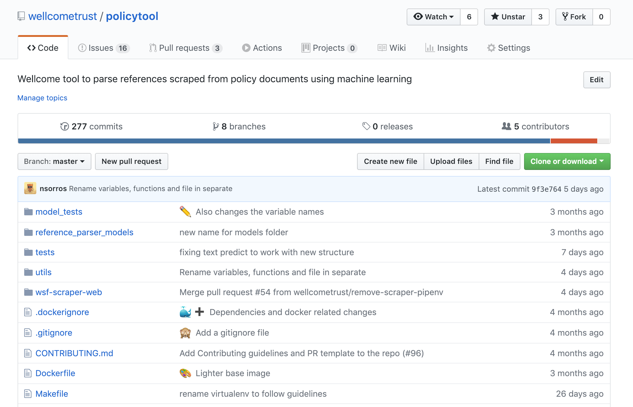
Open source
Notes:
And that is why our work is
Open sourced
We work on creating an interface and API for the data

Slide 26
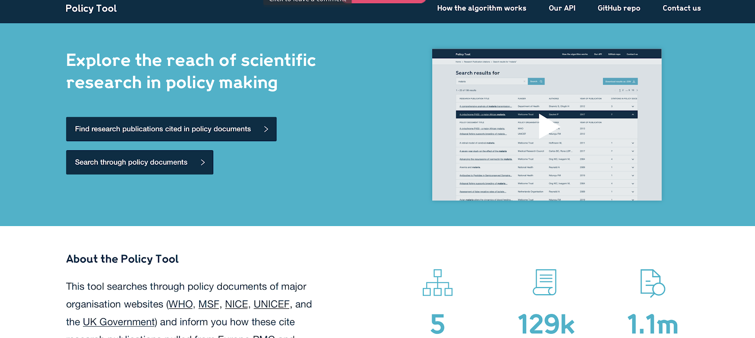
Interface

Slide 27
Other tools

Slide 28
Ambition 3
Knowledge and discoveries are shared, accessed and used in a manner that maximizes health benefit
Notes:
Research being Open

Slide 29
FAIR principles
Findable
Accessible
Interoperable
Reusable
PMID
EPMC
XML
CC-BY
Notes:
Findable. Persistent identifier.
Accessible. Trusted repository.
Interoperable. Machine readable.
Reusable. Open licence.

Slide 30
Ambition 1
Our understanding of science and health is transformed by research
Notes:
Mainly about publications and citations

Slide 31
Wellcome classifier
Notes:
Every funder faces the attribution problem
find publications attributed to the funder by the grantee.
Solutions
Ask the grantee but sometimes they do not report all publications
Pay external providers which is costly and inacurate

Slide 32
ML next steps

Slide 33
Improve Split
Find
Split
Parse
Match
85%
57%
87%
96%

Slide 34
Topics
Malaria
HIV

Slide 35
Category
Guideline
Report

Slide 36
Disease entity recognition

Slide 37
Match authors

Slide 38
Parse grant number

Slide 39
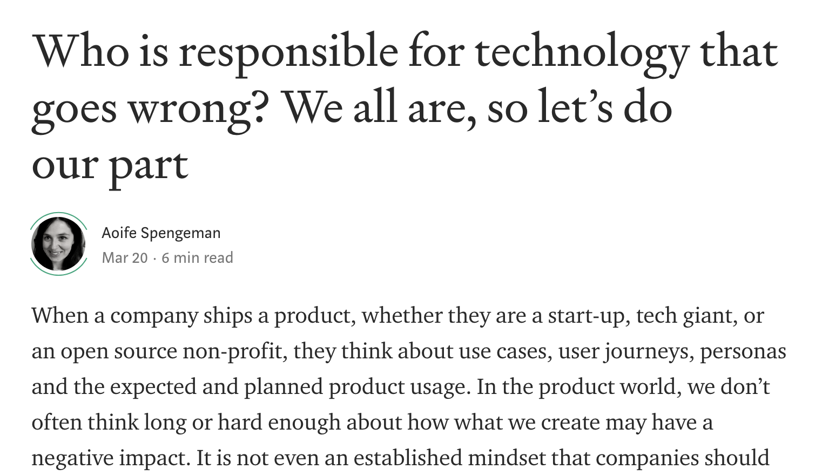
Ethical AI

Slide 40
Take away points

Slide 41
Simple before complex
Notes:
Prototype using simple approaches and iterate
It is also easier to see opportunities looking back than looking forward like the neural parser

Slide 42
Challenge using ML
Notes:
Wellcome classifier was an overkill, simply looking for the world Wellcome ended up being more accurate

Slide 43
Create supply, not demand
Notes:
Most data science teams strive to create demand for their work which is hard.
If possible you can supply a solution for a problem that already has demand like we did for WSF

Slide 44
Questions?
Email: n.sorros@wellcome.ac.uk

