Slide 1
Burden of enteric and diarrheal diseases and the potential impact of vaccines:
Duncan Steele
Deputy Director and Strategic Lead, Enteric Vaccines

Slide 2
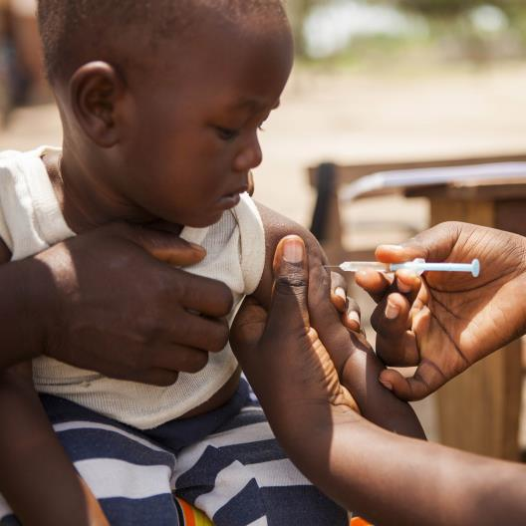
WHAT WE FOCUS ON
What are
the areas
of greatest
need?
Where can we have
the greatest impact?
Notes:
To be successful, we have to focus on a set of problems. To do that, we ask two key questions.

Slide 3
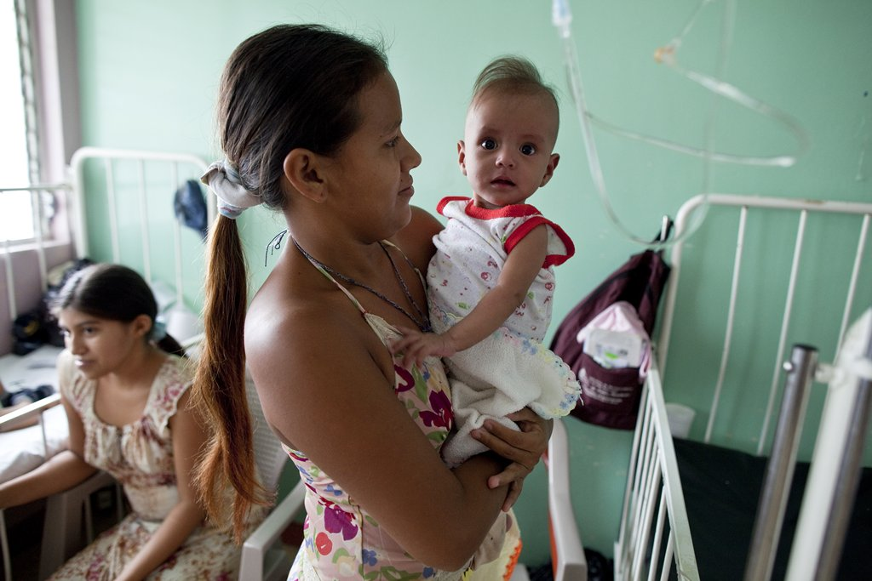
Considerations used to build our strategy
  Diarrhoeal diseases kill over 500,000 children under age 5 each year
  Rate of death declining at ~6% annually (2000-2013) – recently seen to slow down
  Diarrheal incidence decline is not so dramatic
    2.9 episodes per child annually (down from 3.4 episodes per child in 1990)
  Typhoid is associated with ~170,000 deaths every year
    Disease of the most vulnerable and impoverished settings
A mother with a baby recovering from severe diarrheal disease at a hospital in Managua, Nicaragua
Fisher-Walker BMC Public Health, 2012
2
Notes:
Photo ID: BS136459. A mother with a baby recovering from severe diarrheal disease at a hospital in Managua, Nicaragua.

Slide 4
EDD Strategy Overview
Impact
Levers
SOLUTIONS
End diarrheal disease deaths in children under age 5
1. PREVENT diarrheal pathogen infections
Vaccines for diarrheal pathogens
2. TREAT diarrhea in the most vulnerable children
Ideal care package to treat children with diarrhea
Eliminate typhoid as a public health problem globally
3. PREVENT enteric fever
Vaccines for enteric fever pathogens
Prevent and reverse stunting mediated by EED in children
4. PREVENT and REVERSE stunting
Ideal intervention
package for children stunted or at risk
5. ENABLE evidence for intervention development, political commitment & accountability for results
© Bill & Melinda Gates Foundation |
4
Notes:
FLOW: This is to show our overall goals and the key solutions we work on in support of achieving impact.

Slide 5
GEMS identifies highest burden pathogens
Estimated diarrhoeal deaths for U-5 children*
% of total deaths (~700K total**)
Likely under-represents overall burden of enteric and diarrheal disease:
  Diseases from enteric infections can lead to malnutrition, stunted growth, and impaired cognitive development, leading to diminished productivity over a lifetime for millions of people
  8-fold mortality identified in GEMS 60 days post diarrhoea episode would not be captured as diarrhea-related death
Kotloff KL, Nataro JP, Blackwelder W. et al. Lancet 2013; 382(9888): 209-22

Slide 6
Molecular re-analysis of the GEMS samples
~300 cases/controls 0-11 mo from all 7 sites (n=1929)
~300 cases/controls 12-23 mo from all 7 sites (n=1880)
Liu J, Platts-Mills J, Juma J. et al. Lancet 2016; 388(10051): 1291-301

Slide 7
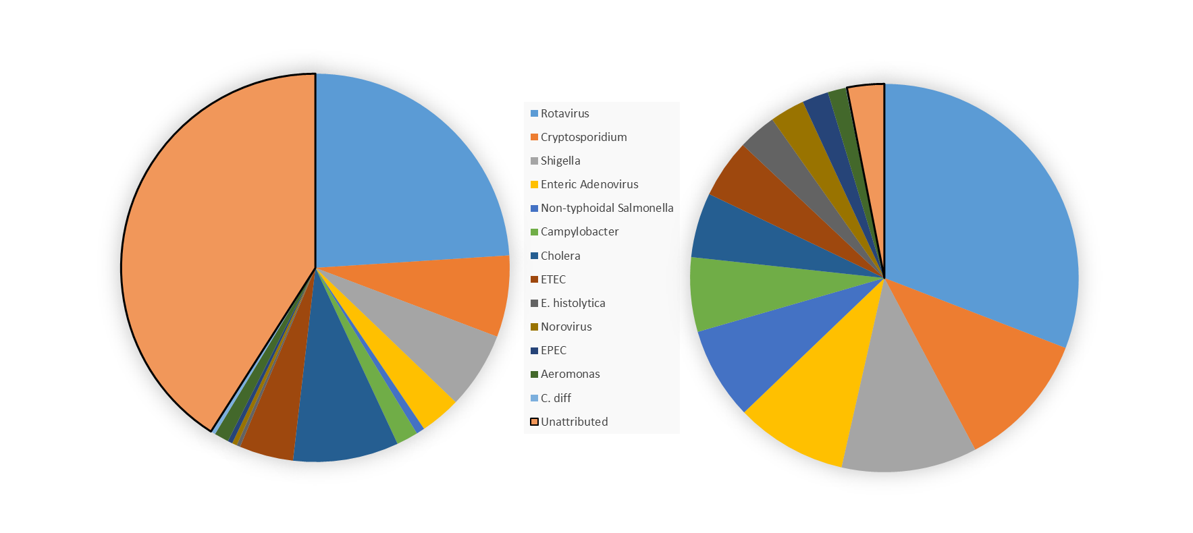
Prioritization of our work is guided by burden
The application of PCR has improved estimates of pathogen attribution
Can now account for 97% of diarrheal etiology (vs 59%) in GBD estimates
Population attributable fractions for 2010,
GBD 2013
Population attributable fractions for 2010,
GBD 2015
3.1% Unattributed
41.0% Unattributed
Source: GBD 2013 & GBD 2015 modeling estimates for 2010
CONFIDENTIAL
© Bill & Melinda Gates Foundation |
7
Notes:
FLOW: this is the first of 4 slides to make some key points related to burden. Here - key point is that we can now attribute almost all of diarrheal etiology and have greater insight on relative burden levels.

Slide 8
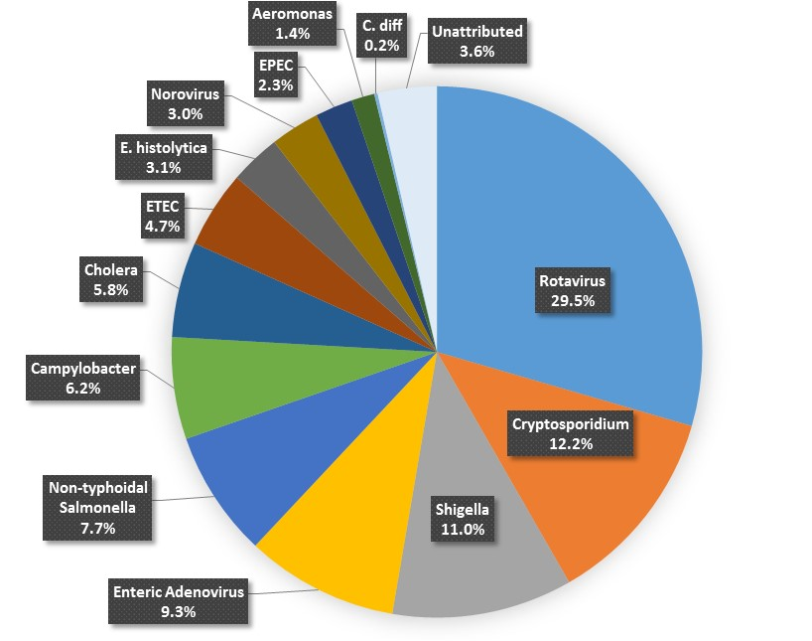
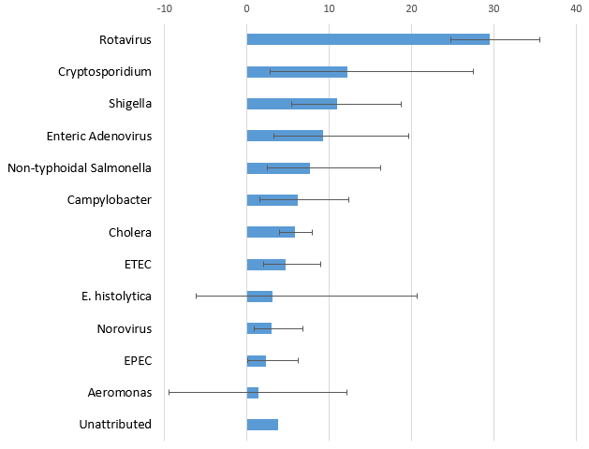
However, most pathogens still have wide confidence intervals
Population Attributable Fraction (%), 2015
Most pathogens (except well-studied rotavirus and cholera) have wide confidence intervals.
Source: GBD 2015 estimates
CONFIDENTIAL
© Bill & Melinda Gates Foundation |
8
Notes:
FLOW: 2nd burden slide. Key point is to show updated values for etiology and that confidence intervals still wide except rota and cholera, which are better characterized.
Anita
Affirmed the prioritization of rotavirus, Shigella and Cryptosporidium in our portfolio.
Indicated that improved diagnostics slightly increase attribution to ETEC while reducing its ranking relative to other diarrheal pathogens.
Confirmed further exploration of iNTS and Campylobacter on our learning agenda.
Led us to question the importance of enteric adenovirus and whether it merits future placement on our learning agenda

Slide 9
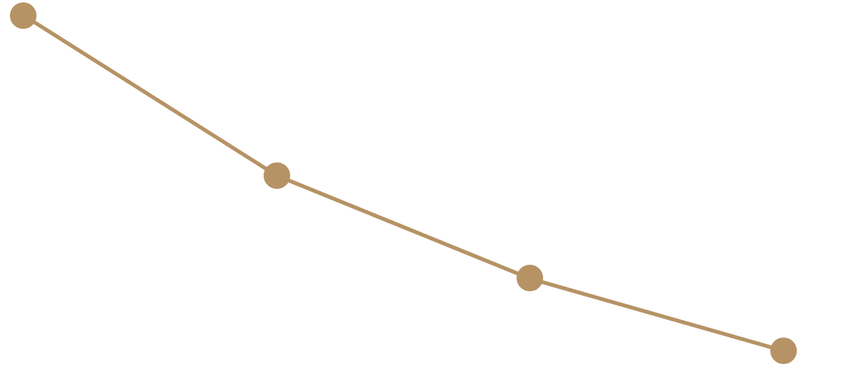
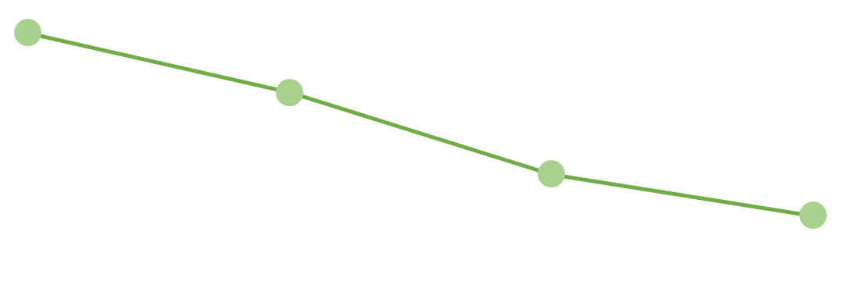
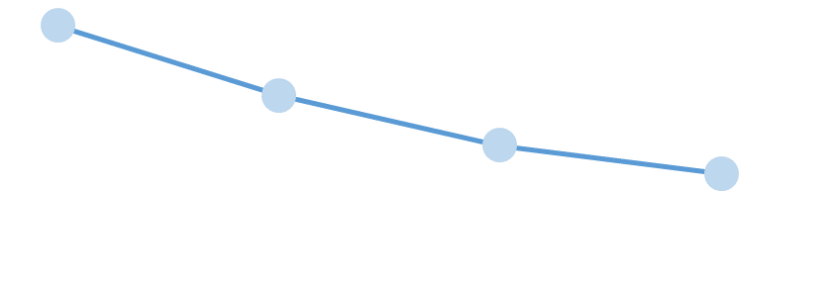
Strategy goals and current state
Impact
Target Indicator
Latest Estimate
To end diarrheal disease deaths in children under age 5
To eliminate typhoid as a public health problem globally
To prevent and reverse stunting mediated by EED in children
Achieve <1 diarrheal death per 1,000 live births by 2030
In 2015, the diarrhea mortality rate for children <5 was 3.77 per 1,000 live births
DRAFT: Reduce typhoid incidence to <5/100,000 globally by 2035
In 2015, the global typhoid incidence rate was 170 per 100,000
Accelerate the reduction of the number of children stunted, contributing to the global goal of 40% reduction of the number of children stunted by 2025
In 2014, 159M children <5 were stunted.
Trend lines from 2000 to ~2015.
Notes:
FLOW: This allows you to speak to the specific targets of our impact goals.
Excel source document: https://bmgf.sharepoint.com/teams/edd/Shared%20Documents/TD%20Prototypes_EDD%20Theory%20of%20Change%20Brainstorm%20Spring%202016.xlsx

Slide 10
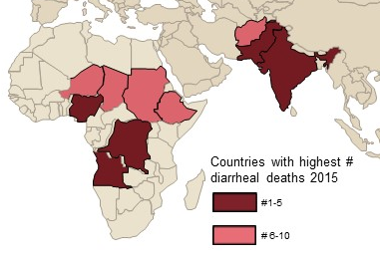
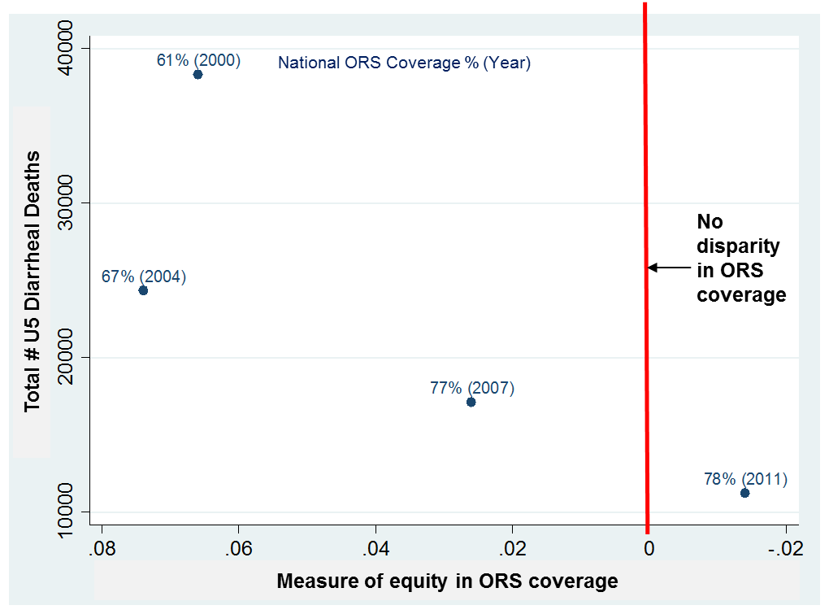
Addressing residual diarrheal mortality will be harder
Introducing and delivering interventions in the highest burden countries
  The 10 highest burden countries accounted for ~66% of all U5 diarrheal deaths in 2015
Addressing co-morbidities, complex disease and the link to malnutrition
  ~50% of U5 diarrheal deaths are attributable to stunting and 34% are attributable to wasting. On average 22% of diarrheal deaths in high mortality countries are attributable to persistent diarrhea.
Reaching vulnerable populations
  As U5MR declines, residual deaths are increasingly concentrated among the marginalized and ultra-poor. Bangladesh succeeded in accelerating diarrheal mortality declines by eliminating ORS inequities with only incremental gains in national coverage.
CONFIDENTIAL
© Bill & Melinda Gates Foundation |
10
Notes:
FLOW: addressing residual mortality will be harder, and here's some of the key considerations to addressing that burden.

Slide 11
CHAMPS: Building KNOWLEDGE TO SAVE CHILDREN’s LIVES
Child Health and Mortality Prevention Surveillance through
Minimally Invasive Tissue Sampling (MITS)
4
3
1
OFFICIAL CHAMPS
SITES
SITES IN
CONTRACT NEGOTIATIONS
COUNTRY IN
EXPLORATION
Bamako, Mali
Bangladesh
Ethiopia
India
NETWORK
and ongoing engagement with in-country public health decision makers
Sierra Leone
Kisumu, Kenya
15
of
Manhiça, Mozambique
GLOBAL
PARTNERS
Soweto, South Africa
Goal = Better primary data: establish a surveillance network that is used as a global reference standard for childhood mortality by 2020
Notes:
There’s clearly a need to address gaps in both the evidence around the levels of diarrheal mortality that are attributable to specific pathogens AND gaps in understanding the overall burden of diarrheal disease mortality in young children.
We’re partnering with the Foundation’s Vaccine Development team to fund enhanced surveillance and epidemiologic studies.
CHAMPS is the Child Health and Mortality Prevention Surveillance study. This study is conducting minimally invasive tissue sampling (MITS) to assess cause of death at 4 established and 4 additional soon-to-be established sites.
The goal is to continue to expand the # of sites and establish a surveillance network that can be used a reference standard for cause of childhood deaths by 2020.

Slide 12
EDD Strategy Overview
Impact
Levers
SOLUTIONS
End diarrheal disease deaths in children under age 5
1. PREVENT diarrheal pathogen infections
Vaccines for diarrheal pathogens
2. TREAT diarrhea in the most vulnerable children
Ideal care package to treat children with diarrhea
Eliminate typhoid as a public health problem globally
3. PREVENT enteric fever
Vaccines for enteric fever pathogens
Prevent and reverse stunting mediated by EED in children
4. PREVENT and REVERSE stunting
Ideal intervention
package for children stunted or at risk
Gut Health
5. ENABLE evidence for intervention development, political commitment & accountability for results
© Bill & Melinda Gates Foundation |
12
Notes:
FLOW: (transition slide) As we will be spending the rest of the meeting on vaccines for diarrheal pathogens (first row of solutions), let us provide an overview for you of the strategies related to the rest of the portfolio, and to set the vaccines work in context.

Slide 13
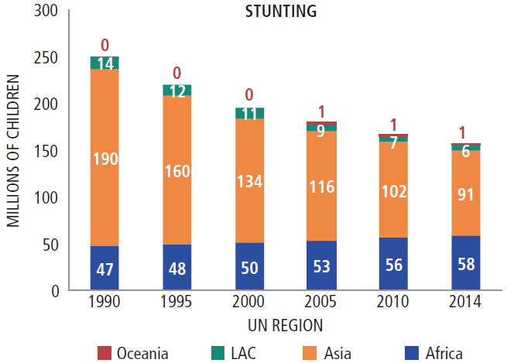
Gut Health strategy focuses on stunting
Gut Health
  We hypothesize that a major contributing factor to stunting is environmental enteric dysfunction (EED).
  We hypothesize that the appropriate interventions could treat or prevent EDD, and thus minimize adverse stunting
Approximately 159M children under 5 are stunted worldwide, a prevalence of 23.8%
Stunting is a major risk factor for:
  Mortality from infectious diseases: Approximately 50% of diarrhea and pneumonia deaths in children <5 years of age are attributable to stunting.
  Lowered vaccine response: High prevalence of sub-clinical enteropathogen presence has been significantly associated with stunting and oral vaccine failure (e.g. oral polio vaccine).
  Impaired cognitive development: Stunting by age 2-3 years predicts poorer cognitive and education outcomes later in life.
Source: Global Nutrition Report: From Promise to Impact, based on data from UNICEF, WHO and World Bank (2015)
Sources: (a) WHO 2014 estimates (latest available) (b) Black et al. Maternal and child undernutrition and overweight in low-income and middle-income countries. Lancet 2013 (b) MAL-ED, PROVIDE studies (c) Guerrant et al The impoverished gut – a triple burden of diarrhea, stunting and chronic disease. Nat. Rev. Gastroenterol. Hepatol 2013.
CONFIDENTIAL
© Bill & Melinda Gates Foundation |
13
Notes:
FLOW: we've also been working on a different kind of treatment - focused on gut health and stunting. we hypothesize a major contributing factor to stunting is EED, and that appropriate interventions could treat or prevent stunting. this is important b/c stunting is a tremendous problem gloabally...highlight a few bullets on the problem.

Slide 14
EDD Strategy Overview
Impact
Levers
SOLUTIONS
End diarrheal disease deaths in children under age 5
1. PREVENT diarrheal pathogen infections
Vaccines for diarrheal pathogens
Treatment
2. TREAT diarrhea in the most vulnerable children
Ideal care package to treat children with diarrhea
Eliminate typhoid as a public health problem globally
3. PREVENT enteric fever
Vaccines for enteric fever pathogens
Prevent and reverse stunting mediated by EED in children
4. PREVENT and REVERSE stunting
Ideal intervention
package for children stunted or at risk
5. ENABLE evidence for intervention development, political commitment & accountability for results
© Bill & Melinda Gates Foundation |
14
Notes:
FLOW: (transition slide) As we will be spending the rest of the meeting on vaccines for diarrheal pathogens (first row of solutions), let us provide an overview for you of the strategies related to the rest of the portfolio, and to set the vaccines work in context.

Slide 15
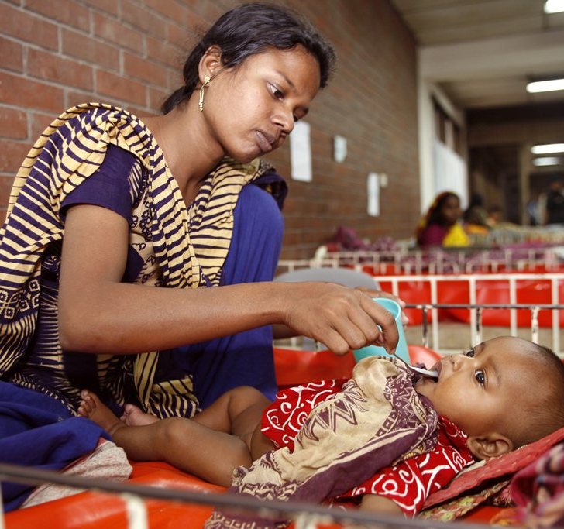
TREATMENT goals
Treatment
  Generate evidence to improve and optimize care guidelines for the most vulnerable children with diarrhea and pneumonia in limited resource settings
  Ensure resources - funding, leadership, strategy - are prioritized for child health globally and in countries with the highest burden of mortality
  Integrate pneumonia and diarrhea treatment into health programming of priority countries
Notes:
FLOW: Introduction to what we're focused on within treatment. Note that this slide shares our treatment goals. the subsequent slides keeps the treatment goals on the left, and provides a little more detail for each.
Photo ID: PP076623. A mother administers oral rehydration solution to her baby at a hospital in Dhaka, Bangladesh.

Slide 16
EDD Strategy Overview
Impact
Levers
SOLUTIONS
End diarrheal disease deaths in children under age 5
1. PREVENT diarrheal pathogen infections
Vaccines for diarrheal pathogens
2. TREAT diarrhea in the most vulnerable children
Ideal care package to treat children with diarrhea
Eliminate typhoid as a public health problem globally
3. PREVENT enteric fever
Vaccines for enteric fever pathogens
Enteric fever (typhoid)
Prevent and reverse stunting mediated by EED in children
4. PREVENT and REVERSE stunting
Ideal intervention
package for children stunted or at risk
5. ENABLE evidence for intervention development, political commitment & accountability for results
© Bill & Melinda Gates Foundation |
16
Notes:
FLOW: (transition slide) As we will be spending the rest of the meeting on vaccines for diarrheal pathogens (first row of solutions), let us provide an overview for you of the strategies related to the rest of the portfolio, and to set the vaccines work in context.

Slide 17
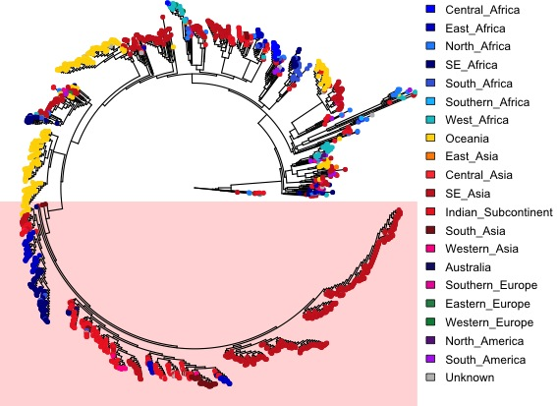
Over last 18 months, we have Expanded our ambition in typhoid
Typhoid
  Quintessential disease of the poor, with the potential to get worse
    Antibiotic resistance is increasing, limiting treatment options
    Water scarcity and rapid urbanization could limit the historical benefits seen with improvements in water and sanitation
  Aggressive control is achievable and desirable
    Biologically feasible – no zoonotic reservoir
    Existing control tools exist
    Promising typhoid conjugate vaccines (TCVs) are on the near horizon
    Many geographies have already eliminated typhoid as a public health concern
S.Typhi haplotype multi-drug resistant H58 has emerged over last 20 years to dominate globally
© Bill & Melinda Gates Foundation |
17
Notes:
FLOW: Duncan to present typhoid. Shifting to our typhoid strategy, over the last 18 months we have expanded our ambition. Why did we do that? (talk about why its important to address (bullets on the page) then note 'However not a global priority'...this segues to next page.
However not a global priority (some speaking points if useful)
Disease burden is not recognized
Not a universal pathogen
Difficult to diagnose
Does not cause dramatic outbreaks
Case fatality rates are usually low in antibiotic era
Very few global champions
Minimum global funding
Competing global and country priorities
Slow progress on TCVs
(Note that our goal in this section is for PATH to understand what we're focused on (and just as importantly, why) so they can put TYVAC (and their portion of TYVAC as a sub-grantee) into context.)

Slide 18
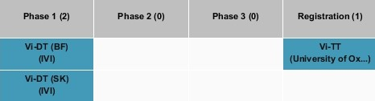

Typhoid progress Against Goals (Vaccines)
Typhoid
TCV Product Portfolio
At least 2 effective TCVs achieve WHO PQ by 2020:
  BBIL submitted Typbar TCV for WHO PQ
  Establishment of anti-Vi lgG reference standard
  Additional TCV candidates in Phase I
  Generate vaccine performance data to support WHO SAGE recommendations, Gavi funding decision, and country adoption:
  Human challenge data for Typbar TCV generated at Oxford University
  Typbar TCV vaccine demonstration project in India (Navi Mumbai)
  TyVAC to conduct effectiveness studies ex India (eg. Nepal, Malawi and Bangladesh)
  Proof-of-concept demonstrated for next generation of broadly cross-protective salmonella vaccine
  Bivalent constructs in discovery (MAPS, typhoid toxin) and preclinical (IVI)
  Non-typhoidal salmonella is on our learning agenda (small-scale evidence generation activities)
WHO
(BBIL)
© Bill & Melinda Gates Foundation |
18
Notes:
FLOW: In support of those goals, there's been good progress over the last year. Two slides here: one focused on product development and one on the other pieces of the portfolio.

Slide 19
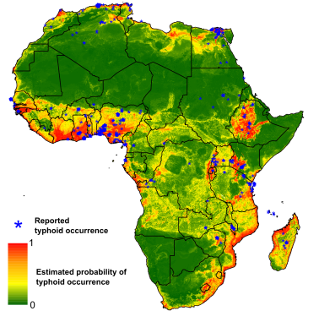
Typhoid Progress against Goals (Continued)
Typhoid
Define and validate a toolkit of cost-effective interventions to reach our impact goal:
Developing/validating environmental surveillance methods (India, Malawi, elsewhere)
Field testing new diagnostic technologies
Build the case for adoption of a global typhoid control goal:
Multi-center severe typhoid surveillance studies – SEAP (Asia) and SETA (Africa)
Planned clinical surveillance in India
Supporting cost-effectiveness analyses for vaccines
Assess the feasibility of typhoid elimination:
S.Typhi risk and disease burden prediction model for sub-Saharan Africa, SETA project
Understanding reservoirs of infection, pathways of transmission, and the relative importance of short-cycle and long-cycle transmission (IDM, Santiago, Kibera)

Slide 20
EDD Strategy Overview
Impact
Levers
SOLUTIONS
1. PREVENT diarrheal pathogen infections
Vaccines for diarrheal pathogens
End diarrheal disease deaths in children under age 5
Enteric vaccines
2. TREAT diarrhea in the most vulnerable children
Ideal care package to treat children with diarrhea
Eliminate typhoid as a public health problem globally
3. PREVENT enteric fever
Vaccines for enteric fever pathogens
Prevent and reverse stunting mediated by EED in children
4. PREVENT and REVERSE stunting
Ideal intervention
package for children stunted or at risk
5. ENABLE evidence for intervention development, political commitment & accountability for results
© Bill & Melinda Gates Foundation |
20
Notes:
FLOW: (transition slide) As we will be spending the rest of the meeting on vaccines for diarrheal pathogens (first row of solutions), let us provide an overview for you of the strategies related to the rest of the portfolio, and to set the vaccines work in context.

Slide 21
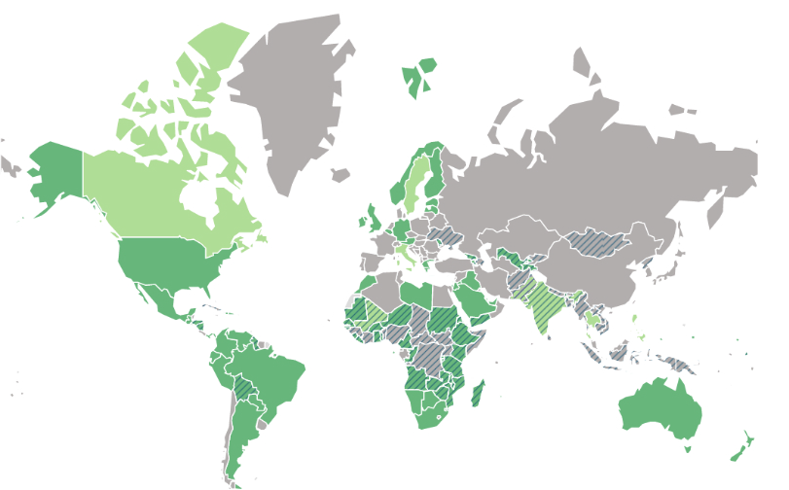
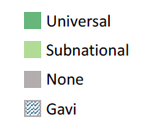
Global Rotavirus Vaccine Introduction
WHO global policy
RAVIN – country support
ROTA Council
84 national introductions into routine immunization systems, including 42 Gavi countries and 6 non-Gavi LMICs
  34 of these have introduced Rotarix® and 7 of these have introduced RotaTeq®
  India has introduced ROTAVAC™
  Planned introductions of note:
    Uganda (2017, 1.7M)
    Nigeria (2018, 7.2M)
    Bangladesh (2018, 3.1M)
    DRC (2018, 3.2M)
Vaccine effectiveness
Immunization schedules
Image used courtesy of VIEW-hub website: http://rotacouncil.org/resources/RVIntroductionStatusMap.pdf

Slide 22
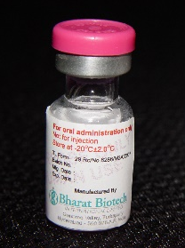
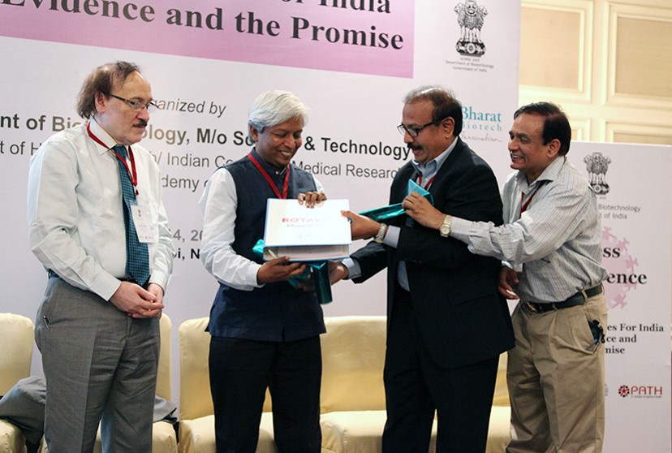

Rotavirus vaccine development
ROTAVAC® licensure in India
  Shown to be safe and efficacious in Phase III trial in India
    54% efficacy against severe rotavirus gastroenteritis
    Nearly 56% protection in the first year of life
  ROTAVAC® products could achieve major impact both in India and GAVI countries
  First generation product to be priced at ~$1 per dose
Dr Krishna Ella, CEO of Bharat Biotech presents the India license for ROTAVAC to Dr MK Bhan, discoverer of the virus strain, and Dr Vijay Raghavan and TS Rao of the Dept of Biotechnology which co-sponsored the vaccine development
Notes:
Vial Picture from Trevor’s rotavirus symposium talk (Sept 2014)
Photo IDs Rotavac: http://www.thehindubusinessline.com/news/science/made-in-india-rotavirus-vaccine-for-rs-54/article4714813.ece
(In photo, from left) Dr. Nita Bhandari, Director, Centre for Health Research and Development, Dr M. K. Bhan, former secretary, Department of Biotechnology, Dr K. Vijay Raghavan, Secretary, DBT, Govt of India and Dr. Krishna M. Ella, Chairman & Managing Director, Bharat Biotech, at the release of Rotavac phase-III trial data in New Delhi on Tuesday. - Photo: Shiv Kumar Pushpakar.

Slide 23
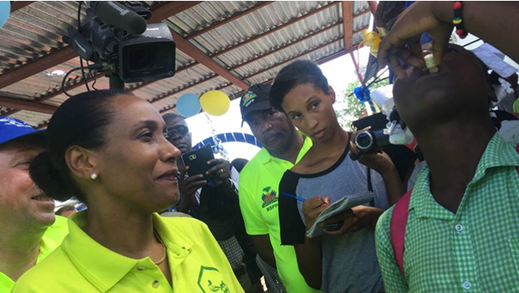
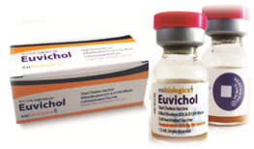
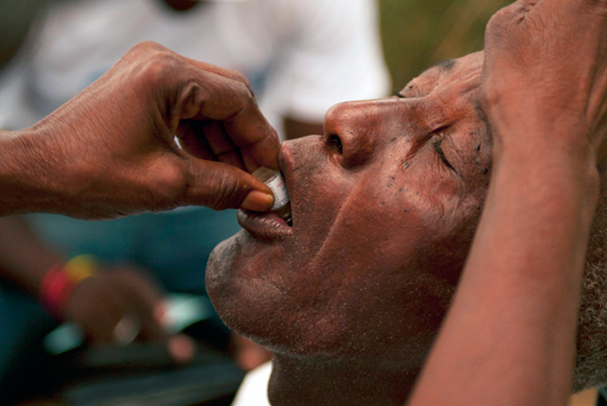
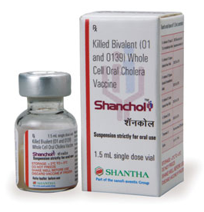
CHOLERA
Cholera
  Cholera is an important part of our portfolio, albeit more mature in terms of our role
  Invested in the Shanchol™ oral cholera vaccine (OCV) and Eubiologics Euviochol™ OCV which have been WHO prequalified
  Supported creation of global OCV stockpile in 2013
    Increasing year-over-year use: Between January and October 2016, >2M doses were shipped in 7 deployments
  Focus is shifting toward sustainability of core partners to control cholera going forward with appropriate data, as well as endemic introductions and guidelines
    Global Task Force for Cholera Control (GTFCC)
Notes:
FLOW: Lastly, since we won't be talking about cholera specifically, this is just to highlight that it's an important part of our portfolio, albeit it more mature in terms of our role. There's been tremendous success and our focus is turning toward sustainability of core partners to control cholera going forward, as well as endemic introductions.
Duncan to present.
Photos:
www.pih.org/blog/second-dose-of-vaccine-delivery-begins
www.haiti.mphise.info/platform-haitian-human-rights-organizations-pohdh-position-oral-vaccine-against-cholera
Top photo: Recent picture from Euvichol (oral cholera vaccine) introduction in Haiti.

Slide 24
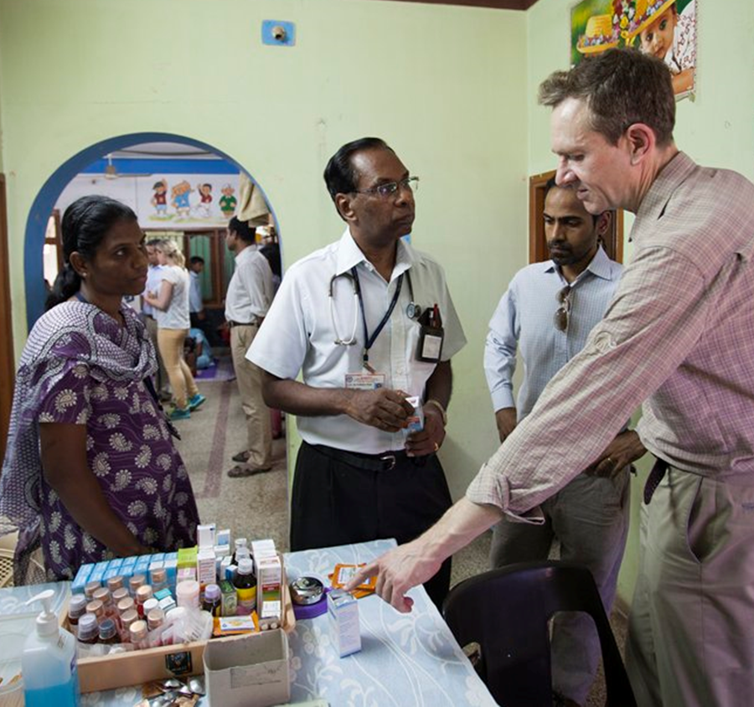
Opportunities for Impact
  Support surveillance for the most significant enteric pathogens to quantify disease burden and improve enteric disease understanding
  Discover and develop interventions
  for gut dysfunction that contribute to malnutrition, growth stunting, and cognitive impairments
  Develop enteric vaccines for reduced risk of diarrheal disease and mortality
  Optimize treatment packages for complex and comorbid disease and target treatment to vulnerable populations
  Continued commitment to generating robust data for informed decisions
    Multi-site epidemiologic and surveillance studies;
    Frequent DHS powered at sub-national level;
    Vital registration systems;
Notes:
*I’ll just really quickly summarize – these key areas for continued and accelerated impact.
SLIDE FROM: EDD GH Slide Library, Feb 2014
MAM: AC352897
Trevor Mundel speaks with Dr. Prabhakar Moses at the Christian Medical College (CMC) Research Study Clinic in Vellore, India on May 28, 2013.

Slide 25

THANK YOU

