Slide 1
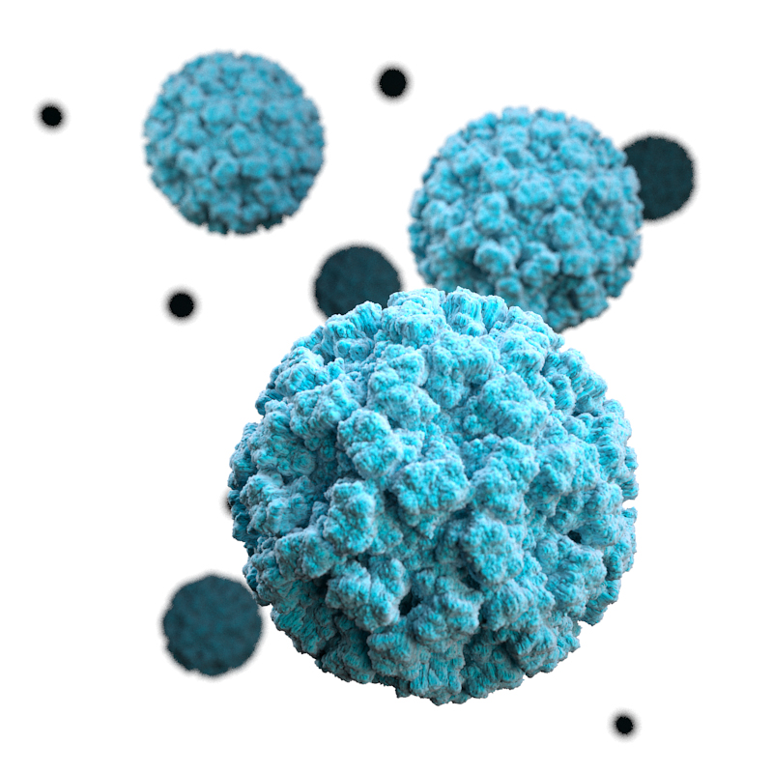
Modeling Norovirus and Strategies for Vaccination in the United States
Molly Steele, Emory
4/16/18

Slide 2
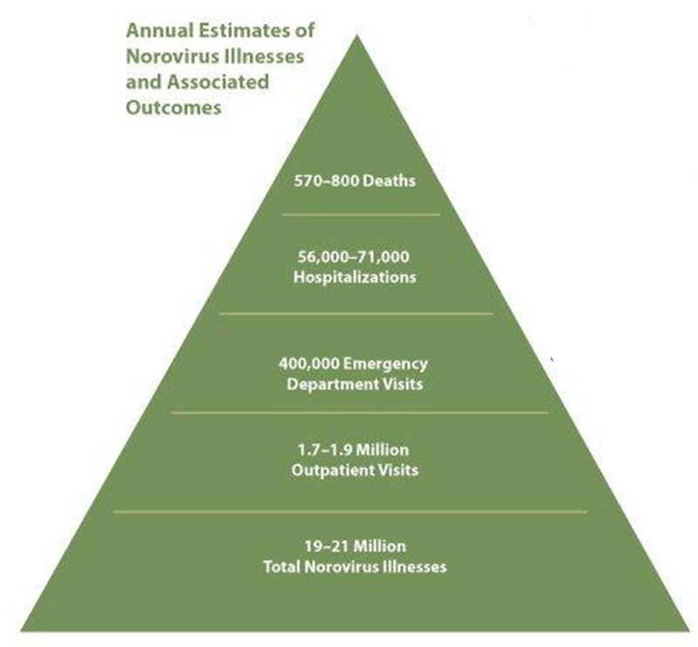
Norovirus
Non-enveloped, single-stranded RNA viruses of family Caliciviridae
Highly infectious
  ID₅₀=18 viral particles
Transmission: fecal-oral or vomitus droplets
Acute-onset of:
  Vomiting
  Watery, non-bloody diarrhea with abdominal cramps
  Nausea
Leading cause of acute gastroenteritis in the U.S.
http://www.cdc.gov/norovirus/php/illness-outbreaks-figure.html
Notes:
For those of you who do not know about norovirus, these viruses are non-enveloped single-stranded RNA viruses from the family Calicivaridae. These viruses are highly infectious, such that 18 viral particles will lead to infection in 50% of those who are exposed to that dose. And the incubation is about 12 to 48 hours.

Slide 3
Age Specific Clinical Outcomes of Norovirus
Lopman et al., 2011, CID
Gastañaduy et al., 2013, JID
Hall et al., 2012, CID
Notes:
Norovirus affects people of all ages however, certain age groups are more susceptible to severe outcomes. Children under the age of five years old have the highest rates of hospitalization and emergency department visits, the vast majority of deaths due to norovirus occur in the elderly.

Slide 4

How Will Vaccines Impact the Dynamics of Norovirus Disease in the U.S.?
Help to guide both developers and public health decision makers in considering how a norovirus vaccine can be used
Notes:
Norovirus vaccines are currently in development. So the question driving this research project was how will vaccines impact the dynamics of endemic norovirus disease in the United States. The goal of this research is to help guide both developers and public health decision makers in considering how a norovirus vaccine can be used.
We addressed this question with a dynamic transmission model

Slide 5
The Model
Deterministic transmission model for endemic norovirus disease in the United States
  Four age groups:
    0-4 years
    5-17 years
    18-64 years
    65+ years
  Heterogeneous contact structure
    (Mossong et al, PLoS Med. 2008)
  Assume single strain of norovirus
  Model is for endemic disease – not applicable to outbreak scenarios
Notes:
The model that I am using in my research is a transmission model for endemic disease in the US. Essentially, this model tracks population groups as they move through different disease states over time.
This is an age structure model, and there are four age groups that I am looking at: 0-4 year olds, 5-17 yr olds, 18-64 yr olds and 65 yrs and older.
In this model we assume that there is a heterogeneous contact structure. We were able to create a contact matrix by adapting data from the POLYMOD study done by Mossong et al in 2008
this model assumes that there is a single strain of norovirus, so it does not consider strain diversity.
And finally this model is developed for endemic disease so it is not applicable to outbreak situations.

Slide 6
Mathematical model of norovirus transmission
Births
Asymptomatic
μ_{a}
Susceptible
λ(t)
Exposed
μ_{s}
Ill
λ(t)
ρ
Immune
θ
Notes:
The model assumes that children are born susceptible to infection. Their first infection always results in symptomatic disease, after which individuals shed virus for a period of time before becoming immune to symptomatic disease. ‘Immune’ individuals can still become infected asymptomatically with the same force of infection as fully susceptible individuals. As such, immunity is presumed to be against disease, not infection. Thus, individuals can cycle through the immune and asymptomatically-infected states if they continue to be exposed to the virus. Eventually, immunity can wane and individuals become fully susceptible to disease again.

Slide 7
Mathematical model of norovirus transmission
Vaccine Asymptomatic
λ(t)
ρ
Vaccine Immune
θ
Births
Asymptomatic
μ_{a}
Susceptible
λ(t)
Latent
μ_{s}
Ill
λ(t)
ρ
Immune
θ
Notes:
The model assumes that children are born susceptible to infection. Their first infection always results in symptomatic disease, after which individuals shed virus for a period of time before becoming immune to symptomatic disease. ‘Immune’ individuals can still become infected asymptomatically with the same force of infection as fully susceptible individuals. As such, immunity is presumed to be against disease, not infection. Thus, individuals can cycle through the immune and asymptomatically-infected states if they continue to be exposed to the virus. Eventually, immunity can wane and individuals become fully susceptible to disease again.

Slide 8
Model Assumptions: Fixed Parameters
Parameter | Value | Source
Duration of natural immunity | 5.3 years | Simmons et al., 2013
Duration of incubation | 32.8 hours | Devasia et al., 2014
Duration of symptomatic infection | 48 hours | Devasia et al., 2014
Duration of asymptomatic infectious period | 10 days | Rockx et al., 2002
Relative infectiousness during incubation period or asymptomatic period | 0.05 | Simmons et al., 2013; Sukhrie et al., 2010
Table adapted from: Simmons, K., Gambhir, M., Leon, J. & Lopman, B. Emerg. Infect. Dis. 19, 1260–7 (2013)
Notes:
There are many parameters in the model that have fixed values so the duration of …
The values for fixed parameters were all derived from previous studied.
In this model we assume that individuals who are exposed and individuals who have asymptomatic infections contribute to transmission. So these individuals are 5% as infectious as symptomatically infected individuals
There are also parameters in this model that have to be estimated because the values cannot be directly observed, so the age specific transmission parameters needed to be estimated using model fitting.

Slide 9
Maximum Likelihood Estimation
R₀ (0-4 years ) = 4.32
R₀ (5-17 years) = 1.27
R₀ (18-64 years) = 1.15
R₀ (65+ years ) = 0.44
Notes:
So to estimate the transmission parameters I used maximum likelihood estimation to fit the model to data on the age-specific monthly hospitalizations due to norovirus that occurred in the United States between 1996 and 2007. So the figure here shows plots of the observed number of hospitalizations (represented by the blue line) vs. the model predictions (represented by the red line) for each of four age groups in the population. So the y-axis is the number of hospitalizations per month, the x axis is the time from 1996 to 2007. This figure shows that the model does a fairly good job of predicting hospitalizations for each of the four age groups.
From model fitting we were also able to get rough estimates of the age-specific R0 for each of the age groups. “and R0 is the number of secondary cases that arise from a primary case in a given age group.” The youngest age group in the population, 0-4 year olds, contribute the most to transmission with and R0 of 4.32. 5-17 year olds and 18-64 year olds contribute less to transmission, with R0s of 1.27 and 1.15. The elderly, 65 and older contribute the least to transmission with an R0 of 0.44
EMPHASIZE THAT THE 0-4 CONTRIBUTE WAY MORE TO TRANSMISSION THAN THE ELDERLY AND WE’LL SEE HOW THAT EFFECTS VACCINE IMPACTS

Slide 10
Maximum Likelihood Estimation
R₀ (0-4 years ) = 4.32
R₀ (5-17 years) = 1.27
R₀ (18-64 years) = 1.15
R₀ (65+ years ) = 0.44
Notes:
So to estimate the transmission parameters I used maximum likelihood estimation to fit the model to data on the age-specific monthly hospitalizations due to norovirus that occurred in the United States between 1996 and 2007. So the figure here shows plots of the observed number of hospitalizations (represented by the blue line) vs. the model predictions (represented by the red line) for each of four age groups in the population. So the y-axis is the number of hospitalizations per month, the x axis is the time from 1996 to 2007. This figure shows that the model does a fairly good job of predicting hospitalizations for each of the four age groups.
From model fitting we were also able to get rough estimates of the age-specific R0 for each of the age groups. “and R0 is the number of secondary cases that arise from a primary case in a given age group.” The youngest age group in the population, 0-4 year olds, contribute the most to transmission with and R0 of 4.32. 5-17 year olds and 18-64 year olds contribute less to transmission, with R0s of 1.27 and 1.15. The elderly, 65 and older contribute the least to transmission with an R0 of 0.44
EMPHASIZE THAT THE 0-4 CONTRIBUTE WAY MORE TO TRANSMISSION THAN THE ELDERLY AND WE’LL SEE HOW THAT EFFECTS VACCINE IMPACTS

Slide 11
Vaccine Scenarios
  Routine immunization of infants
    Vaccine coverage = 90%
    Vaccine efficacy = 50%
  Routine immunization of the elderly at age 65 and every five years after
    Vaccine coverage = 65%
    Vaccine efficacy = 50%
Notes:
There are two strategies that I am currently focusing on. The first is Routine immunizations of infants around the time of birth. The second is Routine immunizations of the elderly at age 65 and every five years after
Make it more clear that for the elderly immunization program they are being vaccinated at 65 and then vaccinated again every five years so they’d receive vaccines at the age of 70 75 80 and 85

Slide 12
Vaccine Impact 1 year
Pediatric Immunization
15%
45%
19%
27%
32%
13%

Slide 13
Vaccine Impact 1 year
Pediatric Immunization
Elderly Immunization
15%
45%
19%
40%
27%
32%
13%
0.5%
0.8%
1.2%

Slide 14
Population Level Vaccine Impact on Clinical Outcomes
Vaccine strategy | Cases averted per 100,000 doses | Outpatient visits averted per 100,000 doses | ED visits averted per 100,000 doses | Hospitalizations averted per 100,000 doses | Deaths averted per 100,000 doses
Pediatric | 178,000 | 21,400 | 3,940 | 760 | 7
 | (119,400, 256,200) | (13,000, 33,400) | (2,450, 6,340) | (530, 1,070) | (5, 11)
Elderly | 9,900 | 1,010 | 310 | 145 | 4
 | (8,400, 12,000) | (600, 1,400) | (200, 430) | (130, 160) | (3, 4)
Notes:
This table shows the MEDIAN AND 95% UNCERTAINTY INTERVALS number of clinical outcomes averted per 100,000 vaccinated individuals by vaccine strategy. The impacts are shown for both within the age group targeted for vaccination and the total population. So I’m going to focus on these total population impacts. When we compare what the model predicts the number of cases averted per 100,000 vaccinees between these two vaccine strategies we see that an infant immunization program is predicted to avert about 21 times more cases in the total population vs. the elderly immunization program

Slide 15
Population Level Vaccine Impact on Clinical Outcomes
Vaccine strategy | Cases averted per 100,000 doses | Outpatient visits averted per 100,000 doses | ED visits averted per 100,000 doses | Hospitalizations averted per 100,000 doses | Deaths averted per 100,000 doses
Pediatric | 178,000 | 21,400 | 3,940 | 760 | 7
 | (119,400, 256,200) | (13,000, 33,400) | (2,450, 6,340) | (530, 1,070) | (5, 11)
Elderly | 9,900 | 1,010 | 310 | 145 | 4
 | (8,400, 12,000) | (600, 1,400) | (200, 430) | (130, 160) | (3, 4)
≈18x
≈21x
≈13x
Notes:
SO I’ve shown you the impact in terms of cases and hospitalizations, but what’s happening in terms of the rest of the clinical outcomes?
This table shows the number of clinical outcomes averted per 100,000 vaccinated individuals by vaccine strategy. The impacts are shown for both within the age group targeted for vaccination and the total population. So I’m going to focus on these total population impacts. When we compare what the model predicts the number of cases averted per 100,000 vaccinees between these two vaccine strategies we see that an infant immunization program is predicted to avert about 21 times more cases in the total population vs. the elderly immunization program

Slide 16
Population Level Vaccine Impact on Clinical Outcomes
Vaccine strategy | Cases averted per 100,000 doses | Outpatient visits averted per 100,000 doses | ED visits averted per 100,000 doses | Hospitalizations averted per 100,000 doses | Deaths averted per 100,000 doses
Pediatric | 178,000 | 21,400 | 3,940 | 760 | 7
 | (119,400, 256,200) | (13,000, 33,400) | (2,450, 6,340) | (530, 1,070) | (5, 11)
Elderly | 9,900 | 1,010 | 310 | 145 | 4
 | (8,400, 12,000) | (600, 1,400) | (200, 430) | (130, 160) | (3, 4)
≈18x
≈21x
≈13x
≈5x
≈2x
Notes:
SO I’ve shown you the impact in terms of cases and hospitalizations, but what’s happening in terms of the rest of the clinical outcomes?
This table shows the number of clinical outcomes averted per 100,000 vaccinated individuals by vaccine strategy. The impacts are shown for both within the age group targeted for vaccination and the total population. So I’m going to focus on these total population impacts. When we compare what the model predicts the number of cases averted per 100,000 vaccinees between these two vaccine strategies we see that an infant immunization program is predicted to avert about 21 times more cases in the total population vs. the elderly immunization program

Slide 17
Take Home Points
Young children (0-4 yrs) are key in norovirus transmission
  Pediatric vaccination provides indirect benefits for all age groups
  Elderly vaccination confers benefits primarily to the elderly
    Beneficial if target is to decrease hospitalizations and deaths
Future Considerations
  Economic Analysis
  Adapt model to be applicable to other developed countries
  Adapt for neonatal vaccination
Notes:
The important message to take home from this presentation is that young children (ages 0-4 years old) are crucial in the transmission of norovirus. And this is evident when comparing the infant and elderly vaccine strategies. Infant vaccination provides indirect benefits to the entire population because vaccinating these young children has a big impact on transmission. For the elderly vaccination strategy there is very little indirect benefit to the population as the elderly are not key players in transmission of norovirus. In fact in terms of protection to the elderly, an infant vaccination strategy confers comparable protection to the elderly as an elderly vaccine program
For future directions with this research we will be doing an economic analysis to assess the costs associated with different vaccine strategies. Additionally as more data becomes available, for example more data on the efficacy of norovirus vaccines, we will adapt this model

Slide 18



Acknowledgments
Ben Lopman, PhD
Karen Levy, PhD
Justin Remais, PhD
Andreas Handel, PhD
John Glasser, PhD MPH

Slide 20
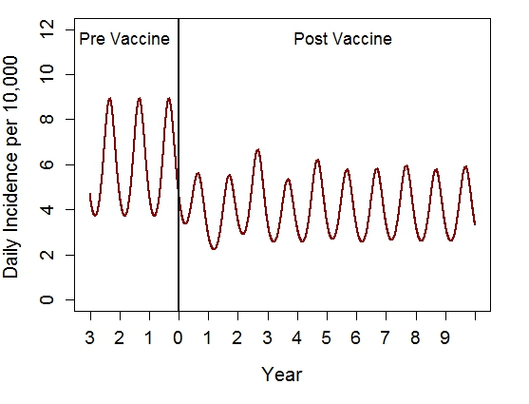
Vaccine Impact: Infant Immunization age
Vaccine Coverage=90% Vaccine Efficacy=50%
Notes:
Here I’m looking at the effect of routine immunizations of infants with vaccine coverage of 90% and efficacy of 50%. The plot here shows the change in the incidence of symptomatic infections within the vaccinated age group (the 0-4 year olds). The y axis represents the daily incidence per 10,000 people and the x axis are yearly time steps. The vertical line plotted here represents when vaccines are introduced, so to the left of the line are the years prior to vaccine introduction and to the right of the line are the years after vaccines are introduced. Prior to vaccination there are seasonal cycles that are characteristic of norovirus. Once infant immunization is the incidence of symptomatic infections in 0-4yr decreases and it takes several years to reach an new stable equilibrium

Slide 21
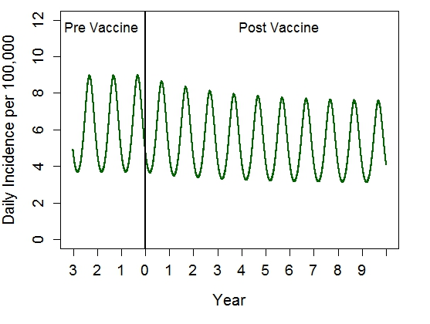
Vaccine Impact: Elderly Immunization age
Vaccine Coverage=65% Vaccine Efficacy=50%
Notes:
Here this is a similar plot, but now I’m showing what would happen to the incidence of symptomatic infections in the elderly if there was routine immunization of 65 year olds with 5 year boosters. This vaccine strategy has 65% vaccine coverage and 50% vaccine efficacy. The y axis represents the daily incidence per 100,000 people (so the elderly have a smaller incidence than 0-4 year age group) and the x axis are yearly time steps. So here, after you introduce vaccines there is a subtle and slow reduction in the incidence of symptomatic infections in the elderly with routine immunizations in this age class.

Slide 22
Model Assumptions: Fixed Parameters
Parameter | Value | Range | Source
Duration of natural immunity | 5.3 years | (3.9y – 6.5y) | Simmons et al., 2013
Duration of incubation | 32.8 hours | (30.9h – 34.6h) | Devasia et al., 2014
Duration of symptomatic infection | 48 hours | (39.0h – 52.1h) | Devasia et al., 2014
Duration of asymptomatic infectious period | 10 days | (1d – 20d) | Rockx et al., 2002
Relative infectiousness during incubation period or asymptomatic period | 0.05 | (0.045-0.055) | Simmons et al., 2013; Sukhrie et al., 2010
Table adapted from: Simmons, K., Gambhir, M., Leon, J. & Lopman, B. Emerg. Infect. Dis. 19, 1260–7 (2013)
Notes:
This is the table of fixed parameter values that I showed before but here it’s also showing the range of values

Slide 23
Uncertainty Analysis
Pediatric Immunization
Notes:
NOTE 100 RUNS
These are results from an uncertainty analysis around routine infant immunization. The x axis represents the % of hospitalizations that are averted over a one year time period and the y axis are the four age groups of the population. The boxplots represents the range of outcomes based on the different parameter values tested. And the line is representing the median % of hospitalizations averted, which is about what the model predicts.
There is a large amount of uncertainty here because there is considerable uncertainly around the parameters that affect transmission. Also with this vaccination program there are greater indirect benefits
And as indirect benefits are the result of a reduction in transmission, and there is a lot of uncertainty around the parameters that determine transmission, the result is that there is a lot of uncertainty in the indirect benefits.

Slide 24
Uncertainty Analysis
Pediatric Immunization
Elderly Immunization
Notes:
NOTE 100 RUNS
These are results from an uncertainty analysis around routine infant immunization. The x axis represents the % of hospitalizations that are averted over a one year time period and the y axis are the four age groups of the population. The boxplots represents the range of outcomes based on the different parameter values tested. And the line is representing the median % of hospitalizations averted, which is about what the model predicts.
There is a large amount of uncertainty here because there is considerable uncertainly around the parameters that affect transmission. Also with this vaccination program there are greater indirect benefits
And as indirect benefits are the result of a reduction in transmission, and there is a lot of uncertainty around the parameters that determine transmission, the result is that there is a lot of uncertainty in the indirect benefits.

