Slide 1
the case for dynamic improvement & Explainability in artificial intelligence (AI) Systems
Uyi Stewart, PhD
Director, Strategy, Data & ANALYTICS
April 17 2019

Slide 2
From Data to Decisions
Notes:
This is the Strategy, Data & Analytics (SDA) Theory of Change (towards improving delivery effectiveness)

Slide 3
The future of AI systems
“these systems will be able to learn from structured and unstructured data, discover important correlations, create hypothesis for those correlations, and suggest actions that produce better outcomes.
In addition, they will have feedback loops where they measure the results of their work and modify the way they do things based on the feedback.”
Kelly & Hamm 2013: pg. 25

Slide 4
Simplified AI System’s Workflow (Data to Decisions)
Human and Policy
Decisions
Training Set
AI Insights
Input Data
AI Algorithm
(initial build)
Test Set
DATA
Poor quality/noisy
Extremely noisy
Low accuracy
Bias
Sparsity
Negative provenance
INSIGHTS
False positives
False negatives
Correlation not causality
Timeliness
Relevance (optimization)
Value of Information
Lack of trust and believability

Slide 5
Opportunities abound for AI to impact Africa and the developing world to accelerate SDGs
On average, every Adult on the African Continent has at least 1 mobile phone
Potential AI use cases :
Image Recognition | Speech Recognition | Natural Language Processing | Scenario Planning

Slide 6
We must clarify the end user:
AI for Who?
Last mile
Illiteracy
Language (acoustic) models
Gender inequality
Culture and beliefs
Local and institutional capacities
Community (usability, learning, behavior)
Technology (infrastructure, adoption/adaptation)

Slide 7
Digital Health Services via Frontline-Healthcare Workers
"Although Africa has 25% of the world's disease burden,
it has only 3% of the world's health care workers" - Reuters

Slide 8
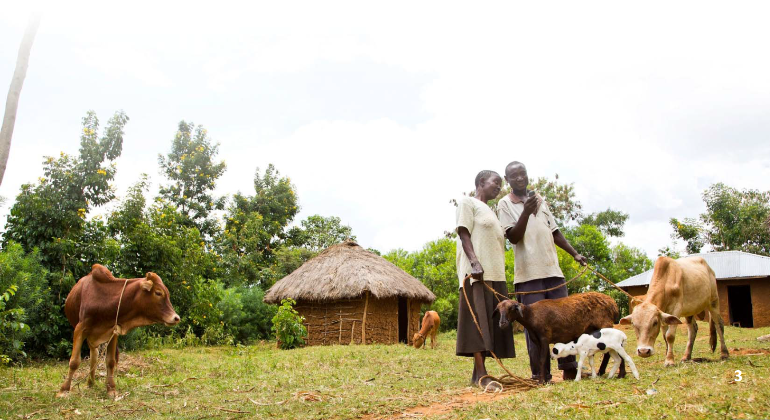
85% of the Africa’s poor live in
rural areas and depend on agriculture
70% of the workforce is producing less than 30% contribution to the total average GDP
Digital Farmer Services via Agriculture Extension Workers
Notes:
B. Abelson, K. R. Varshney, and J. Sun, “Targeting Direct Cash Transfers to the Extremely Poor”
ACM SIGKDD Conf. Knowl. Disc. Data Mining, p. 1563-1572, Aug. 2014.

Slide 9
Caution!

Slide 10
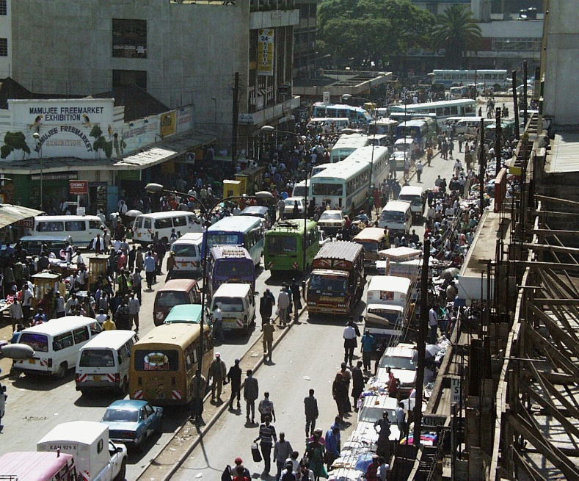
Fixing Traffic Congestion in Nairobi with AI: Twende Twende
Notes:
https://www.forbes.com/sites/ehrlichfu/2015/03/03/fixing-traffic-congestion-in-kenya-twende-twende/#721e67dcfb66
https://pctechmag.com/2014/01/twende-twende-the-mobile-app-that-helps-kenyans-dodge-traffic
References
Andrew Kinai, Reginald E. Bryant, Aisha Walcott-Bryant, Eric Mibuari, Komminist Weldemariam, and Osamuyimen Stewart. 2014. Twende-twende: a mobile application for traffic congestion awareness and routing. In Proceedings of the 1st International Conference on Mobile Software Engineering and Systems (MOBILESoft 2014). ACM, New York, NY, USA, 93-98. DOI=10.1145/2593902.2593926 http://doi.acm.org/10.1145/2593902.2593926
Andrew Kinai, Reginald E. Bryant, Aisha Walcott-Bryant, Eric Mibuari, Komminist Weldemariam, and Osamuyimen Stewart. 2014. Traffic 411: a traffic congestion routing and awareness platform for Nairobi. In Proceedings of the 29th Annual ACM Symposium on Applied Computing (SAC ’14). ACM, New York, NY, USA, 1475-1476. DOI=10.1145/2554850.2555148 http://doi.acm.org/10.1145/2554850.2555148

Slide 11
“one thing we are going to have to build in is the feedback mechanism – when the algorithm makes a mistake
To take that training set and constantly improve it because something new may come…and discourage negative consequences from mistakes…Completing that loop is necessary
It is troubling that today’s deep learning systems are mostly opaque.
One hopes that in the next decade someone comes up with AI systems that are as good or better than what we have today and have a degree of explainability (e.g., notion of dynamic improvement)
- Bill Gates, Stanford HAI keynote, March 2019

Slide 12
Dynamic Improvement in AI: The Neglected Module
DATA
Poor quality/noisy
Extremely noisy
Low accuracy
Bias
Sparsity
Negative provenance
BEHAVIORIAL OR POLICY DECISION
Wrong decision (mistake)
Political economy
Human cognition
Culture (context)
Idiosyncrasies
Actionable (practical)
INSIGHTS
False positives
False negatives
Correlation not causality
Timeliness
Relevance (optimization)
Value of Information
Data Science
Behavioral Science
Decision Science

Slide 13
EXPLAINABILITY: Encoding Human Feedback & Intelligent Error Recovery in AI Systems
Behavioral or Policy Outcome
Plausibility condition
AI MODEL
ERROR?
OUTPUT
(INSIGHT)
INPUT
DECISION
No
Dynamic improvement
D.I.
Yes
ERROR RECOVERY
HUMAN COGNITION?
Real-time Feedback
Real-time Feedback Mechanism
Yes
Match
Crowdsourcing (ground truthing)
Continuous feedback and improvement
Rapid experimentation
Adaptive, dynamic model management
Real time, monitoring
No
Match
Back up AI MODEL
Notes:
Actualizing “Man-machine symbiosis” in Africa’s AI systems
“in not too many years, human brains and computing machines will be coupled together very tightly and the resulting partnership will think as no human brain has ever thought and process data in a way not approached by the information-handling machines we know today.”
J.C.R Licklider (1960)
On one hand, human Knowledge is obscure, very mysterious to machines – Unstructured data analysis is hard for computers – easy for humans – Knowledge is not well defined at all from a computer science perspective – We know how to represent data and information, not knowledge
On the other hand, high dimensional data sets are hard and obscure for humans, at least without the help of the machine – We do not really understand how machines think
Today,
- Suboptimal use of existing human knowledge in AI today
Huge explainability challenges

Slide 14
From Data to Decisions
Some current Investments/ Experiments by BMGF’s Strategy, Data & Analytics (SDA)

Slide 15
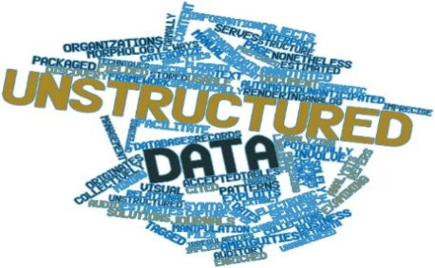
Better Decisions. Better Health & Development.
What? | When? | How, where, who?
Priority setting | Value & strategy | Delivery
Economic modeling
Machine learning
Artificial intelligence
Insights about populations or individuals for targeted delivery
Automated decisions
“one second rule” – A. Ng
Improve efficiency for individuals and processes
Policies for groups or populations

Slide 16
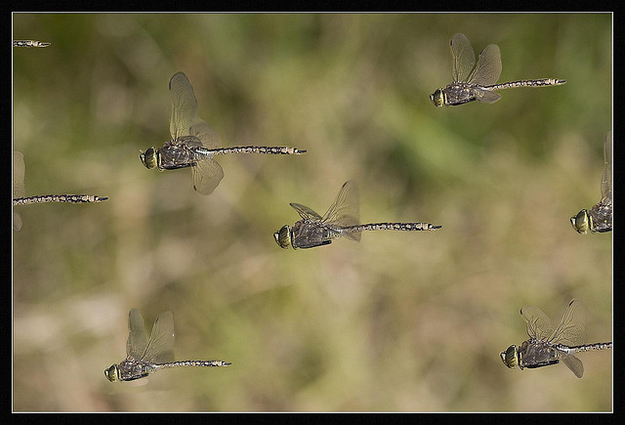
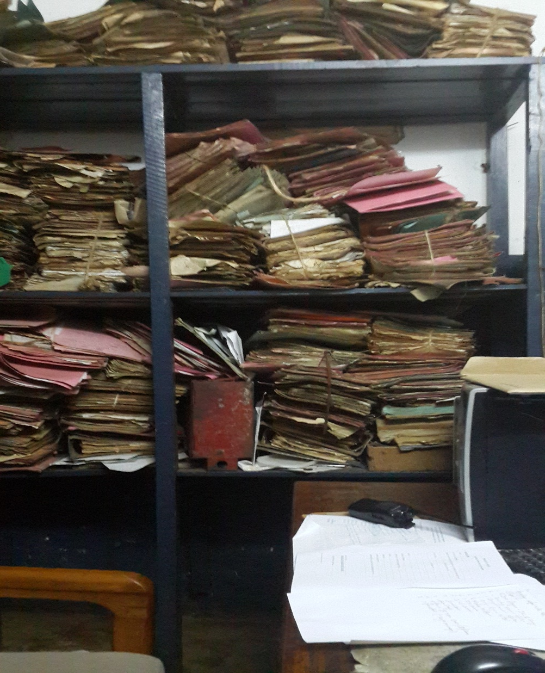
Intelligence is Hidden in the Data… The Human-AI Gap, Indigenous Knowledge, Big Data Analytics for Behavior Change

Slide 17
THANK YOU

