Slide 1
The entomological context for resistance
Tolerance to insecticides by Anopheles vectors of malaria
Dan Strickman, Senior Program Officer (Malaria/NTD, Vector Control)

Slide 2
Part of CropLife International Stewardship Committee since 1984
https://www.irac-online.org/documents/irm-mini-vector-booklet-slides/?ext=pdf

Slide 4
Insecticide resistance management (irm)
Three basic methods:
Rotation
Mixtures
Fine-scaled mosaics
Prevention and Mangement of Insecticide Resistance in Vectors of Public Health Importance, IRAC https://www.irac-online.org/documents/irm-vector-manual/?ext=pdf
WHO Global plan for insecticide resistance management in malaria vectors (GPIRM) https://www.who.int/iris/bitstream/10665/44846/1/9789241564472_eng.pdf?ua=1

Slide 5
How many active ingredients does it take?

Slide 6
Where is there resistance and why do we care?
Difficult to measure:
Multiple causes
Imperfect bioassays
Not uniform in space or time
There are continent scale resources
MAP data set https://www.biorxiv.org/content/10.1101/582510v1
IRMapper http://www.irmapper.com/
WHO Malaria Threats Map https://apps.who.int/malaria/maps/threats/

Slide 9
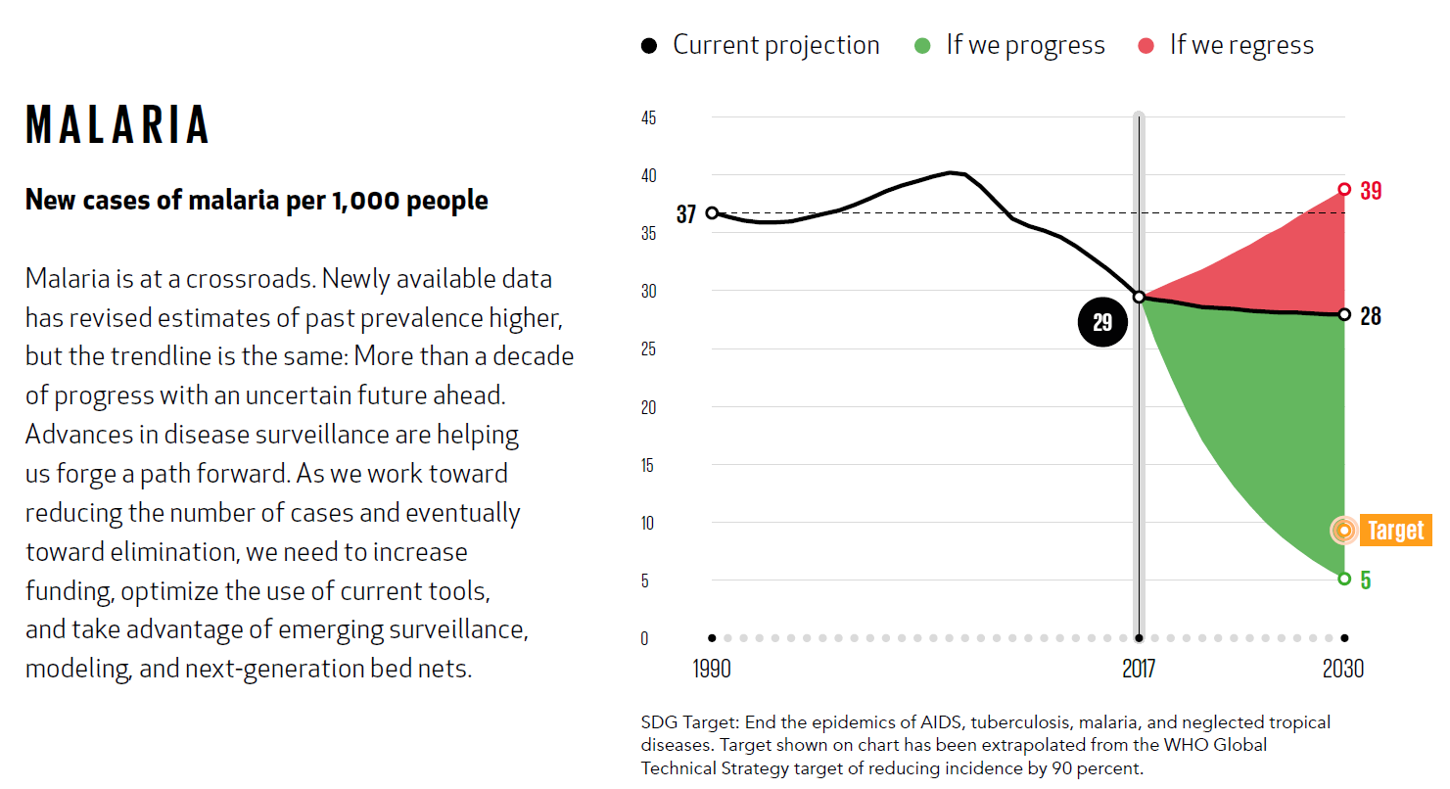
What has changes in IVCC’s strategy? Resistance, ambition, know-how, confidence and new technologies
Regress: relying only on existing tools
Maintain the gain: Novel AIs, repurpose, IRM
Elimination: Disruptive tools with proven public health value
Eradication: Combination and disruptive interventions

Slide 10
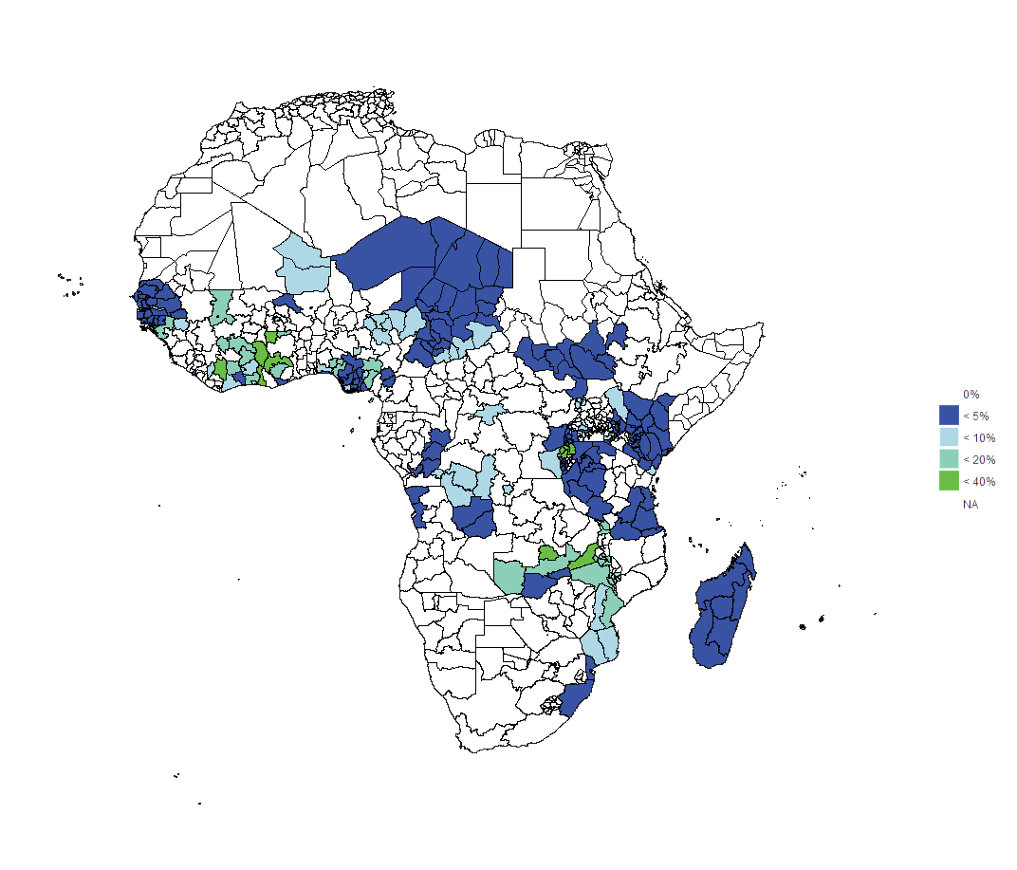
The expected impact were we to maximise our vector control options, and maximise our complementary tools, that is, NG-nets XLL-IRS at 30% coverage but targeting the most burdensome administration units, and adding ATSB to cover 80% of villages plus increasing SMC in the Sahel Region to 90% coverage, increasing first line drug treatment to 50% using ACTs everywhere and administering PEV vaccine in locations that had a prevalence > 10% in 2016 (Model 4).
Prevalence in children under the age of 10 (%) in 2040
Maximal vector control + first-line treatment of clinical cases + seasonal malaria chemoprevention in the Sahel region + vaccine in high malaria burden regions
SCENARIO 6
Next-generation nets at 75% usage everywhere
XLLIRS in the 30% most prevalent regions
Attractive toxic sugar bait (ATSB) everywhere (MAJOR assumption; ATSB efficacy against mosquitoes is taken from a single trial in one location and its generalisability is not yet known)
Seasonal malaria chemoprevention (SMC) - 90% of children under 5 years given prophylactic treatment throughout the rainy season in the Sahel Region
ACT used to treat clinical cases
Vaccine administered to 90% of children in regions with high malaria levels

Slide 11
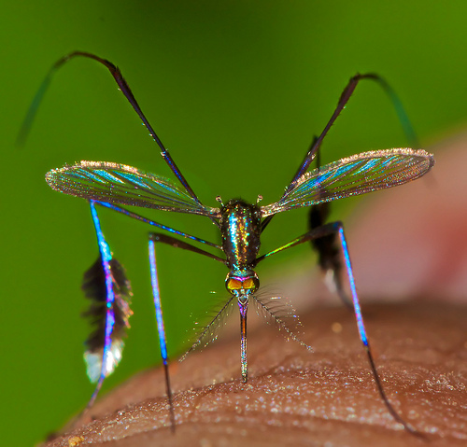
Questions that I can’t answer?

