Slide 1
Data quality for polio eradication:
Accuracy & reliability
5th Annual Disease Modelling Symposium, Seattle, 18-20 April 2017
Research, Policy and Containment, Polio Eradication Department,
World Health Organization, Geneva, Switzerland

Slide 2
Overview
Polio eradication status
Definition of accuracy & reliability
Main data collection systems (focus on AFP)
  Indicators
  Examples of use
  Issues
Re-phrase questions
Summary

Slide 3
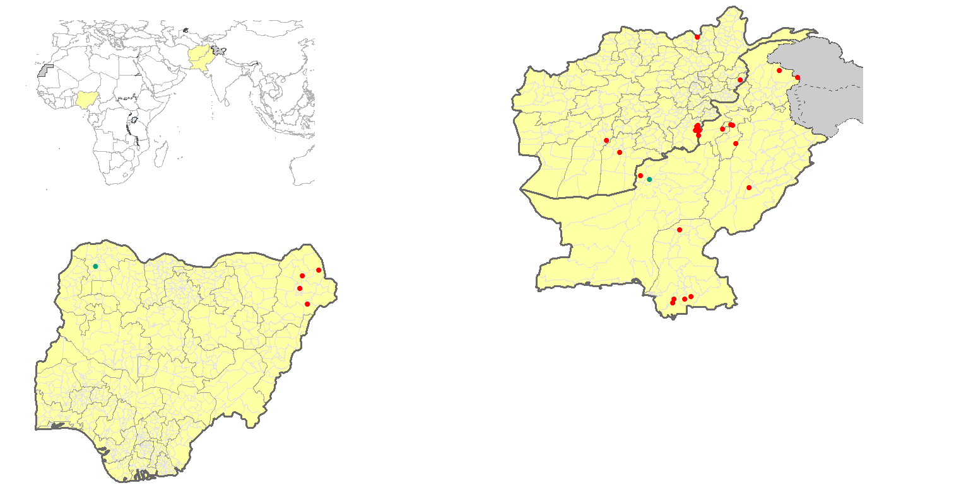
Wild Poliovirus & cVDPV Cases¹, Past 12 months²
Wild poliovirus type 1
cVDPV type 2²
Endemic country
¹Excludes viruses detected from environmental surveillance
²Nigeria, 1 cVDPV2 healthy child contact of WPV1 case (Borno, spec collection 26 Aug)
³Onset of paralysis 05 April 2016 – 04 April 2017

Slide 4
Definitions
Accuracy:
  the fact of being correct and without any mistakes
  accuracy is also the agreement of particular measurement with an accepted standard.
Reliability:
  the quality or state of being reliable
  the extent to which an experiment, test, or measuring procedure yields the same results on repeated trials

Slide 5
Data sources
POLIS (Polio Information System)
  AFP (Acute Flaccid Paralysis) case data, including demographic, epidemiological, vaccination & virological data
  ES (Environmental surveillance)
  Supplemental immunization activity data (SIAs) (dates, geographic extent, and vaccine used)
Lot Quality Assurance Sampling (LQAS)
  Quality (coverage) of supplemental immunization activities (SIAs)
Routine immunization data (maintained by IVB)
  Down to 1st level subnational division levels
Additional program evaluation
  Seroprevalence surveys

Slide 6
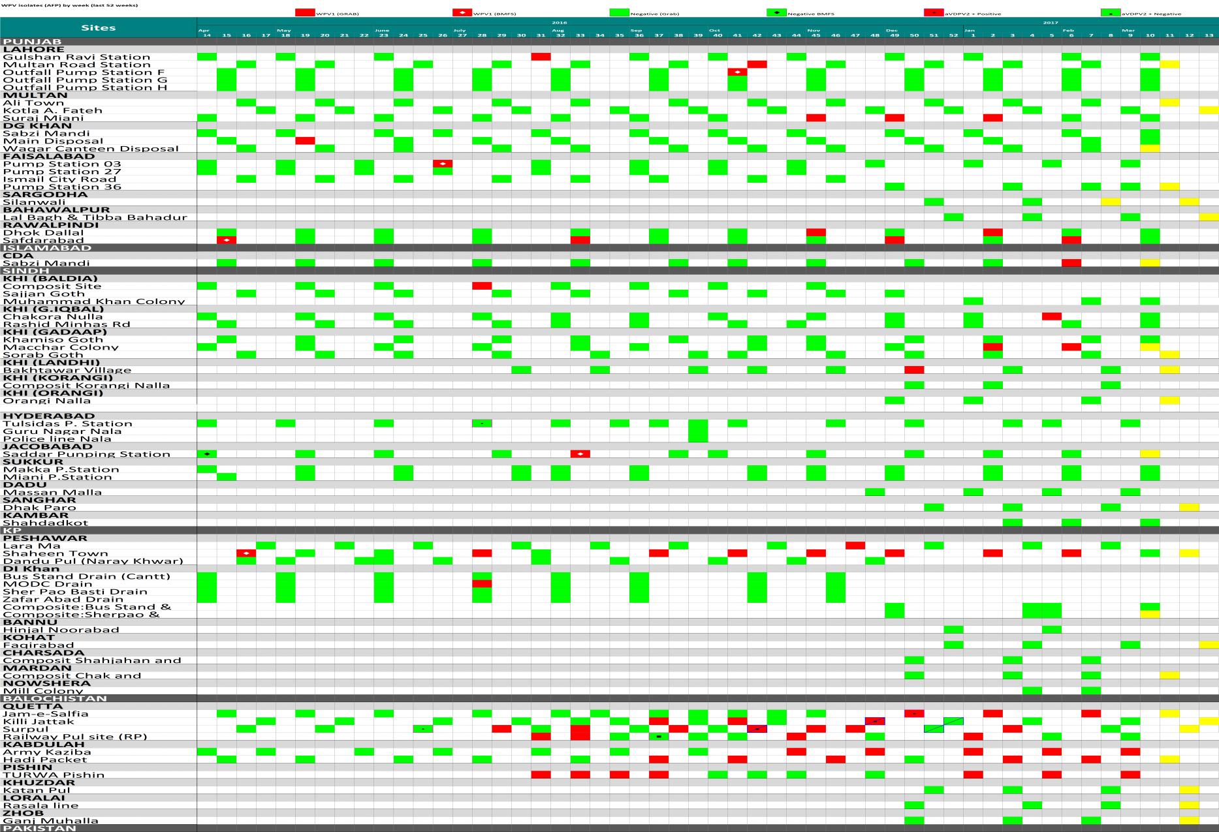
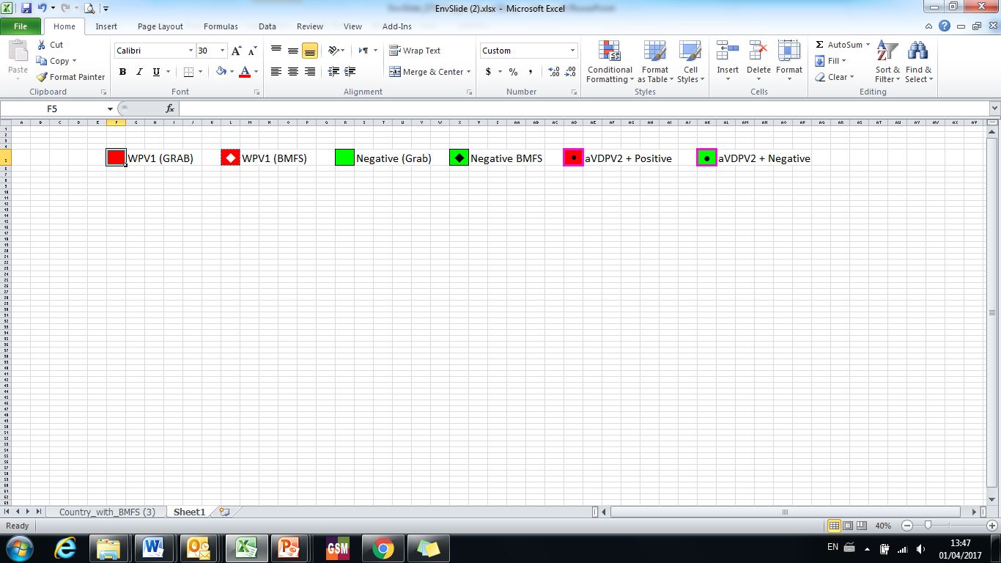
Pakistan: Environmental Surveillance
Persistent and recurrent positives in Quetta and Peshawar major concern
Lahore
Multan
Rawalpindi
Karachi
Peshawar
Quetta Block
6

Slide 7
AFP Surveillance
Case-based information
  Immediate reporting of suspected cases from reporting site (CLINIC)
  Detailed investigation & sample collection (case report form) (POLIO SURVEILLANCE STAFF)
  Stool samples sent for virology to respective laboratories (NETWORK LABORATORY)
  60-day follow-up investigation for presence / absence of paralysis (POLIO SURVEILLANCE STAFF)
Network of surveillance sites (POLIO SURVEILLANCE STAFF)
  Down to district hospitals, community informants
  Immediate reporting, monthly negative reporting, active weekly visits
National Polio Expert Committee (NPEC)
  Classification of reported cases

Slide 8
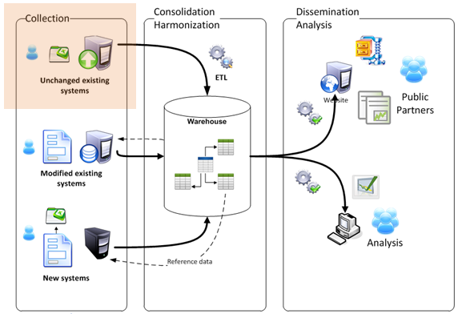
PolIS (Polio Information System)
The primary objective of the Polio Information System (PolIS) is to harmonize and consolidate data from various sources
  Most of the data managed come to us through existing “systems” which report data in varying degrees of quality, therefore:
    We have very little control of the input
    PolIS must process the file to ensure quality

Slide 9
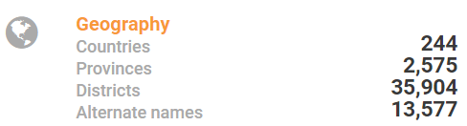
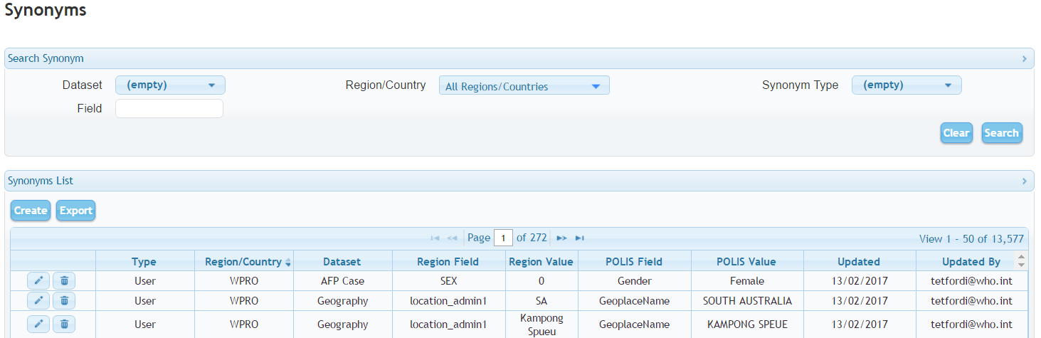

PolIS data quality – Reference data
Statistics and examples of the reference data

Slide 10
AFP Surveillance Quality Indicators
Non-polio AFP rate:
  >2 cases per 100,000 population <15 years of age
  [indicator valid even in absence of paralysis caused by poliovirus]
Stool adequacy rate:
  >80% of AFP cases with two adequate stool samples (within 14 days of onset of paralysis, >24 hours apart, etc).
  [indicator provides information of quality of whole system]

Slide 11
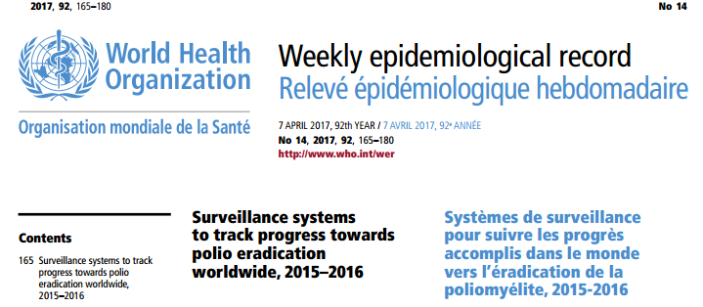
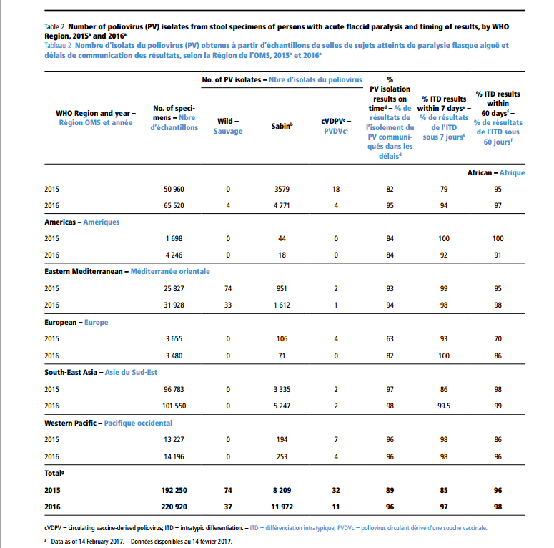

Slide 12
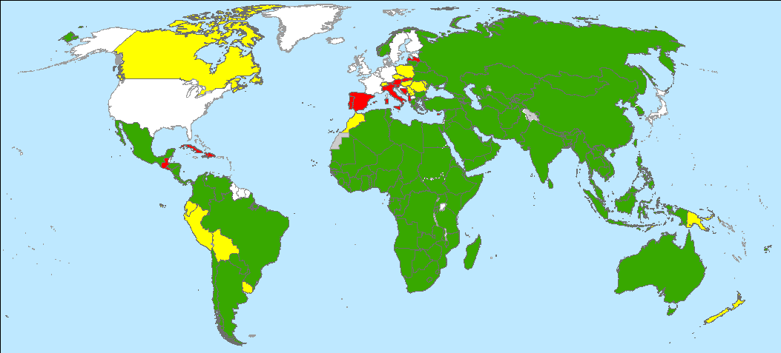
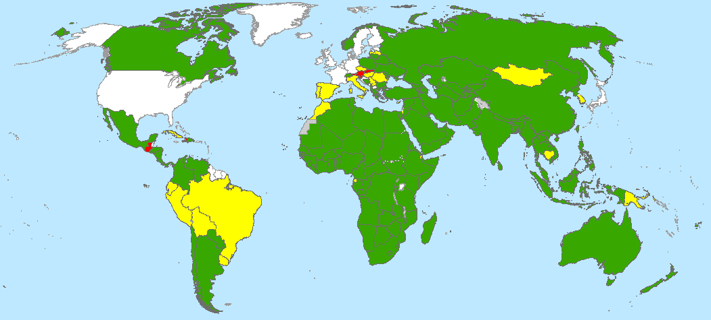
Non-polio AFP Rate, Worldwide, by Country
February 2015 – January 2016
February 2016 – January 2017
< 0.5
0.5 - 0.99
> 1
No AFP Surveillance/data
Data in WHO HQ as of 14 March 2017
The boundaries and names shown and the designations used on this map do not imply the expression of any opinion whatsoever on the part of the World Health Organization concerning the legal status of any country, territory, city or area or of its authorities, or concerning the delimitation of its frontiers or boundaries. Dotted lines on maps represent approximate border lines for which there may not yet be full agreement.
© WHO 2017. All rights reserved

Slide 13
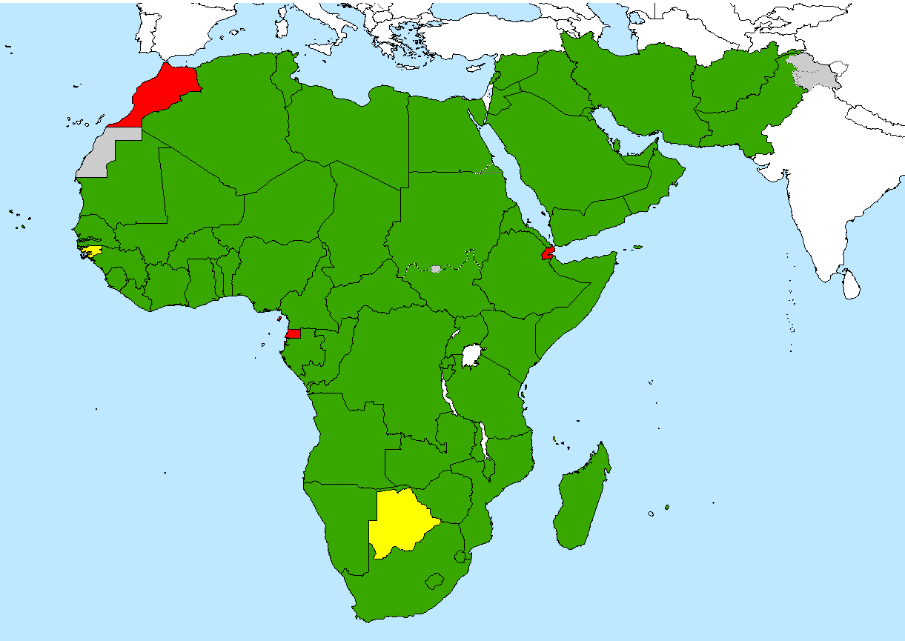
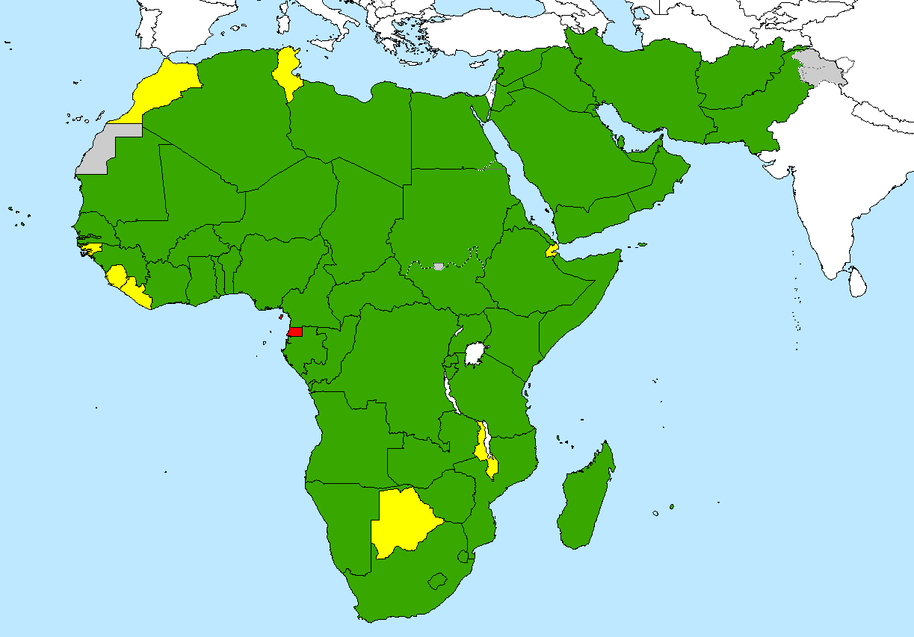
Surveillance Indicators, Endemic Regions (AFRO and EMRO)
February 2016 – January 2017 (Rolling 12 months)
Non-polio AFP rate
< 1
Non-polio AFP rate
is >2/100,000
1 – 1.99
>= 2
Adequate stool collection percentage
< 50%
50 – 79.99%
>= 80%
Data in WHO HQ as of 14 March 2017
The boundaries and names shown and the designations used on this map do not imply the expression of any opinion whatsoever on the part of the World Health Organization concerning the legal status of any country, territory, city or area or of its authorities, or concerning the delimitation of its frontiers or boundaries. Dotted lines on maps represent approximate border lines for which there may not yet be full agreement.
© WHO 2017. All rights reserved

Slide 14
Issues with Data Quality
General:
  Case reporting forms are not completely standardized
  No two country surveillance systems are identical
  Case reporting form completion quality variable
  60-day follow-up not implemented everywhere
Specifically (one example):
  Immunization histories most problematic
    Often no routine immunization records
    Always no SIAs dose records (due to program instructions)
    Affected by further biases, including parents with paralyzed child often not will willing to admit that they did not vaccinate child
Indicators:
  Not able to distinguish well- from less well performing countries

Slide 15
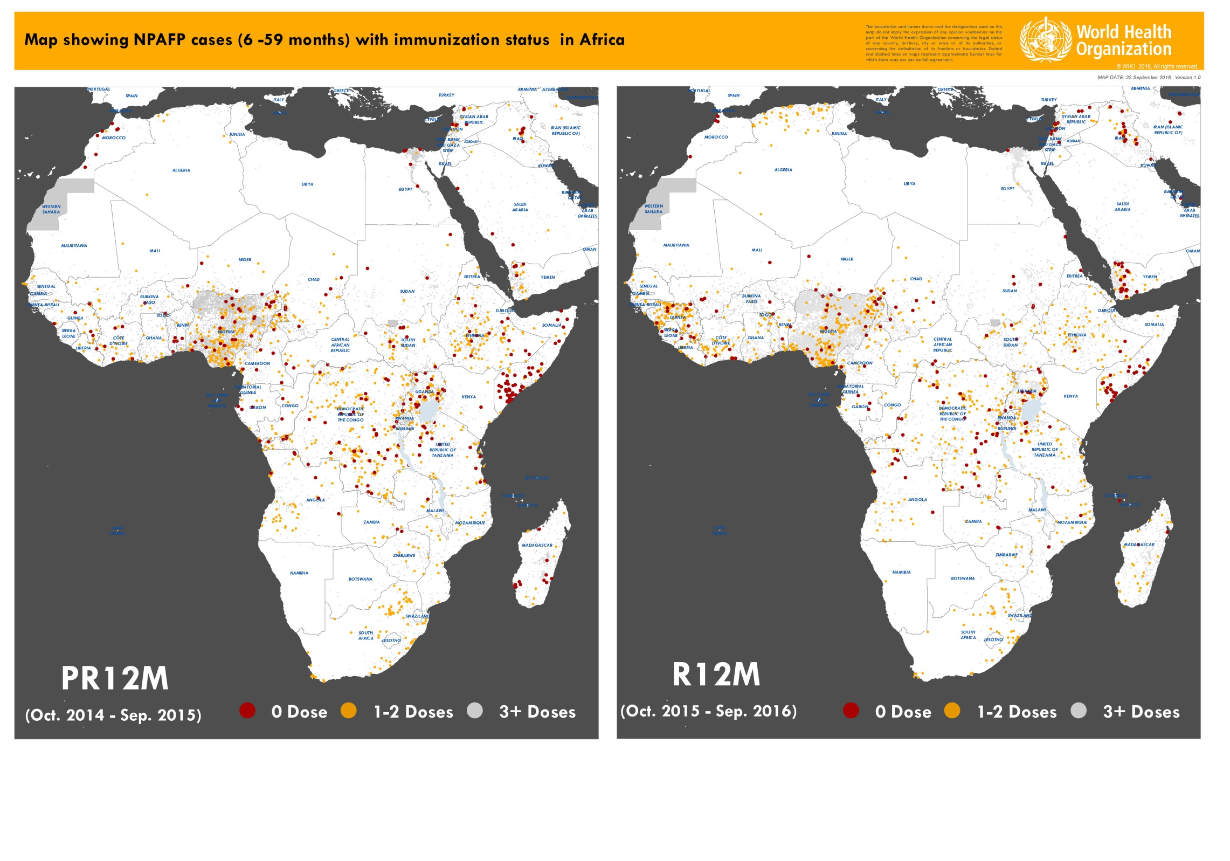
Map showing immunization status of NPAFP cases (6-59 months) in Africa

Slide 16
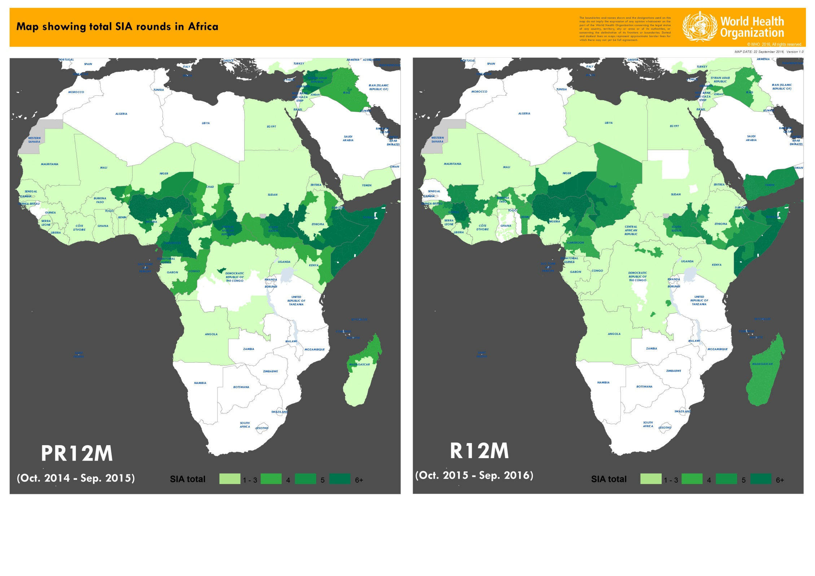

Slide 17
Re-phrase question I
Is the AFP system quality good enough for public health purposes?
  Documented the disappearance of wild poliovirus transmission in all but 3 countries.
  Formed the backbone for Regional Certification in 4 WHO Regions (AMR, WPR, EUR, SEAR)
  Undoubtedly, it will form the base for global certification (supplemented environmental & other forms of surveillance)
Does it needs to be improved?
  Without question, silent areas need to be addressed, and the variability between countries and Regions needs to be decreased.

Slide 18
Re-phrase question II
Is the system good enough for modelling purposes?
  Qualified yes. The key for any modelling exercise is identify key drivers and to include sensitivity analysis.
  "All models are wrong, but some are useful". Let's maximize the usefulness of modelling.

Slide 19
AFP Data Summary
System is unique (global case-based surveillance system); large number of variables
165 countries provide AFP data to WHO
Complemented by laboratory system (146 laboratories processing >220,000 samples -- annual accreditation)
The systems quality, including data quality, depends on the diligence and professionalism of each person involved
Continuous improvements are a must (total quality management should be considered)

Slide 20
Thank You!

Slide 21
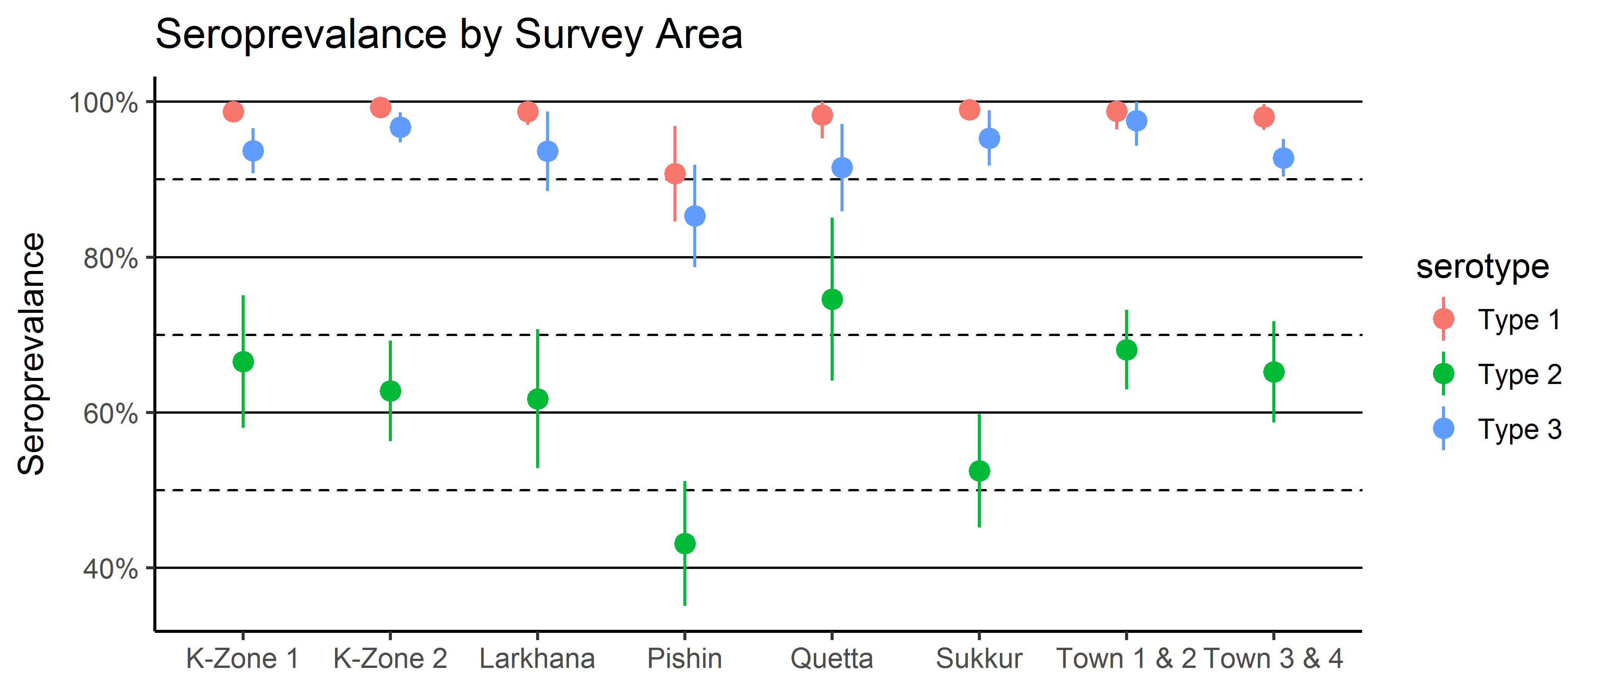
Population immunity: progress and gaps
Sero-survey among children 6-11 months, Nov 16- Feb 17 (preliminary results)
Seroprevalence high for Types 1 and 3. (Except Pishin, driven by pockets of sero-negative children).
Type 2 low- many of the study children born after the tOPV to bOPV switch and routine immunization is sub-optimal.
21
Notes:
Very high for Types 1 and 3. The one exception is Pishin, which appears to be due to a few clusters with very low sero-prevalance, rather than overall low coverage.
Type 2: low immunity, and looks worse when you break it out by birth cohort. We know immunity to PV2 is deteriorating with time, yet it is still interesting to see it ‘borne’ out in the data.

