Slide 1
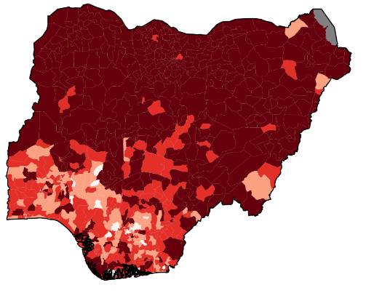
Can we do a better job of predicting
measles outbreaks?
WHO/CDC risk assessment tool
Nigeria, 2016
Very high
High
Medium
Low
Notes:
Hello! Welcome everyone to day 2 of the IDM symposium. My name is Niket Thakkar. I’m an IDM research scientist working mostly on measles.
I thought I’d get us started by comparing two maps. In the middle, is lab confirmed (via blood test) and associated epi-linked measles cases in Nigeria every quarter (the darker the orange, the more severe the outbreak), and you can see measles bounce around the country with non-trivial dynamics. Meanwhile, in the corner, we have the WHO and CDC risk assessment tool – in some sense the state of the art or at least the programmatic approach to assessing district level risk.
So how does this work? The risk assessment tool is a scoring system – things like routine coverage being less than 80% or having a measles case in the last year, etc. things like that add points to particular district. Then those points are totaled up and binned into risk categories. What you get is a very static picture of risk despite measles being a very dynamic thing.
Now, you guys are very smart and you might very fairly say “Niket you’re cheating. That’s a video in the middle and that’s a picture in the corner so one’s dynamic and one’s static.” And you’d be right, I am cheating – and worse still me cheating is sort of a theme for the whole talk so watch out for that.
But even if I wasn’t cheating in this case, this risk assessment tool as a video would looks essentially the same. This scoring and binning approach is inherently static, and based on assessments of the data like “was there a case last year” not “was there a case last week.” The result is a flattened (and frankly rather depressing) picture of risk. It certainty isn’t one that inspires programmatic action.
Ideally, we want to be able to predict measles outbreaks and we want to do it with high spatial resolution and actionable time resolution. We want to be able to say to program officers “hey, we think these areas are gonna have an outbreak soon, let’s go vaccinate over there”. So that’s the motivating question for my talk this morning.
Now I can appreciate that that’s probably easier said than done. And there’s some research showing that it perhaps can’t be done given the realities of the data we have (more on that in a bit). But hopefully I can convince you that we can do a lot. And then, more than that, hopefully I can convince you that given a predictive model, we can start to ask much broader questions about measles eradication strategy. So I’ll touch on that too.

Slide 2
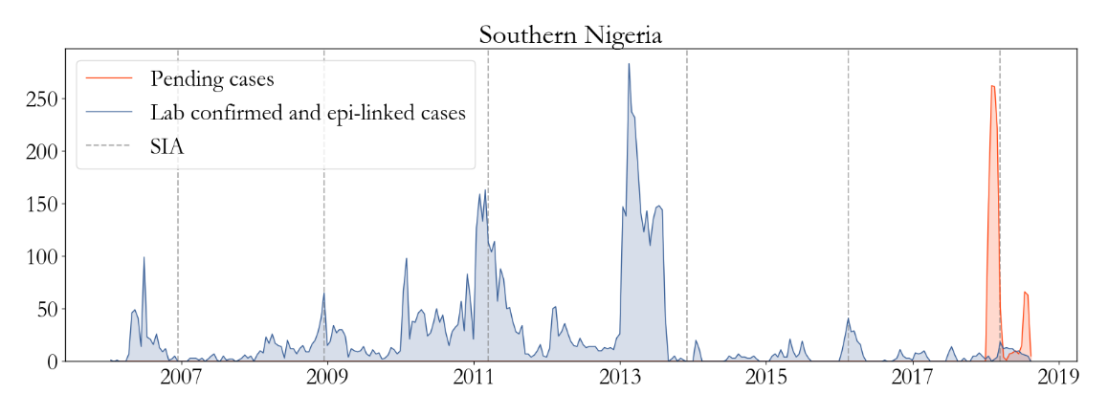
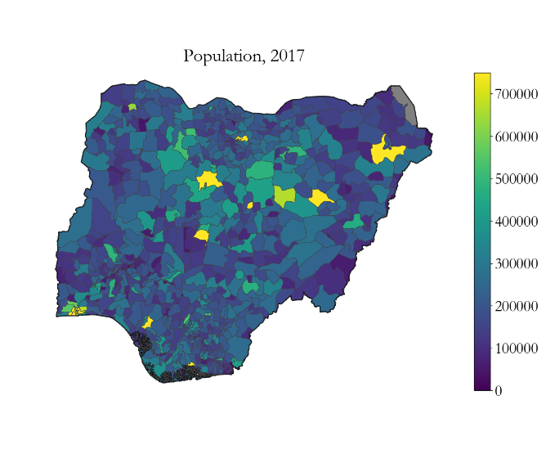
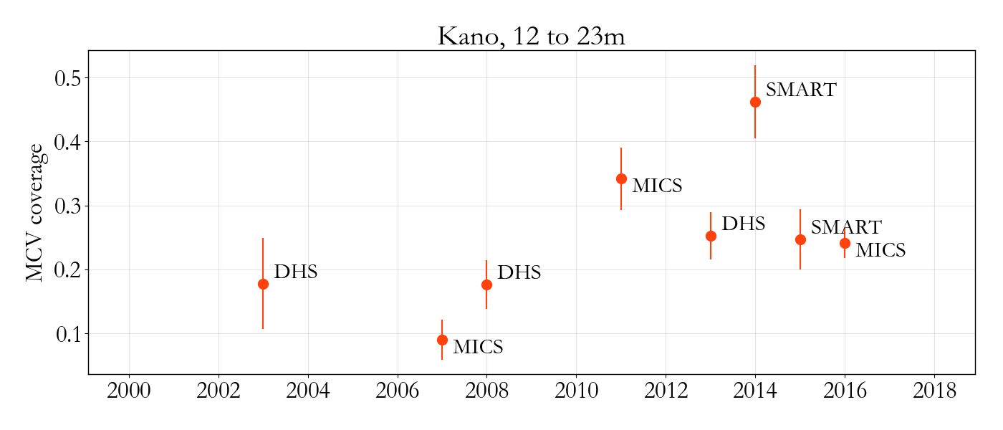
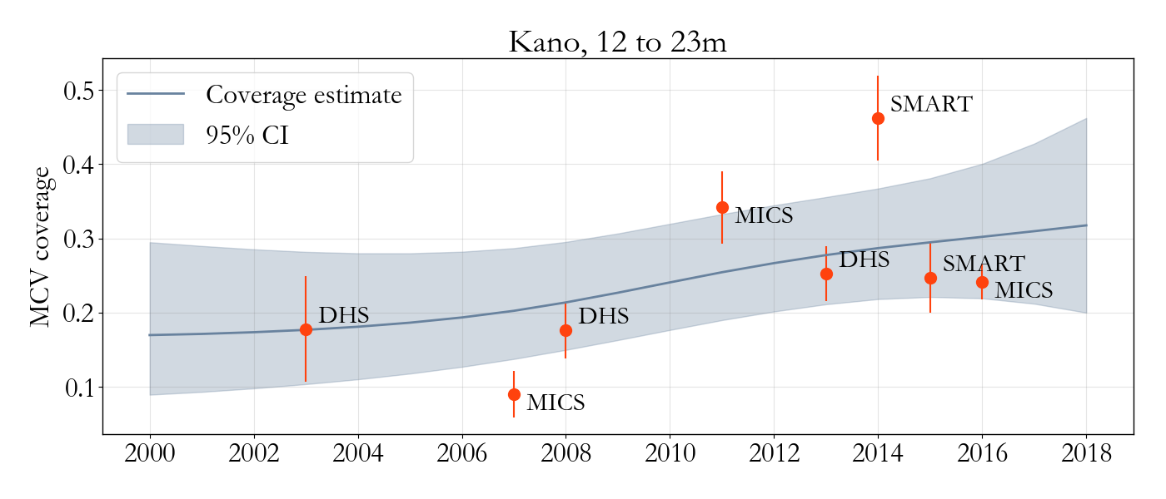
What data do we have?
Measles incidence + campaign history
Demography
(1) http://www.worldpop.org.uk/
(2) Tracy Dong, Laina Mercer, et al. In preparation.
Notes:
So let’s get started.
What data do we have?
Of course we have measles incidence data and a history of past vaccination campaigns. So, for example here, I have lab confirmed and epilinked cases from southern Nigeria in blue, binned into semi-monthly increments. You can see episodic outbreaks, etc. Notice also that there are a large number of “pending” cases (that is, untested cases) in late 2018. That’s actually due to a stock out of lab test kits, one of the realities of working with this type of data. One other key thing is that, but optimistic estimates, this curve is about 1% of total measles cases – the vast majority of measles cases aren’t caught by the surveillance system. So any modeling effort will have to account for that.
Meanwhile the grey lines represent campaigns, times when health workers set up fixed posts throughout the area, advertised a bunch, and got lots of families to line up to get vaccinated. We know when these happened, but we don’t know much about the effect they had on transmission – so that’s also something we’ll have to estimate.
The other data we have is demographics data.
We use world pop for population and birth rates
We also have surveys. In Nigeria there’s a lot of surveys, and we rely on our collaborators Laina and Tracy to smooth them. For other settings, there’s far fewer surveys, sometimes only 1. In that case, even I can solve the smoothing problem.
The reason I included this here though is to show that we try to incorporate as much information as we can.

Slide 3
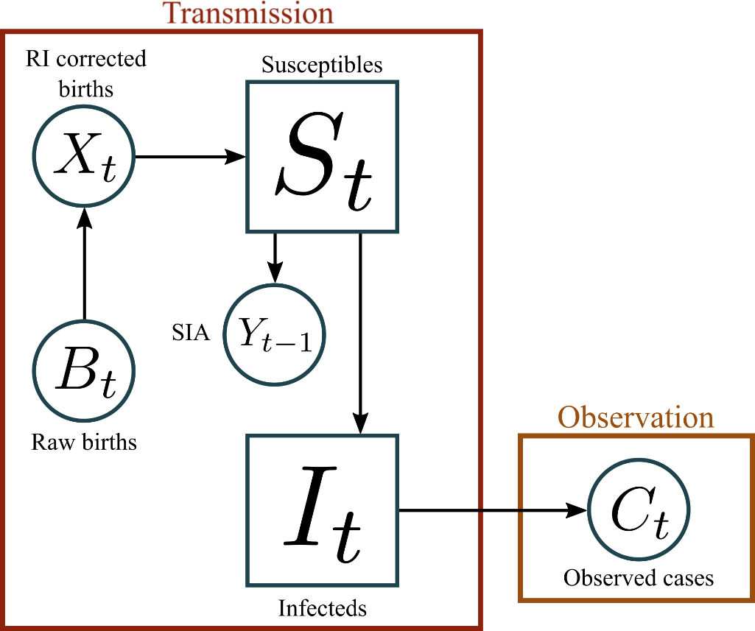
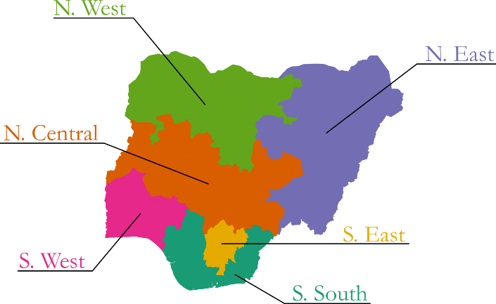
Simple time series models are powerful tools
We apply the model in each region independently.
(1) Finkenstäd et al, Journal of the Royal Statistical Society, 2000
Notes:
Our bread-and-butter method for putting it all together is a simple time series model, sometimes called the TSIR model, sometimes a statespace model, shown diagrammatically here, and as equations here.
WALK THROUGH
One thing to note is that there’s no spatial components to this model, everyone is well mixed and totally isolated. But we’ve found it’s still useful to apply this model at low spatial resolution, so for example at the region level, and for our purposes in this talk it’s a good place to start.

Slide 4
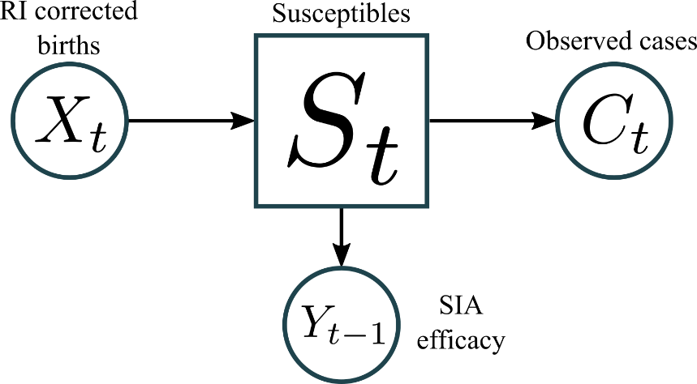
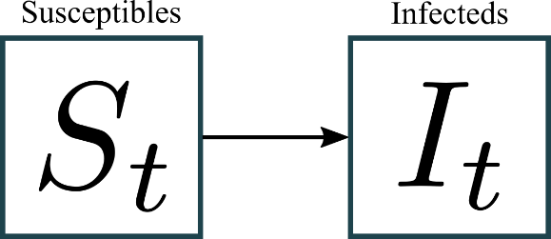
They’re fast to fit
Susceptible reconstruction
Transmission regression
The relationship between fluctuations in susceptibles and infecteds defines seasonality.
Case, population, birth-rate, and routine immunization data are all used here.
(1) Finkenstäd et al, Journal of the Royal Statistical Society, 2000
Notes:
We’ve worked a lot on coming up with algorithms to fit these simple models quickly. What we’ve landed on is a 2 step linear regression process that we iterate over given a set of SIA coverages. In the first step we estimate susceptibility over time and the degree of under-reporting by essentially solving a flow balance problem, balancing births with cases. Then, in the second step, we compare our estimates of susceptibility to our estimates of underlying infections (that is, reporting rate scaled cases), to determine what times of year susceptibles are most likely to be infected and estimate transmission seasonality.
I’m going through this pretty quickly because there’s two high level things I want to get across: (1) All the data is incorporated into the time series model, so in some sense, the time series model is a way to aggregate our data in an informative way (I’ll return to this idea later). (2) The other piece is that we’ve found speed is really critical. We’re using this model to work with policy makers to make decisions about SIA timing for example. In practice, what that looks like, is sitting at a conference room table and people ask “hey what does the model say if instead we use this RI estimate?” and we want to be able to turn around and answer that question right there at the table.
Our method, in some sense, cuts corners on quantifying uncertainty, but we can fit it in about 100 model evaluations (so a few seconds on a laptop). Other, possibly more rigorous, approaches, like MCMC or particle filtering, require millions of model evaluations, which is untenable in practice. That’s why we prefer this approach.

Slide 5
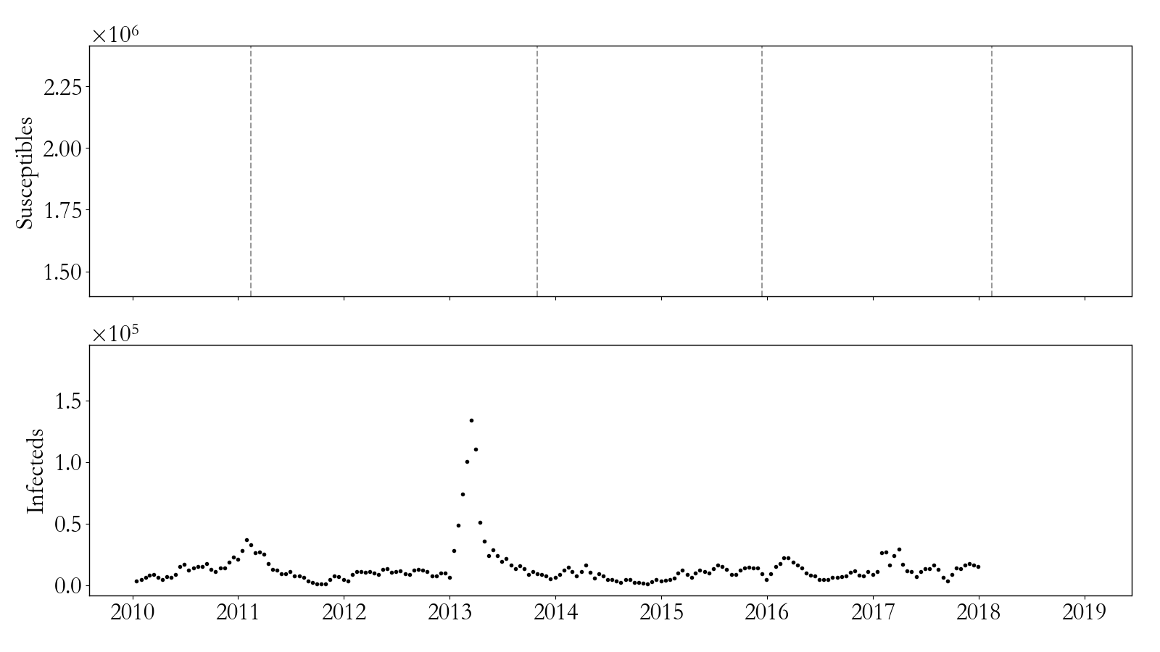
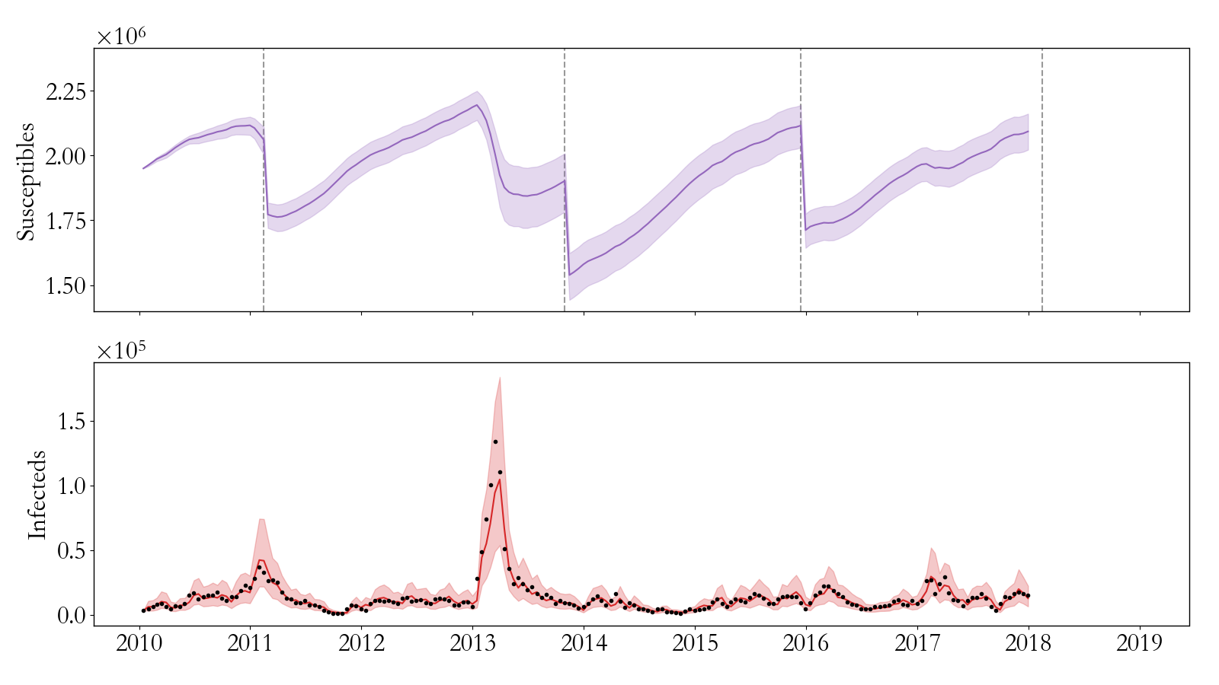
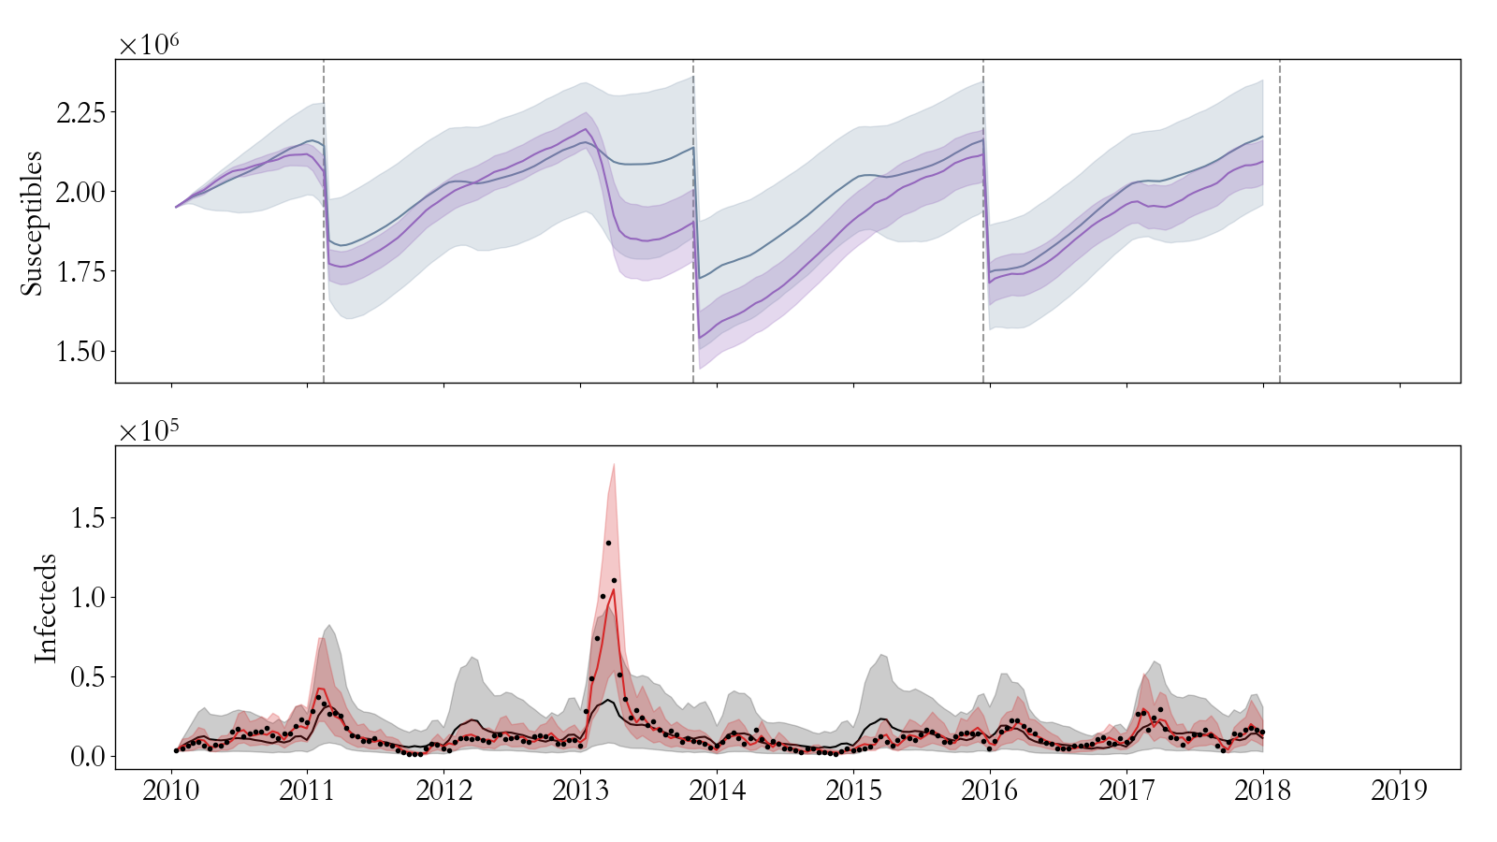
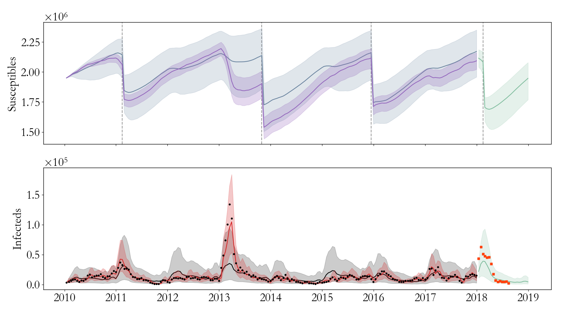
They’re predictive (at low spatial resolution)
Simple models also teach us
about the epidemiology.
SIA
$$S_{t} | I_{t−1}$$
$$S_{t} | I_{0}$$
Extrapolation
Data
$$I_{t} | I_{t−1}$$
$$I_{t} | I_{0}$$
Test data
Extrapolation
R² = 0.89
R² = 0.41
R² = 0.63
Notes:
Moreover, we find at this spatial resolution at least, that the model is predictive.
WALK THROUGH.
So, we’ve used this model to help coordinate campaign timing and evaluate competing campaign policies. I’m not gonna talk much about that. But the other thing is that, with even a simple model like this, we learn a lot of valuable epi.
So I’ll take a small detour to run through a couple examples.

Slide 6
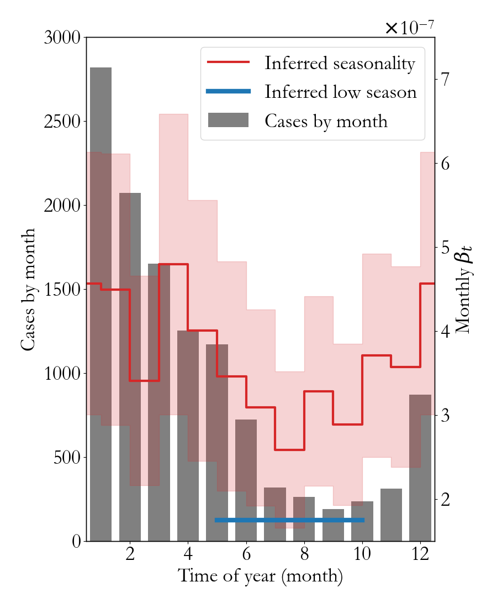
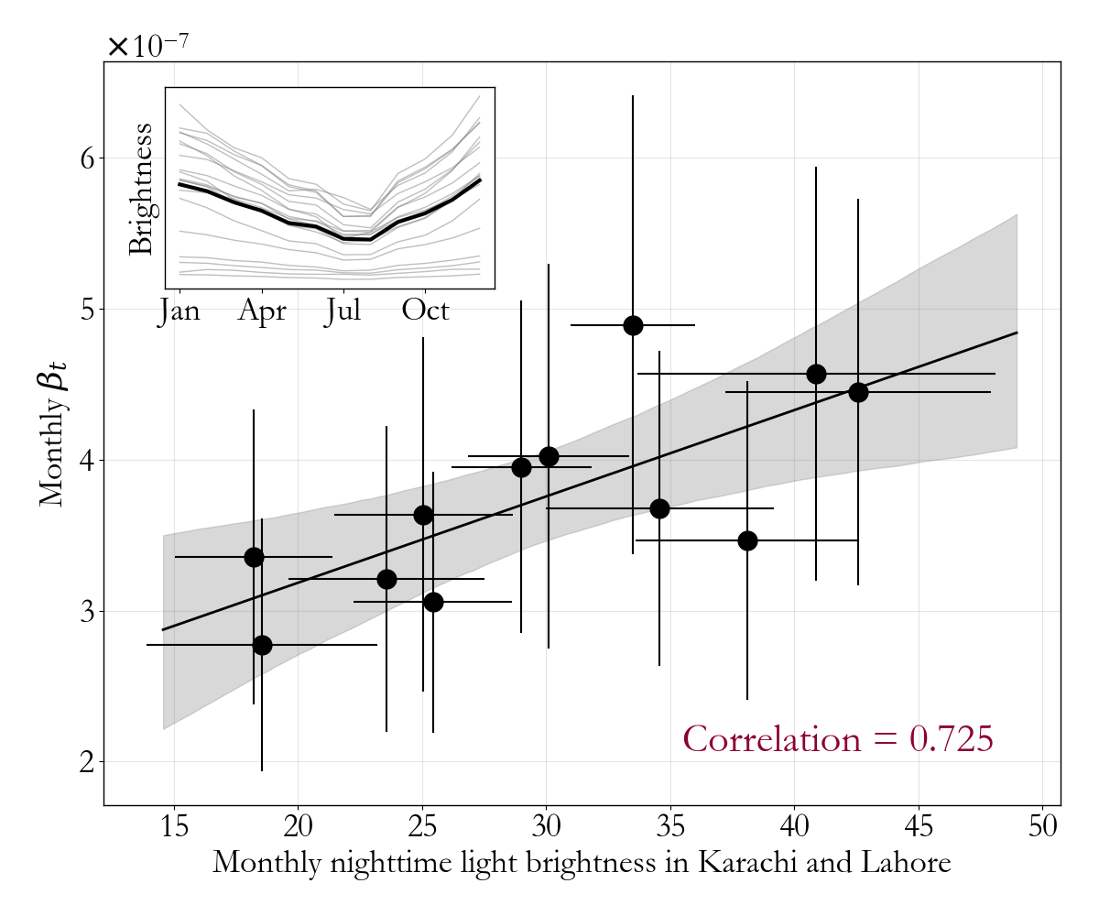
Migration correlates with seasonality in Pakistan
(1) Bharti et al, Science, 2011
Notes:
We’ve worked pretty closely with country partners in Pakistan.
Seasonality correlates with weather. That’s interesting.
Inspired by Nita Bharti and others, we decided to check night time lights imagery in the vicinity of urban areas (as a measure of population density, which is hypothesized to correlate with rural-to-urban migration).
We found a strong correlation
This suggests that measles transmission seasonality might be migration driven, in agreement with results from other settings, particularly urban Niger. It’s something we’re continuing to look into as we continue working with country partners in Pakistan.

Slide 7
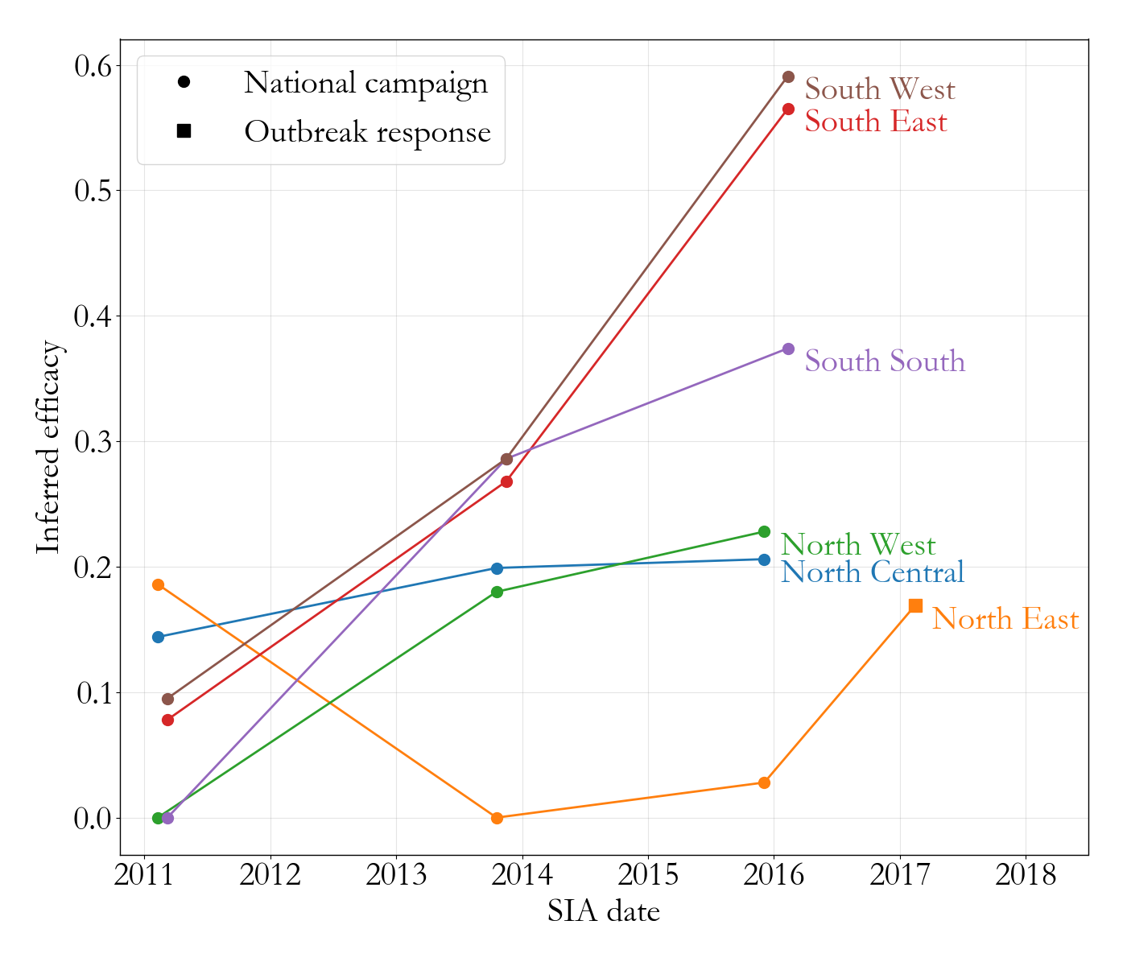
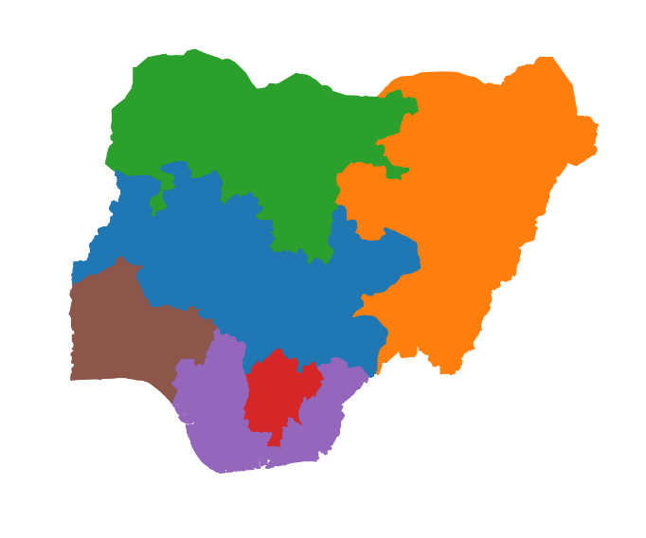
Campaigns have generally improved in Nigeria
Notes:
Returning to Nigeria, we found that, in general, campaigns have been getting more and more effective over time!
That’s optimistic news and speaks to the learning happening on the program side. We think these incidence based measures of SIA efficacy are complimentary to measures based on survey.
The one outlier is the North East, where the 2013 and 2015 campaigns had really low efficacy. That’s potentially due to access issues: the national emergency in the North east due to Boko Haram was declared in early 2012 and then broadened in 2013. That certainly had effects on public health. But, encouragingly, the outbreak response in 2017 seemed to stop some transmission.

Slide 8
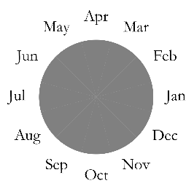
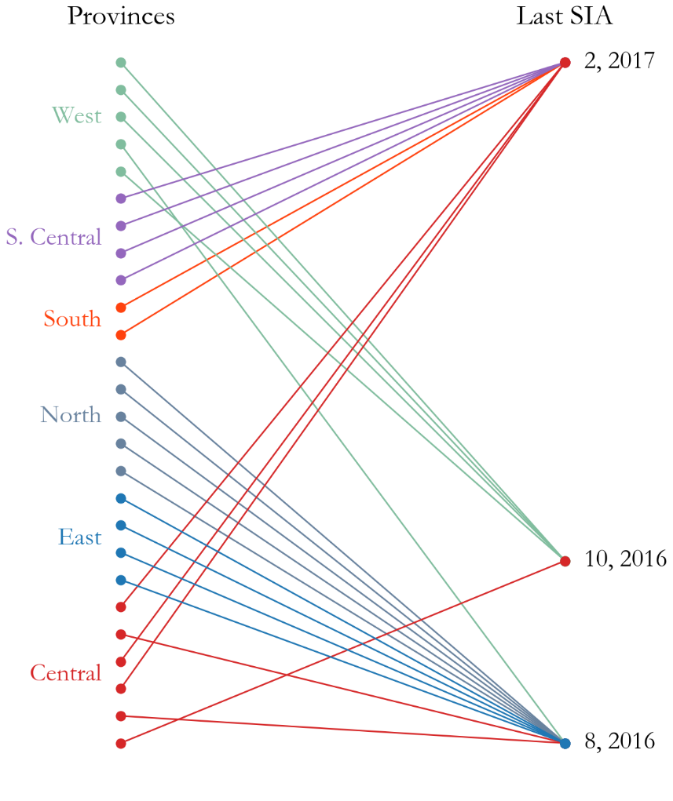
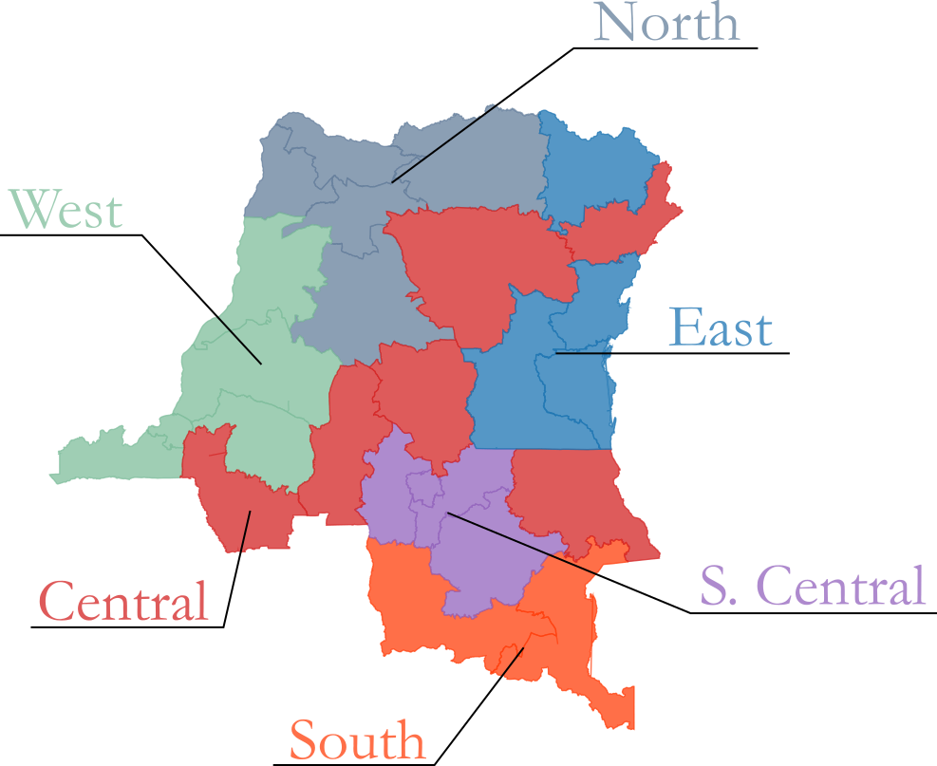
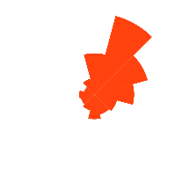
DRC has epidemiologically linked regions
Notes:
Finally, we’ve recently been collaborating with CDC in the Democratic republic of congo.
One thing we found was that the states could be grouped based on similarity in seasonality, and that the time series models fit relatively well to these subsets of the country (suggesting that they could be treated as epidemiological units).
Looking a little deeper, we found that one possible explanation of these groupings is the heterogeneity in SIA schedule. So, for most groups, the time since last campaign was the same in each state. It’s possible that this big, deterministic intervention, had an effect on dynamics in each region. That’s something we’re continuing to look into in collaboration with them.
All of this is to give you a sense of what we get out of fitting these simple models! Not only are they predictive, but they give us operational insight.

Slide 9
Can we increase spatial resolution?
WHO/CDC risk assessment tool
Nigeria, 2016
Very high
High
Medium
Low
Notes:
But I haven’t answered this question yet.
I’m making predictions at region or maybe province level. How can we increase spatial resolution?
It’s a hard question.
For one, the assumption that the models can be isolated is more or less guaranteed to break down. We have a lot of evidence that disticts are connected, and some districts are sparsely populated enough that they couldn’t sustain measles. Worse still we don’t have data on the connections between districts.
Moreover, under reporting becomes a bigger issue as the population in question decreases. Not only is it hard for use to link models spatially, but the problem in some sense is that we can think of too many ways to do it (gravity models and krigging-like methods, etc.). So what’re we gonna do?
I already told you! We cheat.

Slide 10
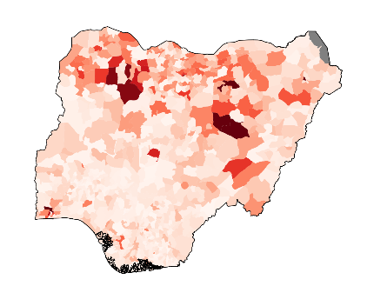
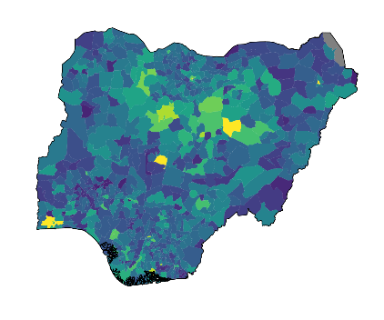
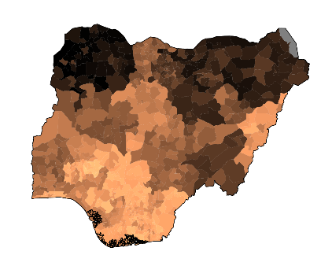
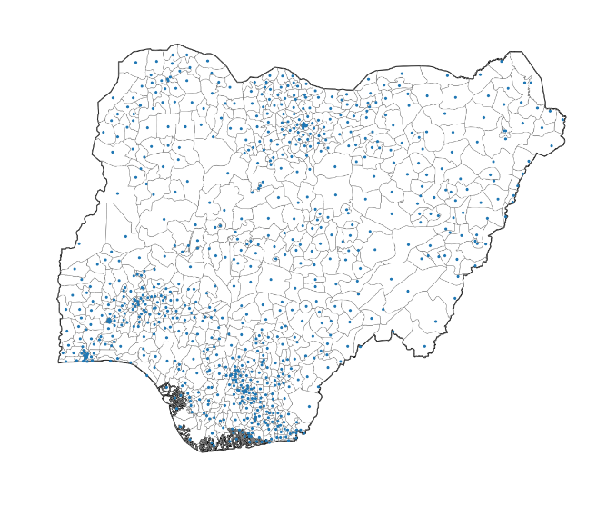
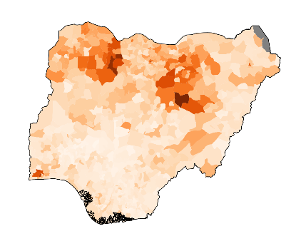
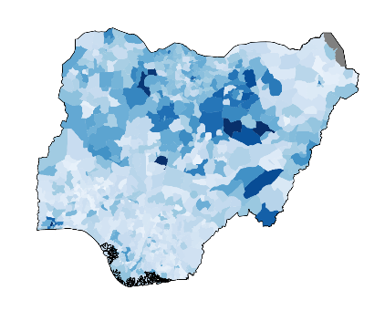
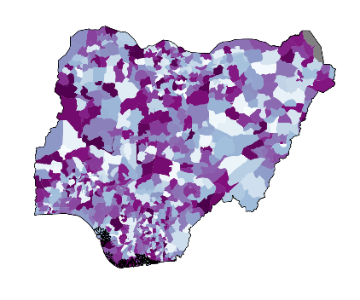
EMOD is a platform for testing new methods
Reported cases
Population
Vaccine coverage
Observable
Hidden
LGA level EMOD simulation
CONFIG
774 linked nodes
[RI_0,...,RI_773]
Maternal antibodies
...
Infections
Susceptibility
Reporting rates
Notes:
In particular, we use EMOD, IDM’s massive, agent based simulation software as a platform for testing new methods.
My colleague Kurt runs a big simulation, with 774 distinct populations all connected to one another. They each have their own demographics, seasonality, altitude, etc. And individual agents have a lot of complexity as well, they have maternal antibodies, and birth dates, and can experience vaccine failure.
The model gives me a lot. It gives me the types of data that we have in real life.
But critically, it also gives me the stuff that we’re always trying to estimate.
And the key is that, since EMOD is a disease modeling software, all of these maps are internally consistent with disease dynamics. So I can try to make predictions on this synthetic data set, and I use the bottom row to diagnose problems with my fast model that I want to be able to run in a conference room.

Slide 11
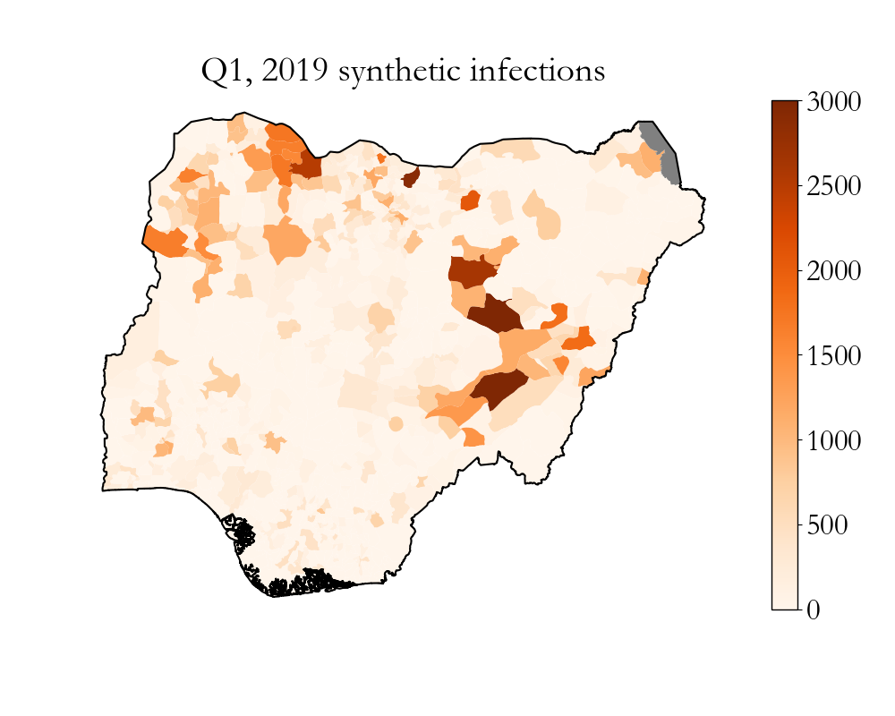
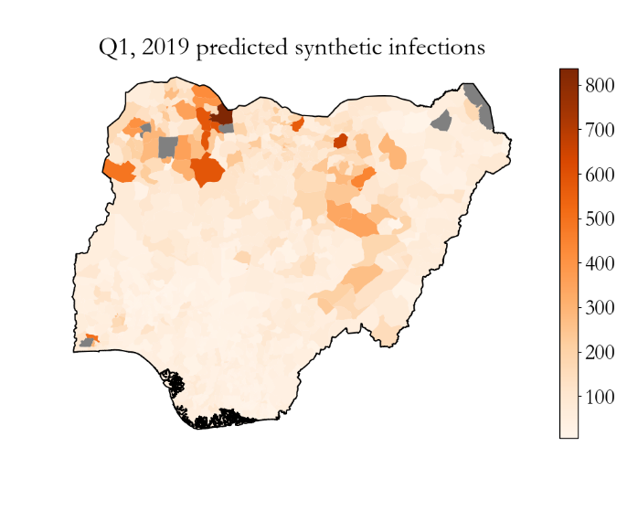
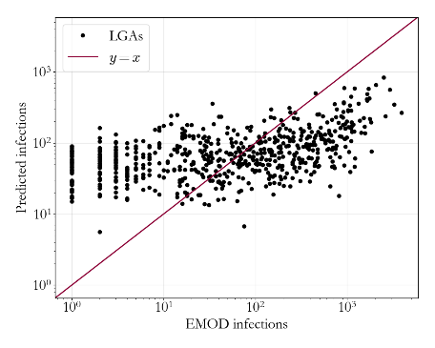
Our simple models fail at high resolution
Independent TSIR models
Performance metric
Prediction accuracy | 14.9 %
Ranking accuracy | 67.3 %
Reporting rate = 1%
Notes:
So to stay focused, I’m going to try to predict this map. Infections in 2019’s first quarter. You can see that the map has a lot going on, it has outbreaks in the east, in the north west, and some sporadic transmission in the south.
To set a baseline, it’s worth seeing how well we do if we just apply the simple model to each district independently – effectively ignoring spatial connectivity between districts.
So. It doesn’t go great.
But this of course isn’t the end of the talk, thank god. Can you imagine if I was just like “anyway, good luck, have a nice day”

Slide 12
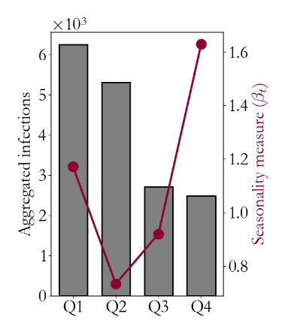
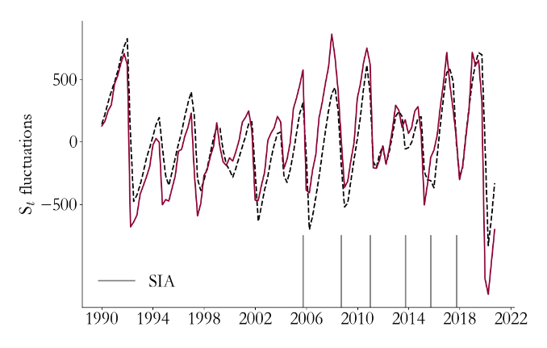
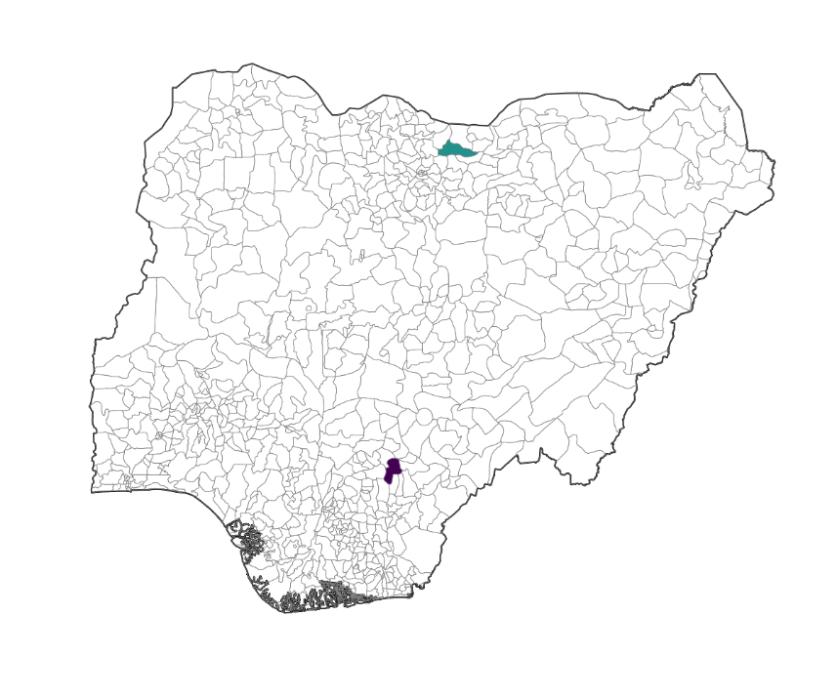
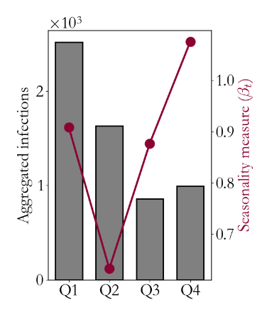
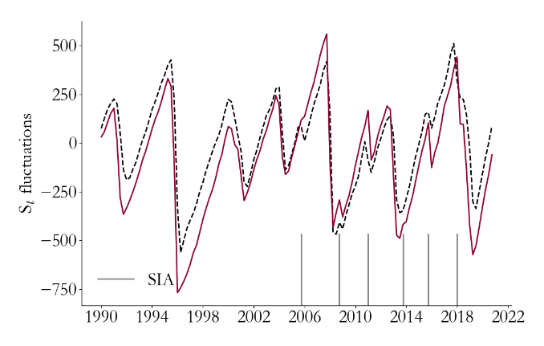
But they still offer valuable insight
Garki, Jigawa
Ado, Benue
Notes:
No. A close examination tells us a lot.
The model may no longer be PREDICTIVE, but it is still DESCRIPTIVE.
Looking at the seasonality, this time quarterly, I see that there’s stronger seasonality in the north than the south. That’s consistent with the actual simulation, where the total number of infections is shown in grey.
If I look at the relative number of susceptibles, I see also that I’m doing a good job. The red is my prediction, grey is what’s in EMOD. You can see that I’m catching the effects of SIAs and major outbreaks.

Slide 13
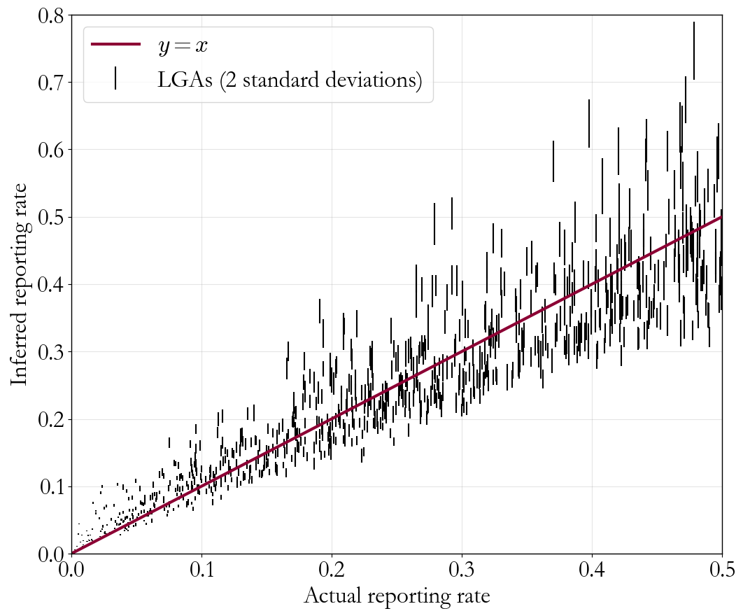
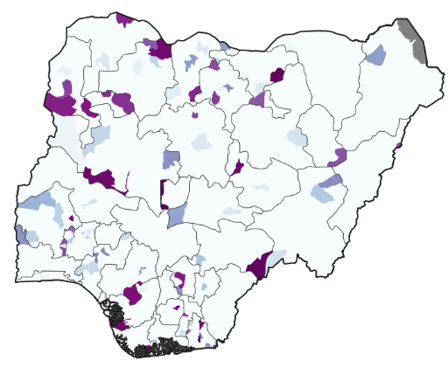
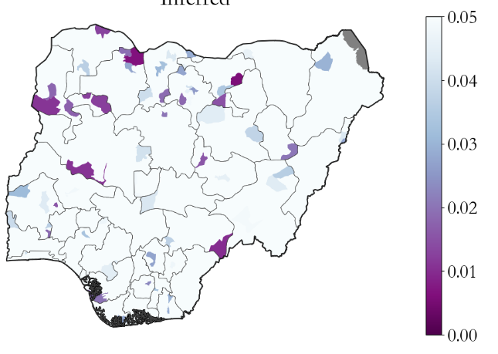
But they still offer valuable insight
Underreporting hotspots
Inferred hotspots
Notes:
Finally, I’m doing a reasonable job of estimating underreporting.
So if my reporting rate was distributed randombly for each LGA between 0 and 0.5 (just for example), these are my estimates. Critically, I do best at the low end, so I can reliably find underreporting hotspots.
So, I don’t have a set of predictive models, but the time series models are doing a good job of combining all my data in informative ways!

Slide 14
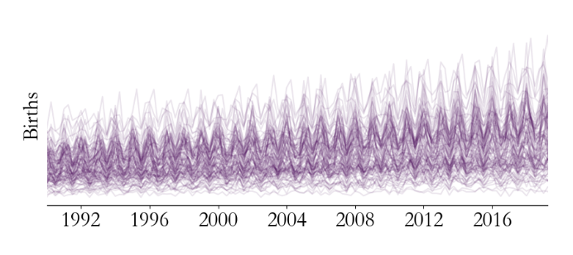
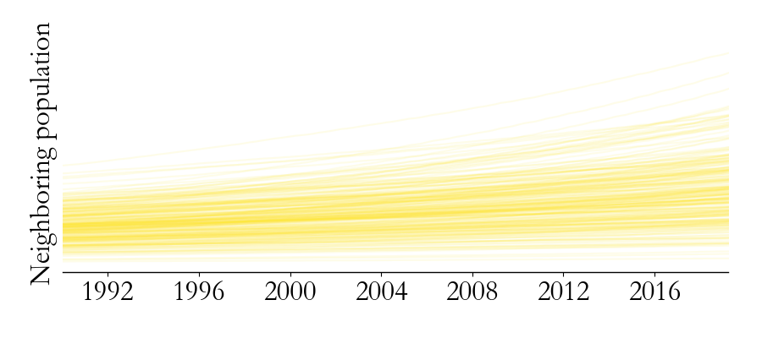
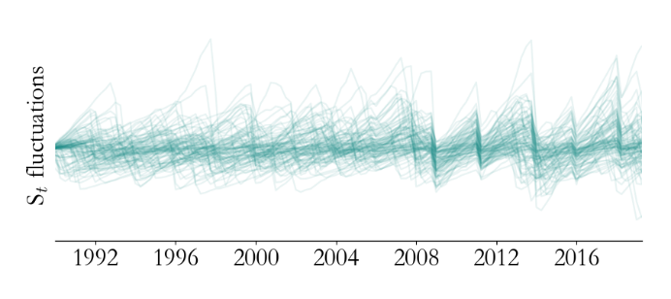
ML can combine time series models for prediction
Direct
SIA Calendar
Birth rate
MCV coverage
…
Cases
Processed
Neighboring population
MCV adjusted births
…
Random Forest
Population
TSIR based
E[$I_{t}$]
$S_{t}−$ E[$S_{t}$]
${∆I_{t}}/{∆t}$
$β_{t}^{i}$
…
Coverage
Notes:
That motivates the following approach.

Slide 15
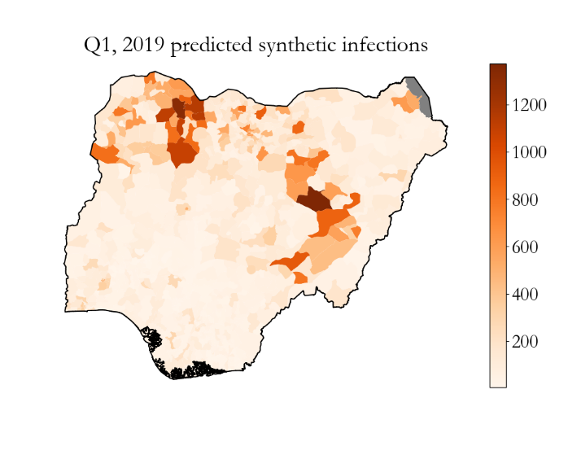
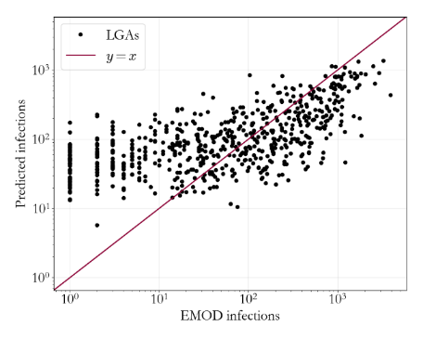
This approach significantly improves accuracy
RF+TSIR models
Performance metric
Prediction accuracy | 45.5 %
Ranking accuracy | 80.5 %
Reporting rate = 1%
Notes:
Testing this new method…

Slide 16
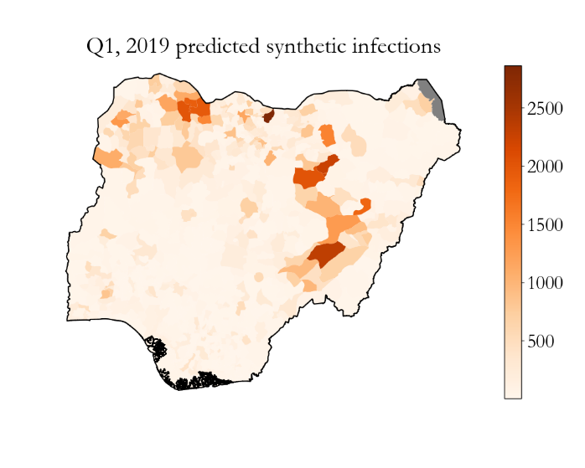
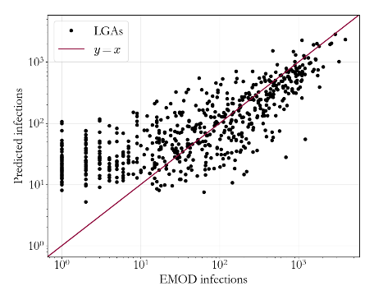
This approach significantly improves accuracy
What can these models teach us?
RF+TSIR models
Performance metric
Prediction accuracy | 71.3 %
Ranking accuracy | 90.7 %
Reporting rate = 5%
Notes:
If the reporting rate was higher…
So, at reasonable reporting rates, we have a predictive model. What can we do with it? I’ll go through two things.

Slide 17
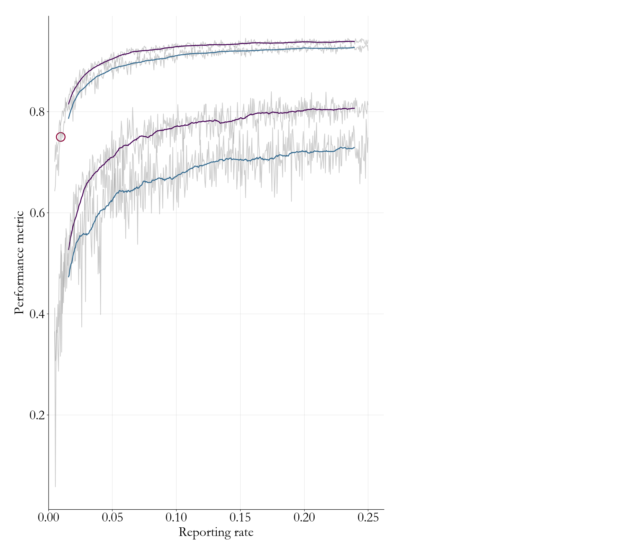
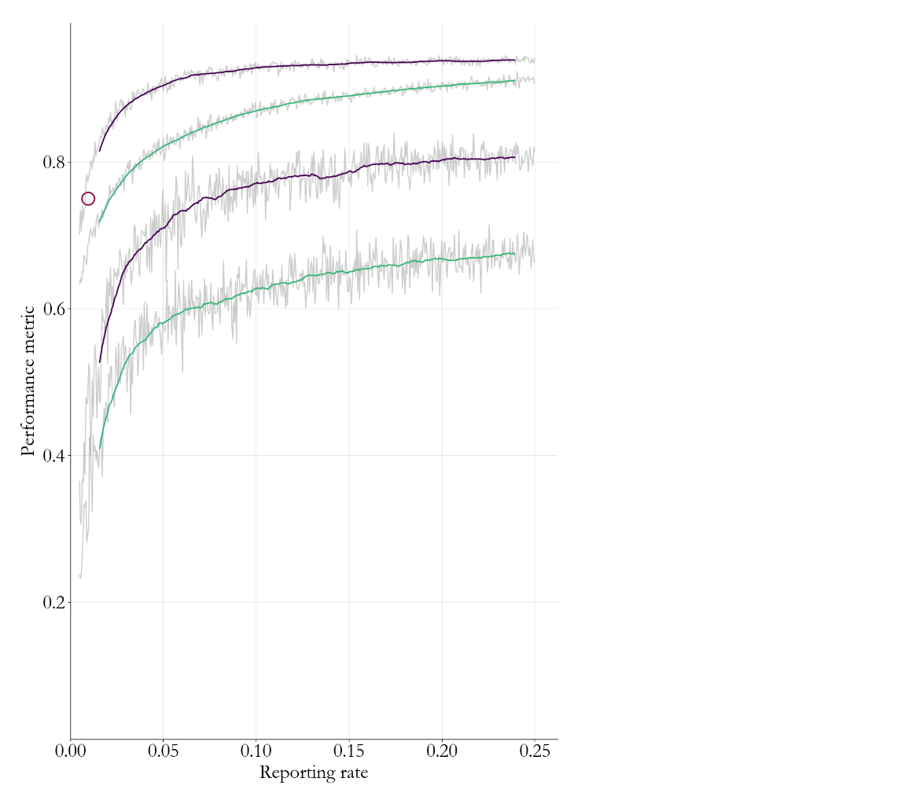
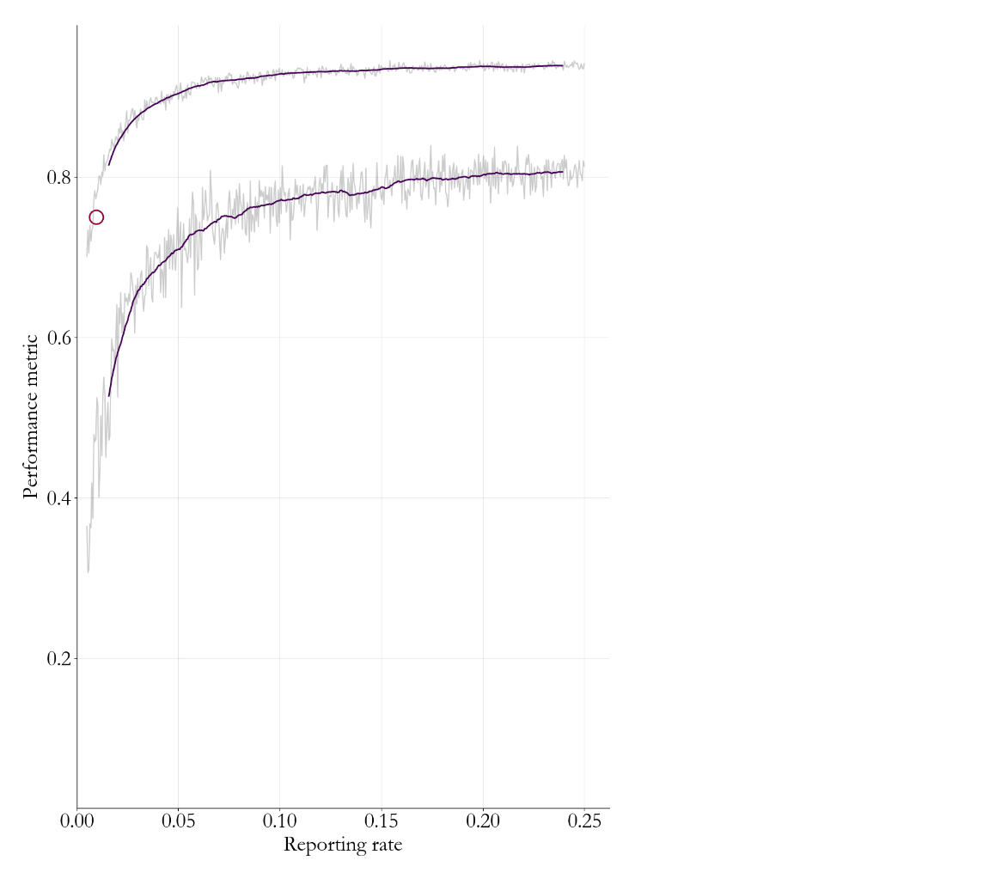
Prediction ability measures our state of knowledge
Ranking accuracy
Prediction accuracy
Q2, 2018 performance (real data)
RF+TSIR
RF (without TSIR)
Biased RI coverage in the north
Notes:
So, plotted here is predictive performance as a function of nationally averaged reporting rate, and you can see I’ve used this procedure on the real data, fitting up to Q2 2018 and predicting the rank and it falls right here.
So we’re not at 5 percent…and we have a ways to go. But, one positive thing about this curve is that, if we make small improvements in surveillance, we seem to be at a place where we get very large improvesments in predictive ability. If we think of predictive ability as a measure of our general state of knowledge, that improvement could be transformative!
Here’s a few other things we see.
We can verify that taking away the basic time series models negatively effects performance – in other words, the epidemiological information that comes from the TSIR fitting is valuable.
So far we’ve been applying this model with unbiased knowledge of RI coverage, and good knowledge of SIAs, etc. What if that’s not the case? We can test that effect on prediction accuracy, test that effect on preditive performance.
What we learn, over all, is that right now we’re in a surveillance system that can’t tell us if our RI estimates are biased. But with small improvesments in surveillance, we can start to make decisions about whether our knowledge of demography needs to improve and in what ways.

Slide 18
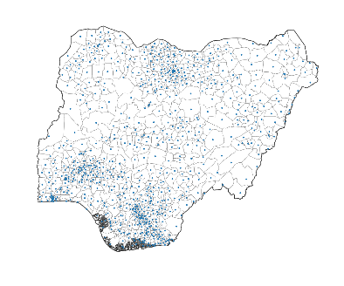
Measuring prediction’s affects on strategy
EMOD
Regional strategy
RF+TSIR
SIAs
Data
Infections per year: 3.9 ± 0.7 $×$ 10⁵
RF+TSIR
Infections per year: 2.8 ± 0.8 $×$ 10⁵
Notes:
We can talk think quantitatively about how prediction accuracy could change measles strategy, and this is the last think I’ll talk about.
…
Overall, I hope I’ve convinced you, that even with imperfect data, simple models can be combined in very powerful ways. An our goal, at a high level, is to use predictive models not only to predict outbreaks, but to guide decision making about broad scale strategy questions.

Slide 19
Thank you!
Collaborators:
Kurt Frey
Yijun Shen
Sharon Chen
Kevin McCarthy
WHO Pakistan
NMYFTCC
Tracy Dong
Laina Mercer
Niket Thakkar
nthakkar@idmod.org
@niket_h_thakkar
Notes:
With that I’ll take any questions. Thanks for your time this morning!

Slide 20
WHO/CDC risk assessment tool
Nigeria, 2016
Very high
High
Medium
Low

Slide 21
WHO/CDC risk assessment tool
Nigeria, 2016
Very high
High
Medium
Low

Slide 22
WHO/CDC measles risk assessment tool Nigeria, 2016
Very high
High
Medium
Low

Slide 23
Measuring prediction’s affects on strategy
EMOD
National calendar
RF+TSIR
SIAs
Data
Infections per year: 3.9 ± 0.7 ∙ 10⁵
RF+TSIR
Infections per year: 2.8 ± 0.8 ∙ 10⁵
Notes:
We can talk think quantitatively about how prediction accuracy could change measles strategy, and this is the last think I’ll talk about.
…
Overall, I hope I’ve convinced you, that even with imperfect data, simple models can be combined in very powerful ways. An our goal, at a high level, is to use predictive models not only to predict outbreaks, but to guide decision making about broad scale strategy questions.

