Slide 1


Novel Population-Level Malaria Treatment Strategies for the 2020s
Nguyen Tran
Center for Infectious Disease Dynamics (CIDD), Dept of Biology, Penn State University
6th Annual Disease Modeling Symposium
April 16th – 18th , 2018
BMGF Malaria Modeling Consortium

Slide 2
How can we treat and cure as many people as possible without driving drug resistance too strongly?

Slide 3

Status Quo Strategies
5-year Cycling
5 years
5 years
5 years
AL
ASAQ
DHA-PPQ
10% treatment failures
10% treatment failures
10% treatment failures
Sequential Deployment

Slide 4


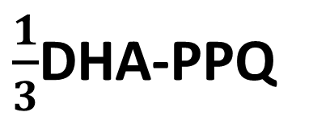
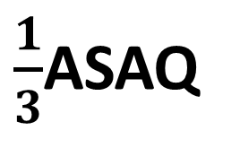
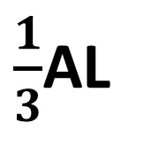
Multiple First-line Therapies (MFT)
$\frac{1}{3}$AL
$\frac{1}{3}$ASAQ
$\frac{1}{3}$DHA-PPQ

Slide 5
Evaluation Criteria
NTF
The total number of treatment failures (including non-treated cases)
UTL
Useful Therapeutic Life: Time until the treatment failure rate reaches 10%
AMU
Artermisinin Mono-Therapy Use: The number of treatments with an ACT where the parasites have resistance to the partner drug
3 ACTs
Sequential Deployment
5-years Cycling
MFT
Model

Slide 6
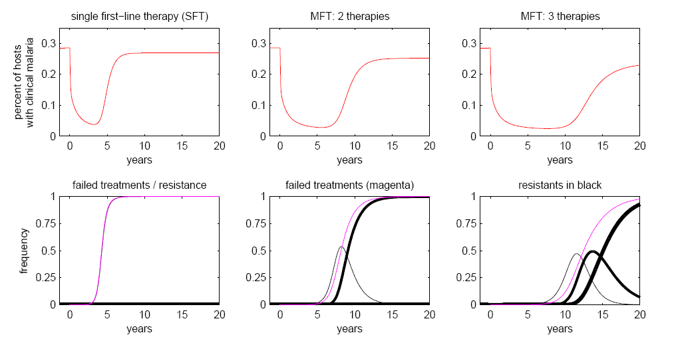
Shape of a drug-resistance epidemic
treatment begins
Number of treatment failures (NTF)
Prevalence
resistance emerges

Slide 7
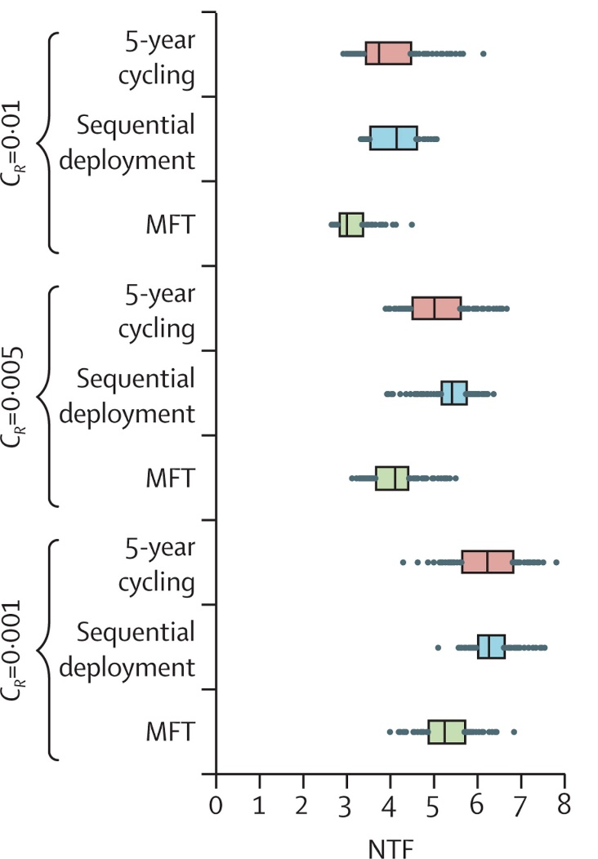
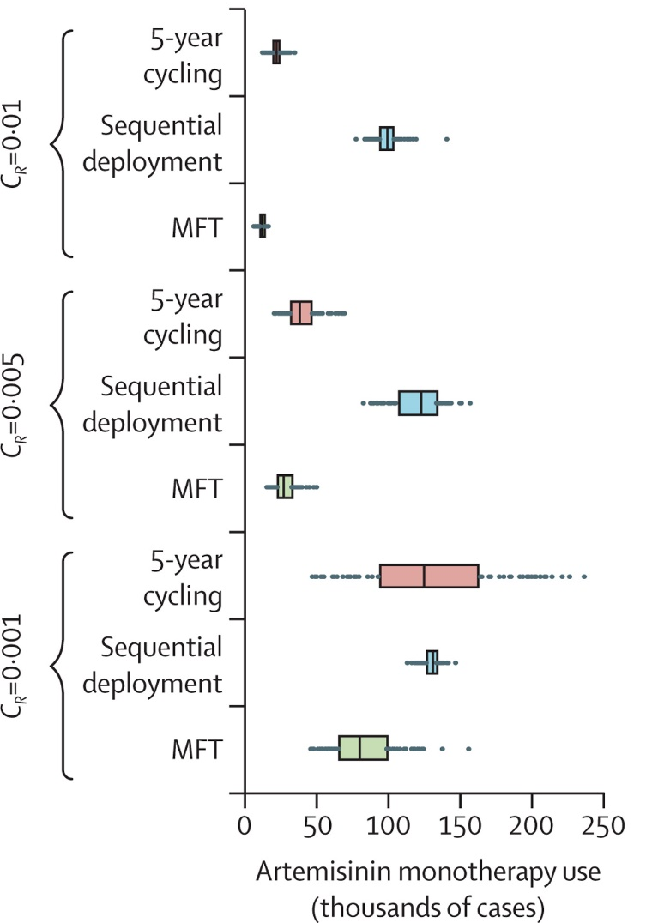
Treatment strategy comparisons with 3 artemisinin-combination therapies
Number of Treatment Failures
( Per 100 Persons, Per Year )
A risk measure of de facto “artemisinin monotherapy use”
Nguyen et al, Lancet Global Health, 2015

Slide 8
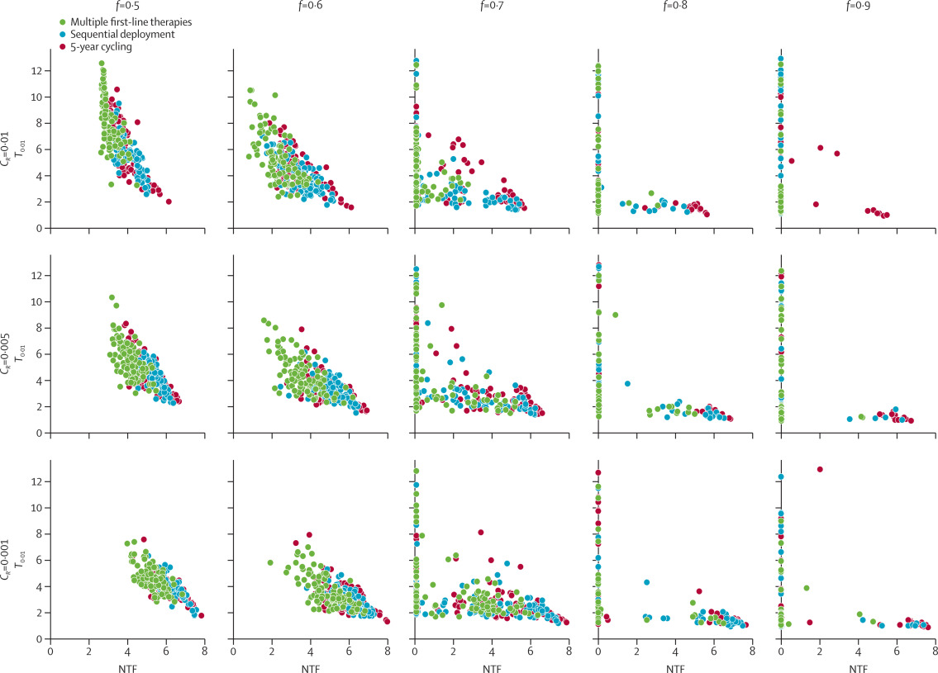
Time taken to reach an average of 1% resistance frequency in the population
Notes:
Variance in time-to-emergence is greater for MFT strategies than for cycling or sequential strategies, resulting in a subset of simulations with long emergence times
low numbers of treatment failures are closely associated with long times to resistance emergence.

Slide 9
There are three main reasons that MFT outperforms cycling or rotation policies in the long-run.

Slide 10
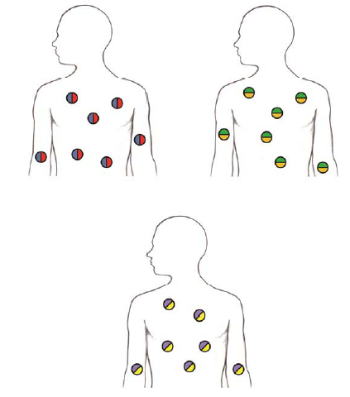

(1) having many different antimalarial compounds in the parasites’ environment makes drug-resistance evolution difficult.
Boni et al, PLoS Med, 2016

Slide 11
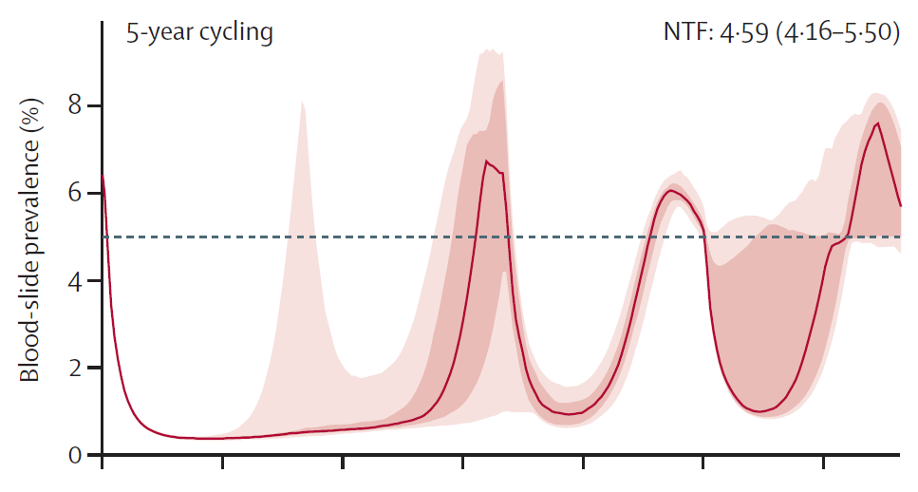
(2) cycling allows for early fixation of resistant genotypes, lowers the mean fitness of the parasite population, and makes future invasions easier.
3
6
9
12
15
Years
Nguyen et al, Lancet Global Health, 2015

Slide 12
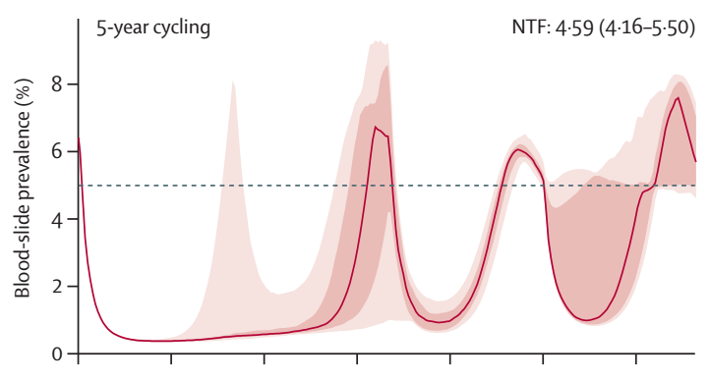
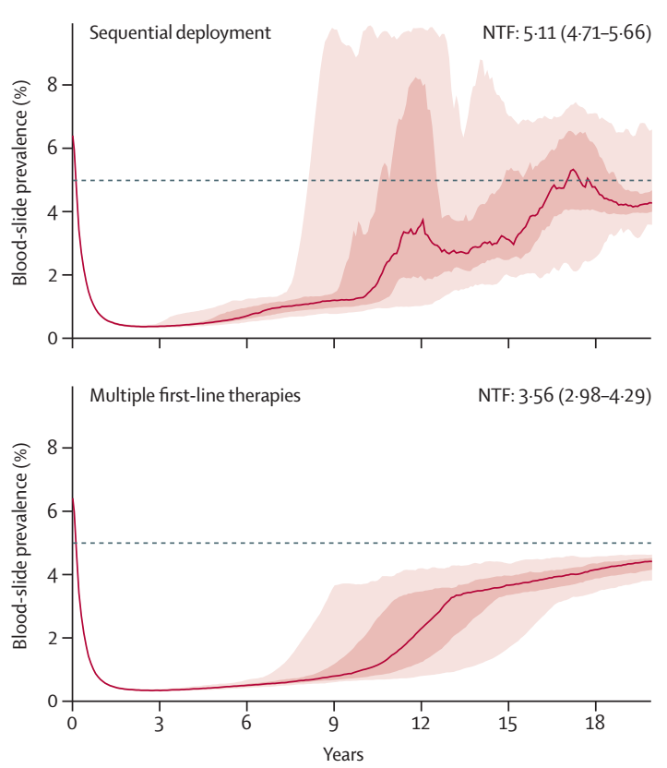

(3) cycling policies are susceptible to epidemiological rebounds.
Nguyen et al, Lancet Global Health, 2015

Slide 13
When does MFT not work well?
When the available therapies have different efficacies.
When a single locus can affect resistance levels to multiple drugs (pleiotropy).

Slide 14
New drug introductions in the 2020s

Slide 15
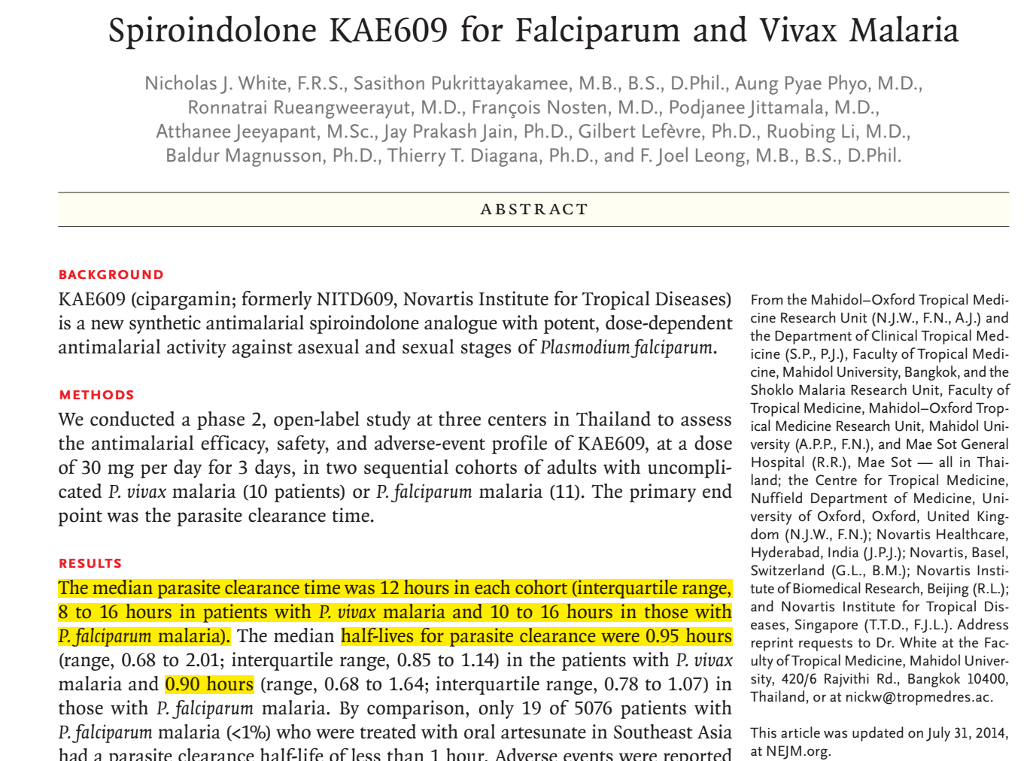

Slide 16
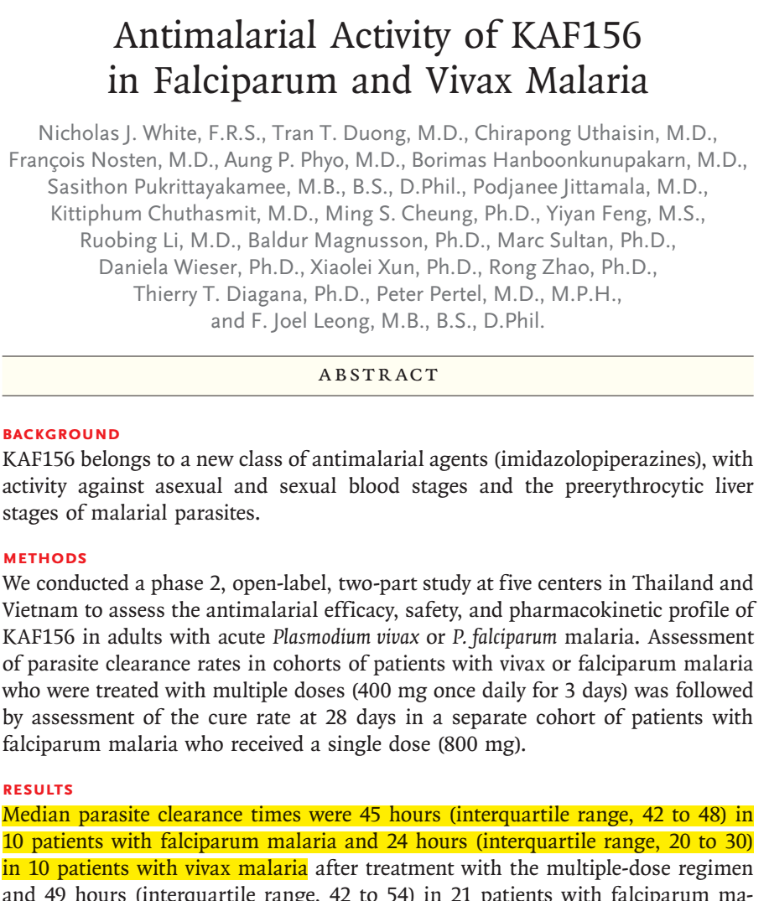

Slide 17
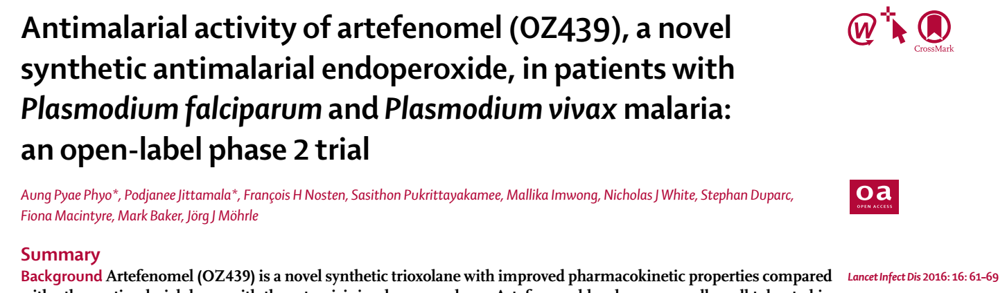
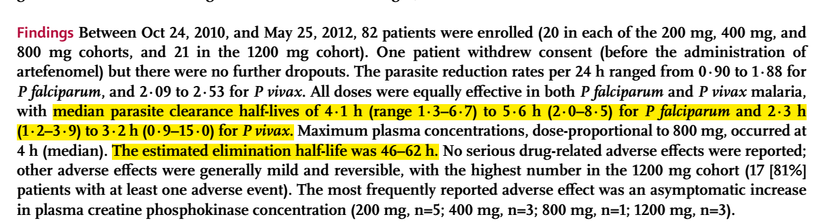

Slide 18
Treatment adjustment for 2020
Country X uses Dihydroartemisinin-Piperaquine (DHA-PPQ) for ten years.
At year ten, OZ439-Amodiaquine combination is introduced at level q.
A fraction q of patients are treated with OZ439-AQ, and the remaining 1-q patients are treated with DHA-PPQ.

Slide 19
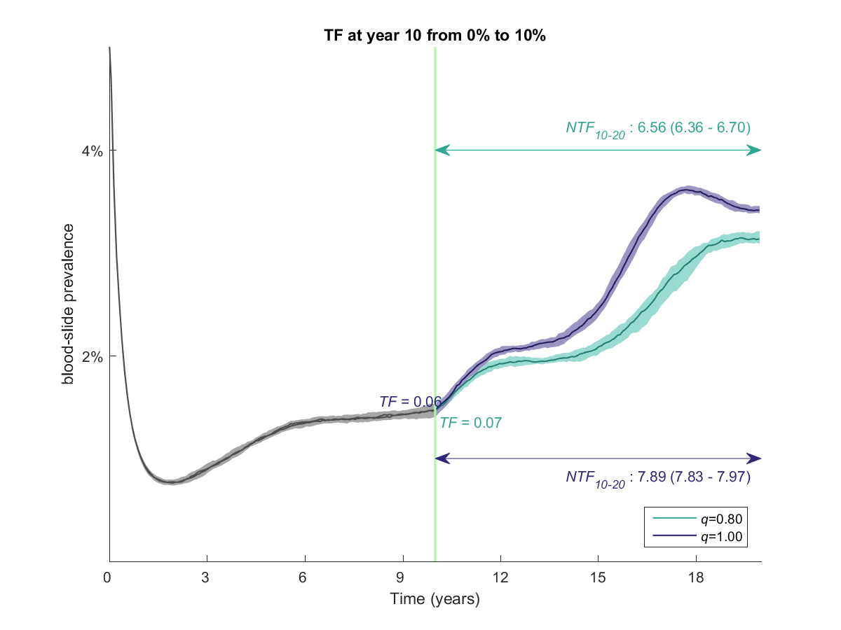
At year 10, replace DHA-PPQ with OZ439-AQ.
Either completely replace (q=1.0).
Or, partially replace so that 80% of patients receive the new therapy (q=0.80) and 20% are still treated with DHA-PPQ.
complete replacement
partial replacement
DHA-PPQ used as
first-line therapy
OZ439 has a longer half-life than DHA, so the rate of evolution goes up after year 10.

Slide 20
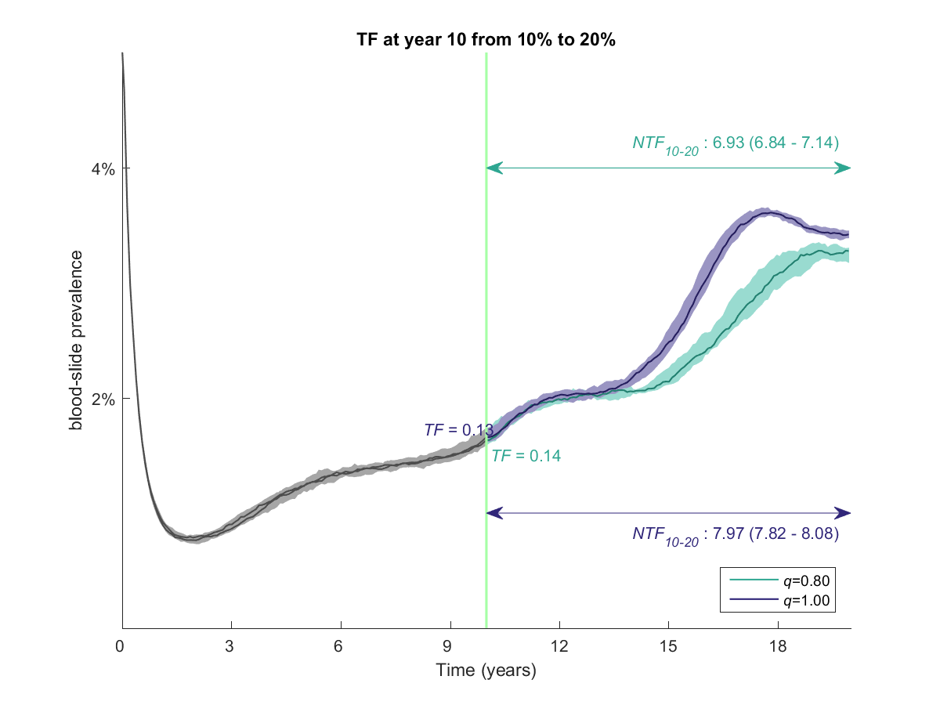
complete replacement
partial replacement
DHA-PPQ used as
first-line therapy

Slide 21

complete replacement
partial replacement
DHA-PPQ used as
first-line therapy

Slide 22
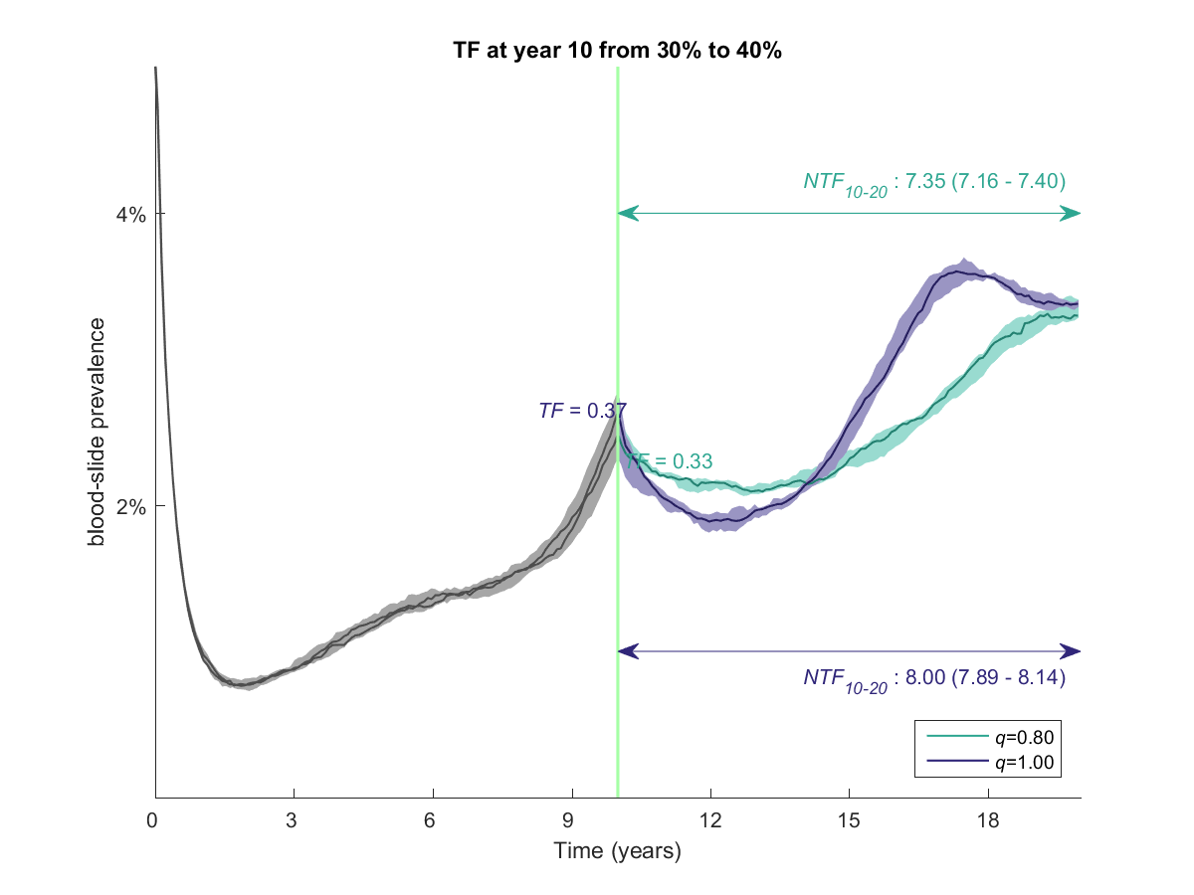
complete replacement
partial replacement
DHA-PPQ used as
first-line therapy
In this situation, your current TF rate is high (37%) so your best short-term strategy is to do a complete replacement.
The best long-term strategy is still a partial replacement.

Slide 23
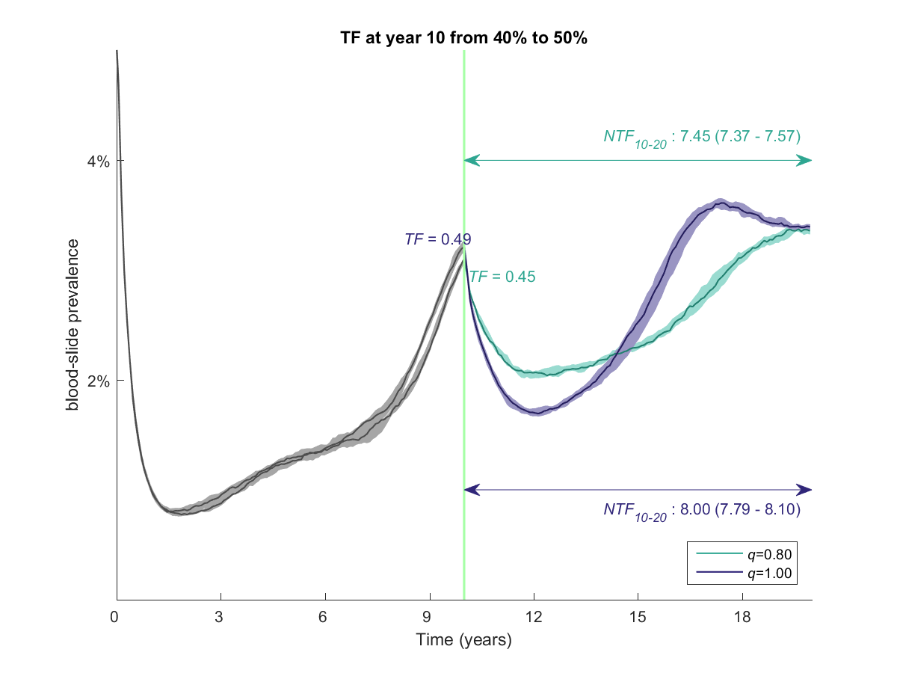
complete replacement
partial replacement
DHA-PPQ used as
first-line therapy

Slide 24
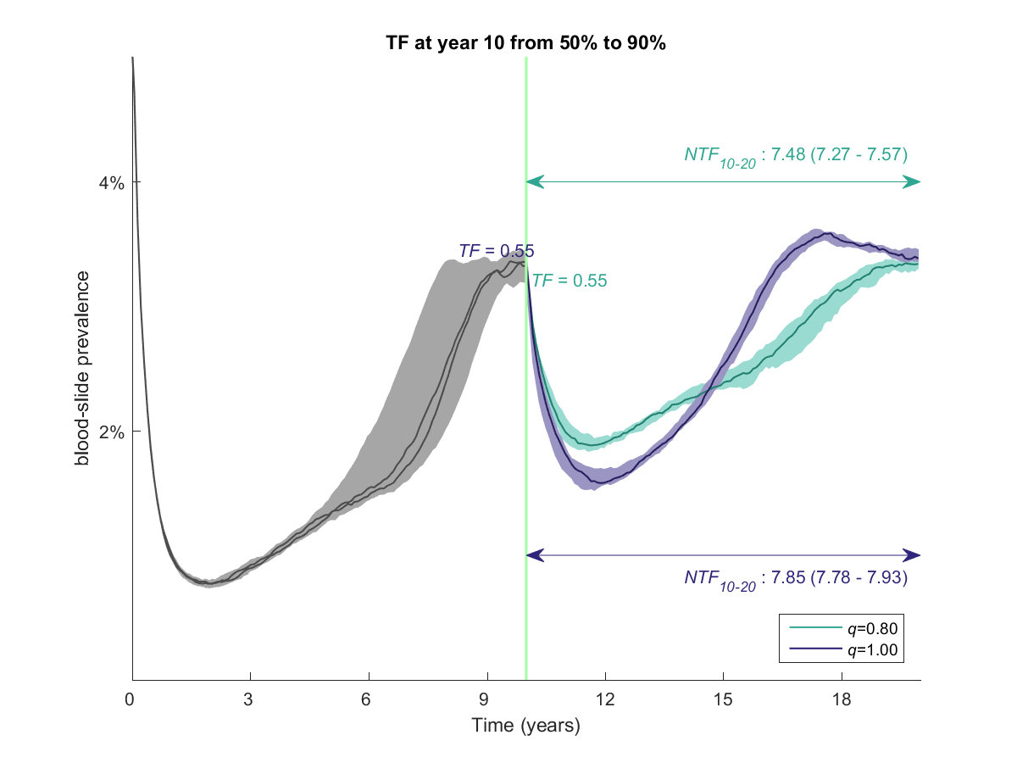
complete replacement
partial replacement
DHA-PPQ used as
first-line therapy

Slide 25
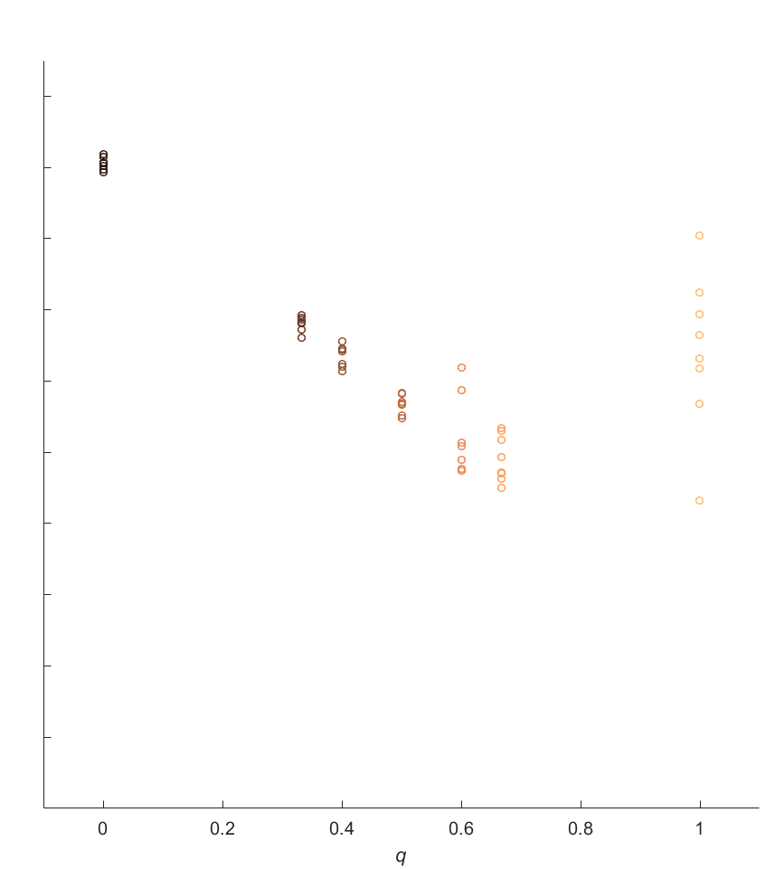
General relationship between q and the number of treatment failures
Number of Treatment Failures
During Years 10 to 20 (NTF₁₀₋₂₀)
0 0.2 0.4 0.6 0.8 1.0
q = “replacement level”
Here, the introduction of the new combination is happening when failure with the previous combination is between 30% and 40%.

Slide 26
Lessons learned from this analysis
1. Do not wait until you have a lot of failures ( supported by all previous modeling work we have done ).
2. Replace early, replace partially.
3. All other things being equal, if you currently have a lot of treatment failures in the population, a complete replacement is the best short-term strategy.

Slide 27
Triple Artemisinin Combination Therapies
(TACTs)

Slide 28
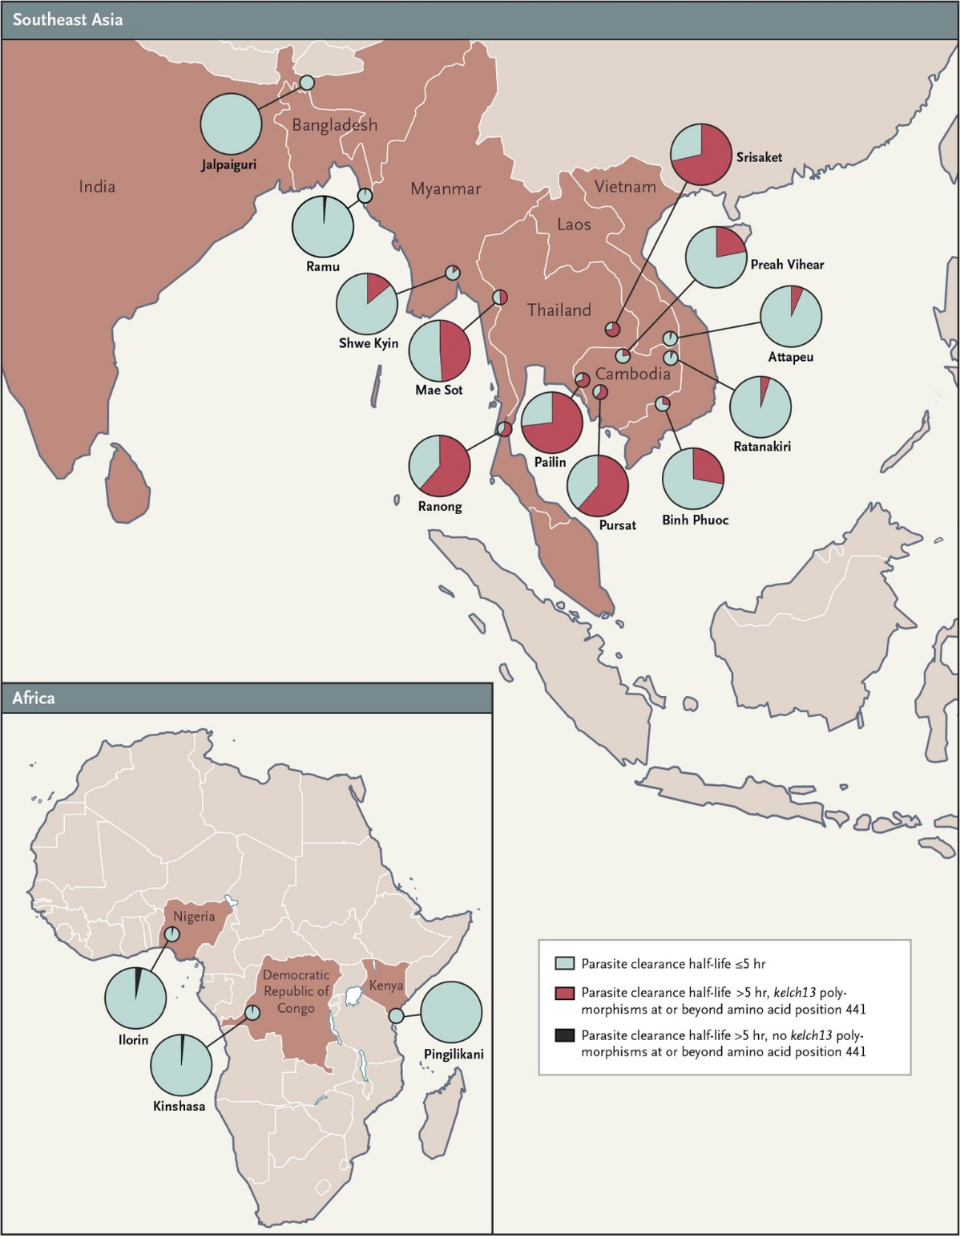
ACT failure rates over 30% with the DHA-PPQ and ASMQ has been reported
The failure of ACTs against malaria infection severely threatens malaria control and elimination efforts
Partial drug resistance will accelerate the spread and emergence of fully resistance strain
Ashley et al, N Engl J Med, 2014

Slide 29
Tracking Resistance to Artemisinin Collaboration II (TRACII)
Involving 15 study sites in 10 countries across Asia and Africa
Investigate the safety, tolerability and efficacy of Triple Artemisinin-based Combination Therapies (TACTs) :
    Dihydroartemisinin-piperaquine with mefloquine (DPM)
    Artemether-lumefantrine with amodiaquine. (ALAQ)
Preliminary results: DPM has 99% efficacy in Binh Phuoc Province (Vietnam) (efficacy of DHA-PPQ is 50%-80% in 2015)

Slide 30
Low transmission settings
AL or ASAQ as first-line therapy
50% of individuals receive treatment
transmission setting has EIR=1 (Pf Pr₂₋₁₀ = 3%)
TACTs are introduced and replaced AL / ASAQ at the year 2020.

Slide 31
AL Baseline
ASAQ Baseline
NTF
NTF

Slide 32

AL Baseline
Baseline
ASAQ Baseline
TACTs slow down the spread of K-13 resistant alleles

Slide 33
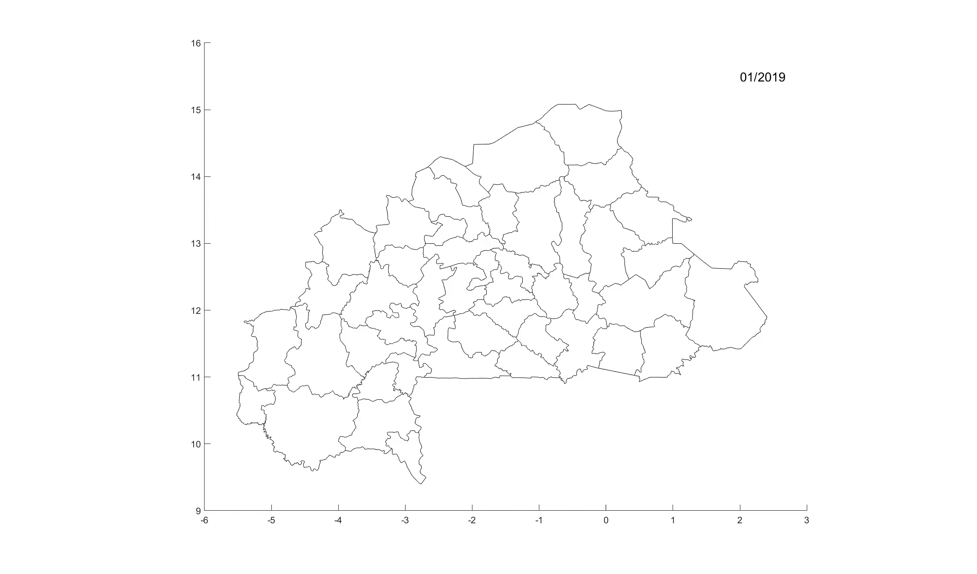
Next…

Slide 34





Tran Tinh Hien
Ha Minh Lam
Dang Duy Hoang Giang
Arjen M Dondorp
Olivo Miotto
Ricardo Aguas
Lisa J White
Nicholas J White
Maciej F. Boni
Tran Nguyen Anh Thu

Slide 35
Thank you

Slide 36
Mefloquine sensitive
Lumefantrine sensitive
Chloroquine resistant
Amodiaquine resistant
Lumefantrine sensitive
pfmdr1 (no second copy)
pfcrt 76T
plasmepsin, 1 copy
Piperaquine sensitive
TYY--C1x
no extra mutations
pfmdr1 86Y
pfmdr1 Y184
Amodiaquine resistant
Lumefantrine sensitive
Amodiaquine resistant
Lumefantrine sensitive
kelch13 C580
Artemisinin sensitive
128 resistant genotypes in the simulation

Slide 37
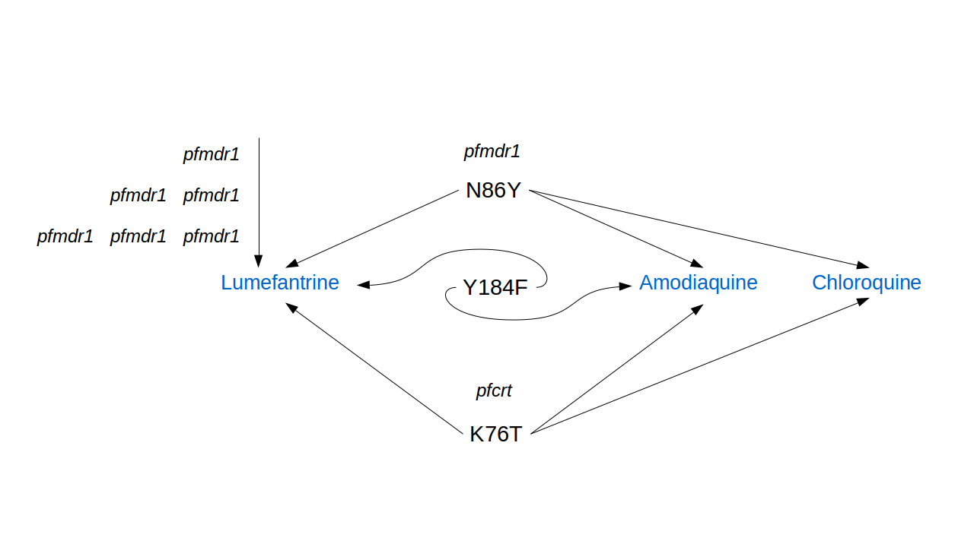

Slide 38
Drug-by-genotype efficacy table
ID | Genotype | AS | LM | AQ | PPQ | MQ | CQ | AL | ASAQ | DHA-PPQ | AS-MQ
0 | KNY--C1x | 69 | 73 | 87 | 90 | 79 | 80 | 92 | 96 | 97 | 94
…
8 | KYY--C1x | 69 | 83 | 70 | 90 | 79 | 64 | 94 | 91 | 97 | 93
…
64 | TNY--C1x | 69 | 77 | 82 | 90 | 79 | 35 | 94 | 94 | 97 | 94
…
127 | TYFYFY2X | 25 | 59 | 73 | 21 | 50 | 20 | 69 | 80 | 42 | 64
  3-day dosing
  Independent acting
  Independent absorption mechanism (different metabolize enzyme)
pfcrt 76T (strong)
pfmdr1 86Y (weak)

Slide 39
Assumptions about drug usage during 2006 – 2040
We assume that AL / ASAQ was not widely used in 2006, and that gradually the usage of AL/ASAQ increased from 2006 to 2020 to 2040
Drug Usage by Year:
 |  | 2006 | 2020 | 2040
Recommended First-line Therapies (RFT) (AL / ASAQ) |  | 2.50 | 17.86 | 40.00
Off-policy Purchase (OPP) |  | 47.50 | 32.14 | 10.00
 | AQ | 14.25 | 9.64 | 3.00
 | CQ | 14.25 | 9.64 | 3.00
 | SP | 14.25 | 9.64 | 3.00
 | AL | 4.75 | 3.21 | 1.00
No Treatment |  | 50.00 | 50.00 | 50.00

