Slide 1
Trends in the HIV incidence rate following ART scale-up in a rural and hyper-endemic South Africa population (2004–2015)
Alain Vandormael, PhD
School of Nursing and Public Health,
University of KwaZulu-Natal, South Africa
IDM Symposium, Seattle,
16 May 2018

Slide 2
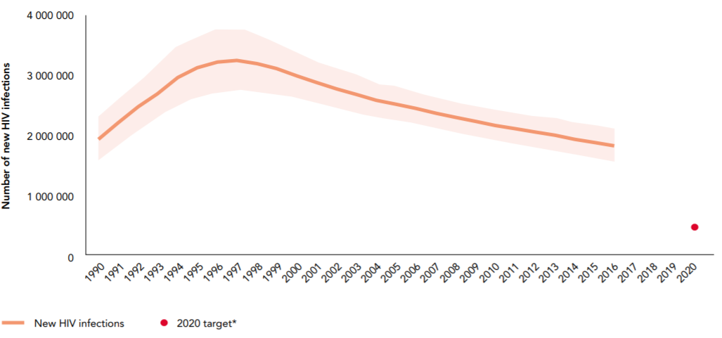
Source: UNAIDS (2017) Ending AIDS: Progress toward 90-90-90.

Slide 3
Notes:
The scale-up of antiretroviral therapy (ART) to more than 20 million people worldwide is at the forefront of efforts to reverse the HIV epidemic by 2030.
An underlying assumption here is that increased ART coverage, in conjunction with other prevention methods, will lower the population prevalence of detectable viremia (PDV_{P}), and thus reduce the overall incidence of HIV infection.
Against this background, the UNAIDS have recently reported an 8% decline in the number of new HIV infections between 2010 and 2015, which they have attributed to ART coverage and other prevention strategies such as voluntary circumcision and condom use.
The UNAIDS results are derived from mathematical models, which relies on non-representative data from infected and uninfected pregnant women attending antenatal clinics.
However, empirical evidence is now critically needed to corroborate whether, and in which populations, HIV incidence has declined following the comprehensive roll-out of combination prevention strategies.

Slide 4
Research Aim:
To quantify trends in the directly-observed HIV incidence rate among men and women following ART scale-up between 2004 and 2015.
Notes:
In this dynamic environment, we have yet to quantify trends in the population incidence of HIV infection among men and women since the nation-wide roll-out of ART in 2004.

Slide 5
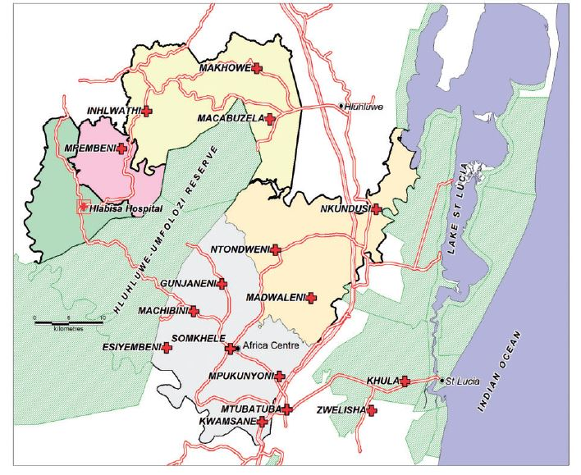
≈ 90,000 people under demographic surveillance
Population-based HIV testing (2004-present)
All consenting adults >15 years age
~30% HIV prevalence
Characterised by high rates of unemployment, mobility and low marital rates

Slide 6
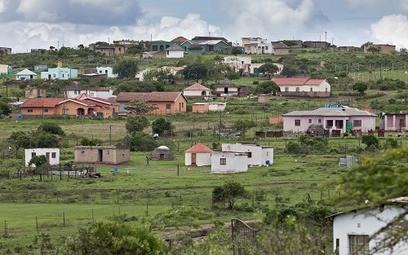
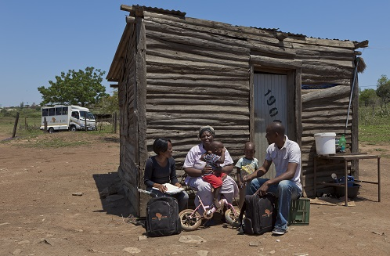
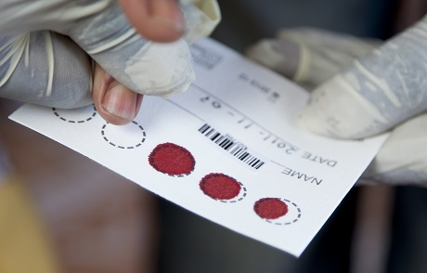

Slide 7
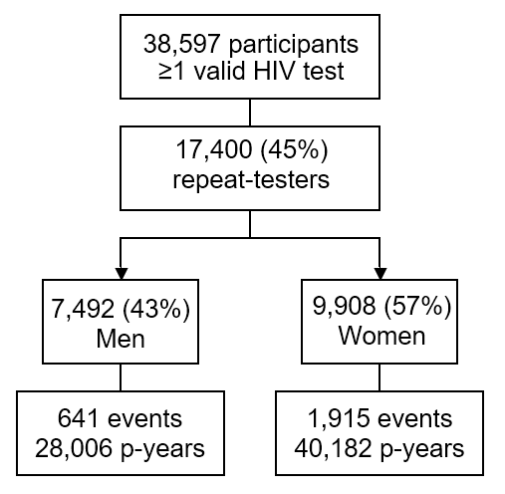
HIV Testing

Slide 8
Viral Load (VL) Testing

Slide 9
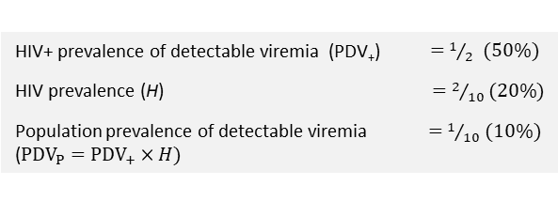
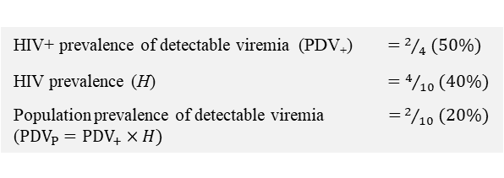

Slide 10
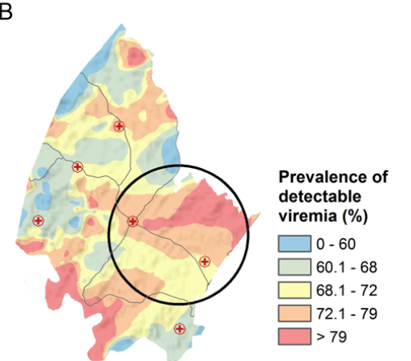
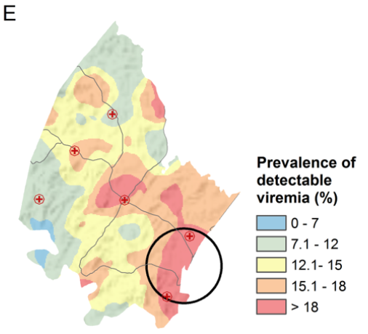
PDV₊ HR = 1.005, p-value = 0.40
PDV_{P} HR = 1.070, p-value < 0.001
Tanser, F., Vandormael, A., Cuadros, D., Phillips, A., de Oliveira, T., Tomita, A., Bärnighausen, T., Pillay, D. (2017). Effect of population viral load on prospective HIV incidence in a hyper-endemic rural South African community: a population-based cohort study. Science Translational Medicine, 9: eaam8012.

Slide 11
p-value<0.001
p-value=0.45
p-value=0.008

Slide 14
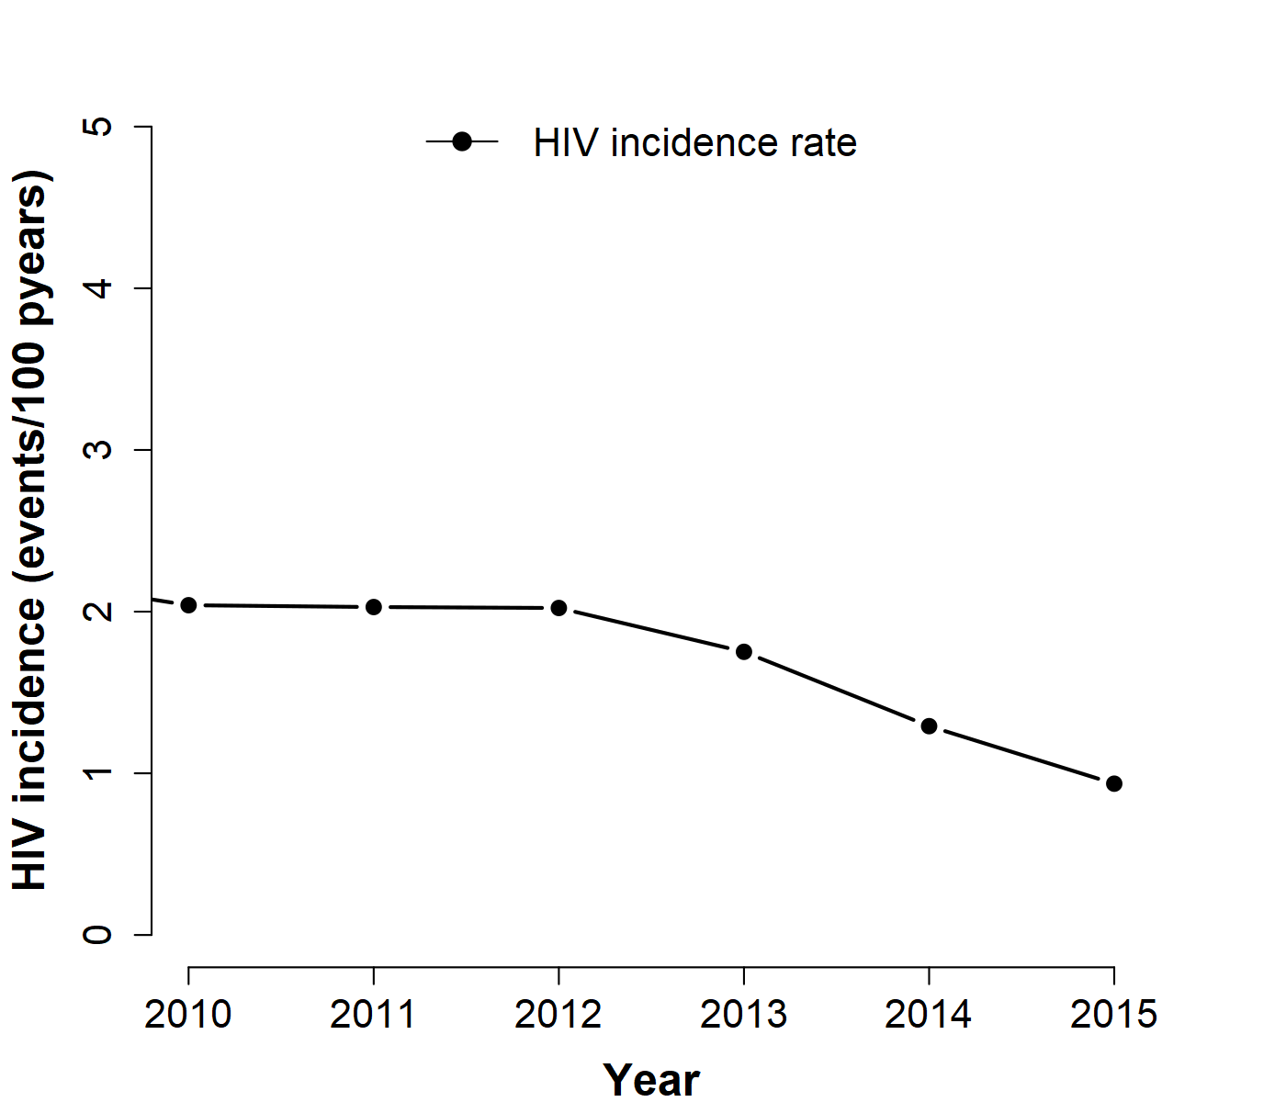
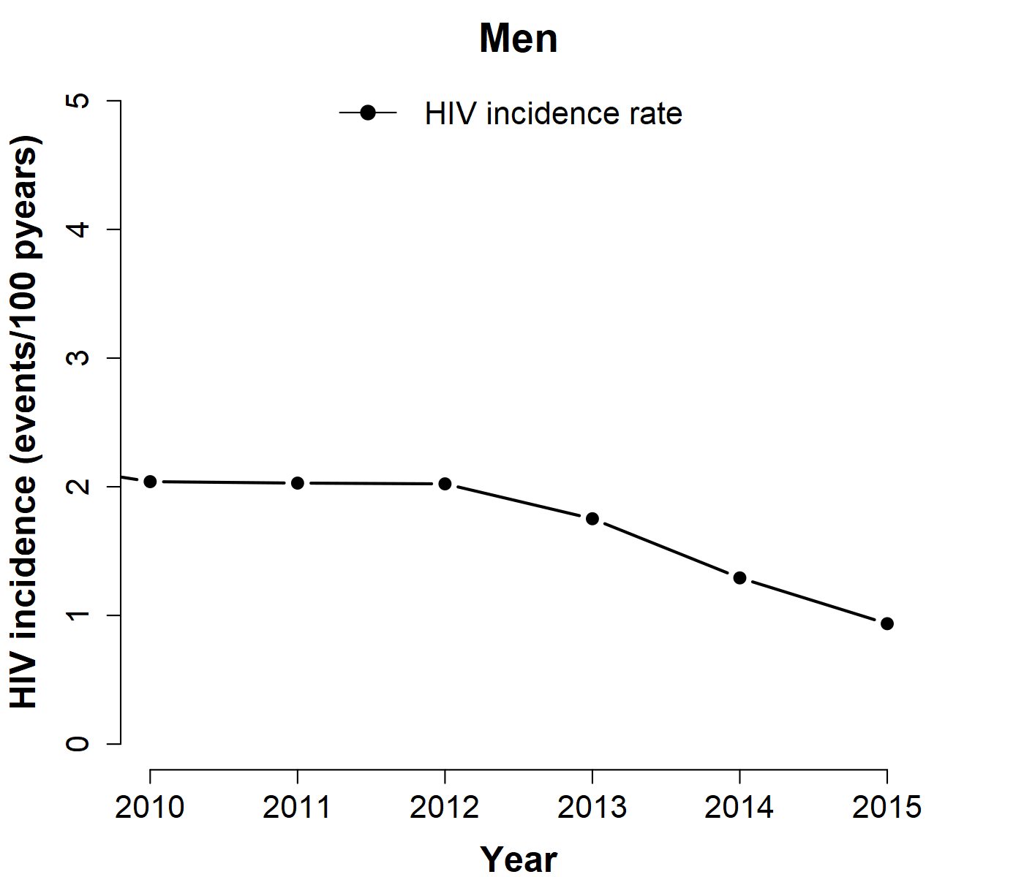
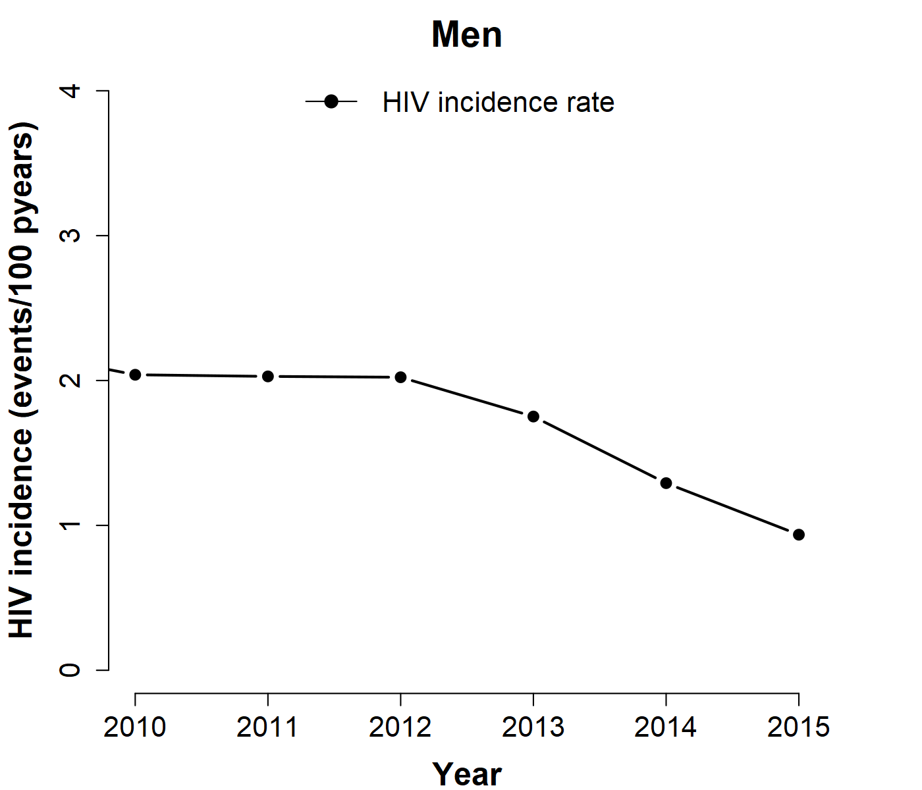

Slide 15
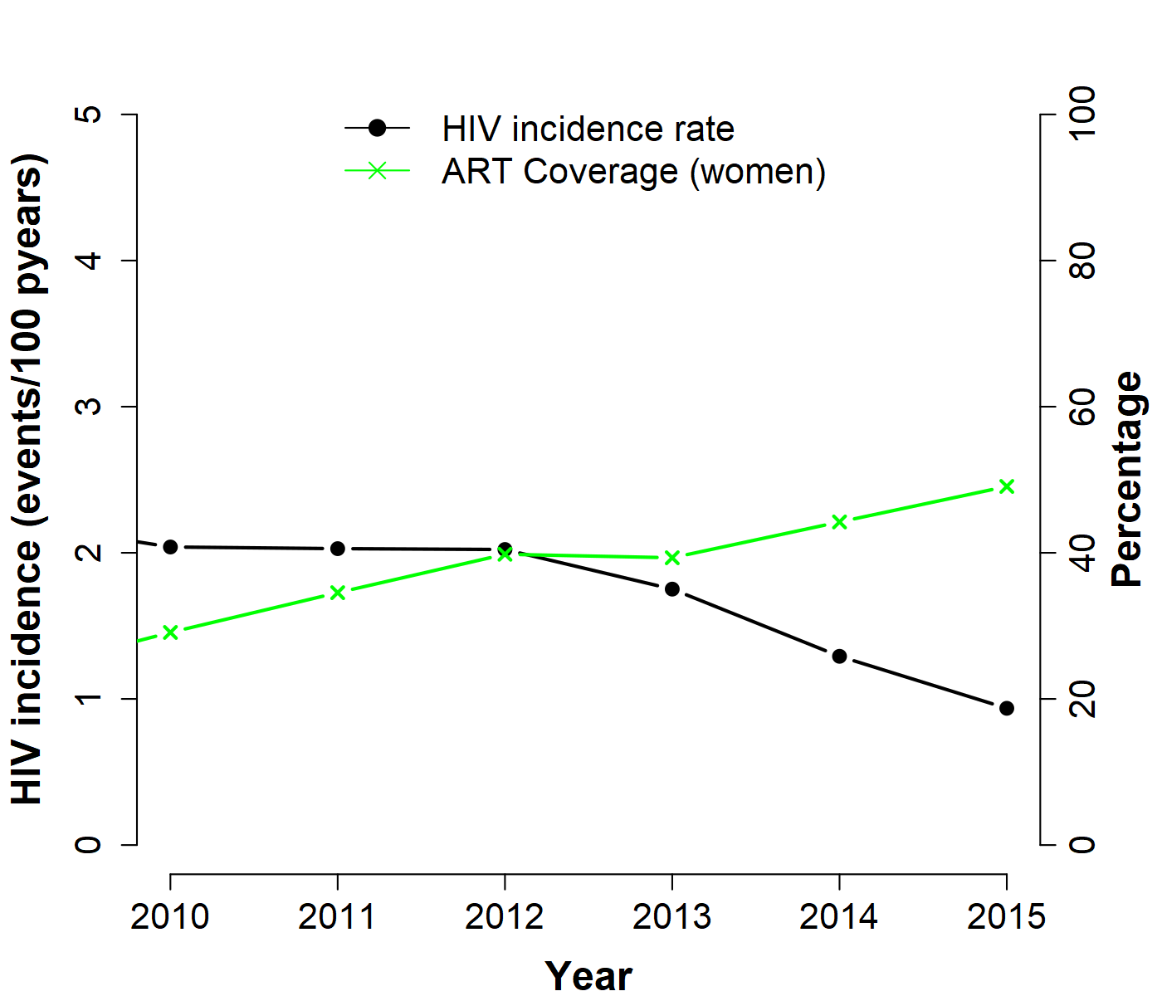
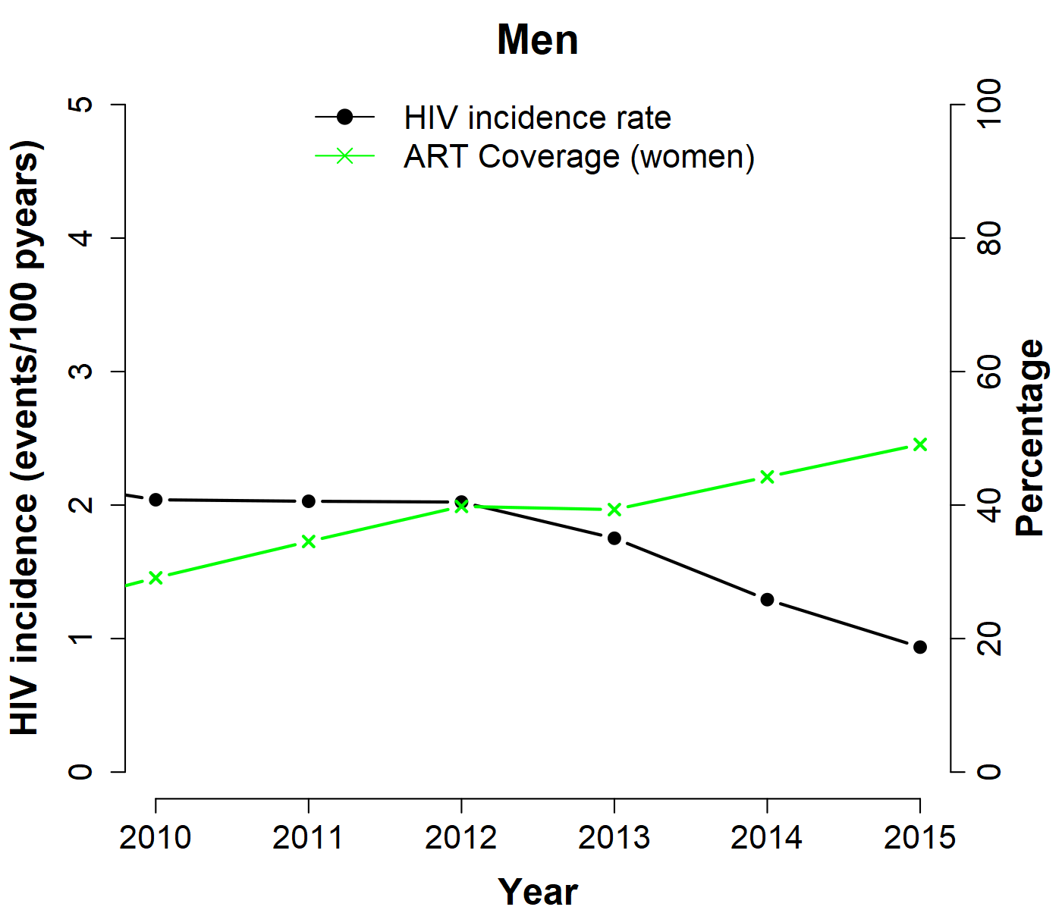
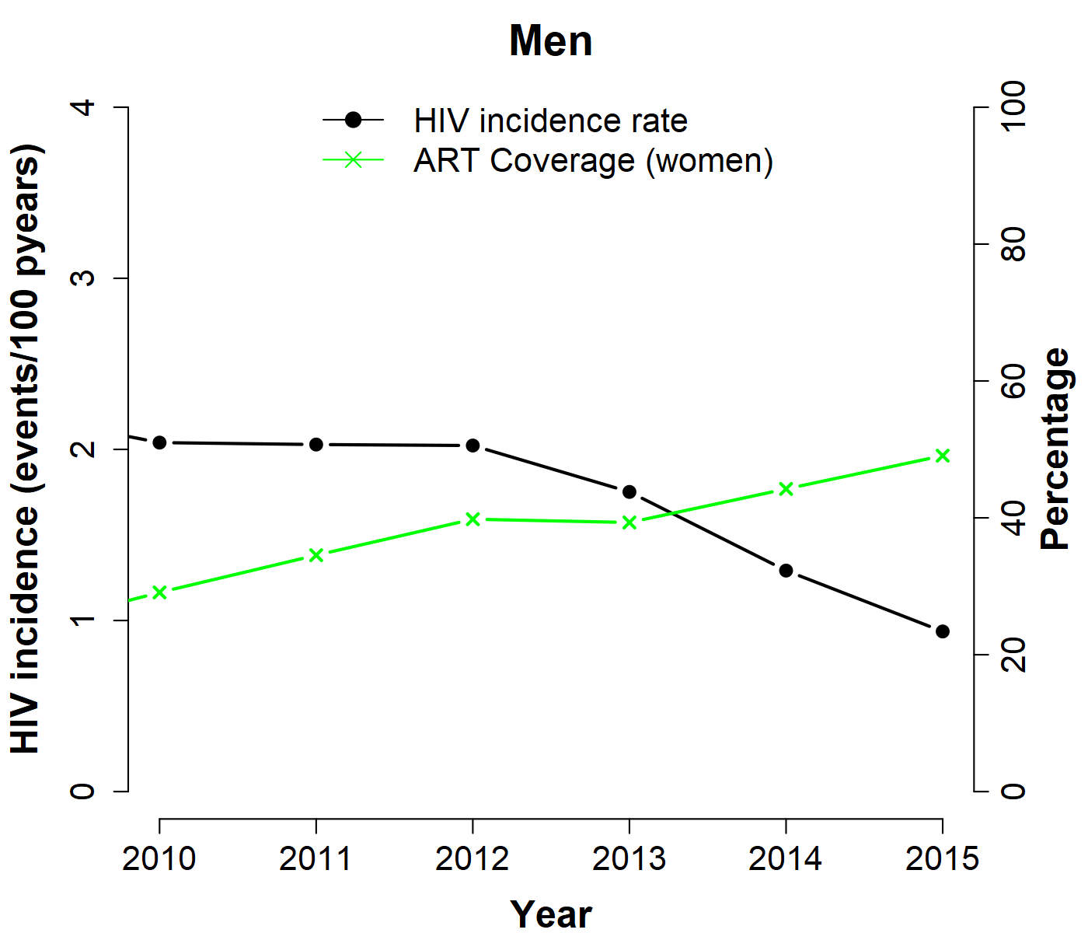

Slide 16
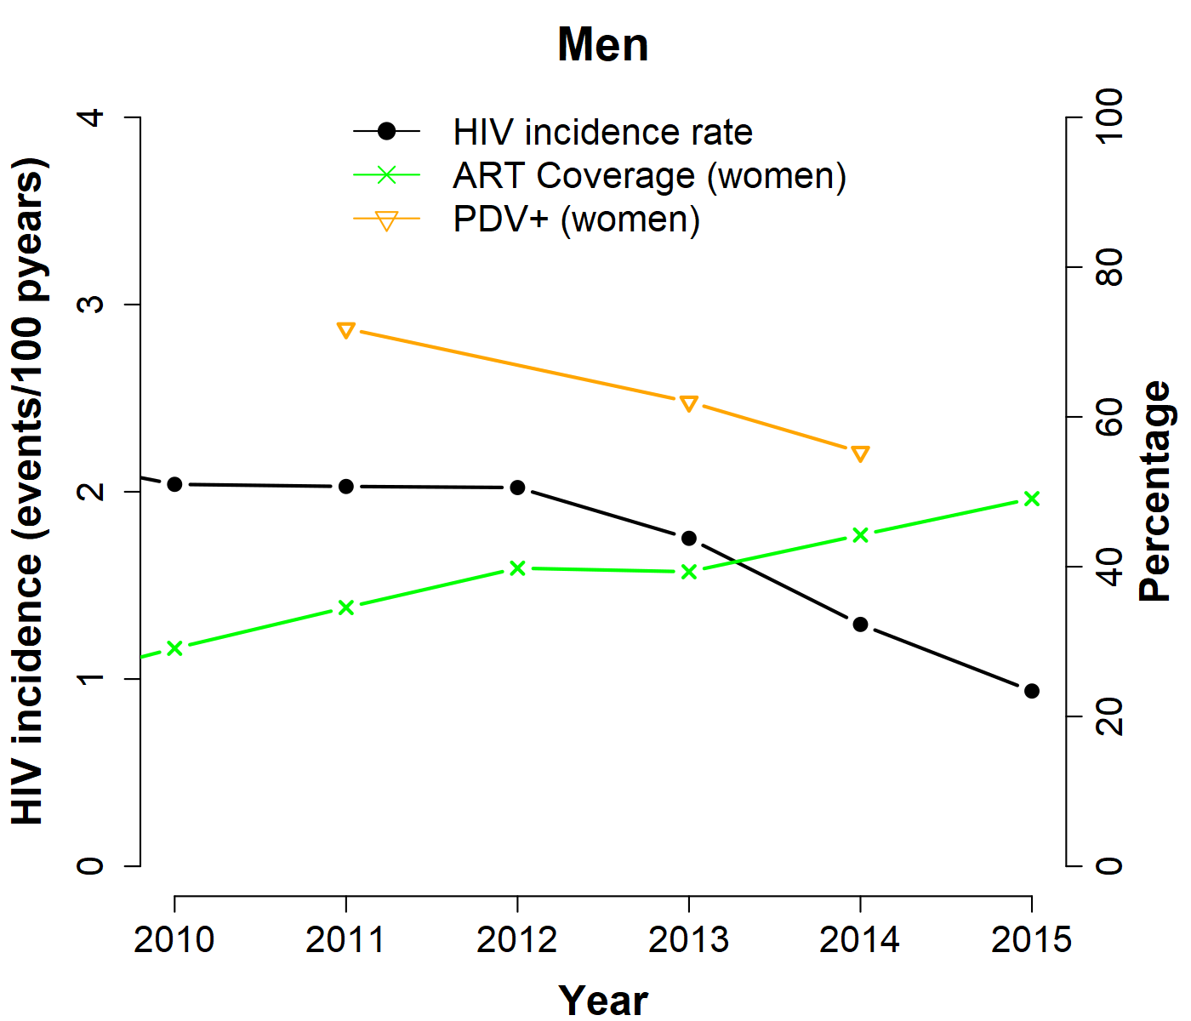

Slide 17
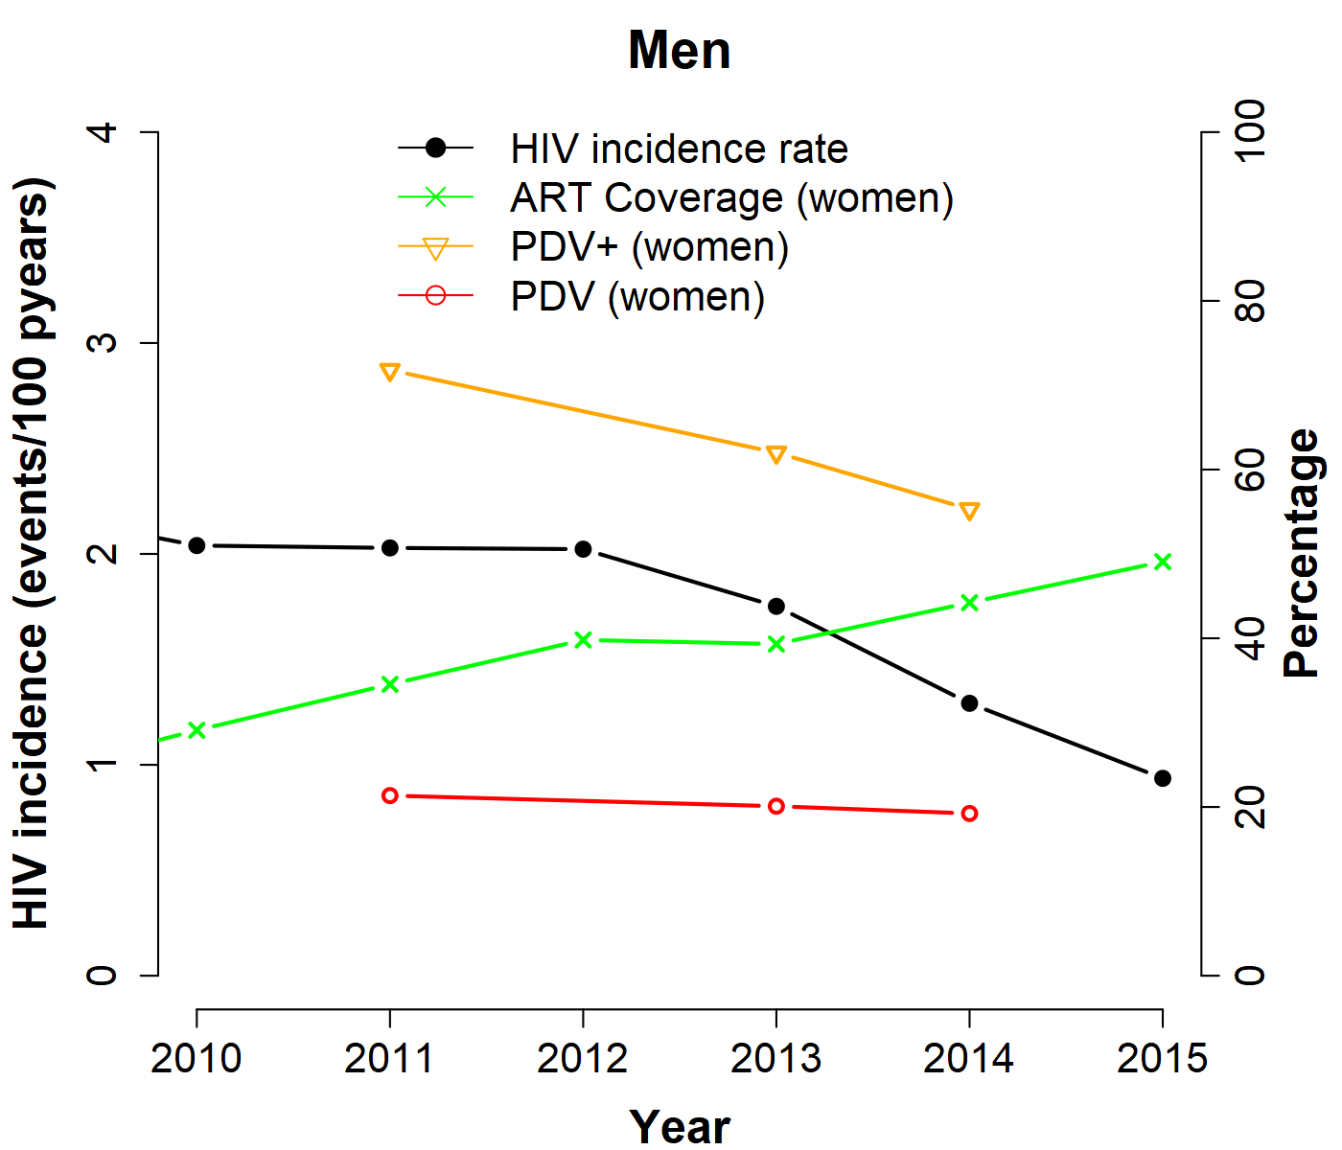

Slide 18
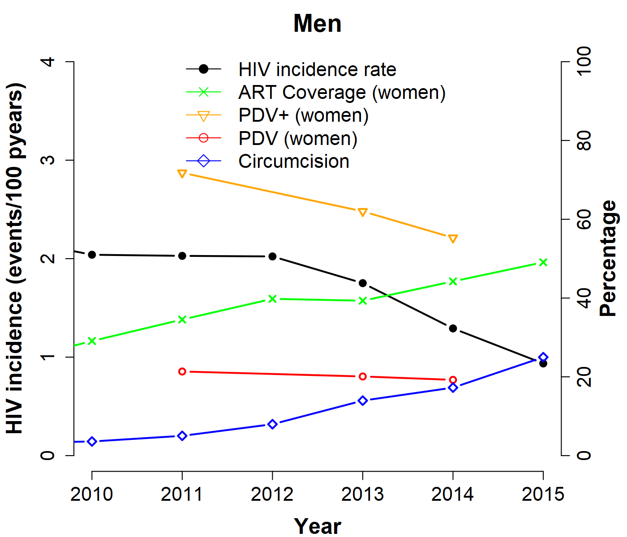

Slide 19
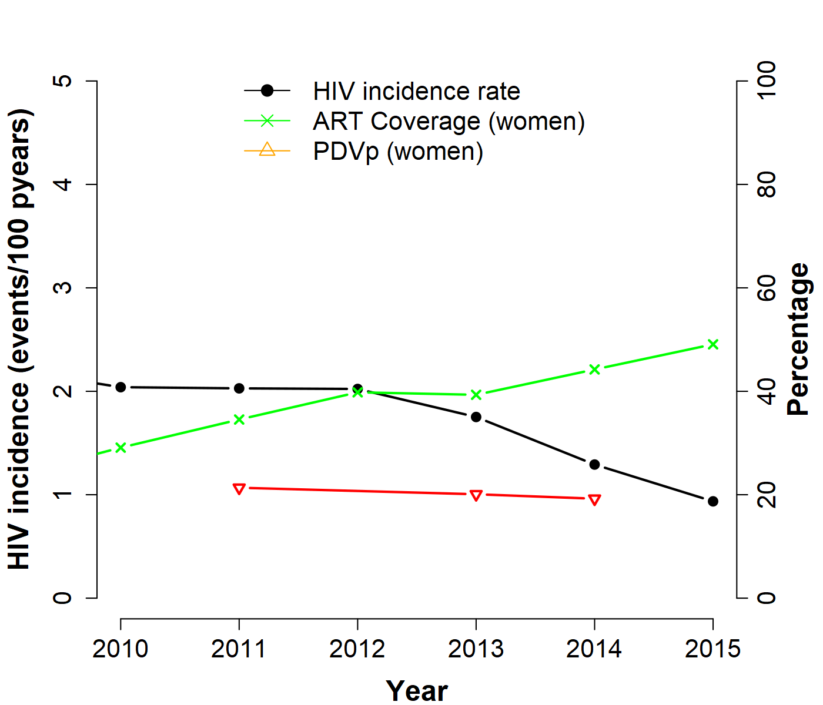
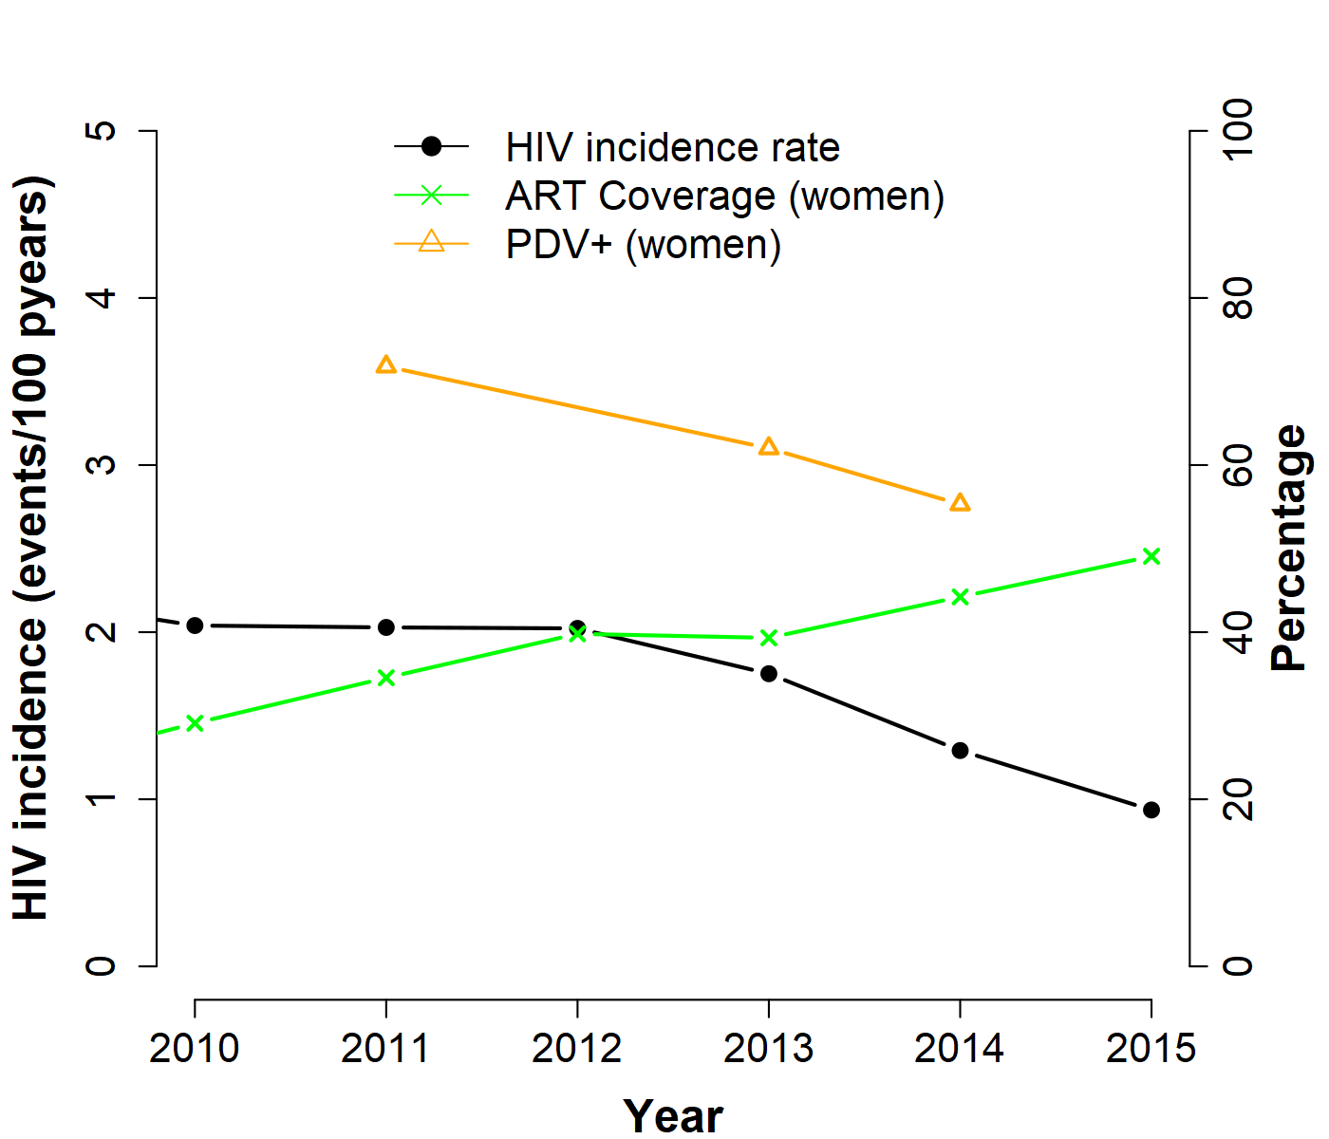
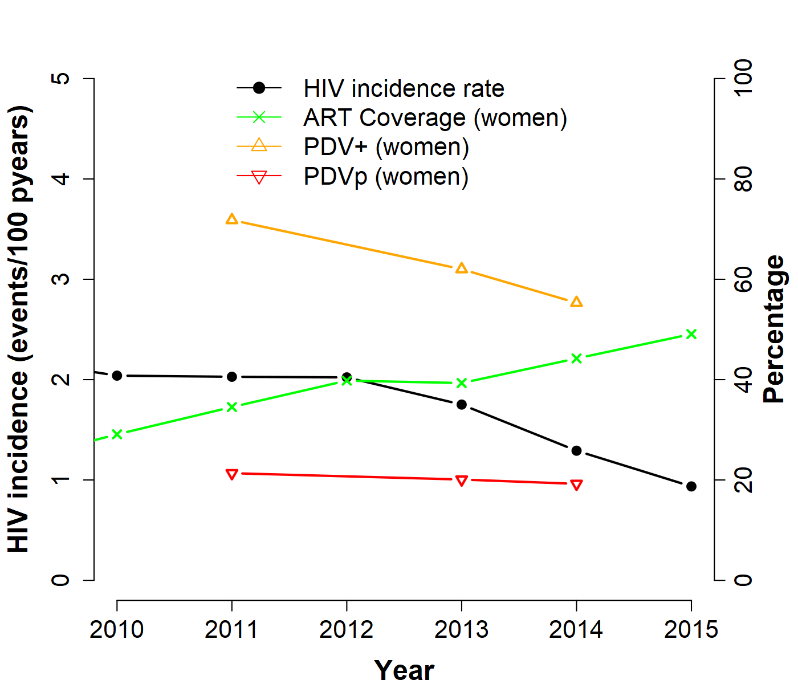
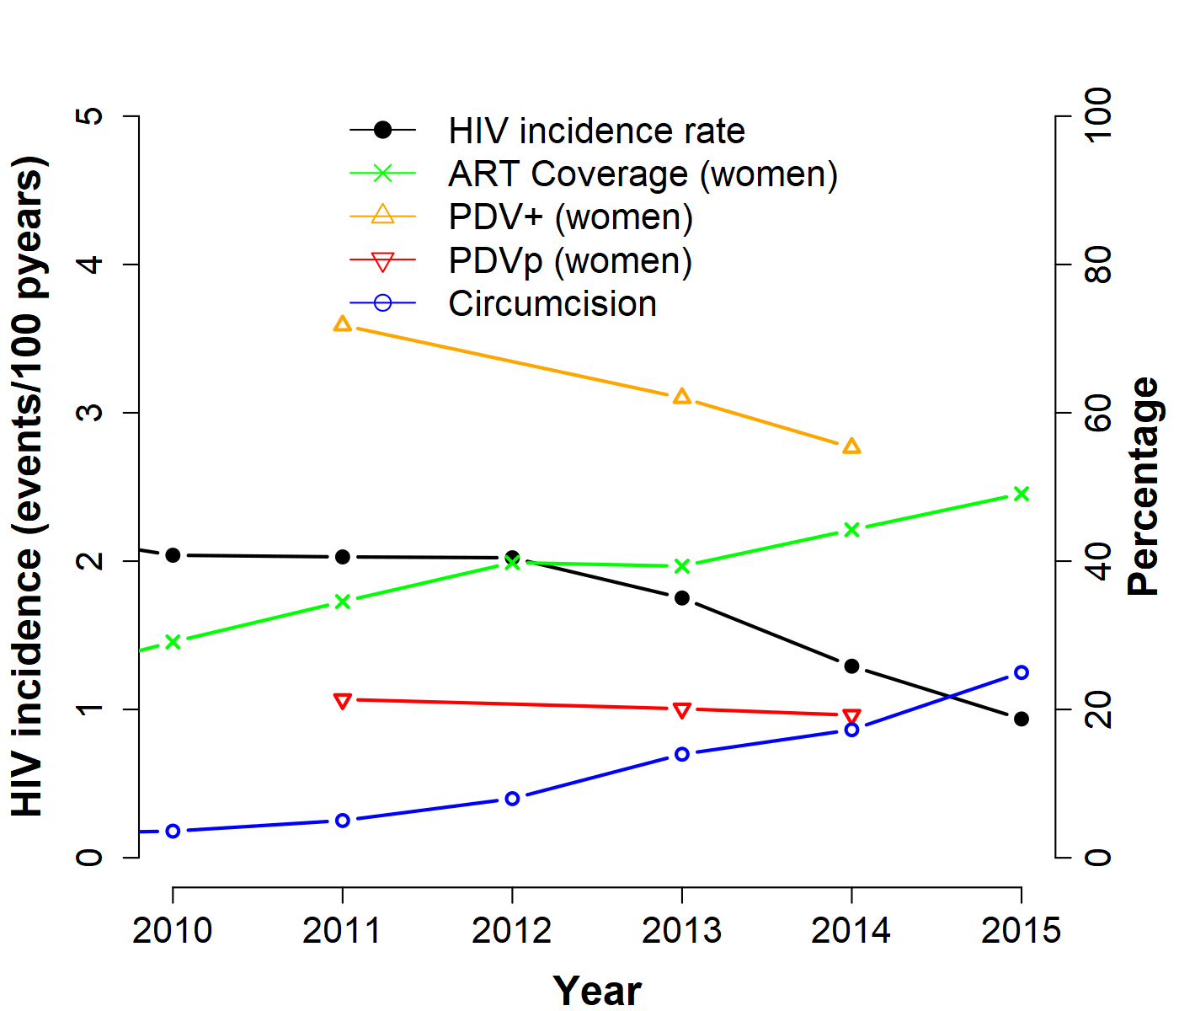
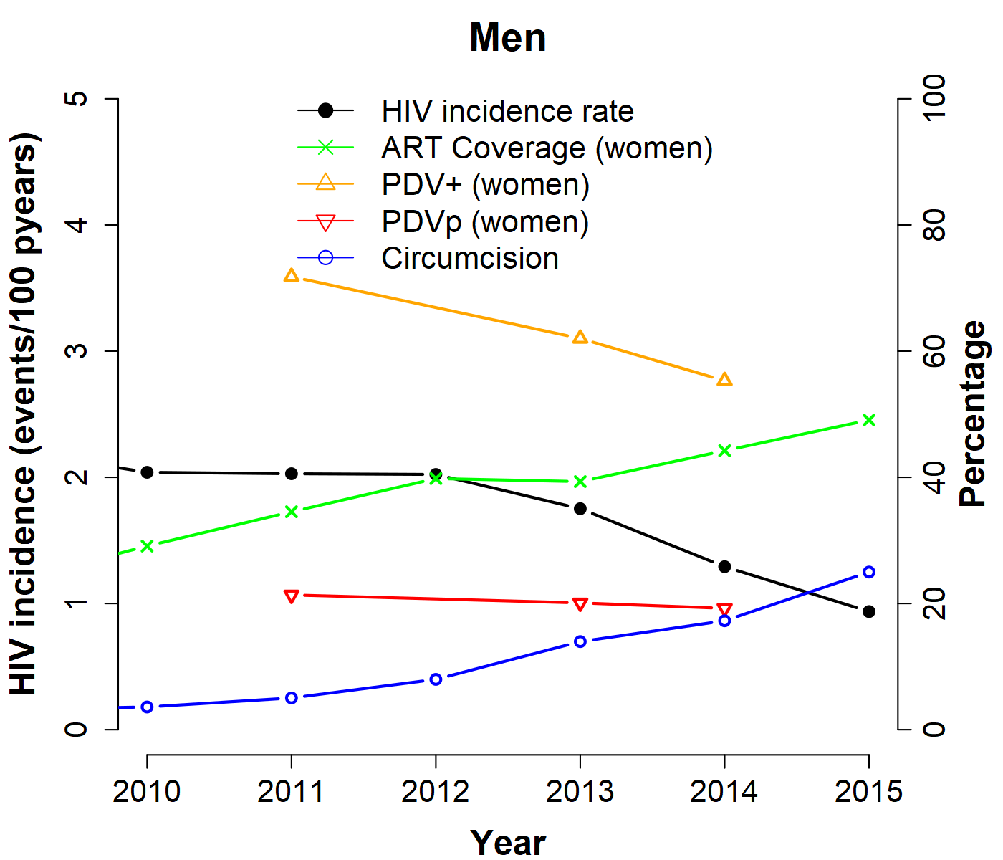
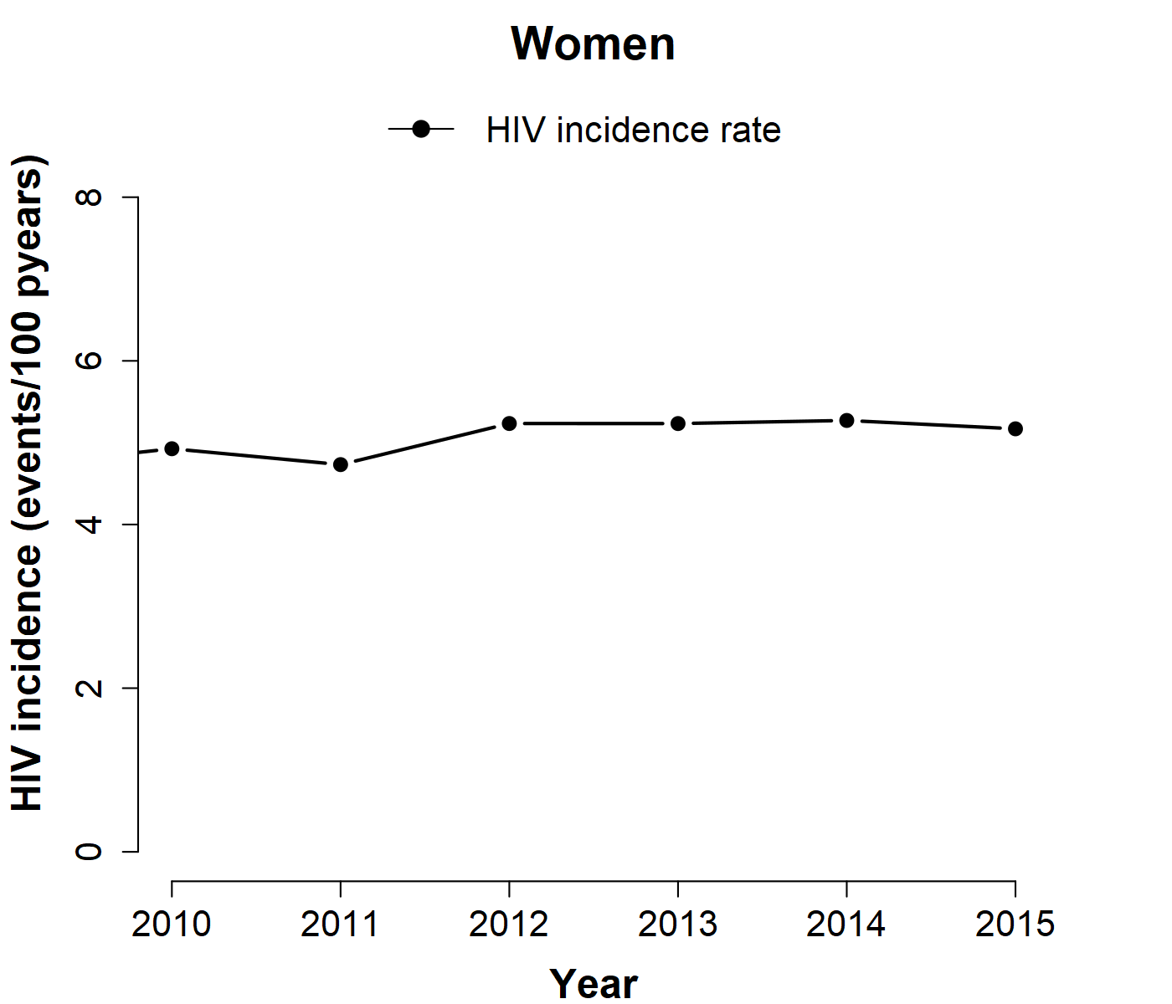

Slide 20
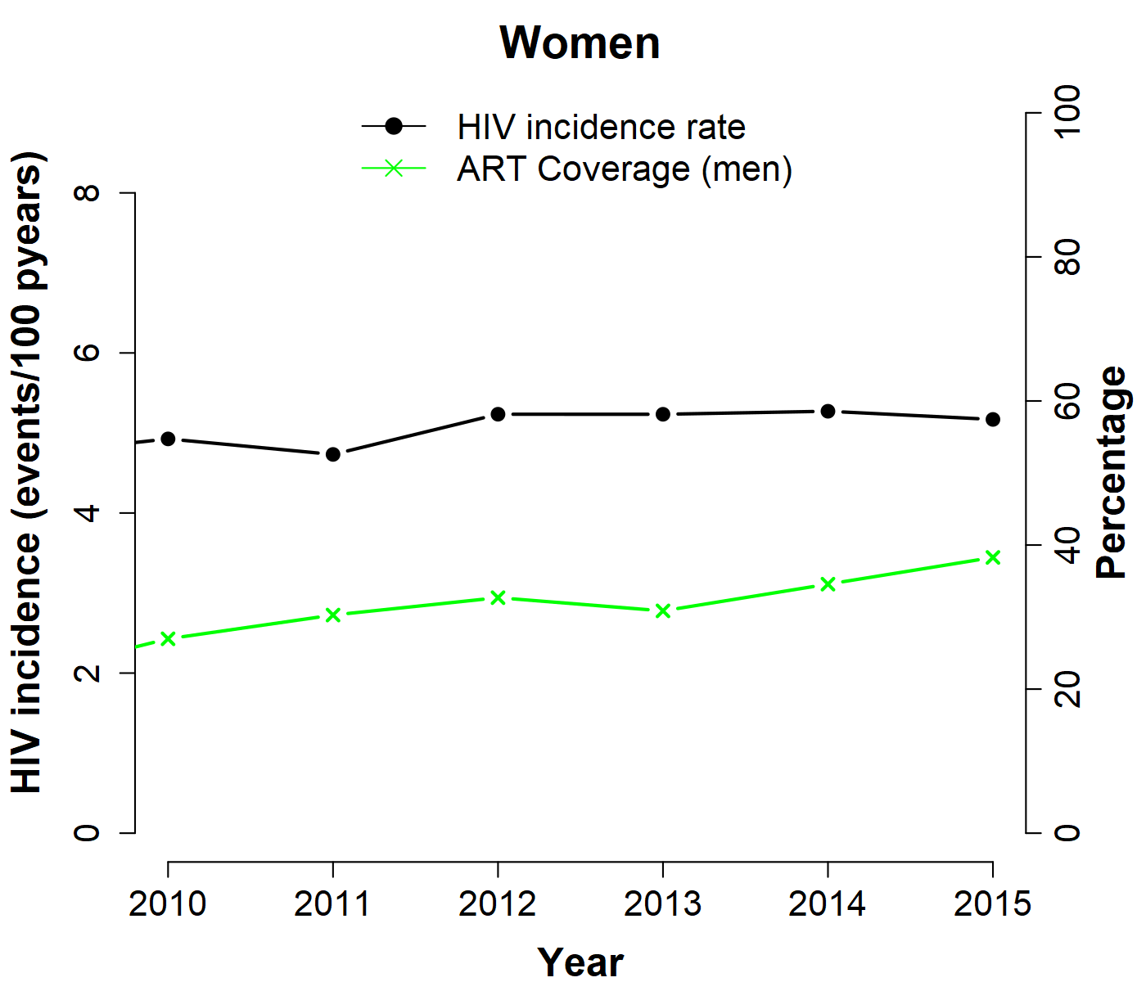

Slide 21
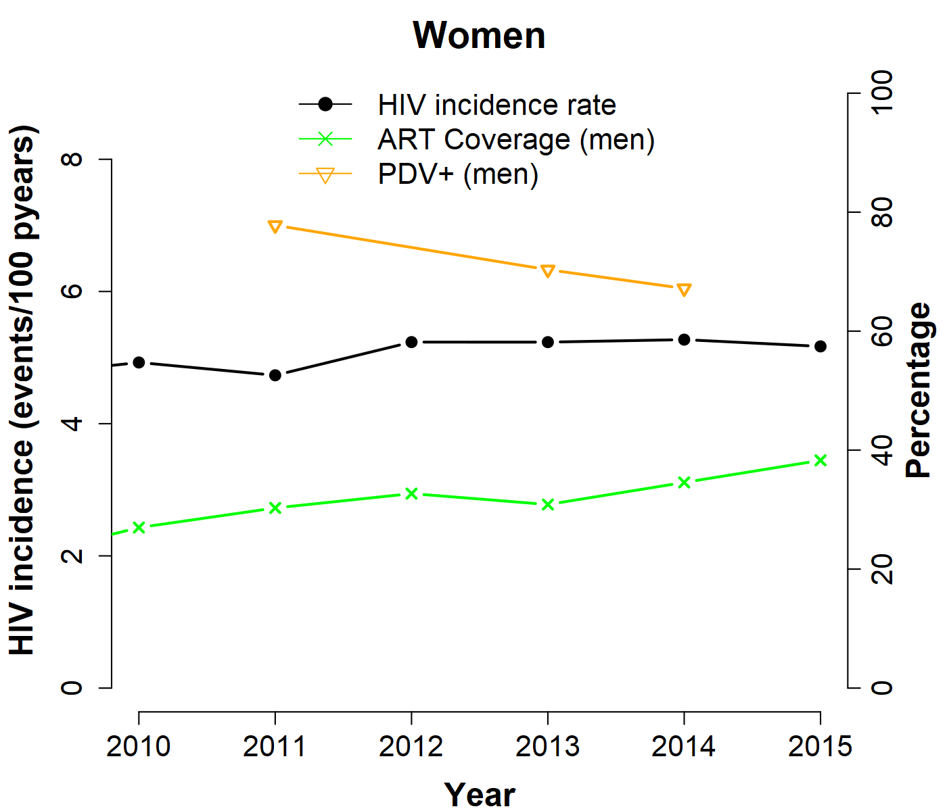

Slide 22
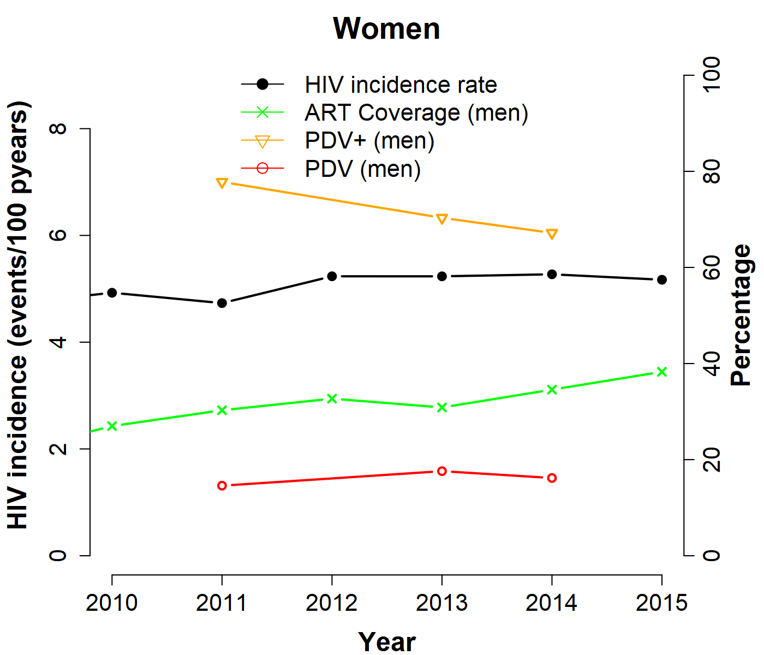

Slide 23
Discussion
Male HIV incidence declined by 50% between 2010 and 2015.
However, there is still a high force of infection among women in our study population.
Compare with a recent population-based study in Rakai, Uganda—greater declines in HIV incidence observed among men.
Hypothesize that the decrease in male incidence is driven by higher uptake of ART among women and increased male circumcision.

Slide 24
Going forward
Use a statistical model to evaluate changes in HIV incidence as a result of ART coverage, circumcision, and prevalence of detectable viremia (PDV_{P}), and age, among others.
Quantify joint/marginal contributions to the incidence rate ratios.
Modelling exercises: by how much must the PDV_{P} decrease for reduction in HIV incidence rate.

Slide 25
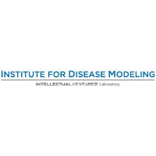
Acknowledgements

Slide 26
b
S$μ$
Susceptible
(S)
b = rate enter sexually active pop.
$μ$ = rate leave sexually active pop.
$β$ = prob. of transmission
c = sex contact rate
$α$ = HIV mortality rate
D = number detectable viremia
S$βc×\left(\frac{I}{N}×\frac{D}{I}\right)$
Infected
(I)
$$I×(μ+α)$$

Slide 27
