Slide 1
Genetic Signals of Plasmodium falciparum Reveal Transmission Dynamics and Track Infections
Sarah K. Volkman

Slide 2
GENETIC SURVEILLANCE ACROSS TRANSMISSION LEVELS
Figure from Gates Foundation: Genomic Epidemiology

Slide 3
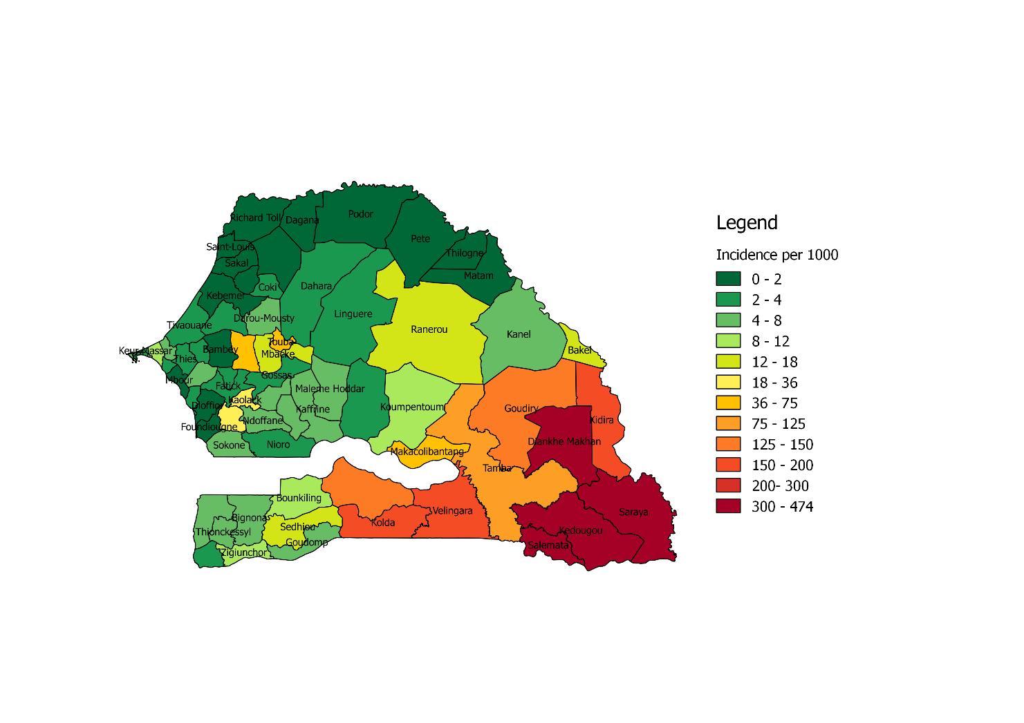
Measure Transmission
Detect changes in transmission and the impact of interventions on transmission
Parasite Relatedness and Connectivity
Determine the sources of infection and distinguish between local and imported infections
Drug Resistance Surveillance
Detect and monitor resistance to drugs and insecticides

Slide 4
GENETIC DIVERSITY & TRANSMISSION INTENSITY

Slide 5
GENETIC RELATEDNESS—IDENTITY BY DESCENT
Identical By Descent (IBD) alleles come from common ancestor.
Identical By State (IBS) alleles are genetically the same.
IBD accounts for meiotic recombination.
Requires ~100 – 200 informative markers.
Methods to estimate IBD from IBS.
Probability that an allele is IBD is a metric of genetic relatedness.
Identity By Descent (IBD)
Relatedness = 0.25
Identity By State (IBS)
Relatedness = 0.50
Aimee Taylor, Wednesday

Slide 6
GENETIC RELATEDNESS—IDENTITY BY STATE
Molecular barcode genotyping.
Barcode only informative at >0.95 relatedness
Barcode estimates IBS, but IBD can be inferred using hmmIBD and population-specific allele frequencies.
More informative genotyping data is being obtained from natural infections.
For the purpose of this analysis relatedness is defined as >0.95 IBS.
SINGLE NUCLEOTIDE POLYMORPHISMS
Independent
High Minor Allele Frequency
Discriminating
Sample 1
C | G | A | G | C | T | G | A | A | T | C | G | A | C | T | C | C | T | A | G | A | G | C | T
T | G | G | G | T | A | G | A | G | A | C | A | A | C | T | A | T | G | C | A | A | C | C | T
C | A | A | A | T | A | C | G | A | T | A | G | T | A | C | A | T | T | C | A | T | G | A | A
Sample 2
Sample 3
Daniels, Malaria Journal 2008

Slide 7
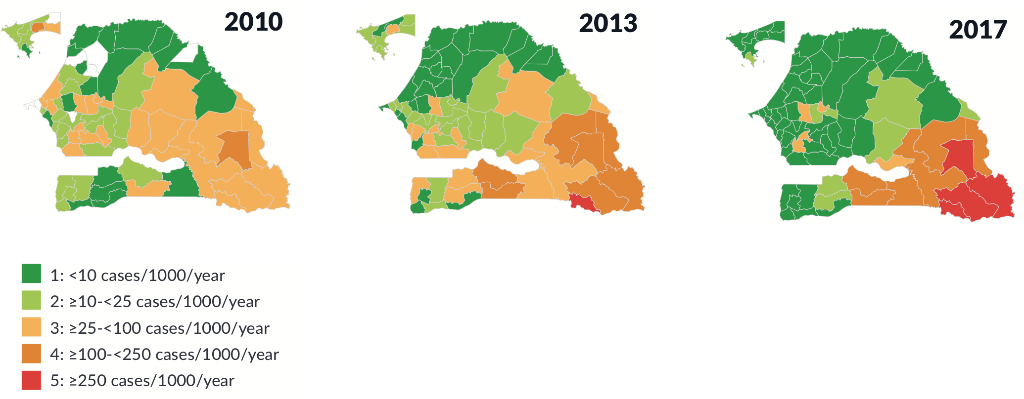
DECLINING TRANSMISSION IN SENEGAL
Stratification of malaria transmission intensity:
Senegal, 2010, 2013, and 2017.
Estimated malaria cases: Senegal, 2005-2017.
Source: PNLP & Senegal: Charting the Path to Malaria Elimination, (2018), PATH Malaria Control and Evaluation Partnership in Africa [MACEPA]

Slide 8
APPLY GENETIC SURVEILLANCE TO RANGE OF TRANSMISSION LEVELS
GREEN ZONE
  Lowest incidence
  Richard Toll (<1/1000)
  Thiès (<5/1000)
CHALLENGES
  Identify infection sources
  Interpret patterns of highly related parasites
KEY INDICATORS
  Parasite relatedness
  Spatiotemporal relationships
OPPORTUNITIES
  Identify parasite origin
  Reveal infection patterns
DECISION-MAKING
  Intervention selection and targeting
Incidence
per 1000
Malaria incidence across Senegal, 2017

Slide 9
INCREASED LIKELIHOOD OF POLYGENOMIC INFECTIONS FROM TRAVELERS
LOW TRANSMISSION REGION: RICHARD TOLL
350
300
250
200
150
100
50
0
Monogenomic
Polygenomic
Individuals with recent travel history are more likely to have polygenomic infections.
Number of Parasites
28.2%
20.1%
Travel No Travel
Fisher Exact Test, One-Tailed, p = 0.03

Slide 10
EVIDENCE FOR IMPORTED INFECTIONS
LOW TRANSMISSION REGION: RICHARD TOLL
Twenty-one percent (21%) of Richard Toll are related to Thiès parasites.
Identical parasites detected in Richard Toll and Thiès consistent with importation.

Slide 11
EVIDENCE FOR LOCAL INFECTIONS
LOW TRANSMISSION REGION: RICHARD TOLL
9
8
7
6
5
4
3
2
1
0
P = 0.01
Genetically similar (concordant) infections are more likely within households with no travel history.
Households (n)
No Travel
Travel
Concordant Discordant
Genetic data can differentiate local verses imported infections, including at household level.

Slide 12
EVIDENCE FOR LOCAL INFECTIONS
LOW TRANSMISSION REGION: RICHARD TOLL
Identical parasites persisting across multiple years suggests local transmission.

Slide 13
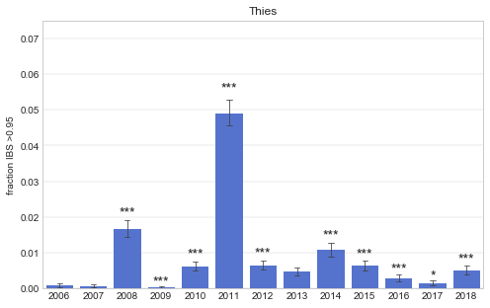
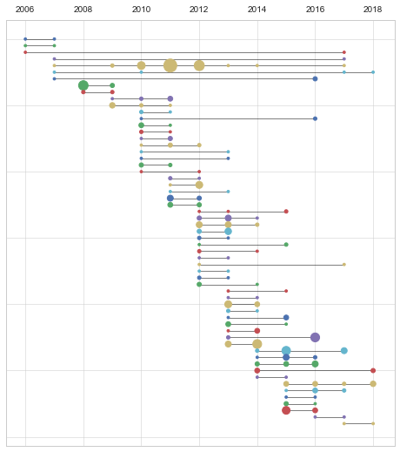
TRANSMISSION DYNAMICS & PERSISTING INFECTIONS
TRANSITION FROM MODERATE TO LOW TRANSMISSION: THIES
Track patterns of highly related parasites within the population, consistent with inbreeding
Persistence of identical parasite barcodes across transmission seasons
2006 2008 2010 2012 2014 2016 2018
0.07
0.06
0.05
0.04
0.03
0.02
0.01
0.00
Fraction of IBS >0.95
2006 2007 2008 2009 2010 2011 2012 2013 2014 2015 2016 2017 2018
Use modeling to interpret observed changes in parasite population structure.

Slide 14


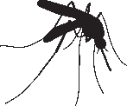
EPIDEMIOLOGICAL MODELING OF SENEGAL GENETIC DATA
ALBERT LEE
Investigating transmission trends: detect transmission declines and rebounds
Reveal spatio-temporal trends of malaria transmission in Thiès, Senegal
CGATATG
CGATATG
CTCAATG
CGCTATG
CGATATG
CGATATG

Slide 15

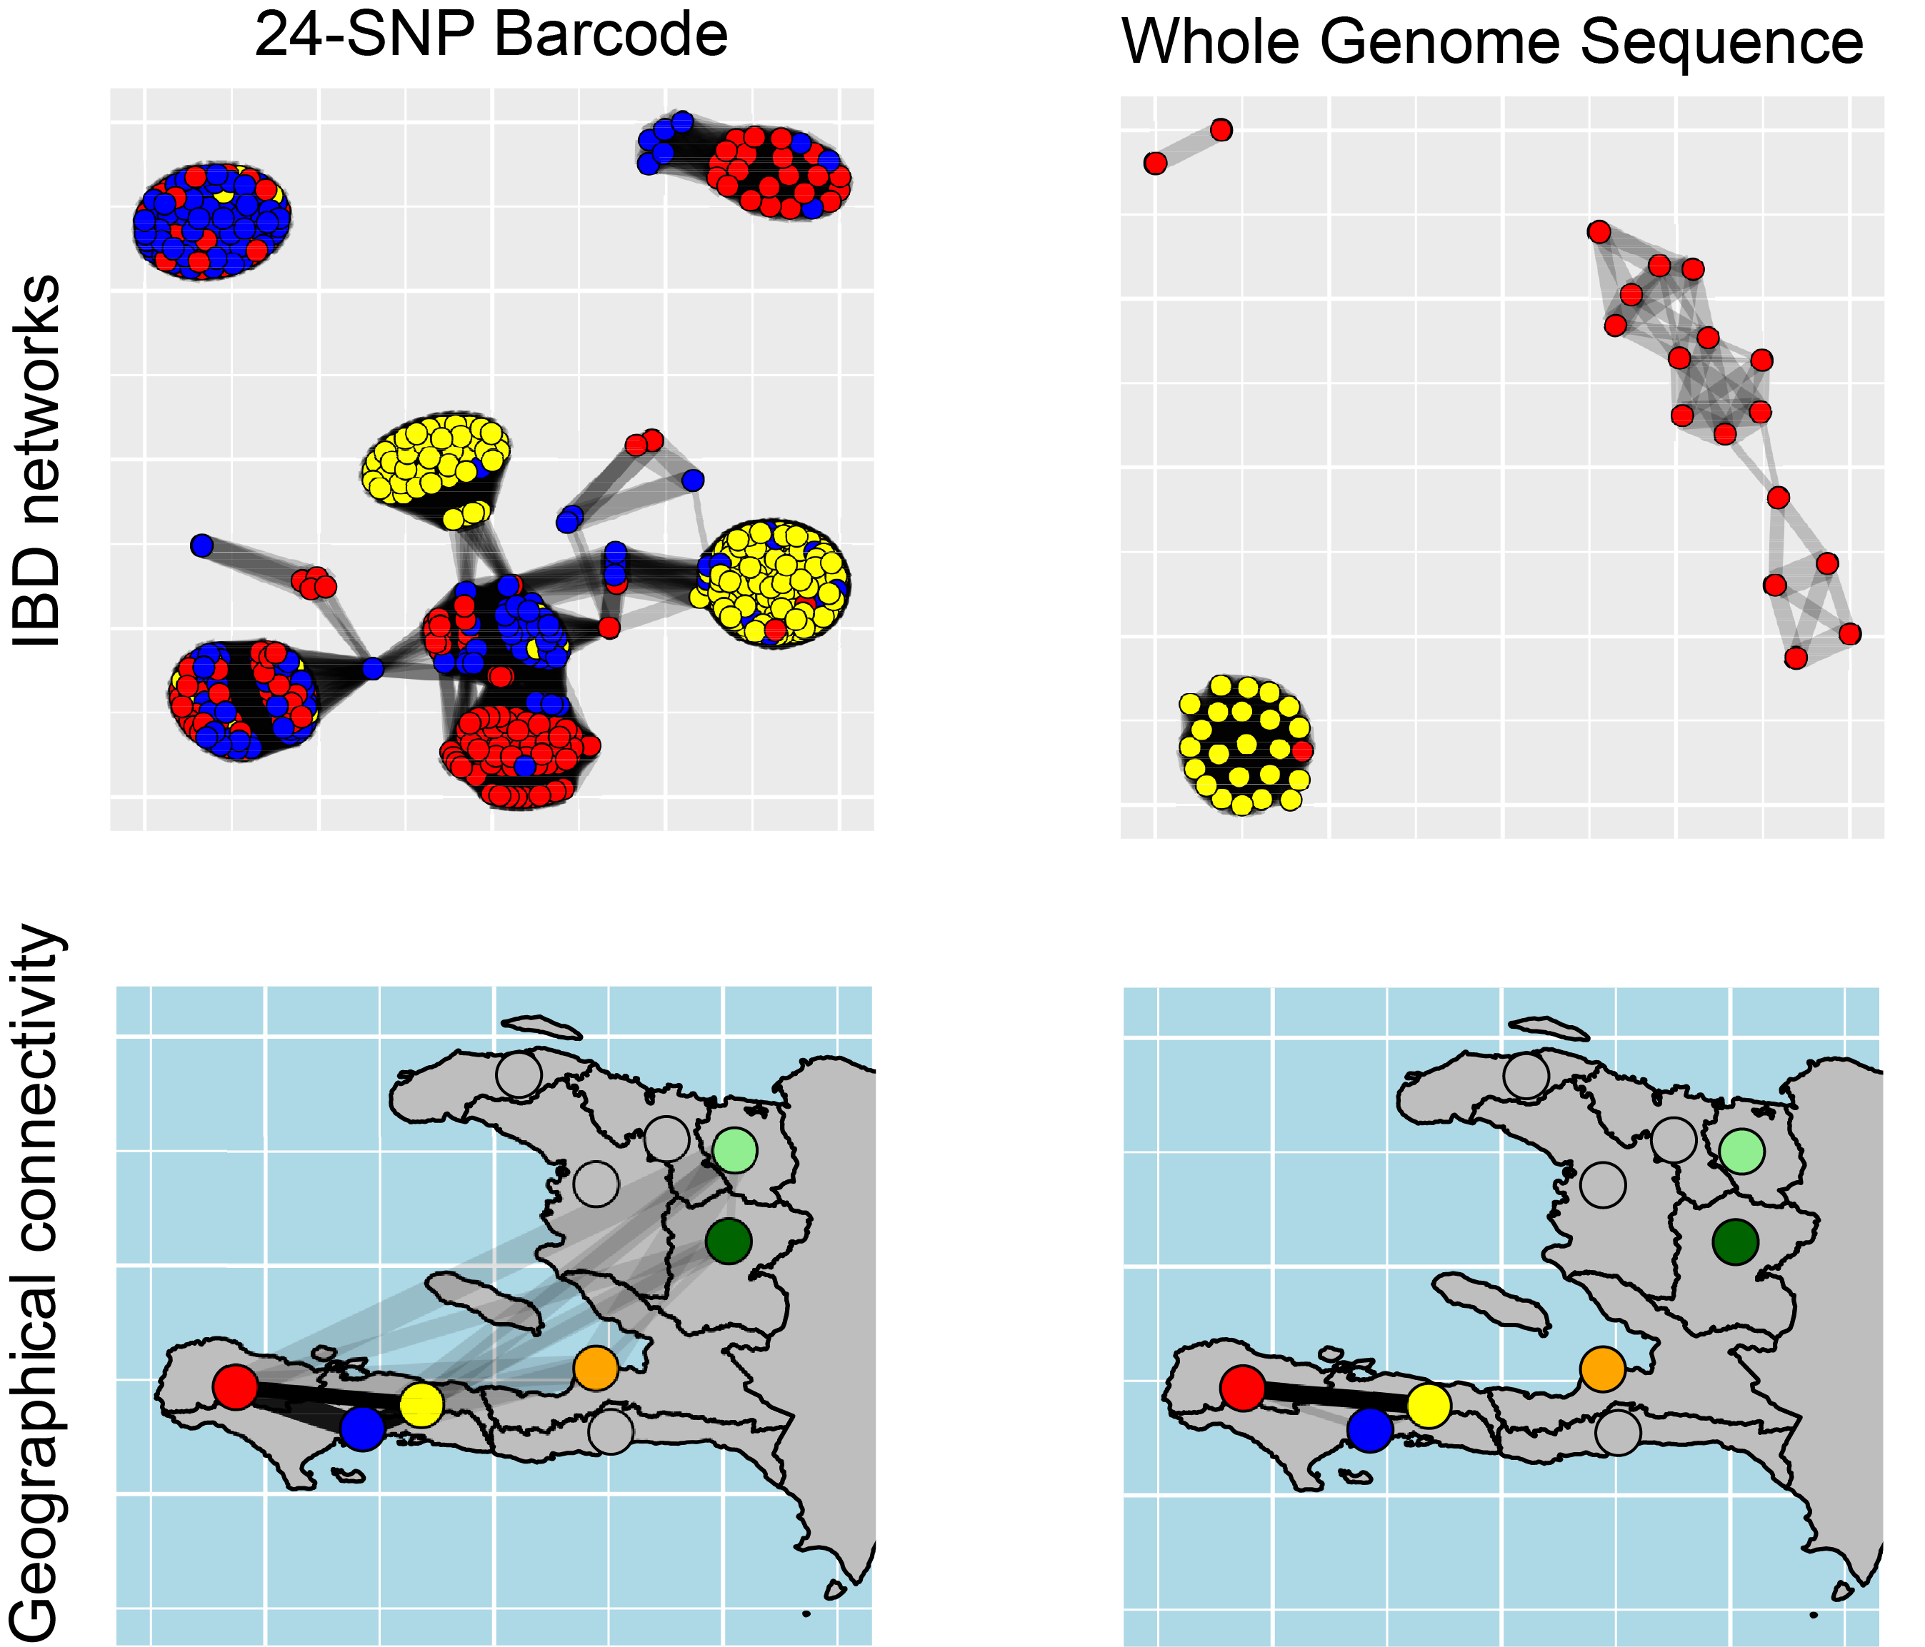
Malaria in Haiti: Genomic Epidemiology at the Lower Limits of Transmission
DETECTING RELATEDNESS IN LOWEST TRANSMISSION CONTEXT—HAITI
SETH REDMOND
    Seth Redmond
    HSPH / Broad Institute /
    Monash University
3 different methods of genotyping bloodspots from malaria +ve patients.
What can we learn from each genotyping method in a region of extremely low diversity?
Session:
Understanding genomic surveillance data and implications for malaria elimination
Weds 11:00-12:15, Juniper

Slide 16
APPLY GENETIC SURVEILLANCE TO RANGE OF TRANSMISSION LEVELS
HIGH BURDEN
RED ZONE
  Highest incidence
  Kédougou (>450/1000)
CHALLENGES
  High complexity of infection
KEY INDICATORS
  Parasite relatedness
OPPORTUNITIES
  Intervention impact evaluation
DECISION-MAKING
  Intervention impact
  Effective intervention combinations
Incidence
per 1000
Malaria incidence across Senegal, 2017

Slide 17
GENETIC measures of transmission to assess impact of interventions KÉDOUGOU, SENEGAL
Changes in parasite relatedness as early indicator of intervention impact on transmission.
Increasing IBD fraction indicates reduction of parasite diversity consistent with decreasing transmission.

Slide 18
APPLY GENETIC SURVEILLANCE TO RANGE OF TRANSMISSION LEVELS
YELLOW ISLAND
  High incidence in “sea of green”
  Diourbel (~100/1000)
CHALLENGES
  Isolated demography (religious schools)
  Historically difficult to deploy interventions
KEY INDICATORS
  Complexity of Infection
  Parasite relatedness
  Spatiotemporal relationships
OPPORTUNITIES
  Identify parasite origin
  Reveal infection patterns
DECISION-MAKING
  Intervention selection and targeting
Incidence
per 1000
Malaria incidence across Senegal, 2017

Slide 19
SHARED PARASITES ACROSS GEOGRAPHY

Slide 20
LARGER PROPORTION OF SHARED PARASITES FROM DIOURBEL
Percentage of parasites within barcode clusters, by site (2018)
Large proportion (47%) of Diourbel parasites share genotype with another parasite.

Slide 21
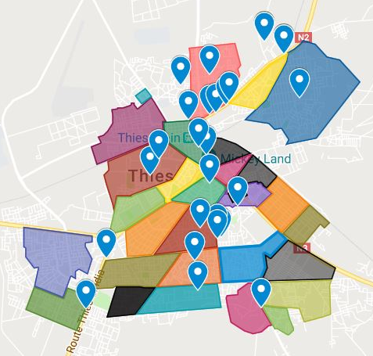
CHALLENGES FOR EPIDEMIOLOGICAL MODELING OF GENETIC DATA
CHALLENGES
  Population-level genetic data of clinic samples
  Aggregated epidemiological data
OPPORTUNITIES
  Interpretation of genetic signals requires fine-scale mapping
  Develop fine spatial maps of population and infections across catchments
  Align genetic and epidemiological data
  Capture samples across seasonality
THIES
THIES

Slide 22
INTEGRATING GENETICS, EPIDEMIOLOGY, MAPPING AND MODELING
Senegal is creating a genetic epidemiology map of the entire country.
Bringing routine data, risk mapping, and genetic epidemiology together to stratify intervention strategies for elimination.
Integrating Genetics, Epidemiology, Mapping, and Modeling

Slide 23

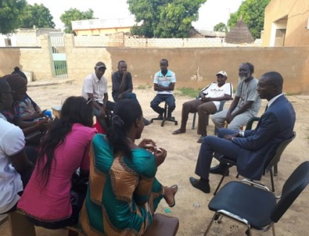

GENETIC SURVEILLANCE FOR DECISION-MAKING
  Surveillance and
  Sampling Design
  Community
  Engagement
  Data Generation
  Data Analysis
  Review
  Decision
  Making
  Implementation
  Interventions
Transmission patterns for stratification of appropriate interventions.
Transmission metrics for intervention impact assessment.
Sources of infection for intervention targeting.

Slide 24








ACKNOWLEDGEMENTS
Michael Hainsworth
Yakou Dieye
Gnagna Dieng
Philippe Guinot
Dyann Wirth
Sarah Volkman
Rachel Daniels
Daouda Ndiaye
Awa B. Deme
Aida Badiane
Caterina Guinovart
Bronwyn MacInnis
Steve Schaffner
Tim Farrell
Doudou Sene
Mouhamad Sy
Fatou B. Fall
Coumba Ndoffene Diouf
Medoune Ndiop
Moustapha Cisse
Alioune Badara Gueye
Oumar Sarr
Richard W. Steketee
Julie Thwing
Kathy Sturm-Ramirez
Edward Wenger
Josh Proctor
Albert Lee
Dan Hartl

Slide 25
Thanks! Merci! Jërejëf!

