Slide 1



Yale
New approaches for estimating the effects of PCVs
Dan Weinberger, PhD
Assistant Professor
Yale School of Public Health
PneumoVIPR Project

Slide 2


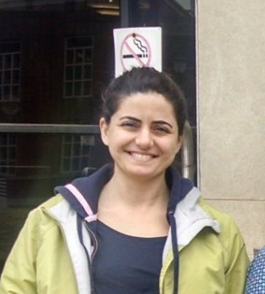





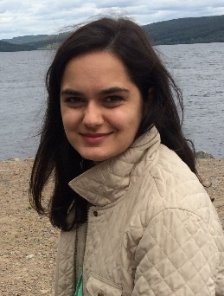

Acknowledgments
Brazilian MoH
Roberto Men Fernandes
Chilean MoH
Rodrigo Fuentes
Ben-Gurion University
Ron Dagan
Noga Givon-Lavi
Kayoko Shioda
Esra Kurum
Christian Bruhn
Josh Warren
Sandy Pingali
George Washington University
Lone Simonsen (co-Investigator)
Sage Analytica
Cynthia Schuck Paim
Robert Taylor
Roger Lustig
Lone Simonsen
Josh Warren
Esra Kurum
Kayoko Shioda
Christian Bruhn
Cynthia Schuck Paim
Funding
Sandy Pingali

Slide 3
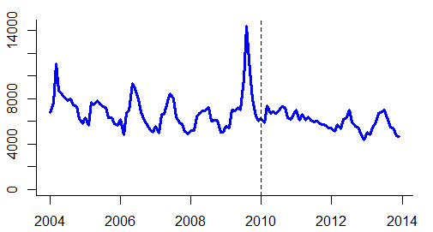
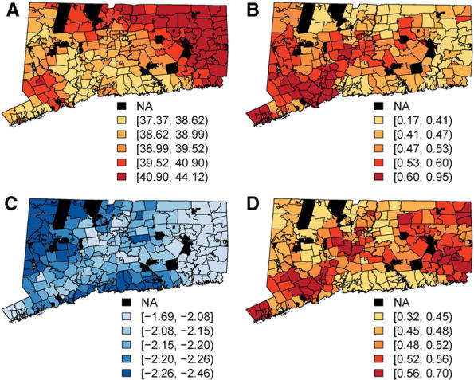
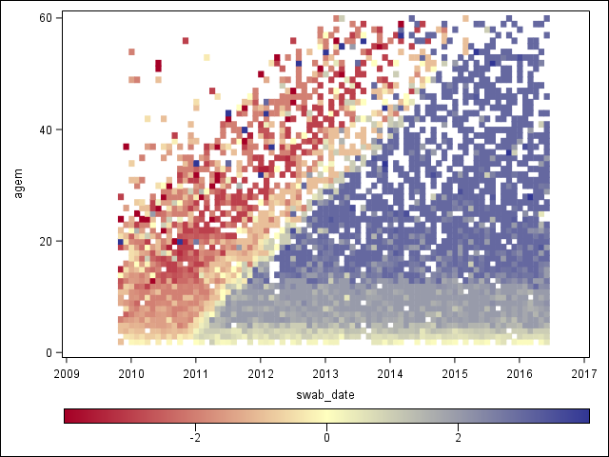
Outline for talk
Evaluating the impact of PCVs using time series data
Evaluating local variations in the impact of PCVs
Evaluating effects of different dosing schedules on carriage

Slide 4
Evaluating the impact of PCVs from time series
Vaccine
Counterfactual
Pneumonia
Counterfactual: What would have happened without vaccine
Estimating this quantity is a major challenge and relies on various assumptions
X% decline
Pre-vaccine
Post-vaccine
Time
Vaccine
Pneumonia
???
Pre-vaccine
Post-vaccine
Time

Slide 5
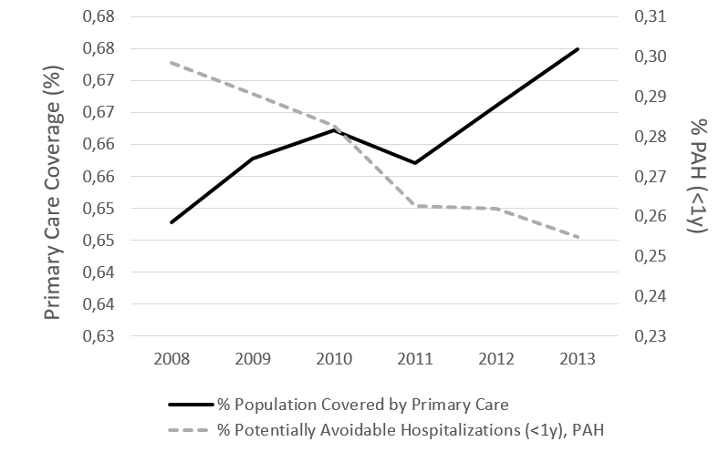
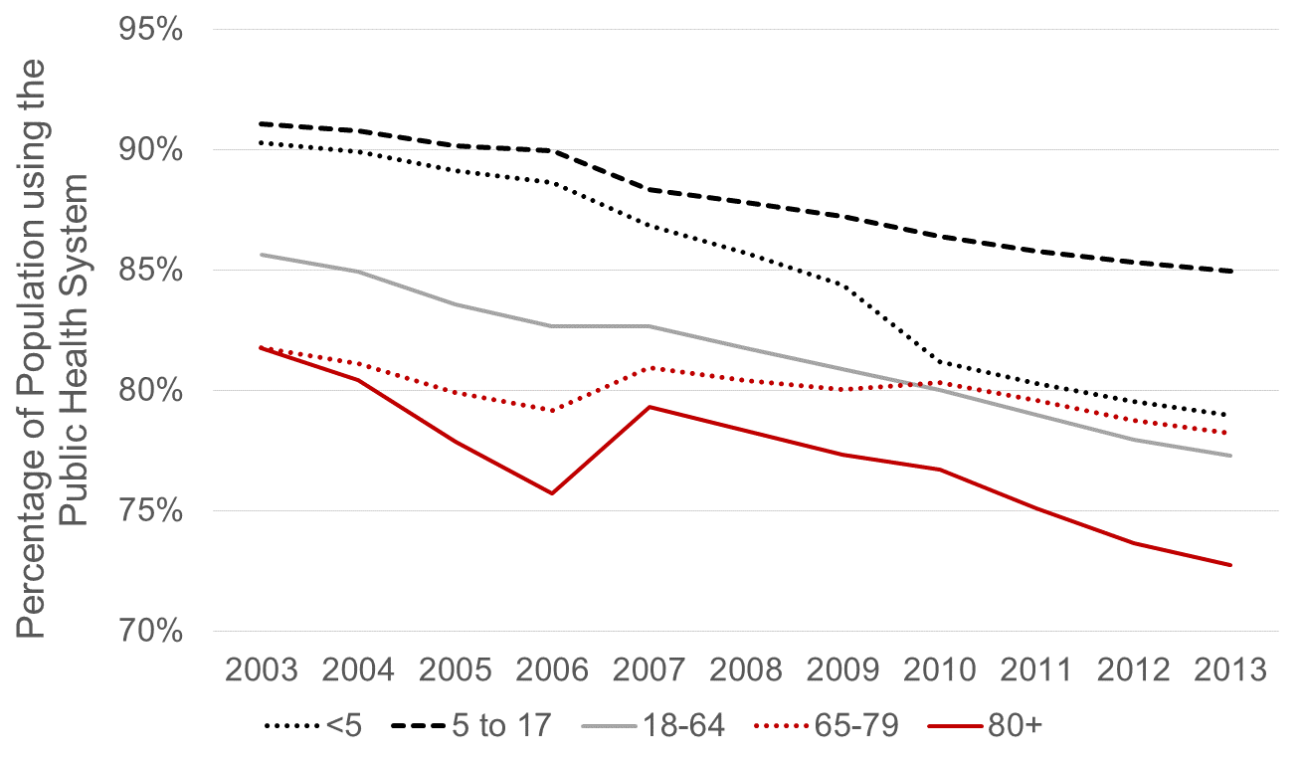
Many factors aside from vaccination can influence disease rates
Changes in access to primary care
Changes in use of public healthcare
Potentially-avoidable hospitalizations

Slide 6
Use of control diseases to detect/adjust for secular trends
Vaccine
Often used qualitatively
  “Pneumonia declines but UTI is stable”
Can be used quantitatively
  “Effect of PCV against pneumonia is X%-Y%”
Pneumonia
X% decline
Pre-vaccine
Post-vaccine
Time
Y% decline
Control disease
(e.g.UTI)
Pre-vaccine
Post-vaccine
Time

Slide 7
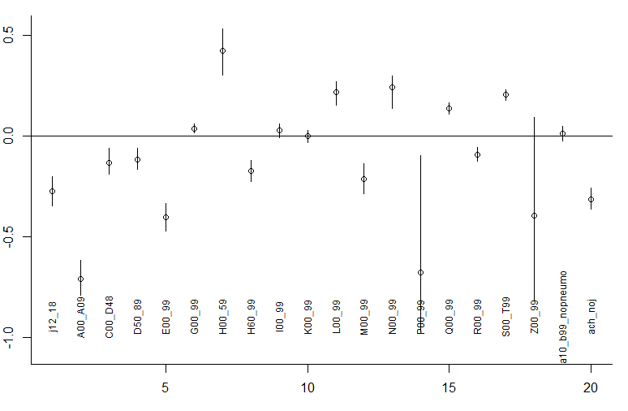
Which control should we choose?
Changes in different disease categories post-PCV10
Log(Rate Ratio)
Infectious gastroenteritis
Diseases of the eye
Diseases of the geritourinary system
**Choosing a single comparator/control is risky—composites are more robust

Slide 8
The ideal control: Shares all causal factors, but is not influenced by vaccine
Vaccine uptake(t)
Factor 1 (t) (e.g., healthcare utilization)
Factor 2 (t) (e.g., SES)
Factor 3 (t) (e.g., population size)
Pneumonia(t)
Perfect control disease(t)
  Regression: E(pneumonia cases_t)= b0 + b1*Perfect_control_t
  The problem: how to identify a good control

Slide 9
Principles for selecting candidate controls
Exclude any that could plausibly be influenced by the vaccine (e.g. pneumococcal/streptococcal septicemia)
Relationship should be stable over time (e.g. exclude diarrhea following rotavax)
Exclude covariates with sparse data (<10 cases/month on average)

Slide 10
What has been used as a control for
PCV impact against pneumonia?
Urinary tract infections
  Acute event
  Definitely not influenced by vaccine
  Only influences some age groups
  Different etiology
Fractures
  Might capture some broad healthcare utilization patterns (?)
  Definitely not influenced by vaccine
  Very different risk factors, causal mechanisms from pneumonia
Bronchiolitis
  Closest in etiology to pneumonia
  Possibly influenced by the vaccine
  Only occurs in certain age groups

Slide 11
Letting the data select controls
Method developed by Google for website analytics (Brodersen)
Select large number of candidate controls a priori
Fit regression model to pre-vaccine time series
  Weight the candidate controls using Bayesian variable selection
Generate counterfactual for post-vaccine period from model
Christian Bruhn

Slide 12
Components of the synthetic control model
  Log(pneumonia cases_t)=b0+ sum(incl_i*b_i*log(control_i_t)) + sum(c_k*season_k) + αt
Binary inclusion indicator for control series i
Time series for candidate control disease i
Monthly dummies to control for
Seasonality
Random walk
“Spike and slab” prior for incl_i*b_i

Slide 13
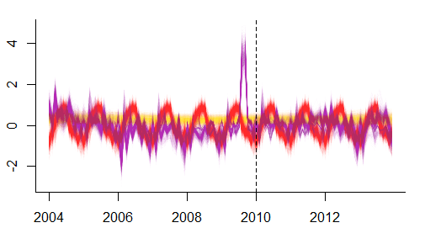
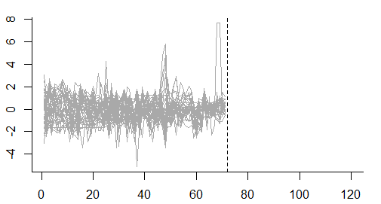
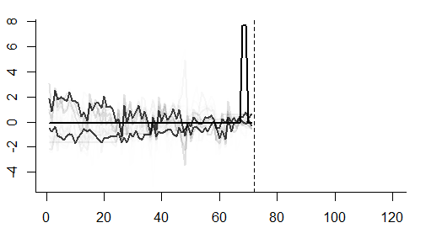
Original pneumonia time series
Regression model (and forecasts) include the synthetic control, seasonal variations, and random changes
Potential control variables
Training period
Evaluation
Controls are weighted based on similarities to pneumonia pre-PCV

Slide 14
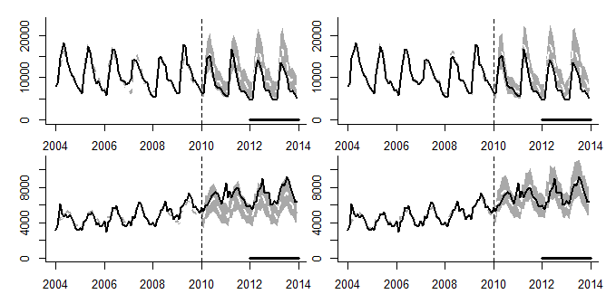
Example: Pneumonia in Brazil
Adjust only for non-respiratory hospitalizations
Adjust for synthetic control
A
B
<12 months
-23% (-30%,-16%)
-25% (-33%,-16%)
C
D
12-23 months
80+ years
+21% (+13%,+30%)
-0% (-12%,+14%)
-Synthetic controls do not affect estimates for <12month old children (no hidden biases detected)
-In adults >80, without synthetic control, would estimates a 21% increase, with synthetic control, no change

Slide 15
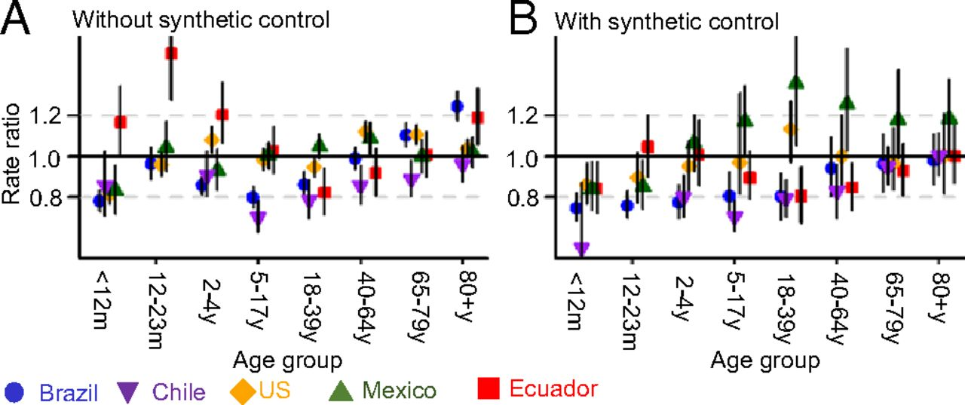
Changes in all-cause pneumonia 24-48m post-PCV:
Brazil, Chile, Ecuador, Mexico, US
Model with synthetic controls

Slide 16
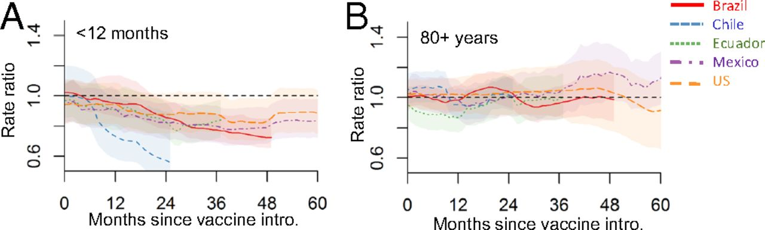
Trajectory of declines in five countries

Slide 17
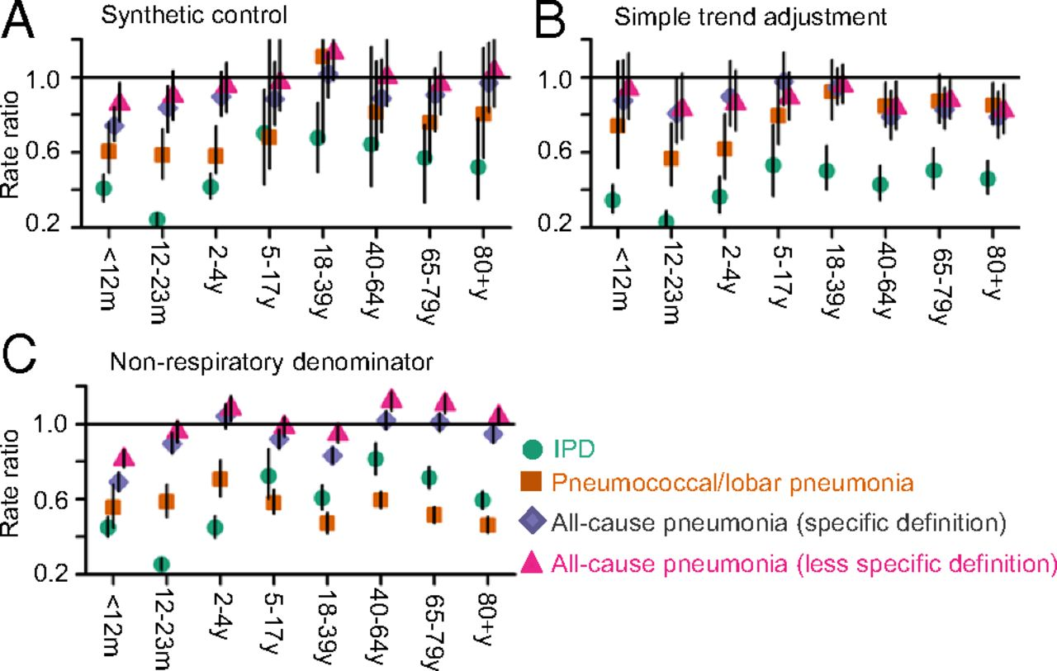
Impact of PCVs against outcomes of varying specificity
Simple trend adjustment
Synthetic control

Slide 18
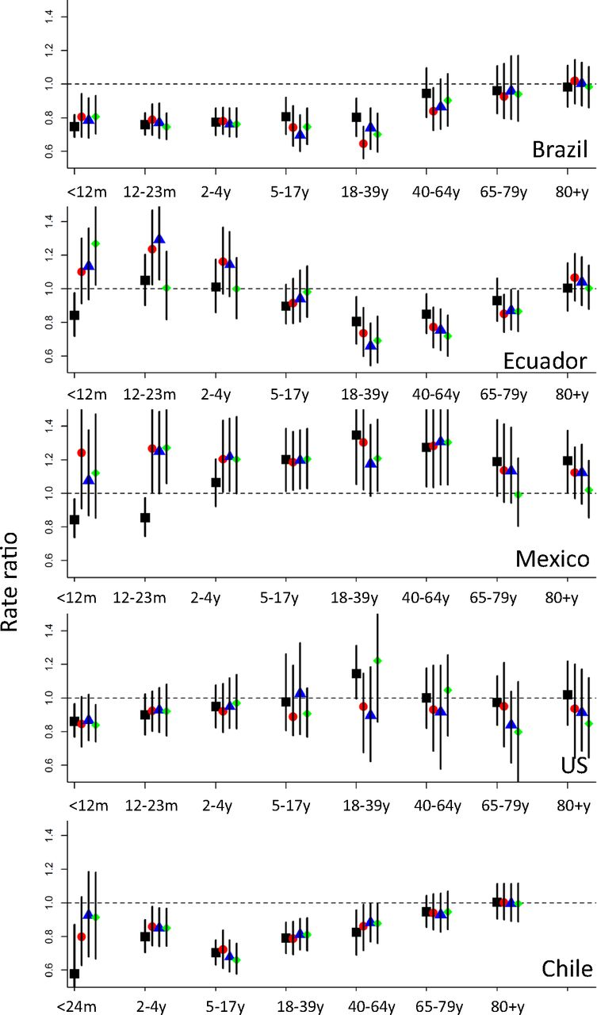
Sensitivity analysis: Drop top-weighted controls
Drop top 1, 2 or 3 components of the synthetic controls

Slide 19
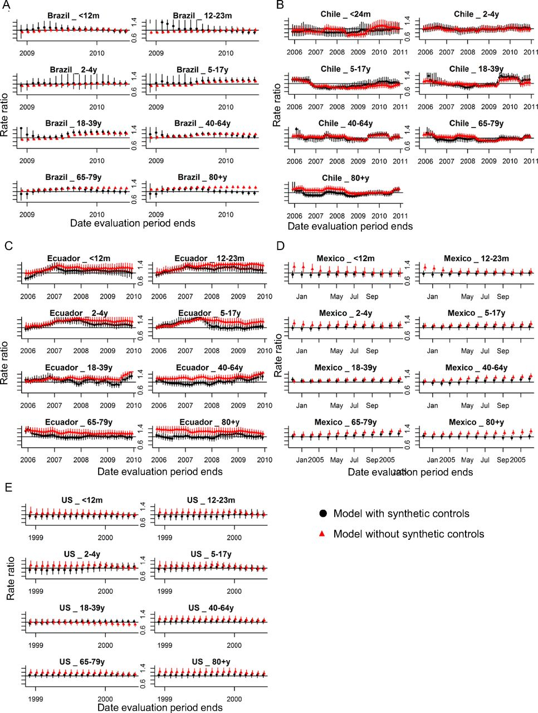
Sensitivity analysis: validating with pre-PCV data
Date when evaluation period ends
Date when evaluation period ends
Date when evaluation period ends

Slide 20
Synthetic controls with subnational data
With disaggregated data, more “noise” in the covariates
  Might not be able to effectively adjust for shared trends
Evaluate state-level variations in Brazil
“Downsampling” simulation to test effect of population size
Kayoko Shioda

Slide 21
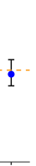
State-level estimate of PCV impact: 80+ years
Rate ratio
North
Northeast
Southeast
South
Central
NATL
Bubble size~ Number of cases

Slide 22
Estimated Rate Ratios for 100 Down-sampled Datasets (80+ Years of Age)
40%
5%
1%
0.5%
0.25%
Smaller populations: less able to adjust for underlying trend

Slide 23
Crude solution: pre-smooth the covariates to allow for detection of underlying trend
40%
5%
1%
0.5%
0.25%
LOESS smoothing reduces bias, but introduces large amount of uncertainty
Methods needed to capture shared underlying trends among covariates

Slide 24
Synthetic Controls: Pros and Cons
Provides flexible and robust approach to estimate vaccine impact
2 strong assumptions
  None of the controls are influenced by the vaccine
  The relationship between pneumonia and the controls does not change over time
Modifications needed for optimal use in small populations
Doesn’t guarantee you will detect/adjust for all confounding, but it increases the chances of success

Slide 25
Outline for talk
Evaluating impact of PCVs using time series data
Evaluating local variations in the impact of PCVs
Evaluating effectiveness of dosing schedules

Slide 26
Are the effects of PCVs consistent across the population?
Many factors can influence measured vaccine impact
  Local variations in serotype distribution, pneumonia etiology
  Local variations in vaccine uptake, dosing
  Host characteristics (e.g., malnutrition, immunological status)
Subnational data can be used to explore heterogeneity
  Invasive pneumococcal disease in Connecticut
  Pneumonia in Brazil

Slide 27
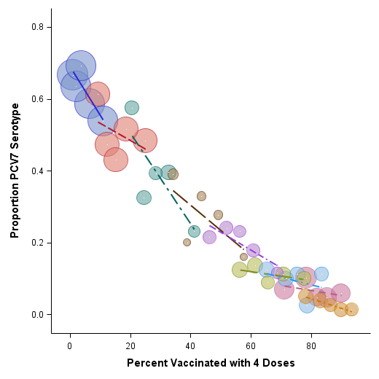
Indirect effect of PCVs vary with local variations in uptake
IPD in adults age 40+
2001
2002
2003
2004
2005
2006
2007
2008
Pingali et al, JID, 2016
2009
Higher vaccine uptake of the booster dose in kids is associated with greater declines in adults…
Sandy Pingali

Slide 28
Unexplained spatial variability in indirect effects
(B) Pre-vaccine level
Josh Warren
Proportion PCV serotypes
(C) Rate of decline
(A)Timing of change
Time
-These variations in adults not explained by variations in uptake, SES
-Role for commuting patterns?
Warren, Pingali, and Weinberger Epidemiology 2017

Slide 29
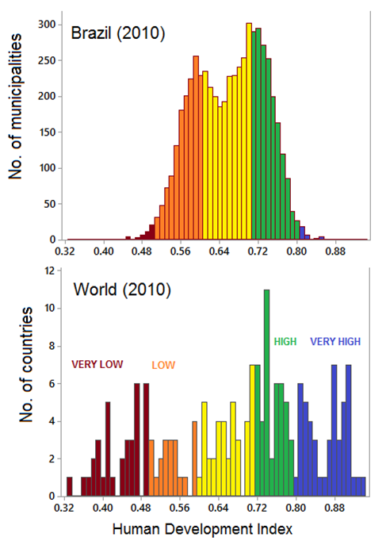
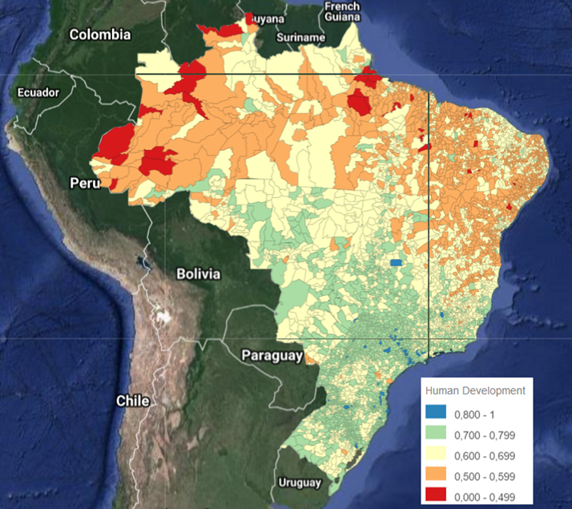
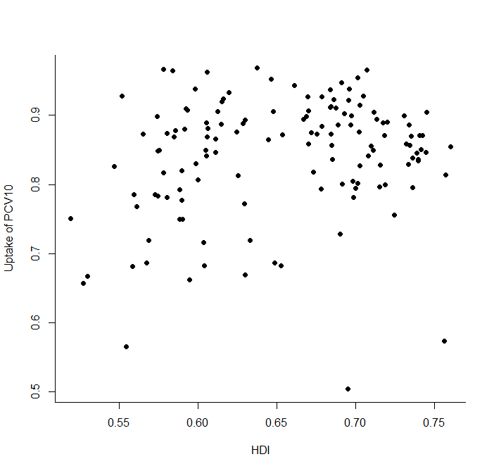
Human development by municipality in Brazil

Slide 30
Evaluating variability in PCV impact in Brazil
Classify the 5000+ municipalities by region and HDI
  Aggregate and analyse time series with synthetic controls
Spatial model linking vaccine uptake and rates of pneumonia in the 135 mesoregions

Slide 31
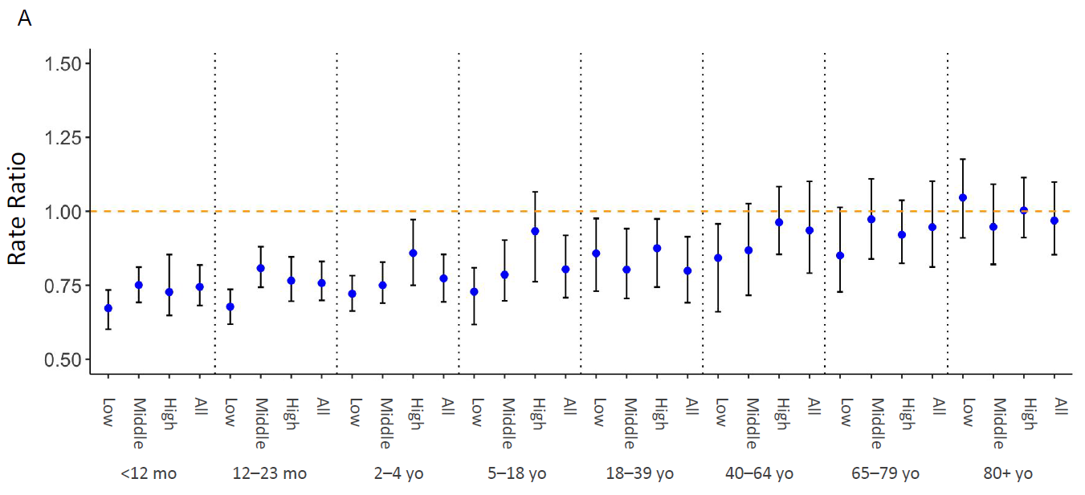
Declines in pneumonia are similar in low and high-development municipalities

Slide 32

Spatial model
$Y\left(s,t\right)|λ\left(s,t\right)\sim Poisson\left\{λ\left(s,t\right)\right\}$
$\ln\left\{λ\left(s,t\right)\right\}=x{\left(s,t\right)}^{T}γ+{\tilde{β}}_{0}\left(s\right)+w\left(s,t\right){\tilde{β}}_{1}\left(s\right)+θ\left(s,t\right)$
Covariates
Spatial-varying intercept
Spatially-varying vaccine effect
Random Intercept
CAR model
Intercept and slope are functions of HDI, region, and spatial component
Josh Warren

Slide 33
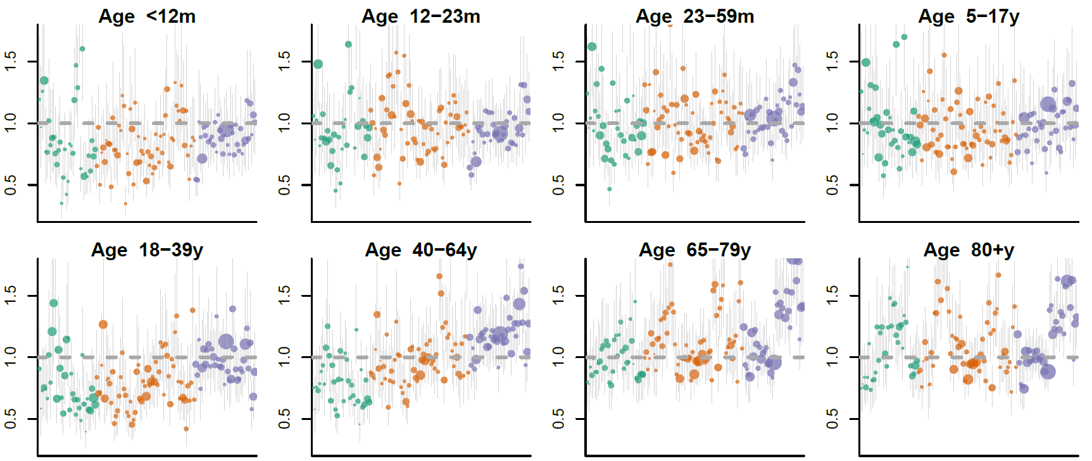
Estimated change associated with PCV10 by mesoregion
Residual bias?
-No significant difference by HDI, some apparent differences by region

Slide 34
What drives the regional effect and residual bias?
In one situation, sharp, unexplained shift in reported cases in 1 large city; biased all estimates for North region
  In Manaus pneumonia increases from 1600 to 3025 cases between 2008 and 2013, while ACH-noresp decreases from 7213 to 4557
Time series were very noisy, making signal detection difficult

Slide 35
Testing for residual bias
Randomly swap vaccine uptake trajectories among the mesoregions within a region
Repeat 50 times
If no bias, swapped effect estimate should be 0
Subtract estimate from real data from swapped estimates

Slide 36
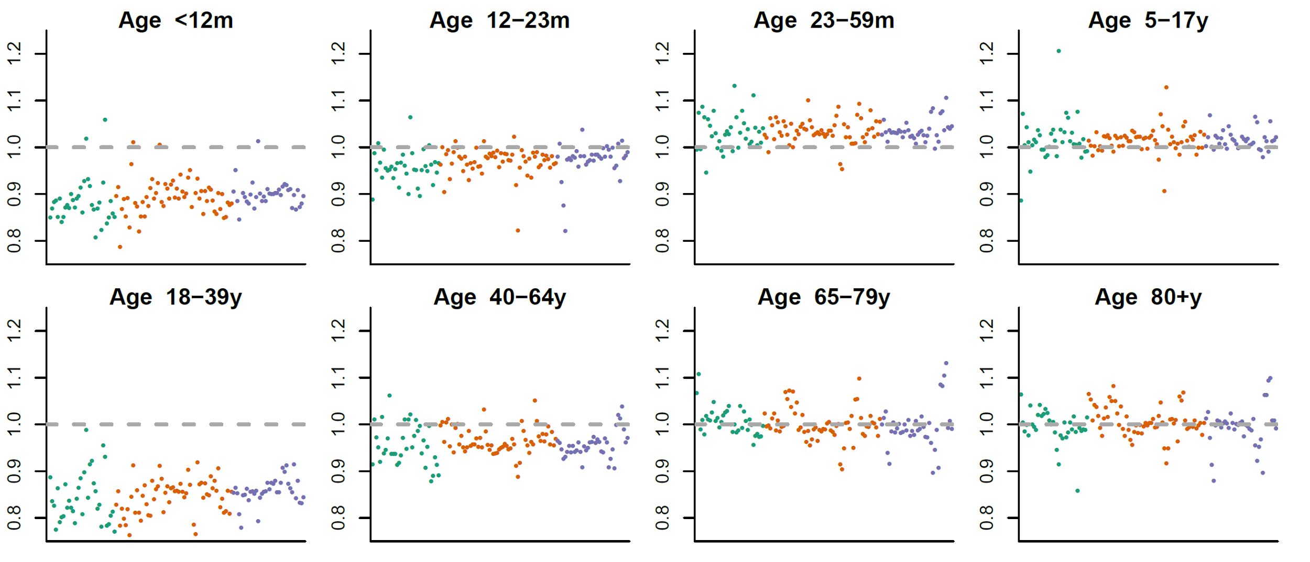
Changes by mesoregion, adjusted using swapped models
No major differences in impact by HDI, if anything, greater impact in low HDI

Slide 37
Conclusions on subnational analyses
At local scales (e.g. ZIP), detect variations in indirect effects
Vaccine effects against pneumonia do not vary by HDI
Better approaches to deal with noisy local data are needed
  Spatial synthetic control?

Slide 38
Outline for talk
Evaluating impact of PCVs using time series data
Evaluating local variations in the impact of PCVs
Evaluating effectiveness of dosing schedules

Slide 39
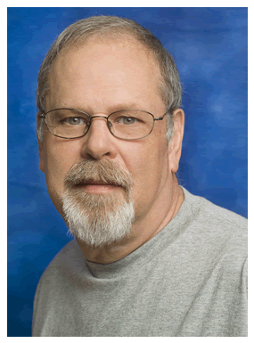
Evaluating effectiveness of different dosing schedules
Is 1+1 = 2+1 = 2+0 = 0+1 ?
Focus on natural variation during switchover from PCV7-PCV13
  Many children partially vaccinated with PCV7, then switch to PCV13
>10,000 nasal swabs from kids at ED in Southern Israel 2009-2016

Slide 40
Switchover from PCV7 to PCV13

Slide 41
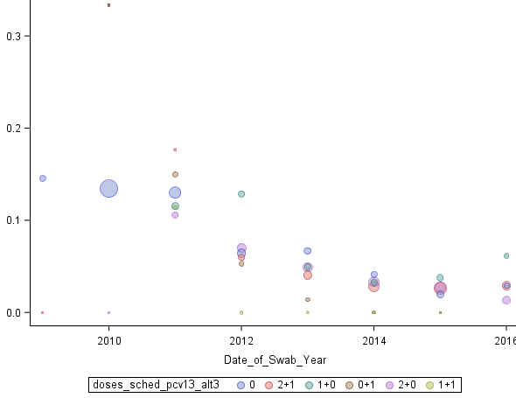
Prevalence of PCV13 serotypes by doses of PCV13 received
Prevalence

Slide 42
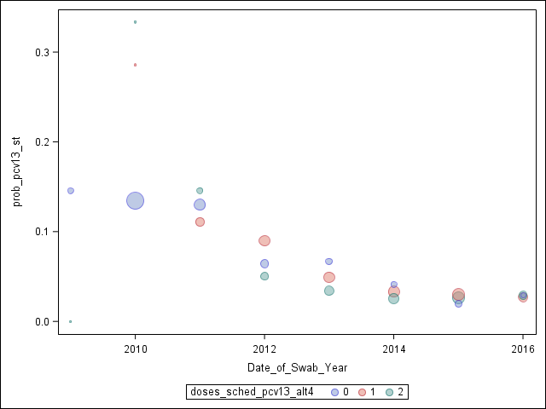
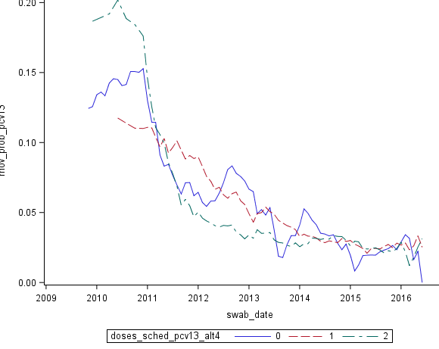
0 doses of PCV13 vs 1+0 or 2+0 vs 0+1 or 1+1 or 2+1
For 2012-2014, grp 2 different than 0

Slide 43
Conclusions on dosing
Too few kids in this study alone to assess dosing directly
  Potentially pooling data across studies would help
Kids with only primary doses of PCV13 (1+0 or 2+0) have carriage similar to unvaccinated kids;
  Kids with booster/catch up dose in second year have lower carriage

Slide 44
Overall conclusions on PCV impact
Synthetic controls can help disentangle vaccine effects
  Also provides more credible estimates across outcomes, countries
  Sensitivity analyses are crucial
  Clear effect of PCVs on all-cause pneumonia in kids, less clear in adults; effect on IPD in all age groups
Disaggregated data can help to detect and explore local variations in vaccine impact
Switchover from PCV7-13 might help to evaluate dosing questions

Slide 45
Looking to the future: synthesizing new data
Now lots of “good” data and estimates of PCVs for pneumonia, IPD, meningitis from different regions
This provides strong prior for future studies
New studies with weaker data could provide spurious findings
Synthesizing new studies with global database will help to improve new country-level estimates of impact
Global database/analysis tool
  Similar to MLST framework

Slide 46
Acknowledgments
Brazilian MoH
Roberto Men Fernandes
Chilean MoH
Rodrigo Fuentes
Ben-Gurion University
Ron Dagan
Noga Givon-Lavi
Kayoko Shioda
Esra Kurum
Christian Bruhn
Josh Warren
Sandy Pingali
George Washington University
Lone Simonsen (co-Investigator)
Sage Analytica
Cynthia Schuck Paim
Robert Taylor
Roger Lustig
Lone Simonsen
Josh Warren
Esra Kurum
Kayoko Shioda
Christian Bruhn
Cynthia Schuck Paim
Funding
Sandy Pingali

Slide 47
Changes in all-cause pneumonia 24-48m post-PCV:
Brazil, Chile, Ecuador, Mexico, US
Model without synthetic controls (adjust for non-respiratory hospitalizations)

Slide 48
Which disease categories contribute most to the synthetic control?
80+y
country.id | Brazil | Chile | Ecuador | Mexico
A10_B99_nopneumo | 0.0729 | 0.1057 | 0.0117 | 0.0626
A41 | 0.7246 | 0.1386 | 0.0234 | 0.0258
ach_noj | 0.1194 | 0.4934 | 0.9649 | 0.1014
C00_D48 | 0.07 | 0.9387 | 0.2425 | 0.0315
cJ20_J22 | 0.0175 | 0.015 | 0.6999 | 0.7706
D50_89 | 0.0488 | 0.2501 | 0.0158 | 0.0207
E00_99 | 0.079 | 0.0407 | 0.038 | 0.5002
E10_14 | 0.117 | 0.0358 | 0.0348 | 0.4404
E40_46 | 0.036 | NA | NA | NA
G00_99_SY | 0.021 | 0.0188 | 0.0178 | 0.023
H00_99_SY | 0.1805 | 0.0219 | 0.026 | 0.0328
I00_99 | 0.6292 | 0.608 | 0.051 | 0.0452
I60_64 | 0.1552 | 0.0323 | 0.0615 | 0.0248
K00_99 | 0.0535 | 0.0345 | 0.0621 | 0.0848
K35 | 0.0153 | 0.0122 | 0.03 | NA
K80 | 0.1365 | 0.0301 | 0.0212 | 0.0245
L00_99 | 0.1427 | 0.0347 | 0.0185 | 0.0411
M00_99 | 0.0306 | 0.0689 | 0.0359 | 0.0252
N00_99 | 0.0622 | 0.0474 | 0.0743 | 0.0334
N39 | 0.0869 | 0.0316 | 0.4343 | 0.0232
P00_99 | 0.015 | NA | NA | NA
pandemic | 0.0106 | 0.0304 | 0.0128 | NA
Q00_99 | 0.032 | NA | NA | NA
S00_T99 | 0.1006 | 0.034 | 0.0344 | 0.0562
Z00_99 | 0.0283 | 0.0116 | 0.031 | 0.0397
Some consistency in which controls receive most weight
Method allows for flexibility between age groups and locations

Slide 49
Resources for synthetic controls
Data and R scripts:
  https://github.com/weinbergerlab/synthetic-control
Point and click interface:
  https://weinbergerlab.shinyapps.io/synthetic_control_1/

Slide 50
Pneumococcal conjugate vaccines
-Target up to 13 serotypes (out of 90+)
-Protect against IPD and
pneumonia and colonization
-Disrupts transmission

