Slide 1
Quantifying Accessibility to Healthcare Facilities
Dan Weiss
Malaria Atlas Project
University of Oxford
Notes:
Somewhat of a placeholder title as I’m going to be talking about quantifying accessibility to any features or locations, heathcare facilities are just one example.

Slide 2
Definition of accessibility
For this talk accessibility = travel time
Alternate definitions exist
For example, lack of wealth could also limit access to healthcare
Notes:
I use accessibility and travel time interchangeably, so I want to be clear that there are other factors (not explored here) that limit people’s access

Slide 3
Presentation structure
Accessibility mapping overview
Accessibility to cities map
Example application – travel time to healthcare in Malawi
Making custom maps for your research – it’s easy!

Slide 4
Accessibility mapping overview
The time is takes to move between locations can be estimated with two factors:
The speed at which we move
The route we take
The speed at which we move can be mapped
Infrastructure, landcover, terrain, and water
The resulting map we call a friction surface
The travel time to a point of interest can be determined with an algorithm that finds the optimal path

Slide 5
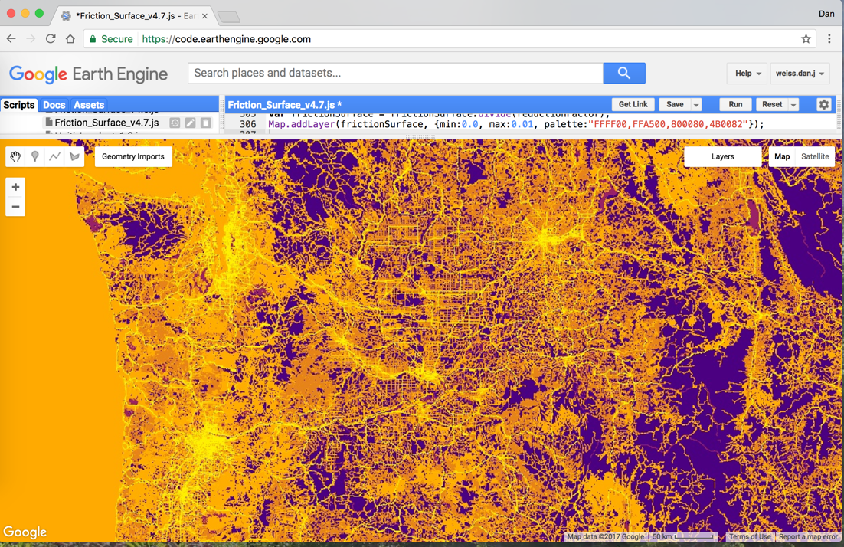
The friction surface
Constructed in Google Earth Engine
Inputs:
Roads (OSM and Google)
Railroads
Water features (rivers, lakes, and oceans)
International borders
Landcover
Topographic conditions (slope and elevation)
The resolution is ~1 km, which dictates the output resolution
This surface is publicly available
Notes:
Scale ranges from yellow (fastest movement) to purple (slowest movement). So here in Seattle it’s easy to move as there are roads everywhere. In the middle of the Olympic or North Cascade mountains, movement on anything be the roads is quite slow.
Of the input layers, the roads layer is the step-change. To my knowledge this remains the only global project that’s even brought together Google roads and OSM – which is particularly important in developing countries where digital geospatial datasets are less common.

Slide 6
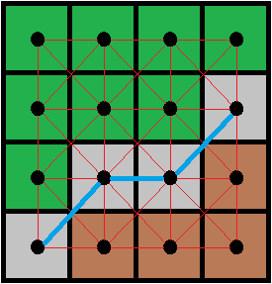
Least-cost-path algorithms
Originally designed to work in graphs, but we apply it in rasters
E.W. Dijkstra. 1959. A note on two problems in connexion with graphs. Numerische Mathematik
Distances calculated between adjacent point centroids
Platforms we use (and provide code for)
R via the Gdistance package (specifically the accumulated cost function)
Earth Engine with the cumulativeCost() function
Other details
Our system uses “great circle distance” for geographic coordinates (longitude and latitude)
Behind the scenes we converts units from degrees to meters
As such all cell values (costs) are rates per meter
Resulting travel time maps are in minutes
Notes:
Originally meant to work on graphs (the mathematical objects), but here we apply it to rasters.
In the cartoon imagine gray is a road, green is forest, and brown is a field – the fastest route is then along the road - this is all the algorithm is doing.
Can be done in R or GEE. Google coded this algorithm into GEE specially for this work, but it’s freely available to everyone.
This can theoretically be done in ArcGIS (Spatial Analyst function too), but not the way we’ve done it – that approach restricts users to projected data (as opposed to geographic)
Our methods takes lat-longs as input, does the math (behind the scenes in meters), and produces output in minutes.

Slide 7
Accessibility mapping caveats
Relative travel time only
Factors such as wealth are not considered
Does not consider timing of travel
Seasonal differences
Time of day differences
Surface travel only
Dominated by roads
Ignores air travel
Necessary abstractions
Water and rail travel not 100% realistic
Notes:
Assumes people move at a single (maximum) rate. This means that people are assumed to have a car in most cases and/or that public transport it instantly available (no waiting on busses)
Ignores flooding and rush hour
Air travel is very complex to consider, since even if we included airports, planes aren’t leaving constantly from all airports to all other airports.

Slide 8
Accessibility to cities map
Notes:
Project origin

Slide 9
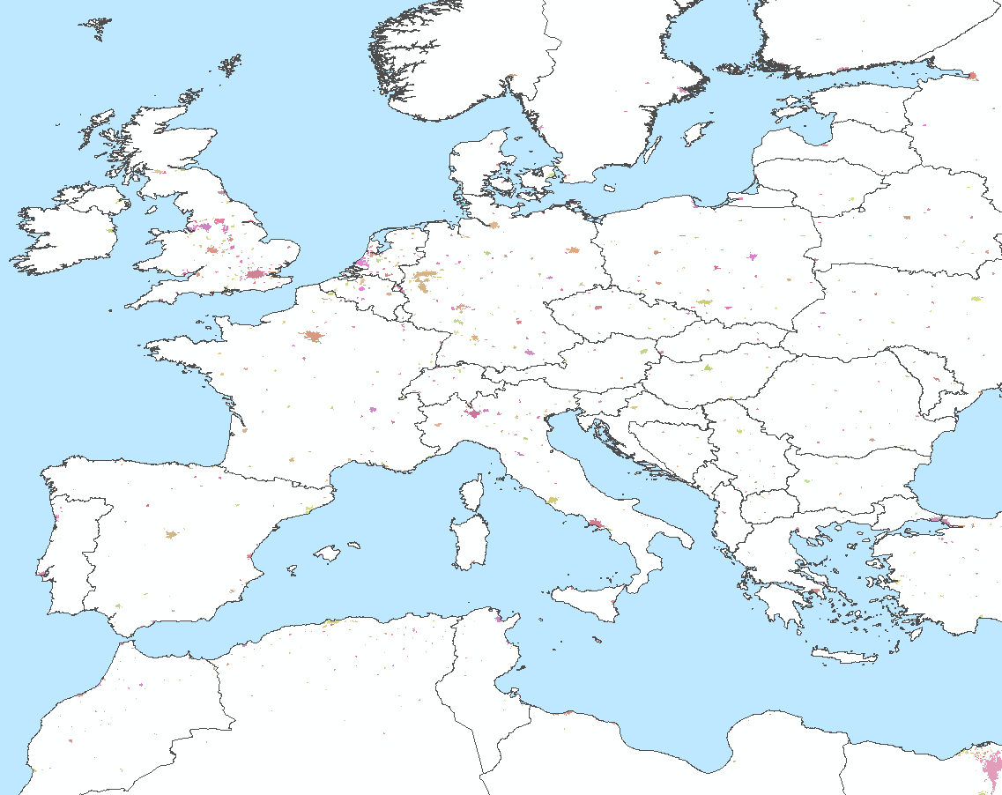
The city points
Any points with known X,Y coordinates can be used
We used the GHSL-HDC data
Required a raster-to-point conversion
13,840 cities (>400,000 points)
“Contiguous area with 1,500 or more inhabitants per square kilometer or a majority of built-up land cover coincident with a population center of at least 50,000 inhabitants”
Notes:
Just as there are many definitions of accessibility, there are many definitions of cities
We used data from an established project – but it’s noteworthy that GHSL doesn’t treat cities as points, but rather polygons (or clusters of pixels)
This is a better representation since cities aren’t points, however the system we made is still based on points because things like hospitals are points at a 1km resolution

Slide 10
Processing
Mosaic tiles from Earth Engine and R
28 tiles required for the global map (21 in Earth Engine and 7 in R)
Majority of the processing was in Earth Engine
Low latitudes
Densely populated areas such as eastern Asia and Europe
Where we needed R
High latitudes (>~55 degrees) including some overlap
Pixels in overlapping areas matched across platforms
International Date Line
Very remote islands beyond the Earth Engine search threshold limit
Notes:
Unfortunately this can’t be done (globally) in a single run. But for single countries (other than Russia, Canada, USA + Alaska) it’s doable

Slide 11
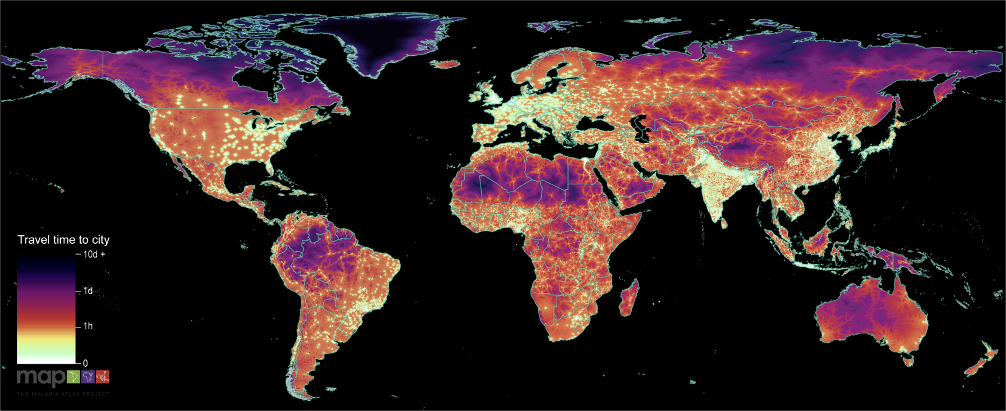
Resulting map
Weiss, D. J., et al. (2018). "A global map of travel time to cities to assess inequalities in accessibility in 2015." Nature 553: 333.
Notes:
Map shows both city density (notice how bright India and China are) and infrastructure (how ever then ‘remote’ areas of the US are fairly accessible)

Slide 12
Utility of travel time for disease mapping
Notes:
This is directly from the paper, but it shows why accessibility to cities is useful as a covariate – it’s directly associated with wealth (right), education (middle), and access to healthcare (right). These matter because malaria is predominately a disease of the rural poor. Illustrates why this map is such a useful covariate for our disease mapping work.

Slide 13
Malawi healthcare case study

Slide 14
Facility data
The Malawi Service Provision Assessment (SPA)
Conducted in June 2013-February 2014
Ministry of Health and the Demographic and Health Survey (DHS) Program
Includes facility locations and descriptions of services provided
Facility descriptions allowed us to differentiate those with emergency services for critically ill children
WHO Emergency Triage, Assessment and Treatment (ETAT)
Resulting points for accessibility mapping
977 total facilities
4 emergency equipped

Slide 15
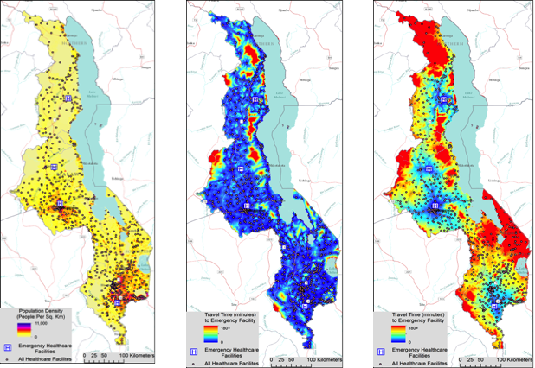
Travel time to healthcare in Malawi
Healthcare facilities from the DHS Malawi Service Provision Assessment (SPA)
Travel time maps
Any facility
Emergency care equipped facility
Notes:
Facilities on population density map (left)
Travel time to any facility (middle)
Travel time to facility equipped for emergency care of critically ill children

Slide 16
Population-level access to healthcare
Travel time maps can then be intersected with population surfaces
Illustrates disparities in access
Percentage of the Malawi population living within different travel times to the nearest health care facility and emergency-equipped hospital 2013-2014
Notes:
Highlighting the problem of poor access in an emergency. Only 11% of the population is within 30 minutes of an emergency equipped facility. Many theoretical solutions to this, but some not practical (e.g., massive infrastructure investment in new roads). Meanwhile expanding services provided by already existing facilities would help a lot, and with accessibility mapping we can help define which facility (if upgraded) would help the most people.

Slide 17
Making custom maps
Notes:
I promise it’s easier than you assume it to be

Slide 18
Getting started
https://map.ox.ac.uk/research-project/accessibility_to_cities/
Notes:
Google malaria atlas project and accessibility
At the bottom of this page are links to the data and code required to make your own maps

Slide 19
Map making options
You supply a table of locations of interest (X & Y coordinates)
The friction surface and code are available on the MAP website
Generate maps in Google Earth Engine (friction surface here too)
https://map.ox.ac.uk/wp-content/uploads/accessibility/Earth_Engine_generic_accessibilty_mapping_script.js
Generate maps using R
https://map.ox.ac.uk/wp-content/uploads/accessibility/R_generic_accessibilty_mapping_script.r
Great “how to” guide: https://medium.com/@abertozz/mapping-travel-times-with-malariaatlas-and-friction-surfaces-f4960f584f08
Generate maps using our online platform
https://access-mapper.appspot.com/
Notes:
The recipe is to take a table of points you have (or can create), download the friction surface, and run code we provide (which is well commented).

Slide 20
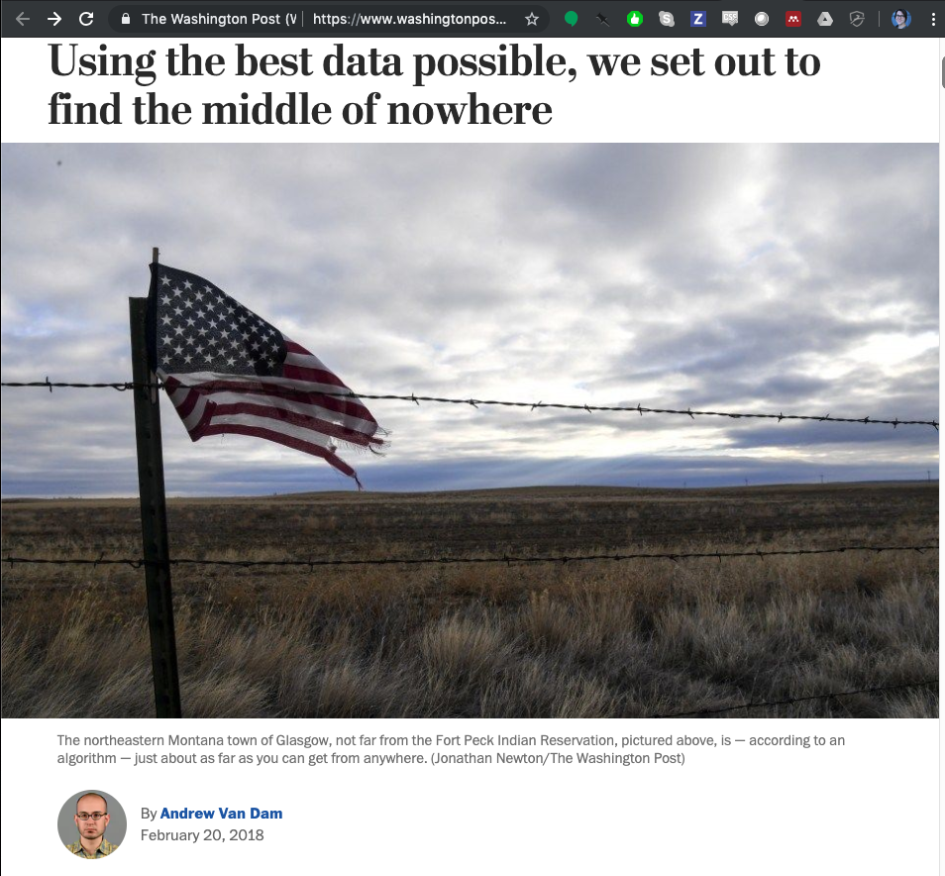
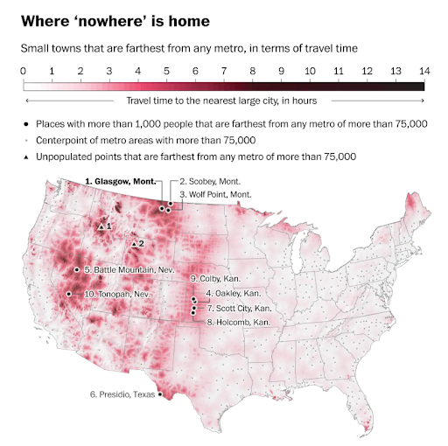
Do it yourself example
Notes:
A journalist (not a scientist) made this map, fairly sure he downloaded R for the first time to do so. Found a table of points. Applied our code, and made this map. Published in the Washington Post.

Slide 21
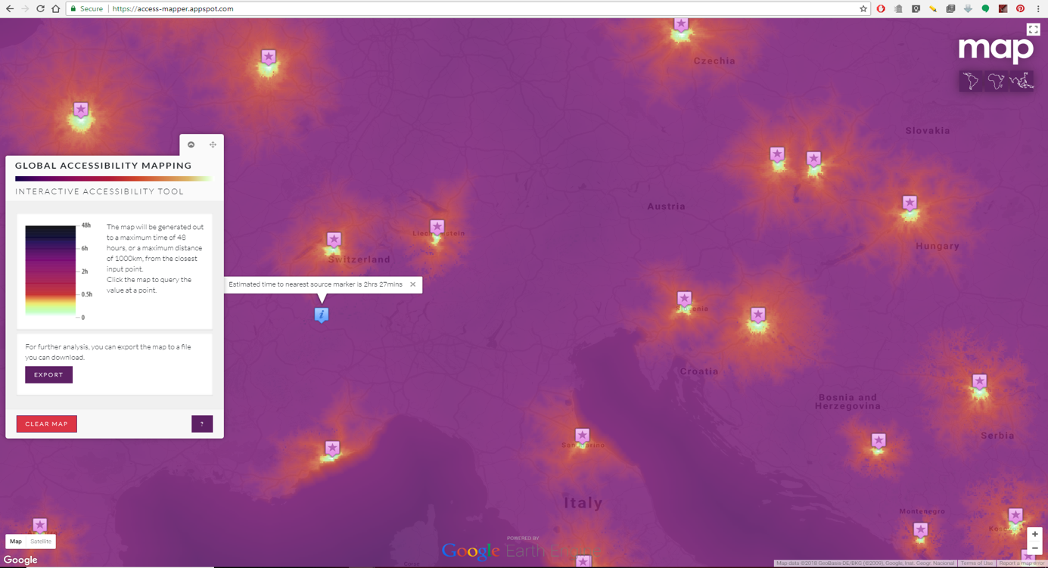
Easiest solution – our online tool
Generate maps using our online platform
https://access-mapper.appspot.com/
Notes:
In this case you just upload the points as a table, click go, and wait a bit. There’s actually a lot of computation happening behind the scenes (all free to you!), and then result show up onscreen (with a link to a downloadable .tif sent to your email).

Slide 22
Examples of how we use this work at MAP
Travel time to cities is a gridded covariate in our disease models
Correlated with numerous metrics of human wellbeing
Input for modeling malaria parasite rate and incidence (core MAP business)
Input for modeling treatment seeking at the pixel level
Used to adjust reported malaria case counts in many countries
Untreated cases are an input into our mortality models
Friction surface is used in catchment modeling
Linking people probabilistically to the healthcare facility they visit
Friction surface has been used for recommending optimal facility placement
Future accessibility in South America upon completion of planned infrastructure
Notes:
Travel time to cities basically a covariate in all of our models because it’s one of the best (and few) metrics we have on human wellbeing
Catchment modeling it so determine the denominator population
Optimal placement project to identify areas where facilities could help the greatest number of malaria cases that currently have more than a 2-hour travel time to a facility.

Slide 23
Collaborative possibilities
Come speak with me if you’re interested in novel use cases
Additional variants are possible via collaboration
The ‘walking only’ friction surface
Notes:
Malawi work started with someone reaching out to me, as did the South America infrastructure work (International center for tropical agriculture). Similar story about another project on breast-cancer screening services in Australia. Among a few others.

Slide 24
Thanks
Accessibility to Cities Project
Ali Lieber, Matt Hancher, and Eduardo Poyart (Google)
Andy Nelson (University or Twente, Netherlands)
Steve Peedell and Will Temperley (JRC)
Harry Gibson, Jen Rozier, and the rest of the team at MAP
Malawi Project
Emily White Johansson (Uppsala University, Sweden)
Cecilia Lindsjö (Karolinska Institutet, Sweden)
Humphreys Nsona (Ministry of Health, Malawi)
Katarina Ekholm Selling (Uppsala University, Sweden)
Norman Lufesi (Ministry of Health, Malawi)
Helena Hildenwall (Karolinska Institutet, Sweden)

