Slide 1
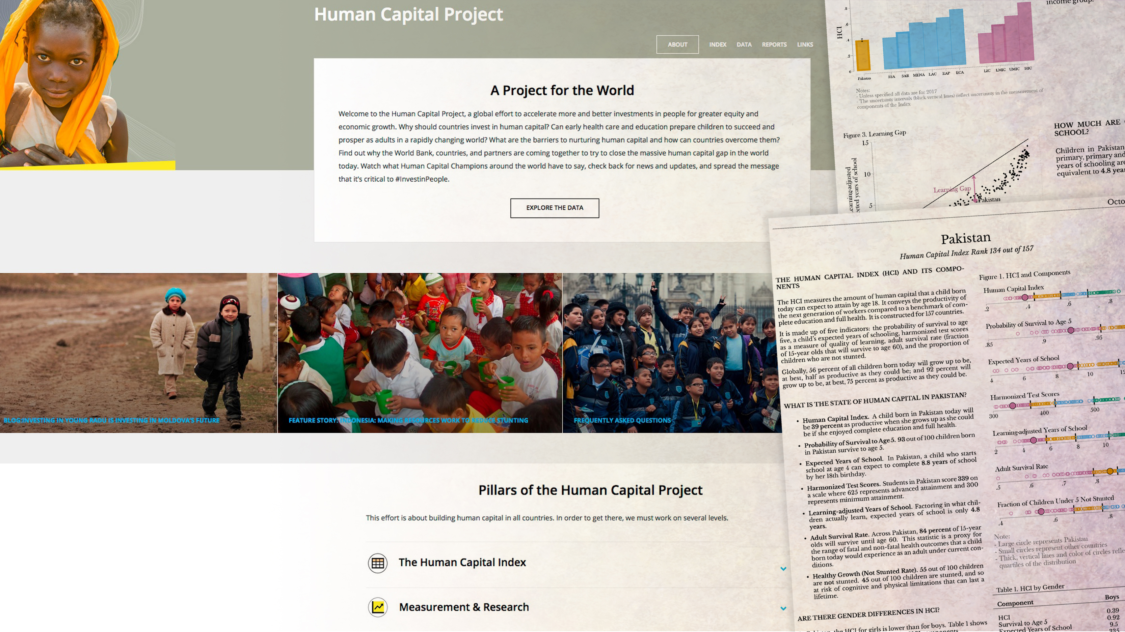


Applying Data Science, Machine Learning and
Artificial Intelligence in
Health and Human Capital

Slide 2
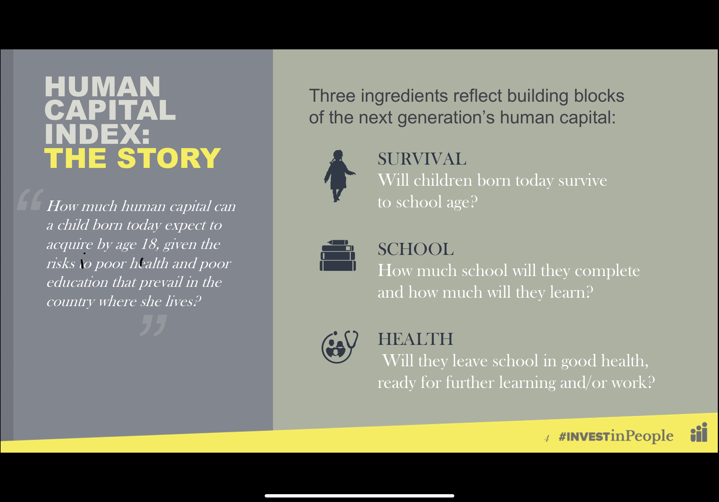

Slide 3
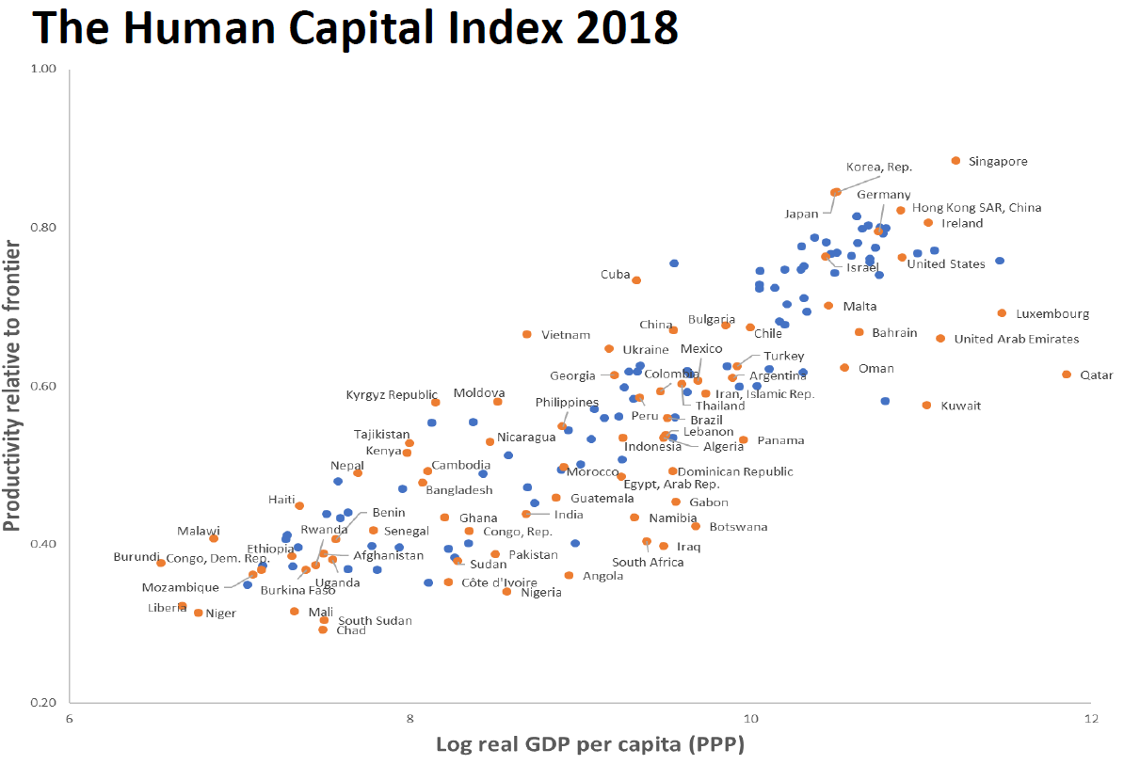

Slide 4

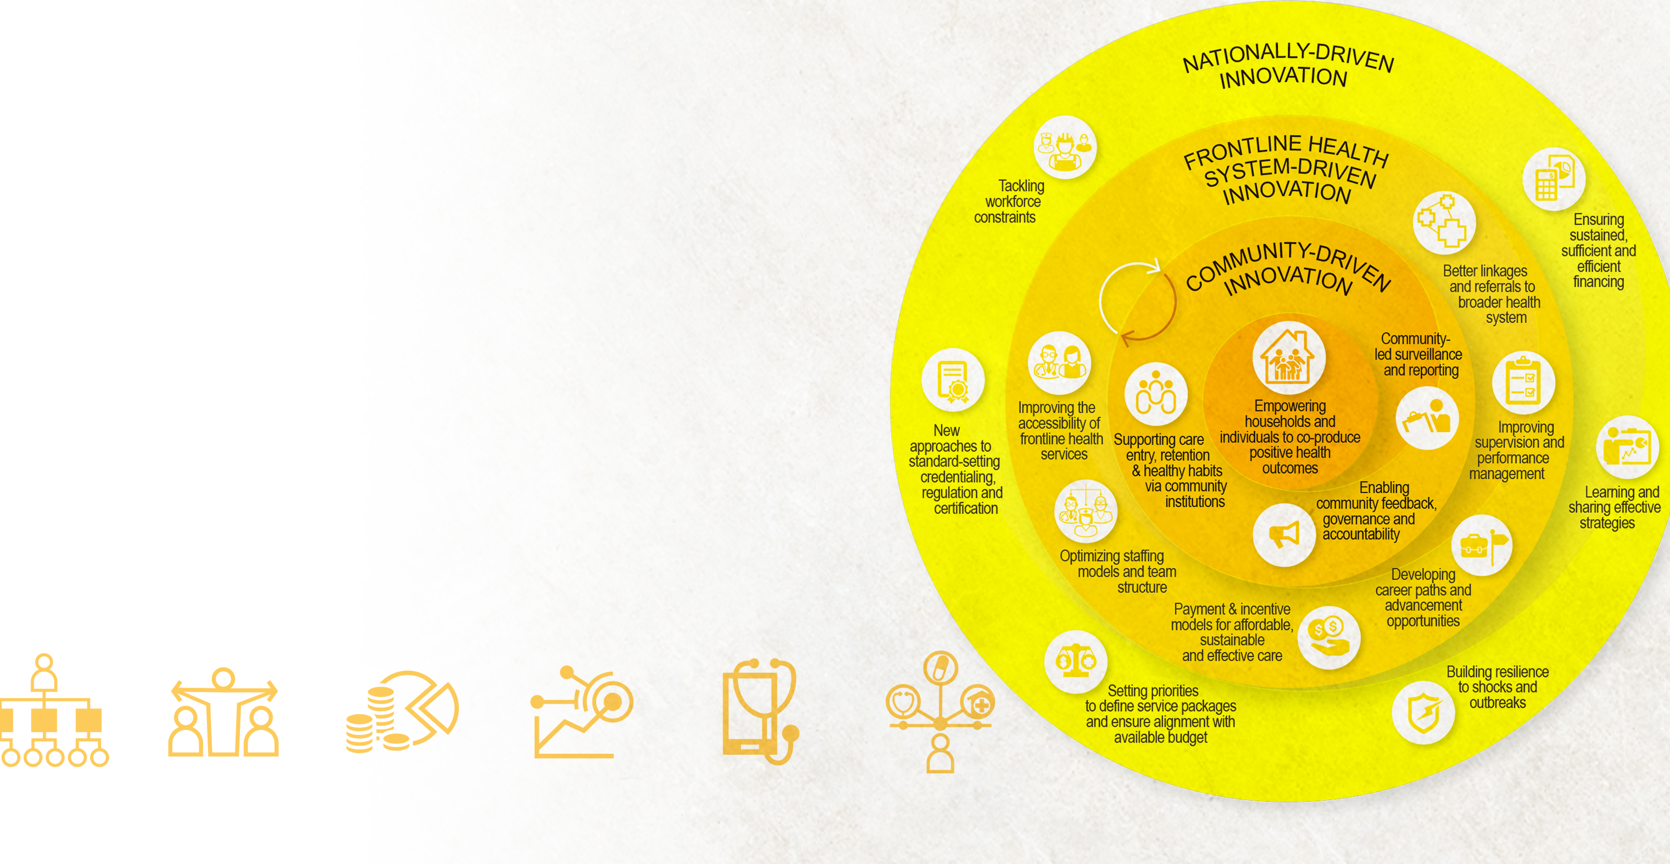

Criteria to assess innovation
Criteria include evidence of:
i) Robust impact
ii) Simplest feasible option with comparable impact
iii) Readiness across country income/capacity ranges
iv) Scalability
v) Rapid development potential

Slide 5
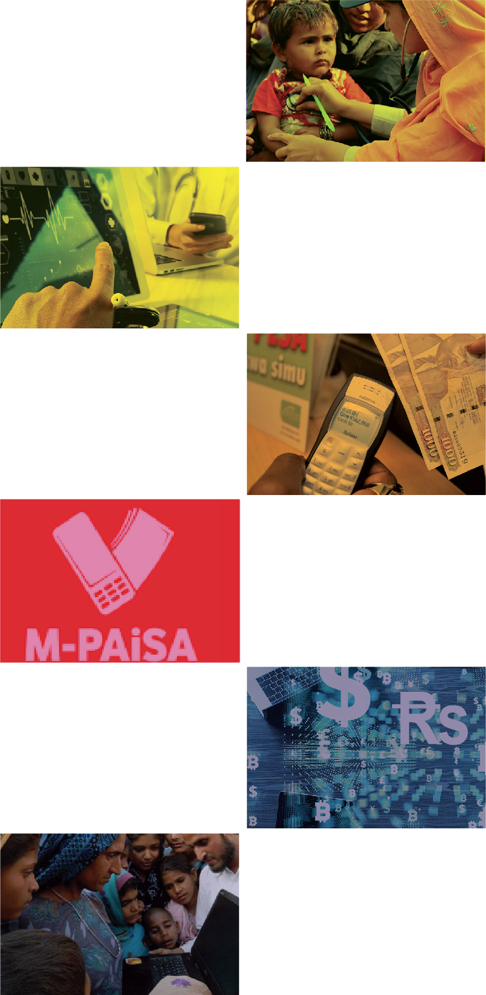
A systems framework for innovation
Right
AREAS
Location science to target disease burden and match services to needs—examples in outbreaks, infectious diseases, immunization, maternal and child health
Right
PREDICTION
Predictive analytics to target and match services to highest priority beneficiaries
Right
ACCESS
Increase financial inclusion through cashless mobile money—M-Pesa reaches 93% of Kenyans, processes 49% of GDP and included 2 billion transactions in the last year
Right
RECIPIENT
Reduce diversion through verifiable mobile payments—M-PAiSA increased Afghan police take-home salaries by nearly 40%
Right
PAYMENT
Cut RBF verification costs through automated machine learning
Right
JOB AIDS
Technology-enabled job aids to increase skills of health teams, especially frontline workers. India’s World Bank-supported Poshan Abiyhaan is world’s largest public sector tech-innovation with 1.1 million smart devices distributed to frontline workers

Slide 6
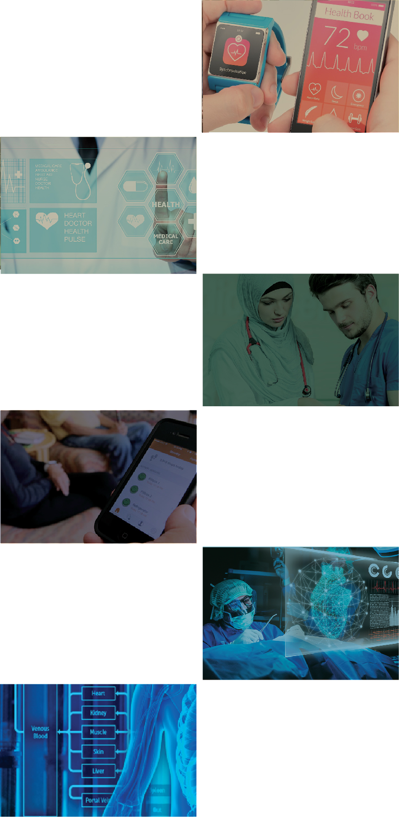
A systems framework for innovation
Right
CHOICES
Informed health choices that promote health through active engagement of consumers in their own health. Reduced health and life insurance rates for fitness band monitored exercise goals. Data-enabled NCD adherence devices
Right
SERVICES
Evidence-based services to maximize health. Informatic-enabled integrated patient care reduced diabetes-related amputations by a third in Scotland and lung disease hospitalization by half in Finland
Right
PROVIDER
Artificial intelligence can match people to the right health providers in the right
settings for the best health outcomes
Right
VALUE
Technology solutions to enhance value by reducing cost at the same or better quality. Examples: health teams supported by cloud enabled decision tools; sensor-equipped AI remote smart-home monitoring of seniors’ movements, eating and adverse events (such as falls or strokes)
Right
MEASUREMENT
Powerful examples of using innovations to strengthen performance measurement
Right
INNOVATION
Innovation to accelerate R&D productivity in discovery, development and safety. Pharmaceutical development is being accelerated by better predictive modeling, expanded (social media) yet better targeting (genetic) trials and real time safety monitoring

Slide 7

Right
AREAS
LOCATION SCIENCE

Slide 8

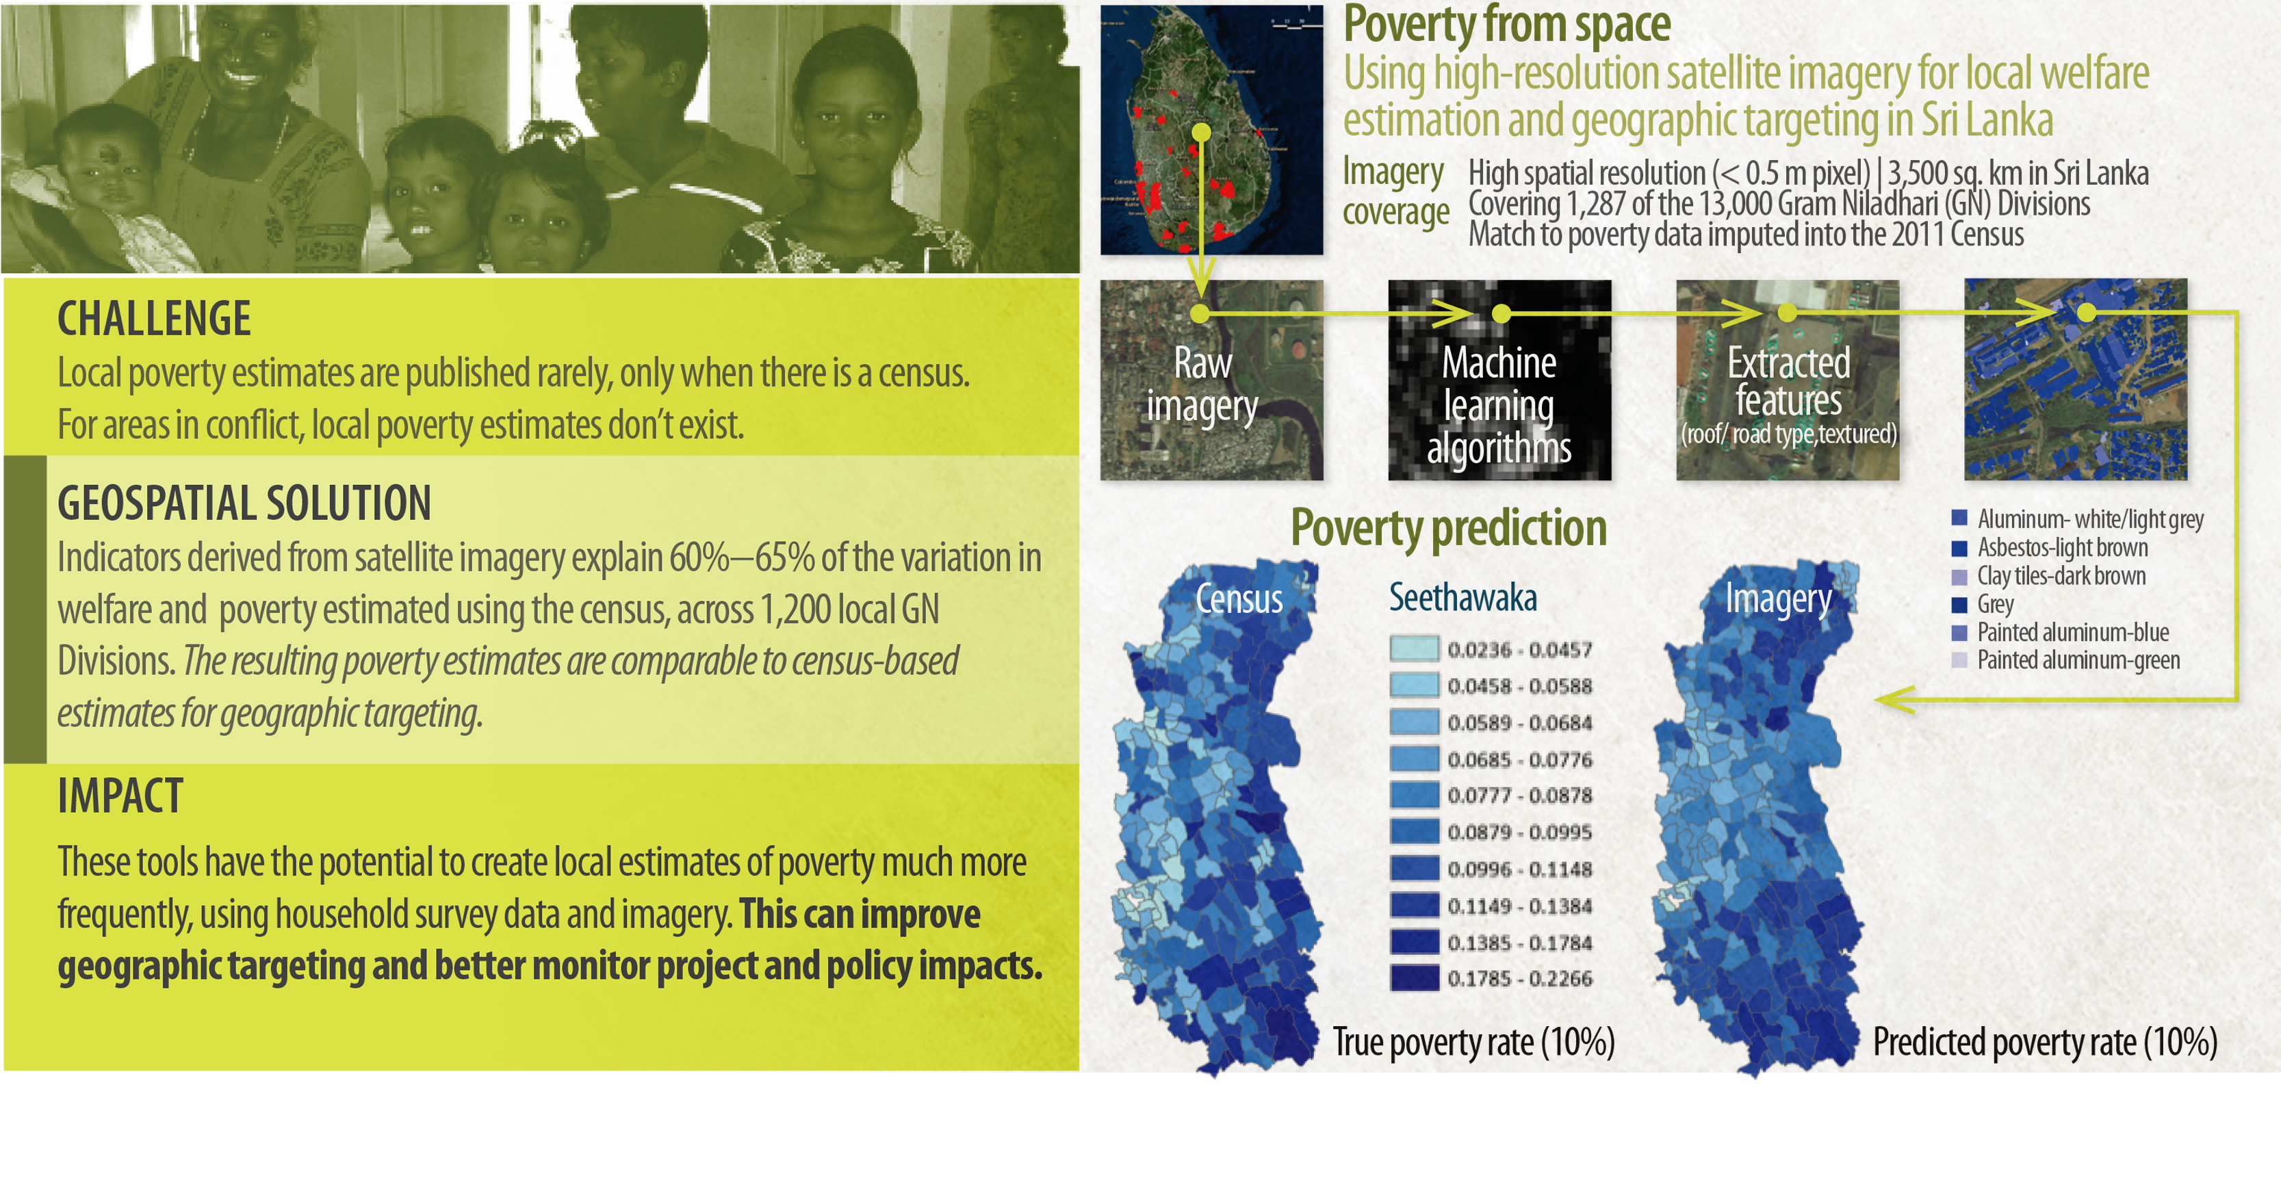
Poverty mapping for welfare targeting in Sri Lanka
Source: Ryan Engstrom, Jonathan Hersh, David Newhouse | Sri Lanka Poverty Team, Poverty and Equity Global Practice

Slide 9
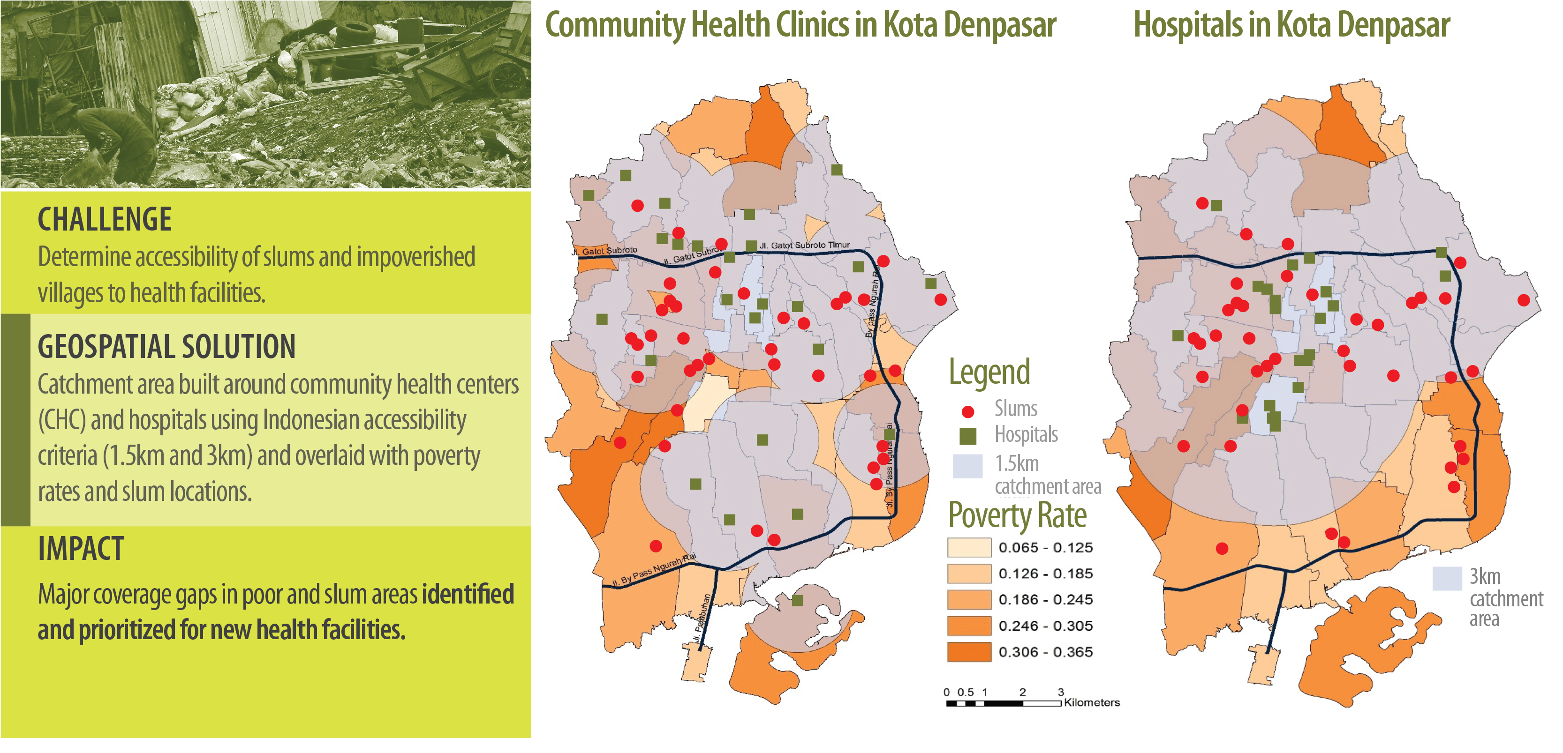
Expanding access in poor and slum areas in Indonesia

Slide 10
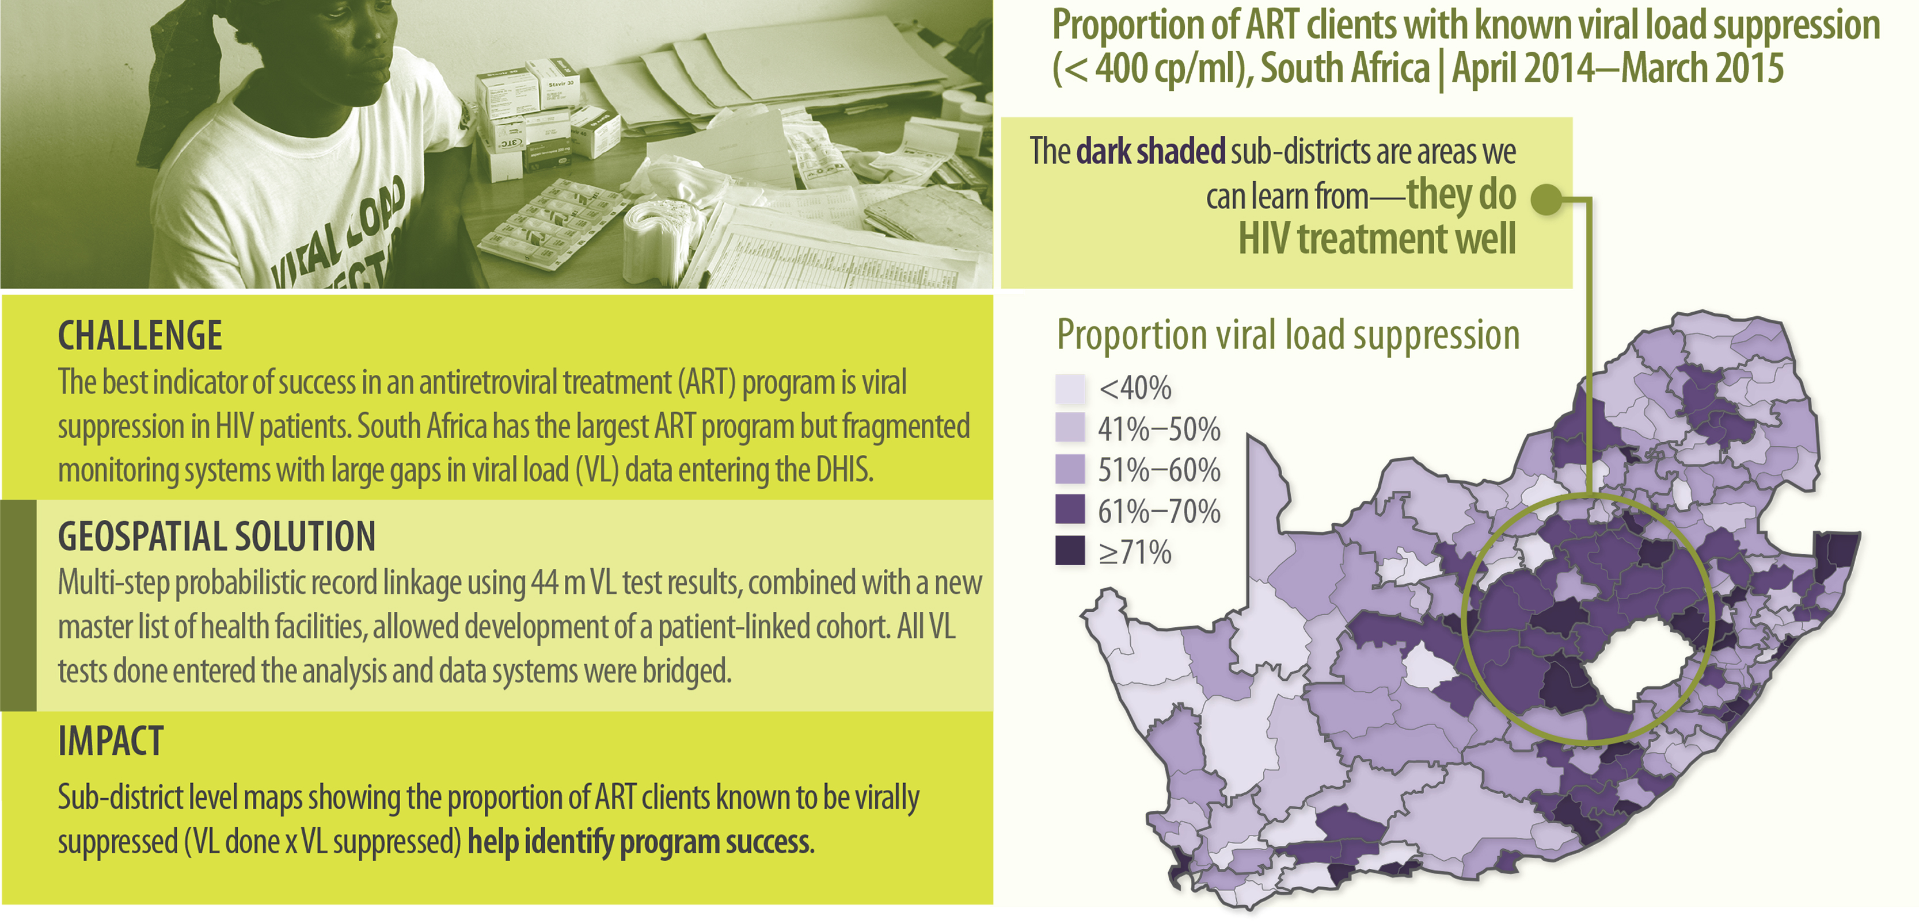
Location Science: AIDS treatment performance in South Africa

Slide 11

Right
PREDICTION
PREDICTIVE ANALYSIS

Slide 12
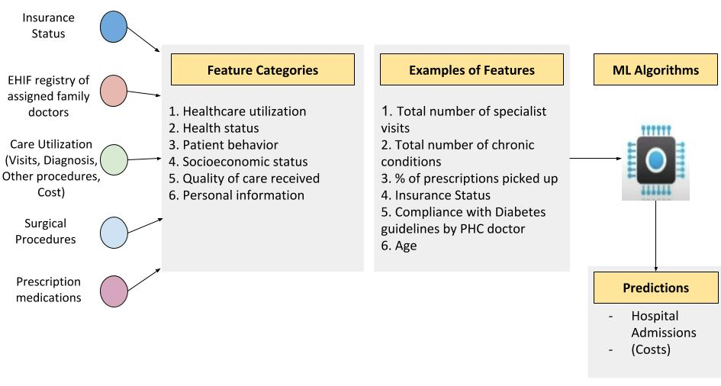
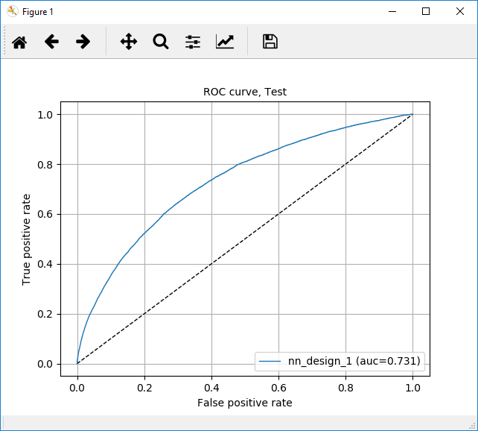
Predicting hospital admissions in Estonia – physician or AI?
Performance of ML models promising
Initially, compared 9 ML algorithms: best algorithm beat the physician recommendation on precision (minimizing false positives), but not recall (minimizing false negatives)
Partially because of challenge of imbalanced classes
Added neural networks
With neural network model recall improved to 69% and precision is 13% (outperforming the physician decision tree on both precision and recall)

Slide 13

Right
ACCESS
FINANCIAL INCLUSION

Slide 14

Financial inclusion through mobile money
Kenya’s pacesetter M-Pesa reaches 93% of Kenyans, processes 49% of GDP and conducted 2 billion transactions in 2018
In Pakistan, with a formal banking penetration of 12–14%, Pakistan’s Easypaisa mobile banking service has grown exponentially since 2009, becoming the world’s third largest mobile bank, serving 18 million people
India’s M-Pesa slow uptake, with 3 million clients and 300,000 active users
Key differences regulatory:
India regulates M-Pesa as bank, not money transfer service, requiring same steps needed to open bank account and posing same challenges for 40% unbanked.
In contrast, Kenya and Pakistan streamline enrolment and both governments use service for disbursements, including salaries and income and education payments

Slide 15
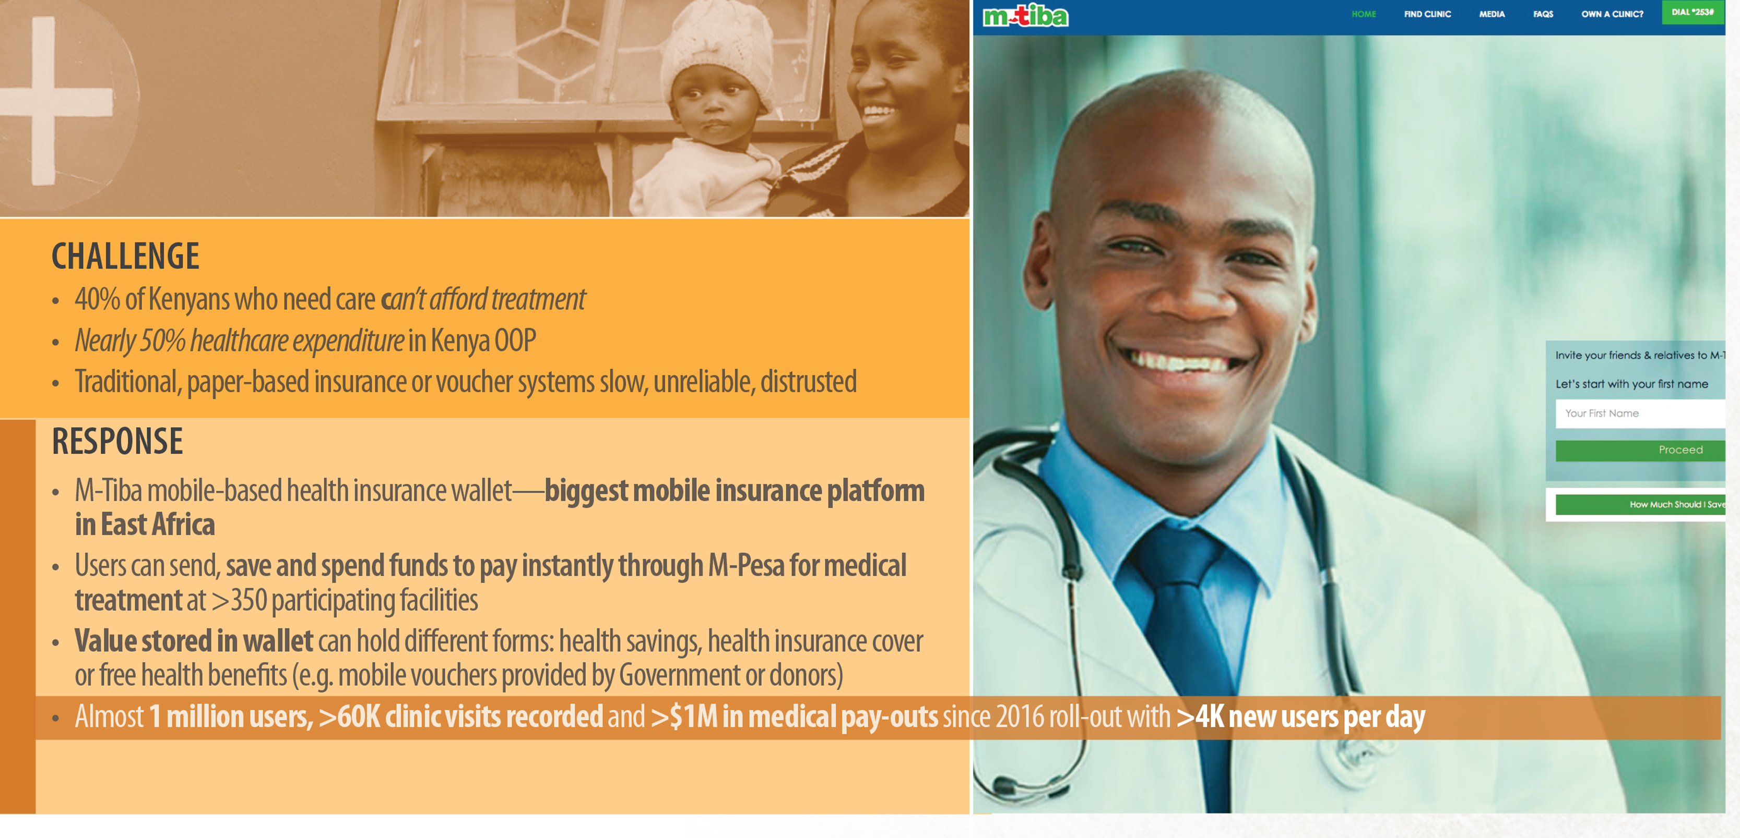
Mobile money health insurance in Kenya

Slide 16

Right
RECIPIENT
DIGITAL VERIFICATION

Slide 17

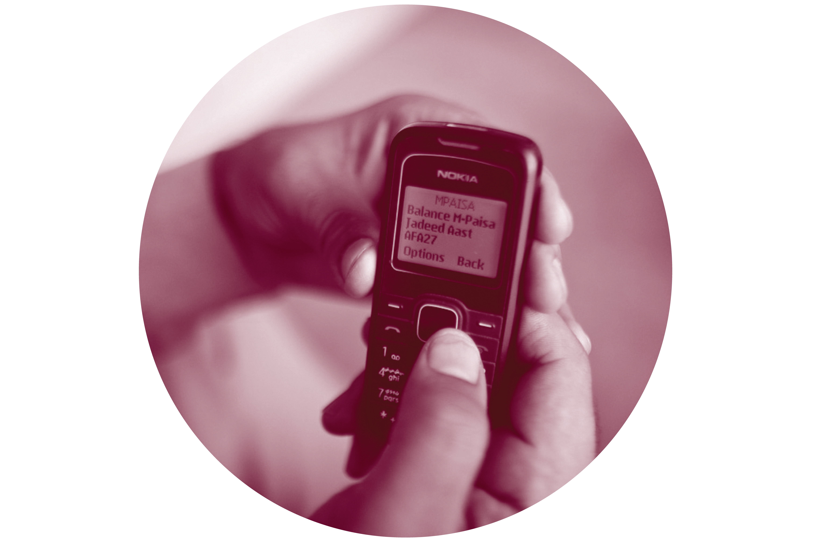

Reduce diversion through electronic/mobile payments
In Afghanistan, M-Paisa increased Afghan police take-home salaries by a third (leading at least one commander to attempt to confiscate SIM cards)

Slide 18

Right
PAYMENTS
MACHINE LEARNING

Slide 19
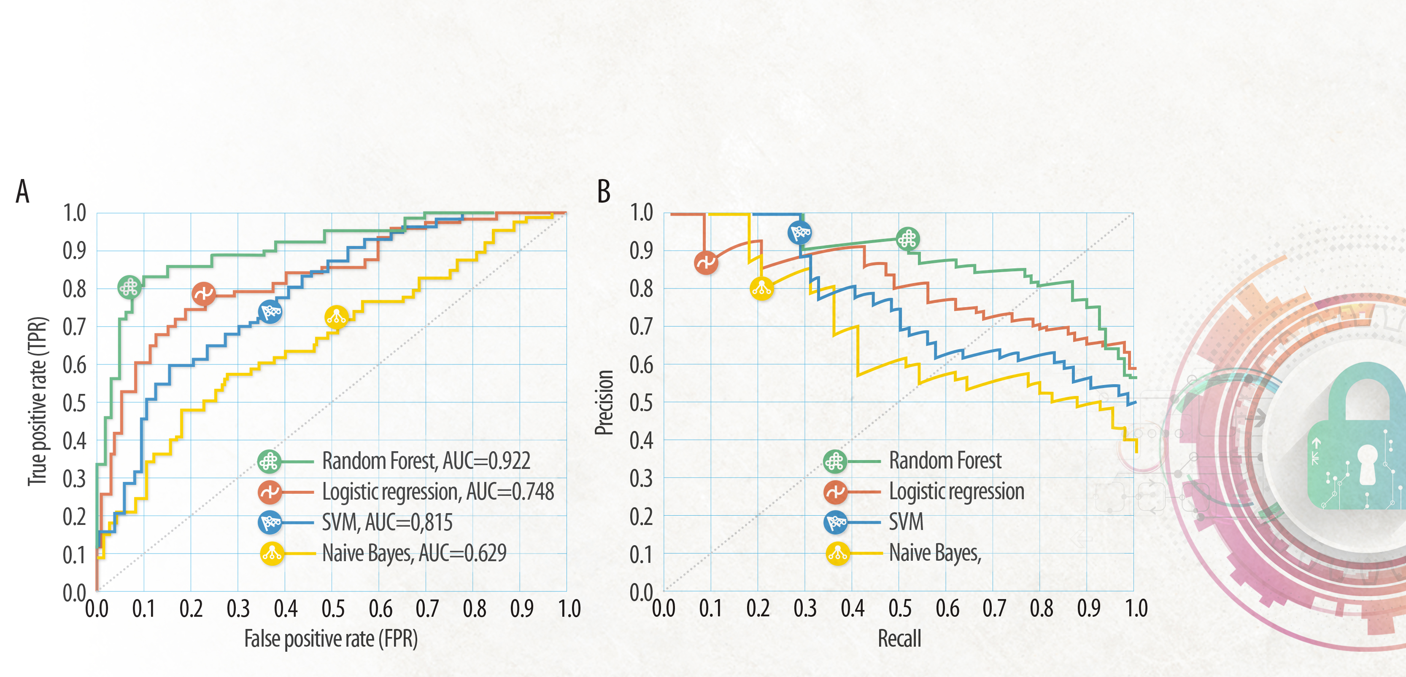
Machine Learning/Artificial Intelligence for fraud prevention
The Centers for Medicare and Medicaid Services in the U.S. saved over $210M in just a year using AI fraud detection methods
In Zambia, a World Bank team showed machine learning approaches, particularly Random Forest, outperformed other fraud detection approaches and increase the cost-effectiveness of verification

Slide 20

Right
JOB AIDS
INNOVATION ACCESS

Slide 21
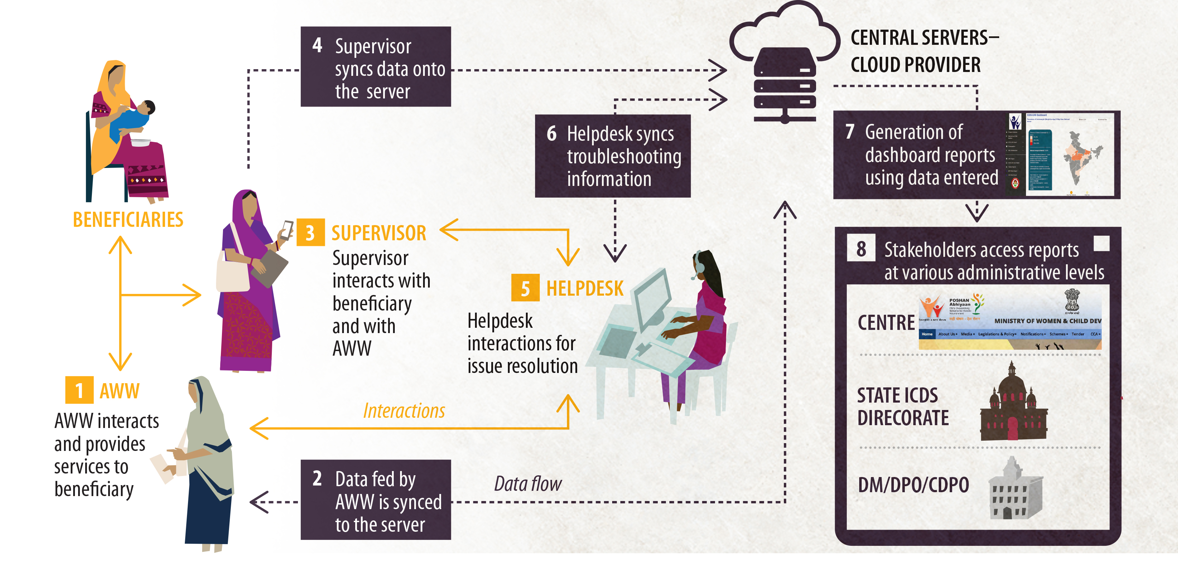
POSHAN Abhiyaan nutrition job aids in India
Scan QR code to access “energized” textbooks with extra content

Slide 22

Right
CHOICES
DATA DRIVEN CHOICES

Slide 23

Data-enabled management
Exercise adherence
  Several health and life insurers including pioneering Discovery Health in South Africa offer discounts for wearing linked fitness band, further discounts for meeting exercise and heart rate targets—and provide individually tailored health advice
Diabetes adherence
  US Virta diabetes smartphone app monitors glucose, weight, blood pressure, activity diet, energy and mood and provides individually tailored patient management, enabling 87% of patients to reduce or eliminate insulin – matching highly invasive bariatric surgery. Such apps could reduce US diabetes costs by $100 million annually
Emergency management
India Cicer (ten 3T Healthcare) wearable device integrates electronic, biological and chemical sensors for real time monitoring (ECG, respiration, pulse, temperature) supported by predictive analytics inside and outside hospital- streams real-time information/alerts to doctors/nurses devices

Slide 24

Right
SERVICES AND PROVIDER

Slide 25
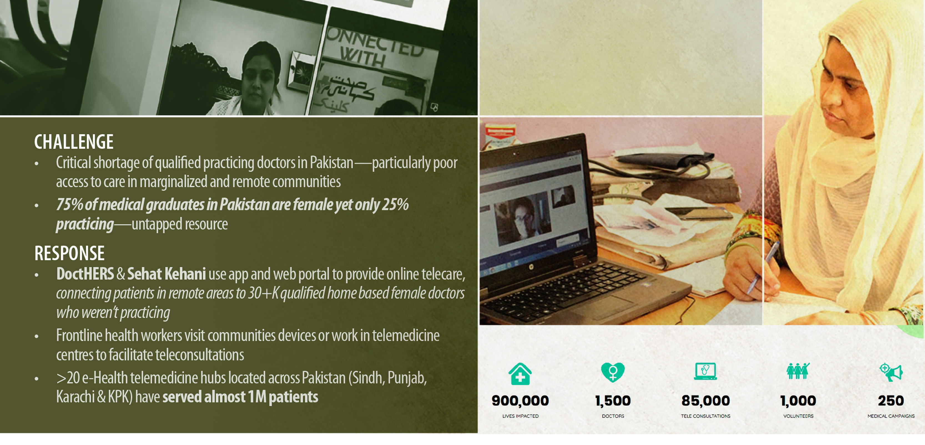
Telemedicine in Pakstan for inclusive employment and access to quality care for underserved communities
Scan QR code to access “energized” textbooks with extra content

Slide 26

Right
VALUE
TECHNOLOGY SOLUTIONS

Slide 27
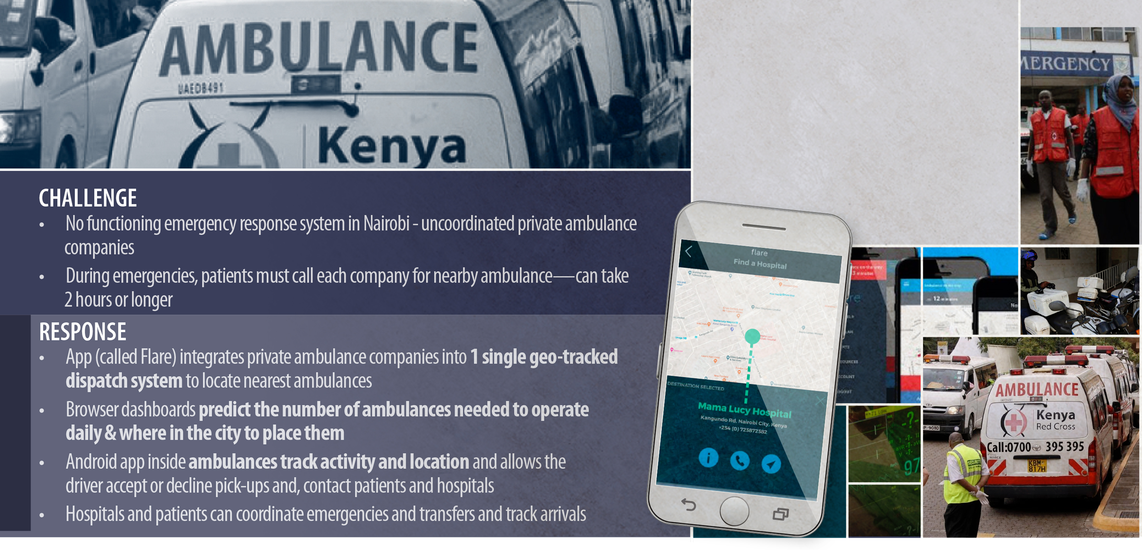
Kenya’s “UBER-ambulance” for emergency transport
During dusitD2 hotel siege, the
first Flare ambulance was on the scene in 12 minutes
“Flare was telling us what is happening, how to position our ambulances, how to evacuate, how to ask for additional resources.”
Ambulance fleet manager during siege

Slide 28

Right
MEASUREMENT
PERFORMANCE INNOVATION

Slide 29
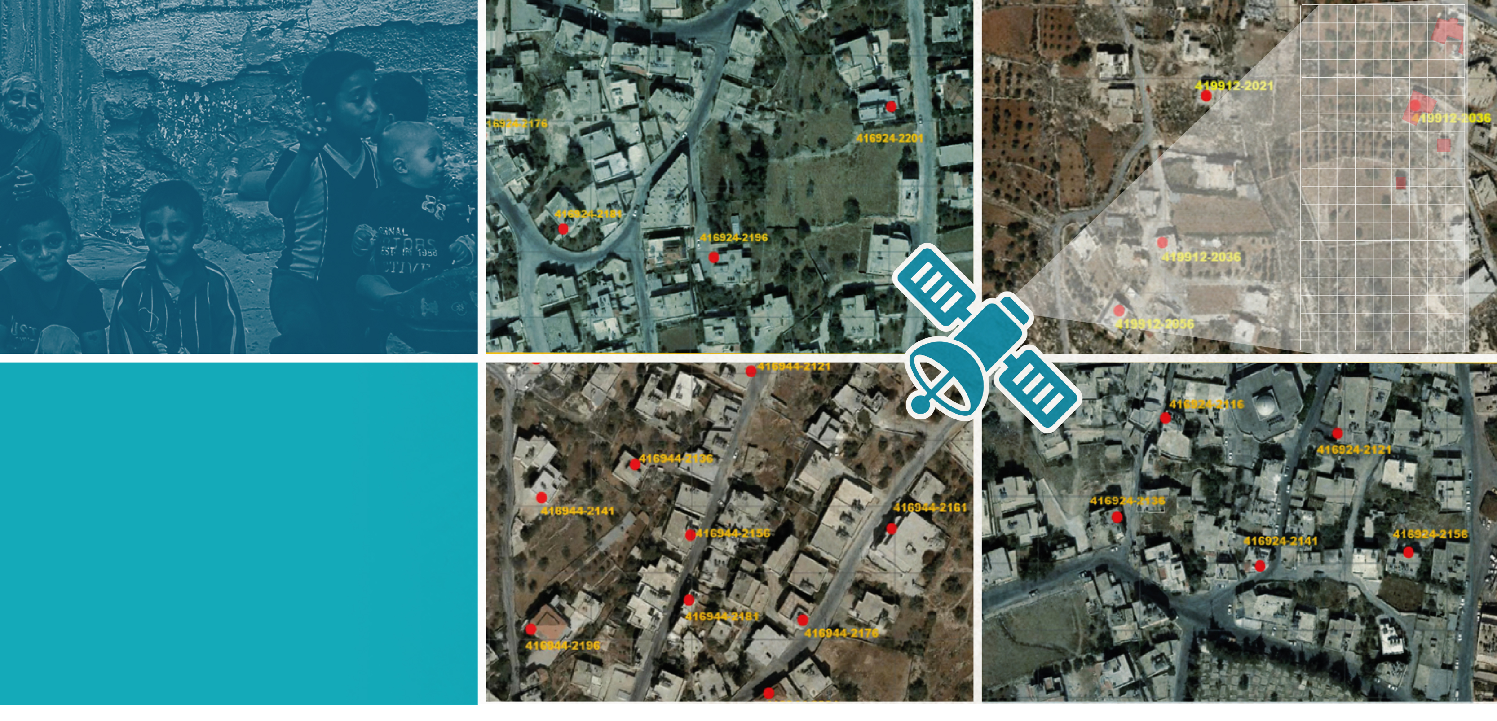
Satellite remote sensing sampling frame for survey in West Bank and Gaza
Used satellite remote sensing to rapidly construct sampling frame for representative survey of 12,000 households in West Bank and Gaza

Slide 30
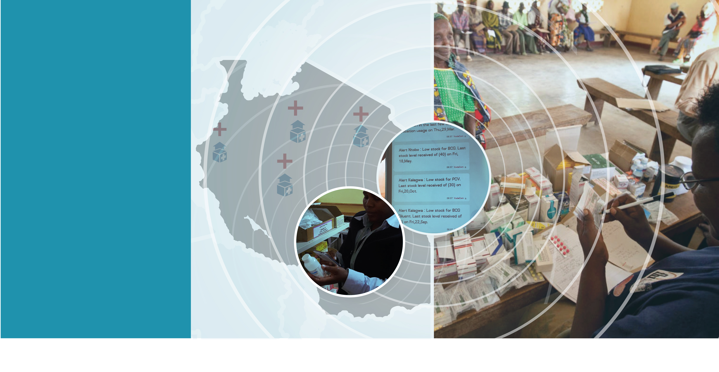
Command centre to reduce stockouts in Tanzania
In Tanzania, an SMS system to report drug
stock-outs to a
GIS-enabled central command centre rapidly halved drug stock-outs.
Image source: Access to medicine index, Novartis Foundation

Slide 31
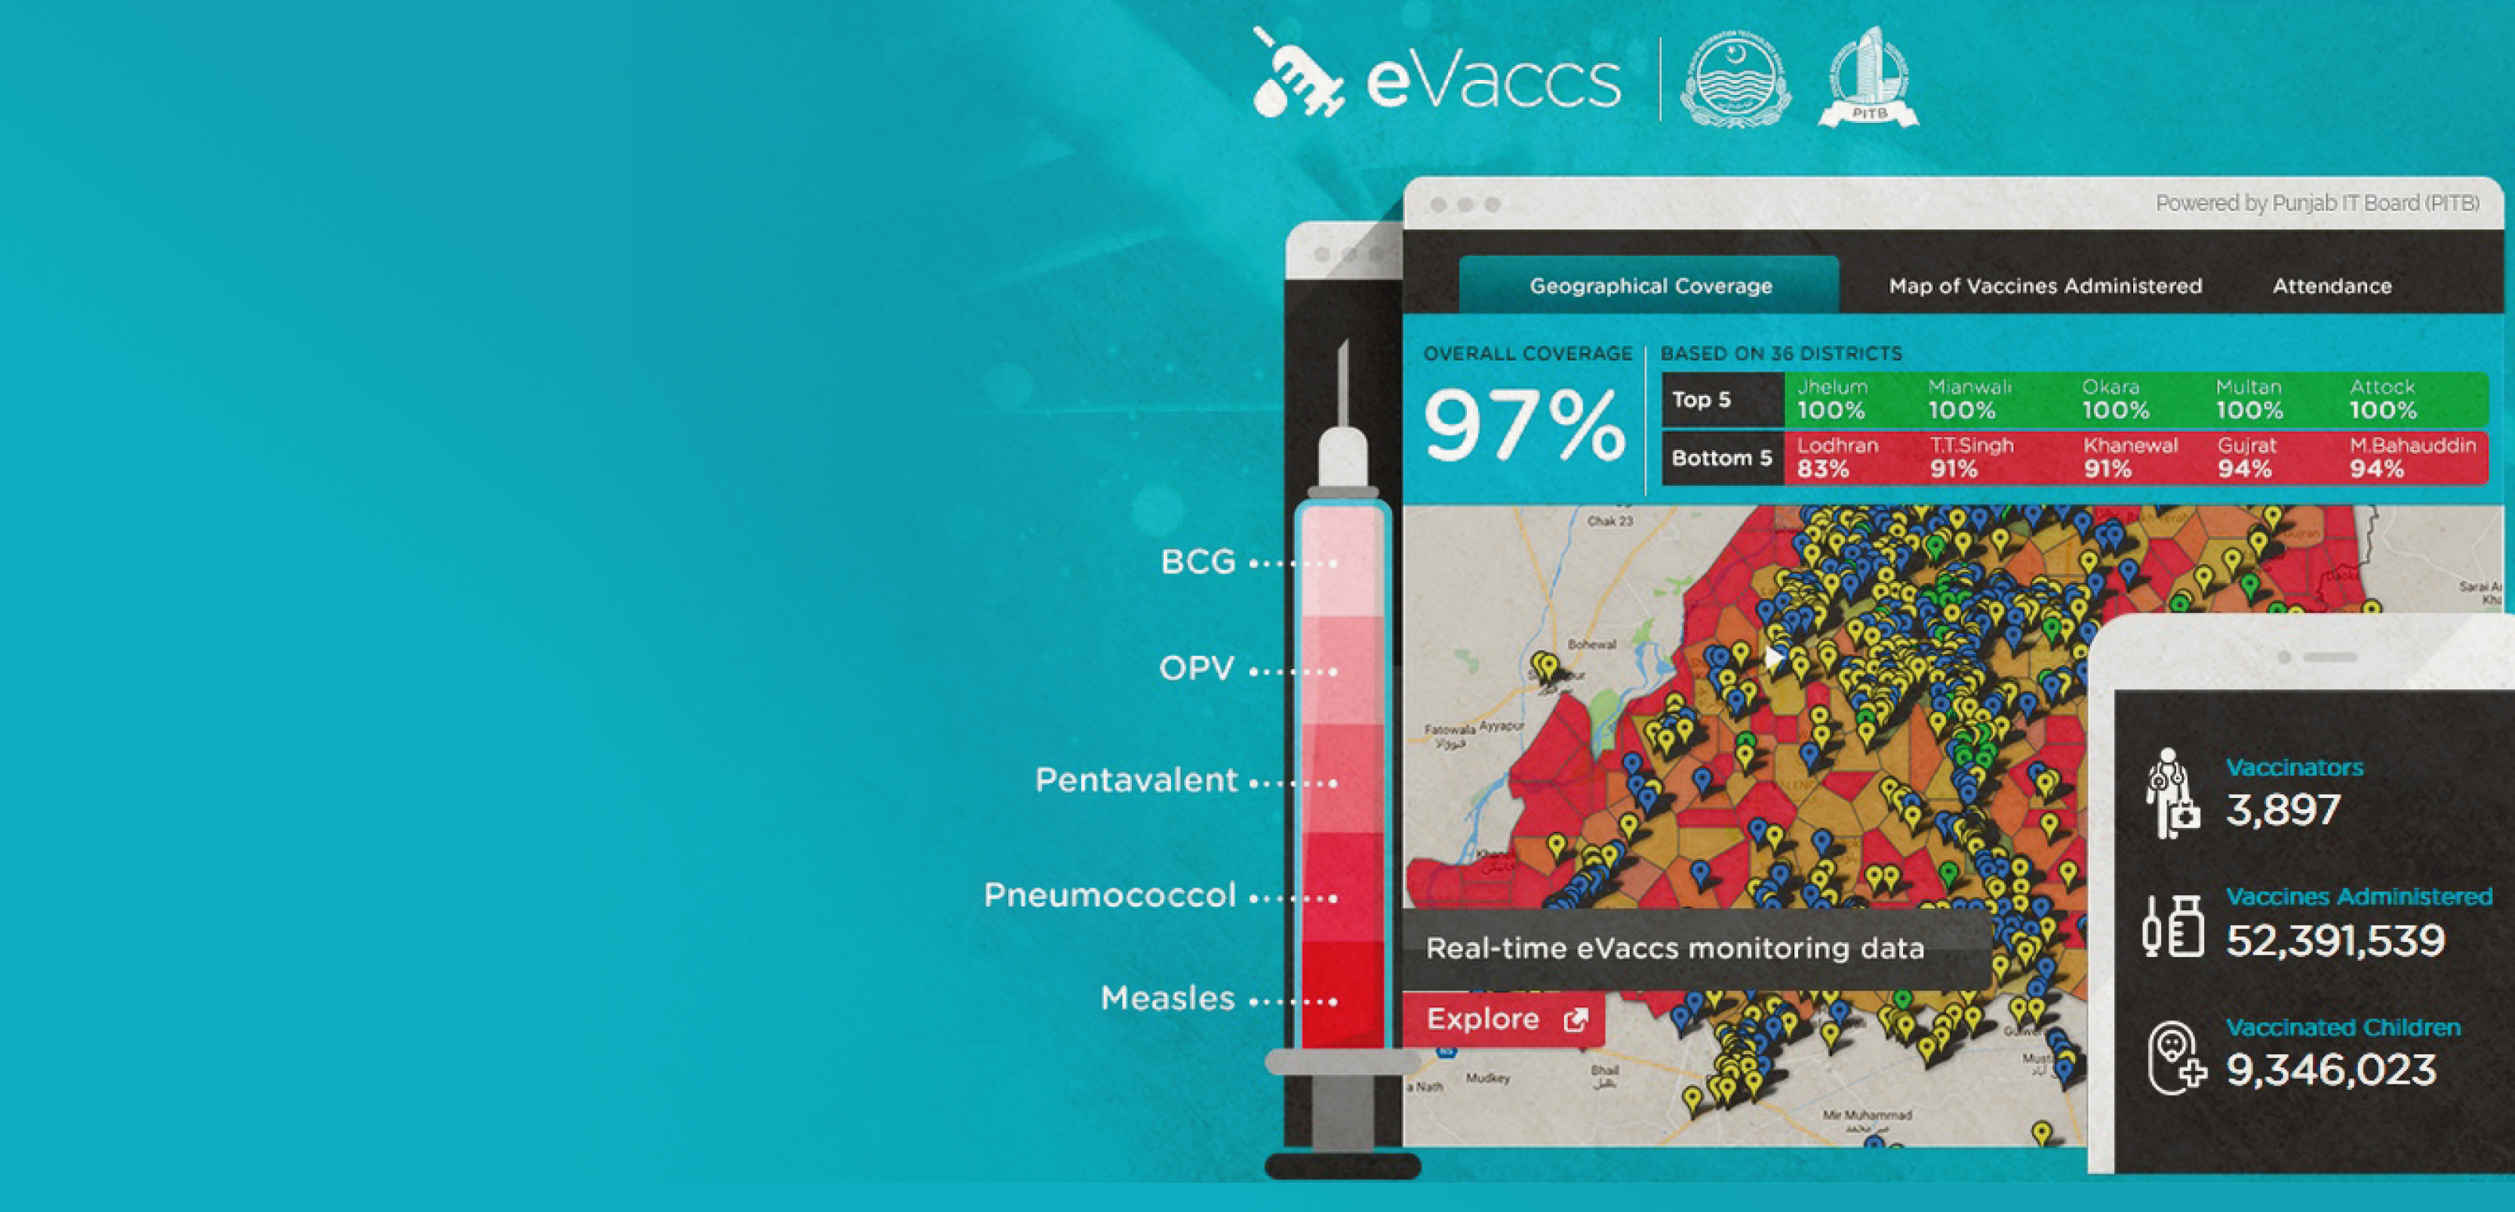
Pakistan immunization case study: power of measurement
Defined granular geographic service delivery units using satellite imagery
Enhanced eVaccs immunization system with data-enabled devices and real-time changed information system, combined it with devices, and automated, real-time monitoring
Improved vaccinator supervision with three geo-validated check-ins
daily at assigned location,
kit station and end of day
Strengthened management practices with live dashboards,
weekly review meetings and real consequences

Slide 32
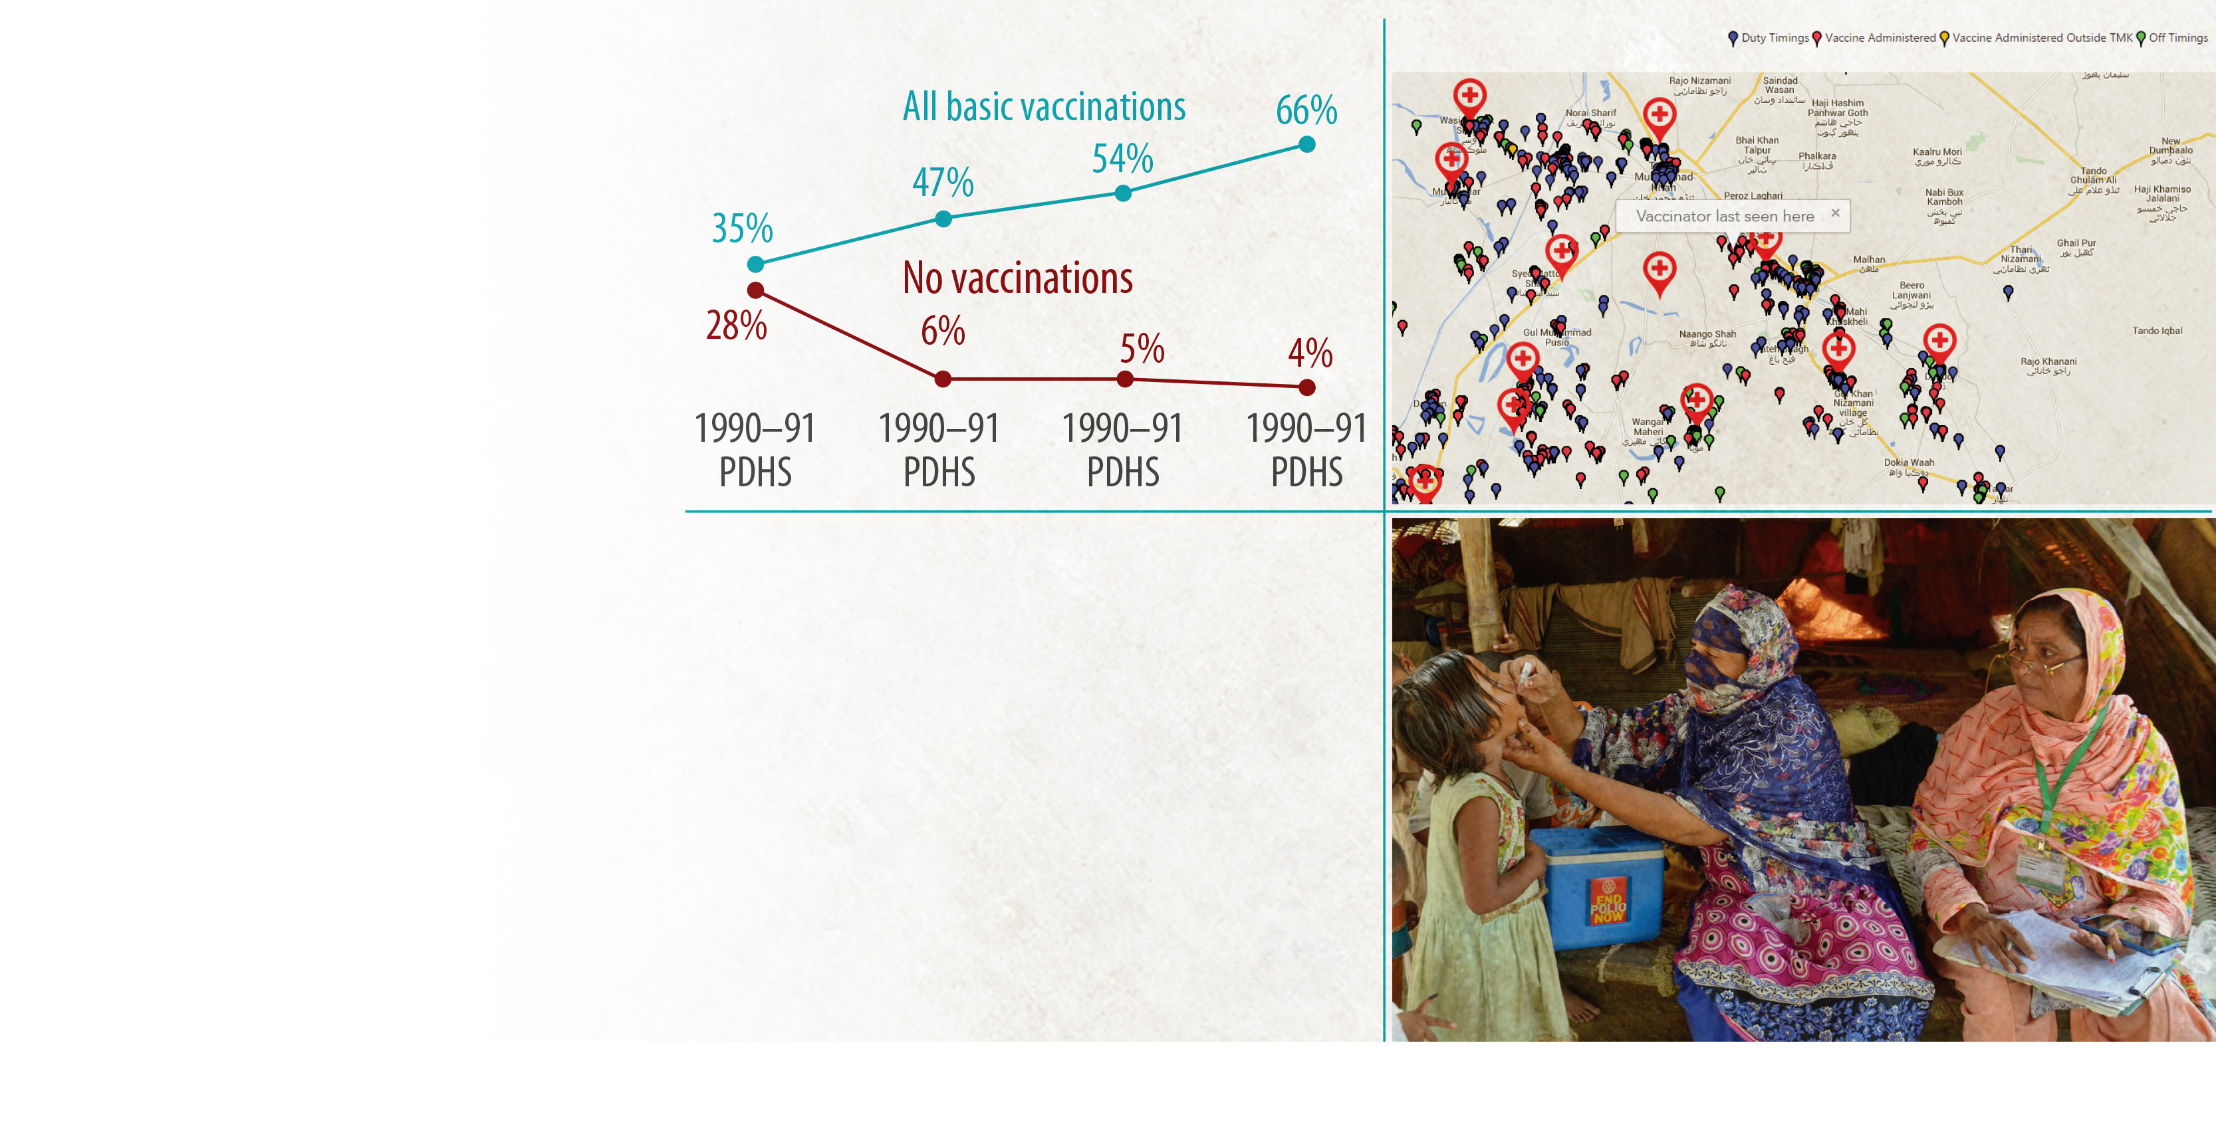
Pakistan immunization case study: power of measurement
Vaccinator attendance increased from
54% to 97% through geo-spatial validation
Vaccination coverage increased rapidly
Polio cases fell from 294 cases in 2014 (world’s highest), to 51 in 2015 to 19 in 2016

Slide 33
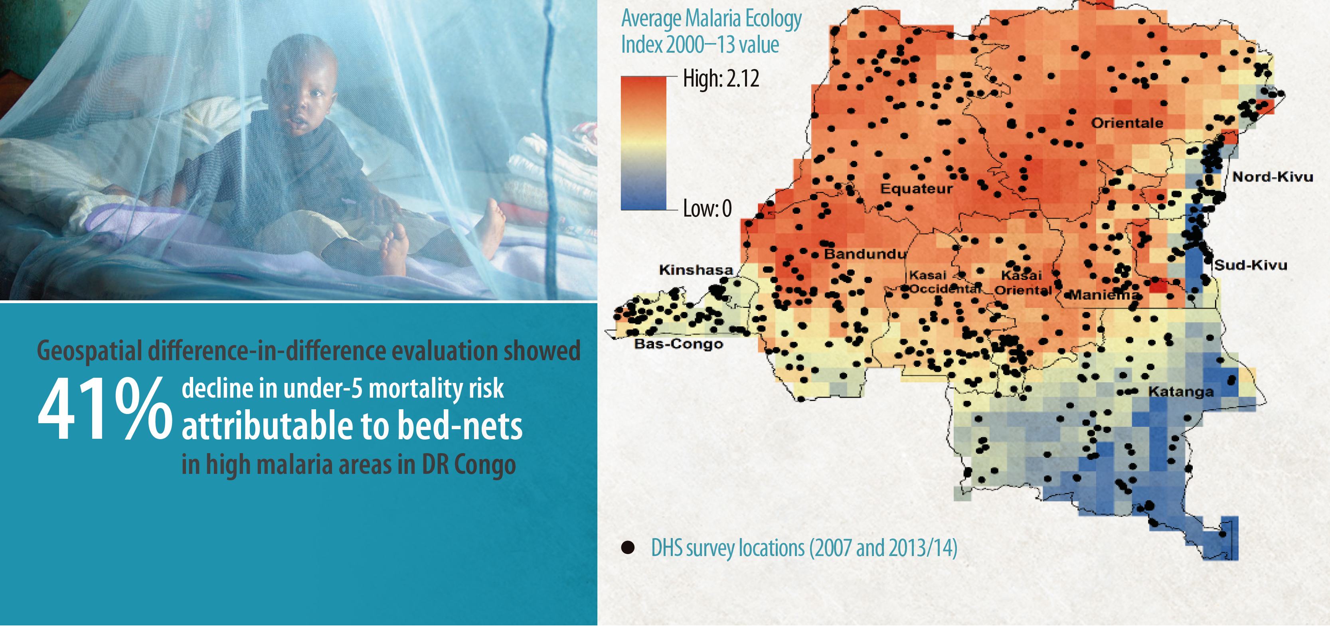
Geospatial evaluation of bed-net impact on malaria in DR Congo

Slide 34

Right
INNOVATION
ACCELERATED R&D

Slide 35
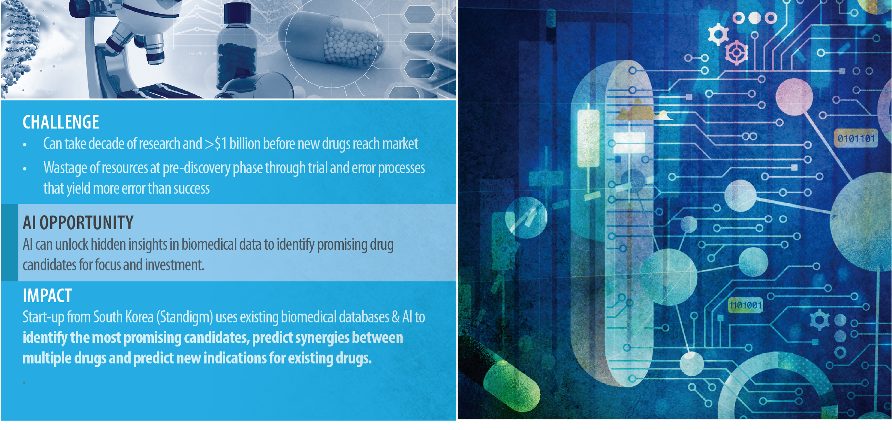
Artificial intelligence for drug development
Scan QR code to access “energized” textbooks with extra content

Slide 36

Implementation Challenges
  Challenges of obtaining and cleaning the data
  Time that it takes to do feature engineering and selection of features
  Challenges of working with imbalanced classes and the use of accuracy in algorithmic evaluations
  Importance of choosing the right metric
    e.g. Slack: Teams who send 2000 messages a month
  Importance of recall in model evaluation relating to healthcare problems
Challenges we were expecting and mitigated
Challenges that surprised our teams
  Extent of hidden technical debt in machine learning solutions
  Challenges with the data licensing
  ‘But machine learning is just regression’
  Need to develop custom model evaluation metrics

Slide 37

Lessons: Applications areas and lowest hanging fruit
In the area of diagnosis and clinical management
  Computer vision for radiology scans
  Clinical decision support systems, like Estonia
In the area of population health
  More granular targeting: reduce the size of the haystack
In the area of health systems management
  Use AI to streamline office functions
  Fraud detection
  Verification monitoring for incentive payments

Slide 38

Lessons: Lowest hanging fruit in private health sector
Source: Deloitte Insights, 2019

Slide 39
More Lessons: ML Production and Lifecycle
Configuration / problem definition
Monitoring
Data collection
Data verification
Machine Resource Management
ML algorithm
Analysis Tools
Feature Extraction
Process Management Tools
Data exploration and vizualisation
ML: small part of actual solution
Algorithm black boxes and reproducibility

Slide 40

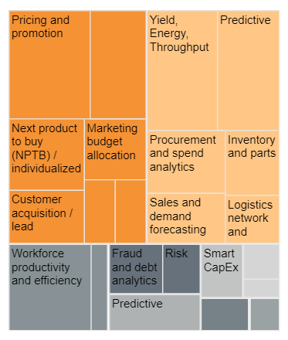
More Lessons: Taming the Hype
  “Sadly, market hype about AI has made
  it trendy to brag about using AI without
  any understanding or experience.” Yao, Jia and Zhou
  Wild west app universe
  Need problem-first approaches: overcoming the ‘shiny-new-object syndrome’
  Most immediate applications of AI in workplace are back-office functions that are not unique to health; reduces costs and automates repetitive tasks

Slide 41
More lessons: Evidence, Assessment and Decision Support
AI progressively expanding. BUT, AI is not the right solution for every problem
How do Governments choose which options to implement?
Significant gaps in the evidence base to help inform technology choices
Knowing and measuring when we’ve been successful
Economic evaluations to help decide which technologies to use
  Not just focused on financial cost, but also system cost, opportunity cost and social cost

Slide 42
More lessons: Building Knowledge, Awareness and Practices in public sector
Creating digital health and technology literacy
Workplace culture changes across the world of work
  Augmented intelligence, not ‘replacement intelligence’
Determining right levels of expertise
Build vs buy choices
Beyond use cases and individual applications: a systems approach to AI and technology in health

Slide 43

Urgent Future Unexplored Priorities
Transfer learning
Model replicability
Create incentives for model maintenance
Continued development in integrated data systems and personal health records
Digital health standards and regulation
Notes:
McKinsey data: 41% of healthcare firms surveyed, indicated that uncertain return on investment was main reason for reticence in investment in AI

