Slide 1

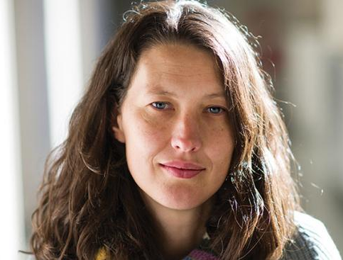

Rubella Surveillance and Control in Low-Resource Settings: Limitations, Biases, and
Potential for Strengthening
Amy Winter, PhD Candidate, Princeton University
Funding Sources:
Advisor:
Jess Metcalf
Assistant Professor of Ecology and
Evolutionary Biology, Princeton University
Notes:
My name is Amy Winter, and I am a PhD candidate in the office of population research at Princeton University. Thank you for inviting my advisor and then for subsequently accepting me as a replacement. I am excited to be here and hope I can relay our work effectively. My advisor’s name is Jess Metcalf and I will be presenting work we have done together in addition to work coming from her lab group.
I titled this talk …

Slide 2
Rubella Surveillance and Control in Information Scarce Settings: Limitations, Biases, and
Potential for Strengthening
Amy Winter, PhD Candidate, Princeton University
Funding Sources:
Advisor:
Jess Metcalf
Assistant Professor of Ecology and
Evolutionary Biology, Princeton University
Notes:
Since this is where mathematical modeling can be most useful when thinking about rubella control and surveillance.

Slide 3


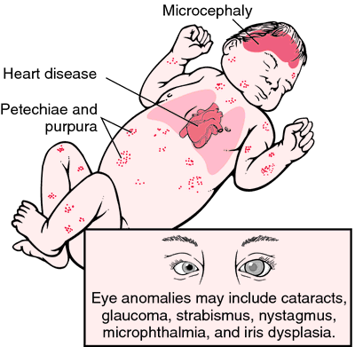
Rubella & Congenital Rubella Syndrome (CRS)
Introduction | Overview | Endemic settings | Control Settings | Conclusions
Generally mild infection among children
From just before conception and during the first 16 weeks of gestation, rubella infection may cause CRS in up to 65% of cases, or may result in spontaneous abortion or stillbirth ¹
Notes:
Rubella a fully immunizing and generally mild illness among children that may consist of an acute rash and low fever
The reason we care about rubella is because infection during pregnancy places the fetus at risk of death and birth defects. Rubella infection just before conception and during first 16 weeks of gestation may causes congential rubella syndrome (CRS) in up to 65% of cases. CRS is generally marked by triad of birth defects that includes micrceophaly, eye disease, and heart diseases.

Slide 4
Rubella Containing Vaccine (RCV)
Introduction | Overview | Endemic settings | Control Settings | Conclusions
A safe, effective, and inexpensive rubella vaccine exists
Fairly easy and cheap public health intervention
  the rubella vaccine can be easily combined with the measles vaccine
  additional 0.30 USD per vaccine dose
Notes:
Fortunately, there is a safe, effective, and inexpensive rubella vaccine that can be used to prevent CRS cases.
Introduction of the rubella vaccine is also a fairly easy public health intervention. The rubella vaccine is easily combined with the popularly administered measles vaccine such that the infrastructure to administer the vaccine already exists within the childhood immunization program.

Slide 5
Current and Future Use of
Rubella-Containing Vaccine
Introduction | Overview | Endemic settings | Control Settings | Conclusions
Introduced to date
(141 countries or 72.7%)
Planned introductions in 2015-2016
(18 countries or 9.3%)
Not Available, Not Introduced/No Plans
(35 countries or 18%)
Not applicable
Data source: WHO/IVB Database, as of 29 September 2015
Map production Immunization Vaccines and Biologicals (IVB),
World Health Organization
Notes:
Given these positive features, the rubella vaccine has already been introduced into 141 of the WHO 194 member countries – you can see these countries in green.
The countries in yellow are those that plan rubella vaccine introduction into public sector vaccination programs in 2016 – 18 countries including India which has the highest burden of CRS
And in grey are countries where the rubella vaccine is not available in the public sector and there are no current plans to introduce the vaccine – which is 35 countries mostly in Africa and in Indonesia.
Introduced to date
Albania, Andorra, Antigua and Barbuda, Argentina, Armenia, Australia, Austria, Azerbaijan, Bahamas, Bahrain, Bangladesh, Barbados, Belarus, Belgium, Belize, Bhutan, Bolivia, Bosnia and Herzegovina, Brazil, Brunei Darussalam, Bulgaria, Cabo Verde, Cambodia, Canada, Chile, China, Colombia, Cook Islands, Costa Rica, Croatia, Cuba, Cyprus, Czech Republic, Denmark, Dominica, Dominican Republic, Ecuador, Egypt, El Salvador, Estonia, Fiji, Finland, France, Georgia, Germany, Ghana, Greece, Grenada, Guatemala, Guyana, Haiti, Honduras, Hungary, Iceland, Iran (Islamic Republic of), Iraq, Ireland, Israel, Italy, Jamaica, Japan, Jordan, Kazakhstan, Kiribati, Kuwait, Kyrgyzstan, Lao People's Democratic Republic, Latvia, Lebanon, Libya, Lithuania, Luxembourg, Malaysia, Maldives, Malta, Marshall Islands, Mauritius, Mexico, Micronesia (Federated States of ), Monaco, Mongolia, Montenegro, Morocco, Nauru, Nepal, Netherlands, New Zealand, Nicaragua, Niue, Norway, Oman, Palau, Panama, Paraguay, Peru, Philippines, Poland, Portugal, Qatar, Republic of Korea, Republic of Moldova, Romania, Russian Federation, Rwanda, Saint Kitts and Nevis, Saint Lucia, Saint Vincent and the Grenadines, Samoa, San Marino, Saudi Arabia, Senegal, Serbia, Seychelles, Singapore, Slovakia, Slovenia, Solomon Islands, Spain, Sri Lanka, Suriname, Sweden, Switzerland, Syrian Arab Republic, Tajikistan, Thailand, The former Yugoslav Republic of Macedonia, Tonga, Trinidad and Tobago, Tunisia, Turkey, Turkmenistan, Tuvalu, Ukraine, United Arab Emirates, United Kingdom, United Republic of Tanzania, United States of America, Uruguay, Uzbekistan, Venezuela, Yemen
Planned introductions in 2015-2016
Botswana, Burkina Faso, Burundi, Cameroon, Comoros, Gambia, India, Kenya, Lesotho, Madagascar, Mozambique, Myanmar, Namibia, Papua New Guinea, Swaziland, Viet Nam, Zambia & Zimbabwe
Not Available, Not Introduced/No Plans
Afghanistan, Algeria, Angola, Benin, Central African Republic, Chad, Congo, Côte d'Ivoire, Democratic People's Republic of Korea, Democratic Republic of the Congo, Djibouti, Equatorial Guinea, Eritrea, Ethiopia, Gabon, Guinea, Guinea-Bissau, Indonesia, Liberia, Malawi, Mali, Mauritania, Niger, Nigeria, Pakistan, Sao Tome and Principe, Sierra Leone, Somalia, South Africa, South Sudan, Sudan, Timor-Leste, Togo, Uganda, Vanuatu,

Slide 6

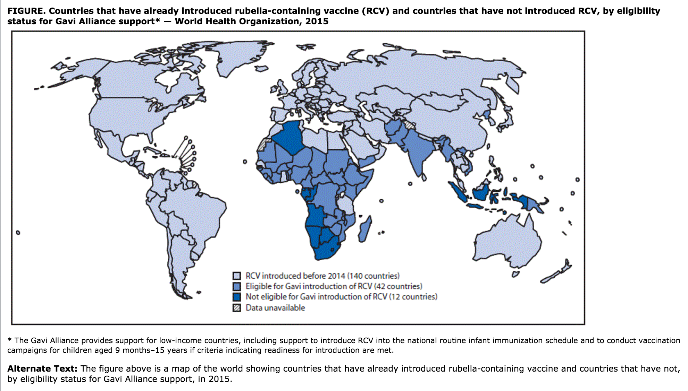
Rubella Vaccine Support
Introduction | Objectives | Methods | Results | Limitations & Conclusions
GAVI is providing support for a one time catch-up campaign with the measles-rubella (MR) vaccine
Notes:
One of the reasons for many countries choosing to introduce the vaccine recently is because GAVI opened a funding window in November of 2011 to help countries introduce the rubella vaccine who have already introduced it. The support includes funding for a one time catch-up campaign with the measles-rubella combined vaccine for all children ages 9 months to 14 years old.
This maps shows the countries that are eligible for this funding that have not yet introduced the vaccine in medium blue. 16 of these countries eligible for GAVI funding plans to introduce the vaccine, as shown on the previous graph. So, there is a lot of momentum for introducing the rubella vaccine, specifically as countries are making stronger goals towards measles elimination.
There are 24 countries remaining who are eligible for RCV funding from GAVI that may still introduce the vaccine.

Slide 7
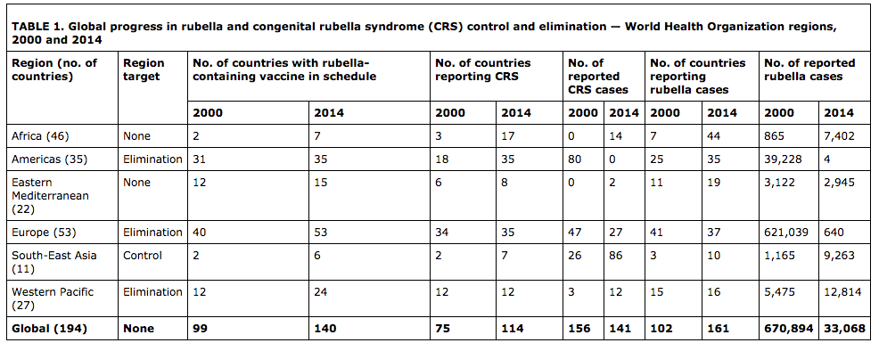
Introduction | Overview | Endemic settings | Control Settings | Conclusions
Global Incidence of Rubella and CRS
?
CDC (2015). "Global Progress Toward Rubella and Congenital Rubella Syndrome Control and Elimination — 2000–2014." MMWR 64(37): 1052-1055.
Notes:
There is a wide range of surveillance system functioning for rubella (and measles) across countries. Historically surveillance system functioning walks hand in hand with control efforts

Slide 8
Introduction | Overview | Endemic settings | Control Settings | Conclusions
Global Incidence of Rubella and CRS
?
Notes:
Such that regions where control efforts have been mostly successful, as in the Americas (endemic rubella eliminated since 2009) and Europe, surveillance of rubella and CRS is also successful. This figure from the CDC shows the number of rubella and CRS cases by region in 2000 and 2014.

Slide 9
Introduction | Overview | Endemic settings | Control Settings | Conclusions
Global Incidence of Rubella and CRS
?
Notes:
On the other hand, the number of rubella and CRS cases in Africa and South-East Asia are under-reported. Uptake of RCV has been the slowest in these regions, therefore we know burden of rubella and CRS is highest here, however the reported surveillance data does not show it. For example, in an endemic rubella region such as India where up to around 22,000 children are being born each year and we would expect most every child to become infected with Rubella given its high transmission. However, for the whole region of SE Asia, there were only 9,000 reported cases.

Slide 10
Introduction | Overview | Endemic settings | Control Settings | Conclusions
Surveillance Issues for Rubella and CRS
(many the same for measles)
Rubella
Epidemiological: up to 50% of infections are asymptomatic
Structural: impediments in presenting for care, recognition and collection of samples by healthcare worker, reporting or sending samples
CRS (in addition to above)
Epidemiological: can result in fetal death, miscarriage, or stillbirth, birth defects low specificity of detecting CRS
Notes:
There are many reasons that surveillance systems in these regions are not working. …
In addition to those above congenital rubella infection can result in fetal death, miscarriage, or stillbirth. Additionally, birth defects associated with CRS have very low specificity of detecting CRS, if born with birth defects very few tested for rubella antibodies.

Slide 11
Introduction | Overview | Endemic settings | Control Settings | Conclusions
Rubella Surveillance and Control
in Information Scarce Settings
Two Types of Rubella Settings
Endemic rubella settings: Countries where RCV has not been introduced where rubella is endemic
Rubella control settings: Countries where RCV has recently been introduced
Notes:
This talk will focus on rubella control and surveillance in information scarce settings. We differentiate between two types of information scarce settings regions, countries where rubella is endemic (although future plans to introduce the vaccine) and countries where control efforts have recently began

Slide 12
Introduction | Overview | Endemic settings | Control Settings | Conclusions
Rubella Surveillance and Control
in Information Scarce Settings
Two Types of Rubella Settings
Endemic rubella settings: Countries where RCV has not been introduced where rubella is endemic
  What is the current burden of CRS?
  What will be the effect of RCV introduction on CRS incidence?
Rubella control settings: Countries where RCV has recently been introduced
  What is the effect of rubella vaccine introduction on CRS incidence?
Notes:
For the country yet to introduce the vaccine, one important question is what is the current burden of rubella and CRS. Knowledge of burden facilitates the need for control efforts. The second major question is what will the effect of vaccine introduction be.
For the country who introduced the vaccine, we want to know if and how successful the rubella vaccination program is currently

Slide 13
Introduction | Overview | Endemic settings | Control Settings | Conclusions
Rubella Surveillance and Control
in Information Scarce Settings
Two Types of Rubella Settings
RUBELLA CONTROL WILL BE DRIVEN BY MEASLES CONTROL
Endemic rubella settings: Countries where RCV has not been introduced where rubella is endemic
  What is the current burden of CRS?
  What will be the effect of RCV introduction on CRS incidence?
Rubella control settings: Countries where RCV has recently been introduced
  What is the effect of rubella vaccine introduction on CRS incidence?
Notes:
Before I proceed, I want to acknowledge that ultimately rubella control efforts will be driven by measles control efforts. The two infections are being tackled simultaneously in most countries via the combined measles and rubella vaccine. And since Rubella has a lower R0, it will be easier to eliminate than measles. That being said the data and methods that I discuss here can be applied to both measles and rubella since they are both fully immunizing acute infections and life histories are fairly well known.

Slide 14
Introduction | Overview | Endemic settings | Control Settings | Conclusions
Rubella Surveillance and Control
in Information Scarce Settings
Two Types of Rubella Settings
Endemic rubella settings: Countries where RCV has not been introduced where rubella is endemic
  What is the current burden of CRS?
  What will be the effect of RCV introduction on CRS incidence?
Rubella control settings: Countries where RCV has recently been introduced
  What is the effect of rubella vaccine introduction on CRS incidence?
Notes:
We will focus on the control and surveillance questions in the endemic rubella setting first.

Slide 15
Introduction | Overview | Endemic settings | Control Settings | Conclusions
S&C in Rubella Endemic Countries
What is the current burden of CRS?
Modeling to Fill Knowledge Gaps, and Address Core Considerations
Key Unknowns to Clarify
Existing Data Sources
Current rubella epidemiology
- Current burden of CRS
- CRS incidence surveillance data
- CRS prevalence estimates
- Rubella age-specific IgG serology to reveal population immunity
Extrapolation from age serology to infer CRS burden
Notes:
The first question is what is the current burden of CRS.

Slide 16

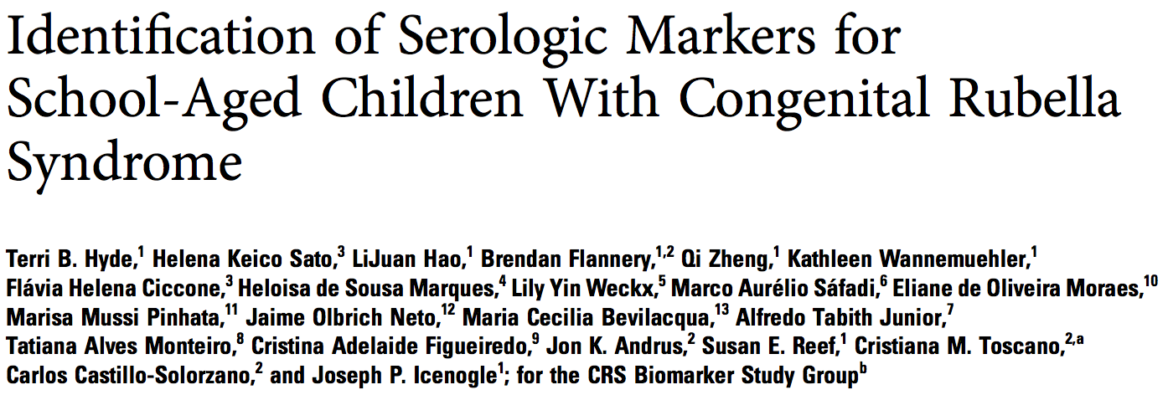
Introduction | Overview | Endemic settings | Control Settings | Conclusions
S&C in Rubella Endemic Countries
What is the current burden of CRS?
Modeling to Fill Knowledge Gaps, and Address Core Considerations
Key Unknowns to Clarify
Existing Data Sources
Current rubella epidemiology
- Current burden of CRS
- CRS incidence surveillance data
- CRS prevalence estimates
- Rubella age-specific IgG serology to reveal population immunity
Extrapolation from age serology to infer CRS burden
Notes:
There is promising new methods out of CDC that is looking at identifying CRS in school age children, but generally we rely on rubella IgG serology. Rubella specific IgG antibodies signal ever exposure to rubella virus (either via vaccine or infection) and therefore can be used as a marker of population immunity levels.

Slide 17

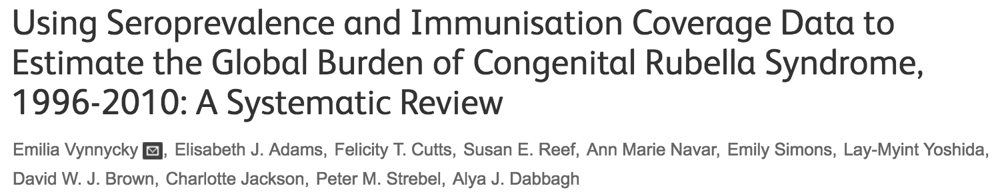
Introduction | Overview | Endemic settings | Control Settings | Conclusions
S&C in Rubella Endemic Countries
What is the current burden of CRS?
Modeling to Fill Knowledge Gaps, and Address Core Considerations
Key Unknowns to Clarify
Existing Data Sources
Current rubella epidemiology
- Current burden of CRS
- CRS incidence surveillance data
- CRS prevalence estimates
- Rubella age-specific IgG serology to reveal population immunity
Extrapolation from age serology to infer CRS burden
Notes:
From this you can estimate CRS burden, Vynnycky et al took on this task to estimate global burden of CRS.

Slide 18
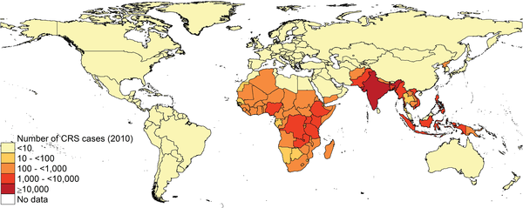
Introduction | Overview | Endemic settings | Control Settings | Conclusions
S&C in Rubella Endemic Countries
What is the current burden of CRS?
Estimated median numbers of CRS cases born by country in 2010
?
105,000 CRS cases globally
(range: 54,000-180,000)
Notes:
They collated Rubella IgG serological surveys from data sources all over the world to estimate global CRS burden is 105,000 cases of CRS annually. These estimates are powerful and useful in the current landscape of rubella and CRS surveillance.

Slide 19
Introduction | Overview | Endemic settings | Control Settings | Conclusions
S&C in Rubella Endemic Countries
What is the current burden of CRS?
Rely on age-specific IgG serology
  few age groups
  non population based samples
Estimate annual average force of infection for < 13 years old and ≥ 13 years old using catalytic model
  then estimate CRS incidence from force of infection
overestimate CRS burden
Notes:
Although the serological surveys they pulled range in quality, sample sizes, survey design, timing, and location. As a result force of infection were only estimated for two age groups (<13 yo and >= 13 yo) using the standard catalytic model. The two age group estimation of force of infection is systematically biased and overestimates CRS burden.

Slide 20
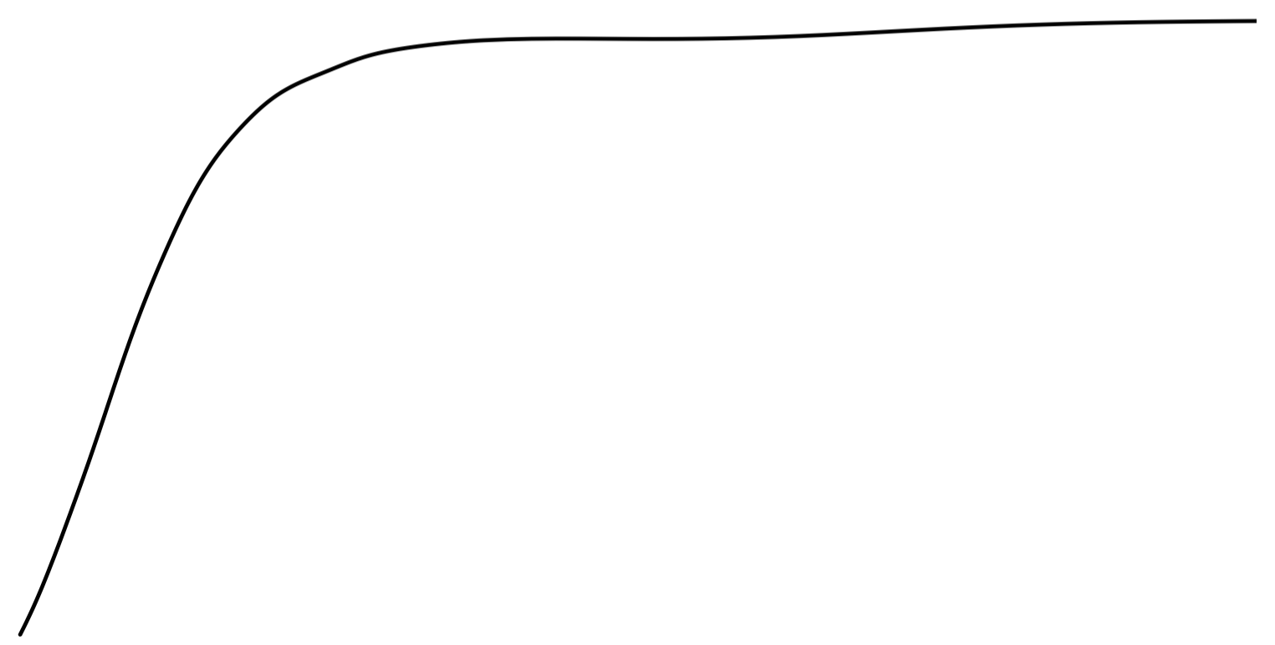
Introduction | Overview | Endemic settings | Control Settings | Conclusions
S&C in Rubella Endemic Countries
What is the current burden of CRS?
A
Rely on age-specific IgG serology
  few age groups
  non population based samples
Estimate annual average force of infection for < 13 years old and ≥ 13 years old using catalytic model
  then estimate CRS incidence from force of infection
overestimate CRS burden
Proportion seropositive
Notes:
This result will likely not be surprising to many of you. The bias is simply based on non-linear averaging of the age-specific force of infection estimates that results in an overestimate of age-specific force of infection over the age of 13 years old. Figure 1 displays this results using a simulation where we estimate force of infection among two age groups (red line), and the truth in the black line.
Figure 1: Non-linear averaging can bias estimates of Congenital Rubella Syndrome. A) Proportion of seronegative individuals (y axis) in every age class (x axis) for three different age-class designs, ranging from two bins (red); to a few (blue); to many (green); the ‘true’ curve is shown as a dotted line; B) Corresponding estimates of the Force of Infection (y axis) over age (x axis), colours as above, and ‘true’ curve again shown as a dotted line; C) The proportion of cases occurring in Women of Childbearing Age (WCB age) estimated from each of these, showing considerable over-estimates from the wider age class designs, ‘truth’ shown as the vertical dotted line; D) The range of estimates of proportions of cases occurring in WCB age (y axis) for different two age class designs, organized along the age of the break between the age classes (x axis), showing consistent over-estimates. i.e., almost all values are above the horizontal line, which indicates the true value. The red vertical line indicates that design illustrated on previous panels. So, most all two age groups will overestimate proportion WCB.
A nonlinear average is simply an average taken of a nonlinear function of some variable quantity. The value of such an average is generally different from the value of the nonlinear function at the average of the variable quantity. Jensen’s inequality is the result of nonlinear averaging a function that curves in a consistent direction, i.e. is concave up or concave down. For concave up functions, Jensen’s inequality says that the average of the function is greater than the function of the average, while for concave down functions, the opposite result is true.

Slide 21
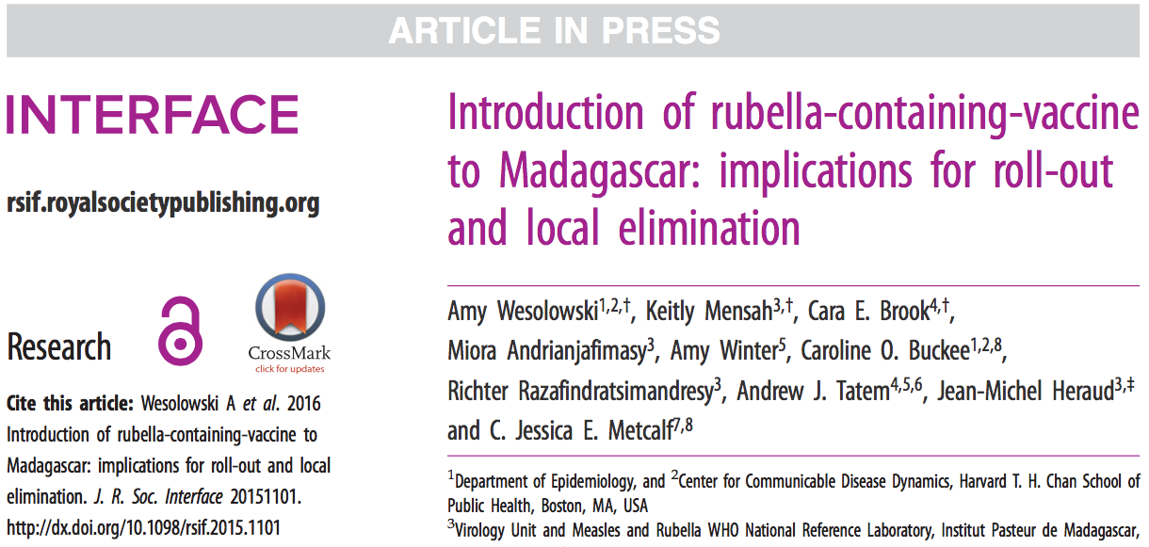
Introduction | Overview | Endemic settings | Control Settings | Conclusions
S&C in Rubella Endemic Countries
What will be the effect of RCV introduction on CRS incidence?
Will introducing RCV increase the burden of CRS?
Are there locations at highest risk of CRS increases?
Will introducing RCV result in rubella elimination?
Notes:
The second question is looking at the effect of RCV introduction on CRS incidence. This is a tough question in places where we don’t even know the burden of rubella and subsequent CRS cases. An article we currently have in press by Weslowski et al lays out the core questions related to the effect of introducing the rubella vaccine, particulalry
Will introducing RCV increase the burden of CRS?
Are there location at highest rick of CRS increases?
Will introducing RCV result in rubella elimination.

Slide 22
Introduction | Overview | Endemic settings | Control Settings | Conclusions
S&C in Rubella Endemic Countries
What will be the effect of RCV introduction on CRS incidence?
Will introducing RCV increase the burden of CRS?
Are there locations at highest risk of CRS increases?
Will introducing RCV result in rubella elimination?
Modeling to Fill Knowledge Gaps, and Address Core Consideration
Patching existing data sources with mathematical modeling can explore effects of RCV introduction
Key Unknowns to Clarify
Existing Data Sources
Current rubella epidemiology
- Transmission parameters (R0, seasonal changes)
- Contact pattern over age
- Country demography
- Rubella age incidence data
- fever-rash surveillance
- rubella IgM serology
- Rubella IgG serology
- Contact diaries
- National census, surveys
- Analytic results for R0
- TSIR for seasonality
- Age structured model predictions for CRS burden following vaccinations
RCV Coverage Predictions
- Measles vaccination coverage
- MOH administrative measles vaccination coverage, or survey data
Spatial variability
- in rubella dynamics
- in vaccine access
- in demography
- Spatial connectivity
- Spatially indexed fever-rash surveillance
- Spatially indexed IgM or IgG serology
- Spatially refined data on vaccine coverage
- Subnational demographic data (www.worldpop.org.uk)
- Geospatial mobility data
- Meta-population models to predict extinction probability
- Age-structured meta-population models to predict CRS burden following vaccination
- Estimating travel from spatial interaction models
Notes:
We will use our work exploring RCV introduction in Madagascar to demonstrate how models can be used to predict effects of RCV introduction, even in setting with poor or lacking rubella surveillance. In the process I will work my way though this figure.
TSIR – gets transmission probability for rubella, use beta to get connectivity scalar for metapopulation dynamics, can get estimates of R0
Age-structured model – deterministic to assess impact of vaccination on cumulative 30-year incidence of CRS and annual incidence of CRS
Metapopulation dynamics - we also sought to identify areas in Madagascar most likely to be affected by stochastic metapopulation dynamics
Figure connectivity – show that connectivity affects population dynamics, see average age of infection increases and either a result of smaller population because less connected often smaller (although never seen density-dependent dyancmis) or that extinction and reconolozation dynamics play out. Peru paper also showed the importance of metapopulation dynamics for rubella.
Good thing at prior to vaccine intro is can pull historical data in country since all endemic rubella setting. Ideal is most recent data.
Is there any data to show our projections are verified in … countries. Could be intersting to validate the model in costa rica or greece using historical data to see if we would have predicted it.

Slide 23

Introduction | Overview | Endemic settings | Control Settings | Conclusions
S&C in Rubella Endemic Countries
What will be the effect of RCV introduction on CRS incidence?
a. Will introducing RCV increase the burden of CRS?
Rubella childhood vaccination paradox:
Inadequate routine vaccination coverage
average ages
of infection
fertility
potentially increase CRS Burden!
Notes:
The first question when introducing the rubella vaccine is will RCV increase the burden of CRS. This is an historically known potential result known as the rubella childhood vaccination paradox in which inadequate childhood rubella vaccination coverage can increase the burden of CRS. This occurs because inadequate vaccination can increase the average age of infection without sufficiently reducing incidence of rubella.
The graph to help explain this paradox, this shows the distribution of rubella cases by age in the case of no vaccines (blue line) and inadequate vaccination coverage among children (red line). As you can see with inadequate vaccination coverage the number of rubella cases falls (the distribution shrinks), and the distribution of cases shifts to the right such that the average age of infection (the dotted vertical lines) increases about two years. If you place the fertility curve on top you see that there are more rubella cases among women of reproductive age in the low vaccine scenario.
Empirically this paradox has been displayed in Greece and Costa Rica in the short term, and only theoretically been demonstrated in the long term as cumulative increases in CRS.

Slide 24
Introduction | Overview | Endemic settings | Control Settings | Conclusions
S&C in Rubella Endemic Countries
What will be the effect of RCV introduction on CRS incidence?
a. Will introducing RCV increase the burden of CRS?
Modeling to Fill Knowledge Gaps, and Address Core Consideration
Key Unknowns to Clarify
Existing Data Sources
Current rubella epidemiology
- Transmission parameters (R0, seasonal changes)
- Contact pattern over age
- Country demography
- Rubella age incidence data
- fever-rash surveillance
- rubella IgM serology
- Rubella IgG serology
- Contact diaries
- National census, surveys
- Analytic results for R0
- TSIR for seasonality
- Age structured model predictions for CRS burden following vaccinations
RCV Coverage Predictions
- Measles vaccination coverage
- MOH administrative measles vaccination coverage, or survey data
Notes:
To answer whether RCV introduction will increase the burden of CRS there are a number of parameters that need to be known, including transmission parameters, contact patterns over age, country demography. the following type of data can help us estimate these parameters includng rubella age incidence data coming from surveillance, Rubella IgG serology, contact diaries, and national census. We also need RCV coverage predictions, which we can pull from looking at measles coverage levels using admin or survey data.

Slide 25
Introduction | Overview | Endemic settings | Control Settings | Conclusions
S&C in Rubella Endemic Countries
What will be the effect of RCV introduction on CRS incidence?
a. Will introducing RCV increase the burden of CRS?
Modeling to Fill Knowledge Gaps, and Address Core Consideration
Key Unknowns to Clarify
Existing Data Sources
Current rubella epidemiology
- Transmission parameters (R0, seasonal changes)
- Contact pattern over age
- Country demography
- Rubella age incidence data
- fever-rash surveillance
- rubella IgM serology
- Rubella IgG serology
- Contact diaries
- National census, surveys
- Analytic results for R0
- TSIR for seasonality
- Age structured model predictions for CRS burden following vaccinations
RCV Coverage Predictions
- Measles vaccination coverage
- MOH administrative measles vaccination coverage, or survey data
Notes:
Figure A shows the number of rubella cases based on measles-rubella surveillance system n Madagascar. This are all laboratory confirmed cases or tested positive for rubella IgM antibodies. The number of cases are under-reported for a rubella endemic region, however, these is still some information we can use here to pull out the seasonality of transmission using TSIR modeling approach (Figure B). We can also estimate the cumulative distribution function of rubella cases by Madagascar province, and average age of infection the vertical lines (Figure C). The inverse in birth rate divided by average age of infection we estimate the R0 of rubella ranging from 2 to 5.

Slide 26
Introduction | Overview | Endemic settings | Control Settings | Conclusions
S&C in Rubella Endemic Countries
What will be the effect of RCV introduction on CRS incidence?
a. Will introducing RCV increase the burden of CRS?
Modeling to Fill Knowledge Gaps, and Address Core Consideration
Key Unknowns to Clarify
Existing Data Sources
Current rubella epidemiology
- Transmission parameters (R0, seasonal changes)
- Contact pattern over age
- Country demography
- Rubella age incidence data
- fever-rash surveillance
- rubella IgM serology
- Rubella IgG serology
- Contact diaries
- National census, surveys
- Analytic results for R0
- TSIR for seasonality
- Age structured model predictions for CRS burden following vaccinations
RCV Coverage Predictions
- Measles vaccination coverage
- MOH administrative measles vaccination coverage, or survey data
R₀ ranges 2 to 5
Notes:
Figure A shows the number of rubella cases based on measles-rubella surveillance system n Madagascar. This are all laboratory confirmed cases or tested positive for rubella IgM antibodies. The number of cases are under-reported for a rubella endemic region, however, these is still some information we can use here to pull out the seasonality of transmission using TSIR modeling approach (Figure B). We can also estimate the cumulative distribution function of rubella cases by Madagascar province, and average age of infection the vertical lines (Figure C). The inverse in birth rate divided by average age of infection we estimate the R0 of rubella ranging from 2 to 5.

Slide 27
Introduction | Overview | Endemic settings | Control Settings | Conclusions
S&C in Rubella Endemic Countries
What will be the effect of RCV introduction on CRS incidence?
a. Will introducing RCV increase the burden of CRS?
Modeling to Fill Knowledge Gaps, and Address Core Consideration
Key Unknowns to Clarify
Existing Data Sources
Current rubella epidemiology
- Transmission parameters (R0, seasonal changes)
- Contact pattern over age
- Country demography
- Rubella age incidence data
- fever-rash surveillance
- rubella IgM serology
- Rubella IgG serology
- Contact diaries
- National census, surveys
- Analytic results for R0
- TSIR for seasonality
- Age structured model predictions for CRS burden following vaccinations
RCV Coverage Predictions
- Measles vaccination coverage
- MOH administrative measles vaccination coverage, or survey data
R₀ ranges 2 to 5
D
E
F
G
routine only
routine +
catch-up
Notes:
Using an established age structured deterministic models we can crank the handle on the model and infer the burden of CRS (FIGURE D). By pulling in measles vaccination coverage rates (which act as predictions for the rubella vaccine coverage rates) – FIGURE E – we can then continue to crank forward the model under two scenarios one where you introduce the vaccine and one scenario where you don’t and compare the CRS incidence. Figure F shows the Ratio of CRS incidence in the routine only vaccine scenario. WE find that Introduction of RCV into the routine programme results in a reduction in the burden of CRS in all but five regions (F, Androy, Atsimo-Andrefana, Atsimo-Atsinana, Ihorombe, Melaky). If an SIA with 60% coverage is introduced at the same time as the start of routine vaccination against rubella, and maintained at four-year intervals targeting up to five year olds, then the burden of CRS is successfully reduced in all 22 regions (Figure G). So overall, at the district level, we find cumulative burden of CRS decreases, with no transient outbreaks at current measles vaccination coverage levels and assuming catch-up campaign.

Slide 28
Introduction | Overview | Endemic settings | Control Settings | Conclusions
S&C in Rubella Endemic Countries
What will be the effect of RCV introduction on CRS incidence?
b. Are there locations where the burden of CRS will increase following RCV introduction?
c. Will introducing RCV result in rubella elimination?
Key Unknowns to Clarify
Existing Data Sources
Modeling to Fill Knowledge Gaps, and Address Core Consideration
Current rubella epidemiology
…
….
…
…
RCV Coverage Predictions
…
…
Spatial variability
- in rubella dynamics
- in vaccine access
- in demography
- Spatial connectivity
- Spatially indexed fever-rash surveillance
- Spatially indexed IgM or IgG serology
- Spatially refined data on vaccine coverage
- Subnational demographic data (worldpop.org.uk)
- Geospatial mobility data
- Meta-population models to predict extinction probability
- Age-structured meta-population models to predict CRS burden following vaccination
- Estimating travel from spatial interaction models
Notes:
The second questions requires us to look at a smaller spatial scale to explore location where there may be a potential for an increase in CRS burden. Here spatial variability information on transmission, vaccine, and demography is key. Still using the same surveillance data, just now looking at the district level.

Slide 29
Introduction | Overview | Endemic settings | Control Settings | Conclusions
S&C in Rubella Endemic Countries
What will be the effect of RCV introduction on CRS incidence?
b. Are there locations where the burden of CRS will increase following RCV introduction?
c. Will introducing RCV result in rubella elimination?
Key Unknowns to Clarify
Existing Data Sources
Modeling to Fill Knowledge Gaps, and Address Core Consideration
Current rubella epidemiology
…
….
…
…
RCV Coverage Predictions
…
…
Spatial variability
- in rubella dynamics
- in vaccine access
- in demography
- Spatial connectivity
- Spatially indexed fever-rash surveillance
- Spatially indexed IgM or IgG serology
- Spatially refined data on vaccine coverage
- Subnational demographic data (worldpop.org.uk)
- Geospatial mobility data
- Meta-population models to predict extinction probability
- Age-structured meta-population models to predict CRS burden following vaccination
- Estimating travel from spatial interaction models
A
Connectivity
Notes:
Figure A shows that connectivity affects population dynamics because at low connectivity, the average age of infection increases. Connectivity is measured based on the amount of outgoing travel from each location from the gravity model using travel time distance between district centroids, This correlation between connectivity and average age of infection is likely means that extinction and recolonization dynamics are playing out in Madagascar at the district level.

Slide 30
Introduction | Overview | Endemic settings | Control Settings | Conclusions
S&C in Rubella Endemic Countries
What will be the effect of RCV introduction on CRS incidence?
b. Are there locations where the burden of CRS will increase following RCV introduction?
c. Will introducing RCV result in rubella elimination?
Key Unknowns to Clarify
Existing Data Sources
Modeling to Fill Knowledge Gaps, and Address Core Consideration
Current rubella epidemiology
…
….
…
…
B
C
RCV Coverage Predictions
…
…
Spatial variability
- in rubella dynamics
- in vaccine access
- in demography
- Spatial connectivity
- Spatially indexed fever-rash surveillance
- Spatially indexed IgM or IgG serology
- Spatially refined data on vaccine coverage
- Subnational demographic data (worldpop.org.uk)
- Geospatial mobility data
- Meta-population models to predict extinction probability
- Age-structured meta-population models to predict CRS burden following vaccination
- Estimating travel from spatial interaction models
A
Connectivity
Notes:
To assess the third question, if introduction of RCV will result in rubella elimination, we used meta-population analysis which allowed these important extinction and recolonization of rubella. The results of the metapopulation analysis is show in Figures B and C. The y-axis is the the proportion of regions predicted to go extinct post RCV introduction. Figure B shows as connectivity decreases more regions are predicted to result in rubella extinction. At current measles vaccine coverage level after 20 years of vaccination, the probability of rubella extinction in all regions ranges from 15% (at low levels of connectivity) to 8% (at a high level of connectivity). [This probability was estimated as the proportion of simulations (across the 100 simulations) that went extinct in all 22 regions.] If vaccination coverage was increased to 90% in all locations, the probability of rubella extinction increases to 39%, regardless of connectivity scalar (from the points clustered at the top of Figure C). So, what we learn is there are districts at risk of extinction and recoloization dynamics that could ba a risk of increases in CRS, and addition that rubella will likely no go extinct in all regions at the current level of routine vaccination coverage.

Slide 31
Introduction | Overview | Endemic settings | Control Settings | Conclusions
Rubella Surveillance and Control
in Information Scare Settings
Two Types of Rubella Settings
Endemic rubella settings: Countries where RCV has not been introduced where rubella is endemic
  What is the current burden of CRS?
  What will be the effect of RCV introduction on CRS incidence?
Rubella control settings: Countries where RCV has recently been introduced
  What is the effect of rubella vaccine introduction on CRS incidence?
Notes:
We will now move onto rubella control and surveillance in setting where the vaccine has recently been introduced.

Slide 32
Introduction | Overview | Endemic settings | Control Settings | Conclusions
S&C in Rubella Control Countries
What is the effect of RCV introduction on CRS incidence?
Modeling to Fill Knowledge Gaps, and Address Core Consideration
Key Unknowns to Clarify
Existing Data Sources
Current rubella epidemiology
…
…
…
…
Spatial variability
…
…
…
…
…
Post vaccine unknowns
- RCV coverage
- Population immunity profile
- MOH administrative RCV coverage, or survey data
- Pre and post rubella serological surveys of vaccination age children
- Rubella IgG age-specific serological survey
- Subnational susceptibility mapping
- Age structured meta-population models to predict CRS burden
Notes:
In addition the previously mentioned rubella epidemiologic parameters and spatial variability parameters, vaccine requires new information including knowing the actual Rubella vaccine coverage (not just predicted based on measles vaccines). You can get estimates from administrative data or survey data, or from pre and post serological surveys A second piece of needed information is population immunity profile post vaccine introduction. Here rubella IgG serology is most helpful. Although…

Slide 33

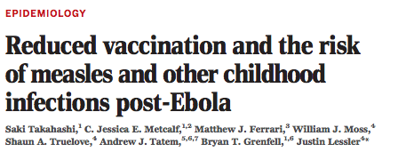
Introduction | Overview | Endemic settings | Control Settings | Conclusions
S&C in Rubella Control Countries
What is the effect of RCV introduction on CRS incidence?
Modeling to Fill Knowledge Gaps, and Address Core Consideration
Key Unknowns to Clarify
Existing Data Sources
Current rubella epidemiology
…
…
…
…
Spatial variability
…
…
…
…
…
Post vaccine unknowns
- RCV coverage
- Population immunity profile
- MOH administrative RCV coverage, or survey data
- Pre and post rubella serological surveys of vaccination age children
- Rubella IgG age-specific serological survey
- Subnational susceptibility mapping
- Age structured meta-population models to predict CRS burden
Notes:
Although an analytic method known as susceptibility mapping can estimate population immunity over space. Science paper by Takahasi et al 2015 (Jess as the senior author) showed how you can use small spatial scale estimates of birth rates (such as those that come from worldpop) and spatial vaccination coverage (here used DHS survey data) to determine population immunity profile post vaccine introduction.
----- Meeting Notes (4/20/16 13:20) -----
i sjess seniot

Slide 34
Introduction | Overview | Endemic settings | Control Settings | Conclusions
S&C in Rubella Control Countries
What is the effect of RCV introduction on CRS incidence?
Modeling to Fill Knowledge Gaps, and Address Core Consideration
Key Unknowns to Clarify
Existing Data Sources
Current rubella epidemiology
…
…
…
…
Spatial variability
…
…
…
…
…
Post vaccine unknowns
- RCV coverage
- Population immunity profile
- MOH administrative RCV coverage, or survey data
- Pre and post rubella serological surveys of vaccination age children
- Rubella IgG age-specific serological survey
- Subnational susceptibility mapping
- Age structured meta-population models to predict CRS burden
nested within existing surveillance system
Notes:
What I am going to take a little extra time to look are rubella IgG serological survey that is nested within the existing surveillance system.

Slide 35
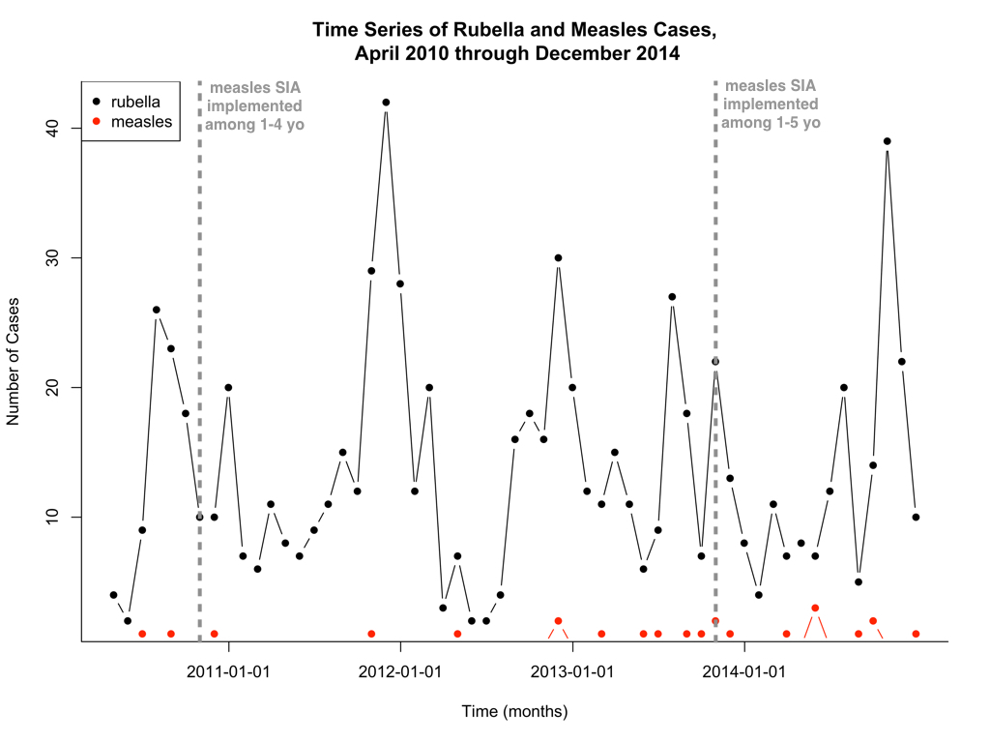
Introduction | Overview | Endemic settings | Control Settings | Conclusions
S&C in Rubella Control Countries
What is the effect of RCV introduction on CRS incidence?
IgG serology data nested within measles/rubella surveillance system
A
Notes:
Therefore, we can leverage existing data to understand population immunity post vaccine introduction. Surveillance systems standard protocol include sending in serum from rubella or measles suspected individuals for lab testing. The serum is then generally tested for measles and/or rubella IgM antibodies. Additionally, testing these samples for IgG antibodies can capture population immunity, and can be especially important in in the honeymoon period when there are very few cases being reported, and hence a state of disappearing data.
I am going to show you some recent work from Madagascar that pulled IgG serological data from stored serum from surveillance system. This work is actually for measles, but given both fully immunizing diseases and from the same surveillance stock of samples it can be easily applied to rubella as well.

Slide 36
Introduction | Overview | Endemic settings | Control Settings | Conclusions
S&C in Rubella Control Countries
What is the effect of RCV introduction on CRS incidence?
IgG serology data nested within measles/rubella surveillance system
Non-probability sample
A
2010: 320 samples
2011: 479 samples
2012: 497 samples
2013: 600 samples
2014: 616 samples
B
Notes:
Figure B shows the number of sample per year between 2010 and 2014, and the distribution of samples by age. As you can see this is a non-probability sample that highly over samples from young ages.

Slide 37
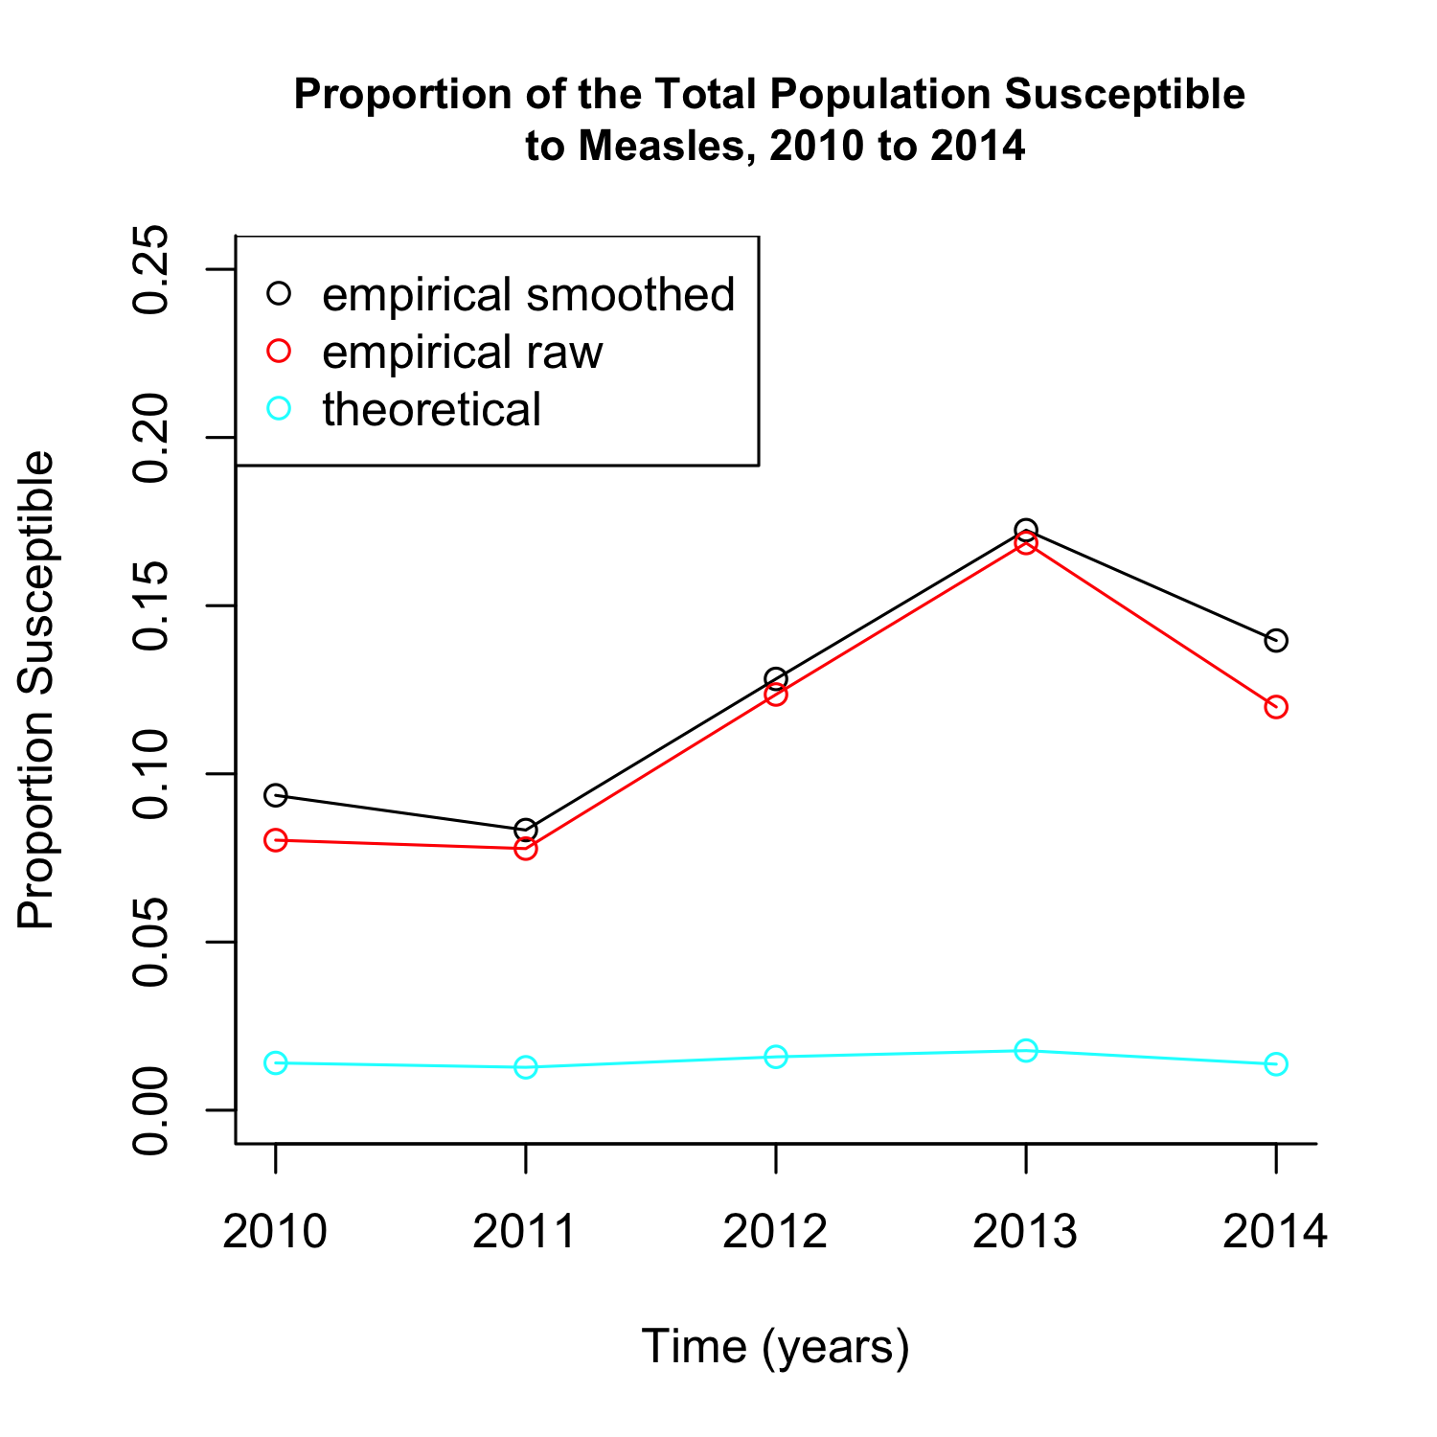
Introduction | Overview | Endemic settings | Control Settings | Conclusions
S&C in Rubella Control Countries
What is the effect of RCV introduction on CRS incidence?
C
IgG serology data nested within measles/rubella surveillance system
Non-probability sample
A
2010: 320 samples
2011: 479 samples
2012: 497 samples
2013: 600 samples
2014: 616 samples
B
Notes:
Adjusting by age for this sample to match the census distribution we find that in 2014, about 15% of Madagascar's population is susceptible to measles. Leveraging existing data sources, there is potential for preventing post honeymoon period outbreak of measles in Madagascar.

Slide 38
Introduction | Overview | Endemic settings | Control Settings | Conclusions
Conclusions
Mathematical modeling can be used in scarce-information settings to estimate the burden of CRS and inform future vaccination policy
Population-based age-structured serological data is powerful
reduce CRS estimation bias
inform unknown epidemiological parameters
determine population immunity levels in honeymoon period
Inform future rubella control vaccination policies
Rubella control will be driven by measles control

Slide 39
Thanks for listening!
Funding Sources:
Amy Winter
awinter@princeton.edu
Jess Metcalf
cmetcalf@princeton.edu

