Slide 1


Parallel evolution of influenza across multiple spatiotemporal scales
Katherine Xue
Bloom lab
Fred Hutchinson Cancer Research Center and
University of Washington
IDM symposium
April 17, 2018

Slide 2
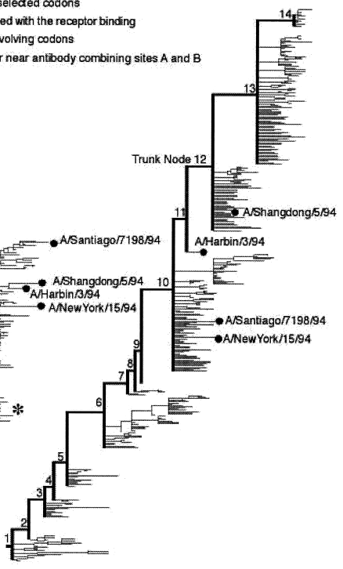

Influenza evolves rapidly across the globe.
WHO recommended strains
(Northern hemisphere, H3N2)
2016-2017: A/Hong Kong/4801/2014
2015-2016: A/Switzerland/9715293/2013
2014-2015: A/Texas/50/2012
2013-2014: A/Victoria/361/2011
2012-2013: A/Victoria/361/2011
2011-2012: A/Perth/16/2009
modified from
Fitch et al., J. Hered. 2000

Slide 3
How is within-host diversity transformed into global variation?
within-host
between-host

Slide 4
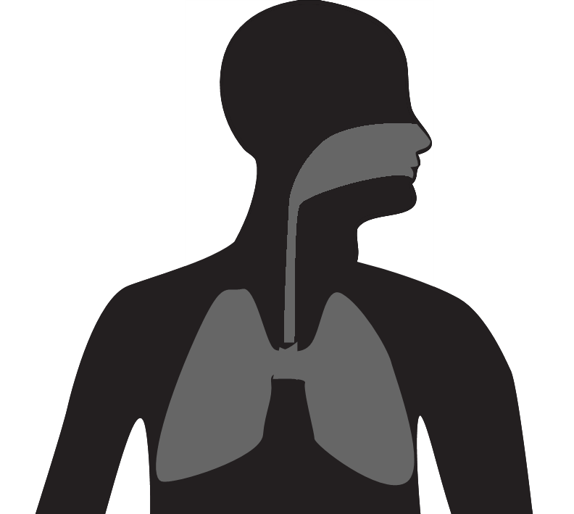
What transforms genetic diversity within hosts into evolution between hosts?
novel antigenic variants
within-host between-host
concordance

Slide 5
What transforms genetic diversity within hosts into evolution between hosts?
within-host adaptation
within-host between-host
concordance
divergence
α-2,6-linked
sialic acids
α-2,3-linked
sialic acids

Slide 6
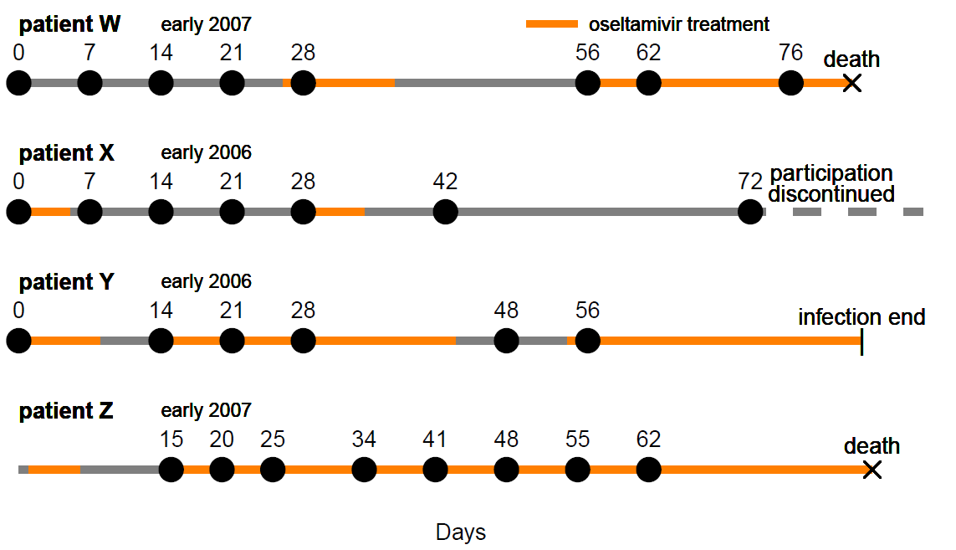
How does influenza evolve within hosts?
acute infections
5-7 days
chronic infections

Slide 7





We tracked influenza’s evolution in long-term H3N2 infections in immunocompromised patients.
day 0: first flu-positive nasal wash
Terry Stevens-Ayers, Angela P. Campbell, Janet Englund, Steve Pergam, Michael Boeckh
FHCRC and SCCA
Xue et al., eLife, 2017

Slide 8
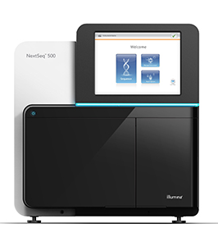
We deep-sequenced influenza populations.
nasal wash
bulk RNA
viral cDNA
viral DNA
tagmented libraries
Illumina sequencing

Slide 9
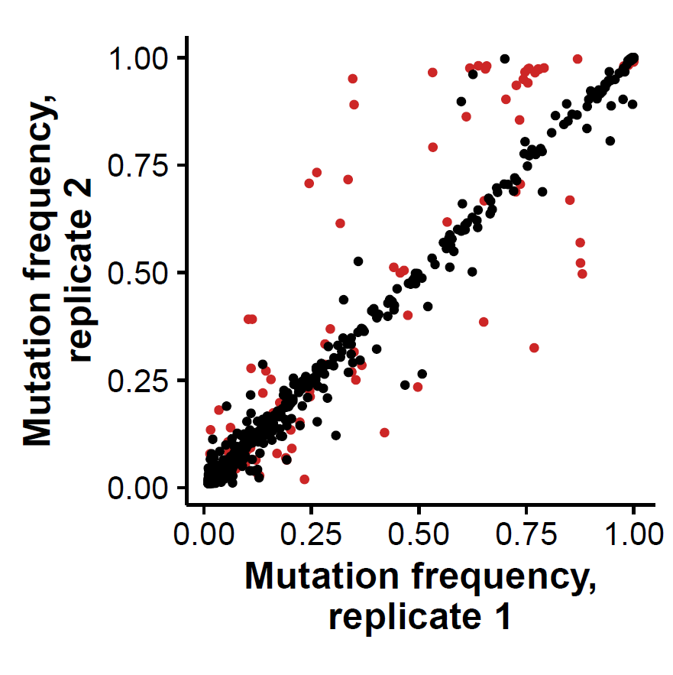
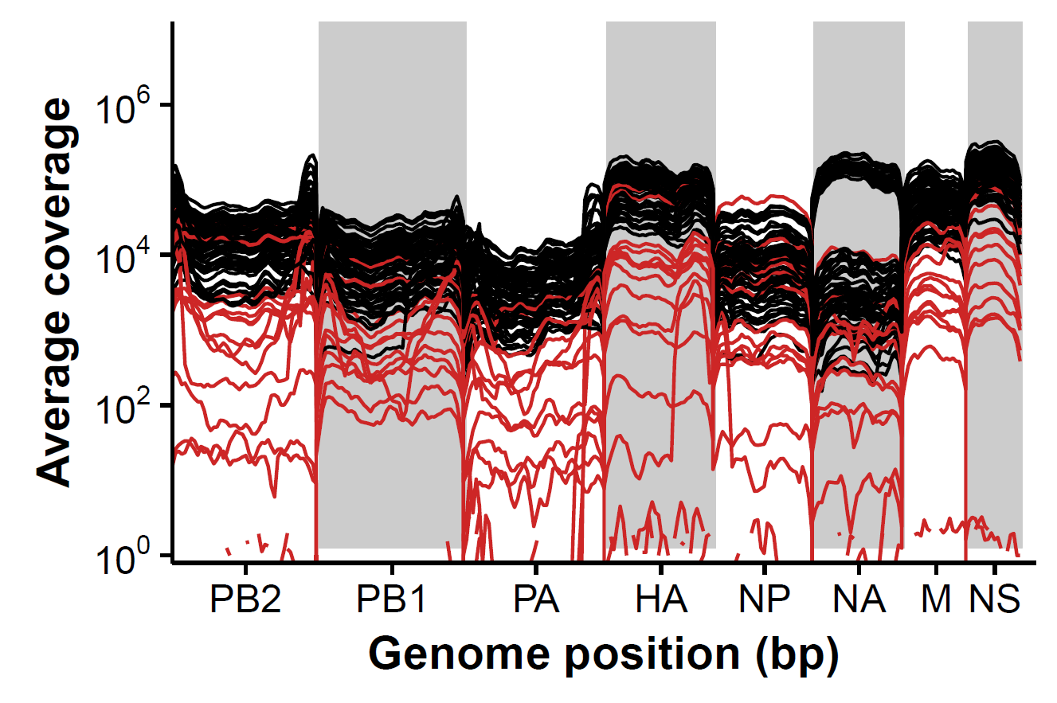
What genetic variation is present within hosts?
high-quality samples
low-quality samples

Slide 10
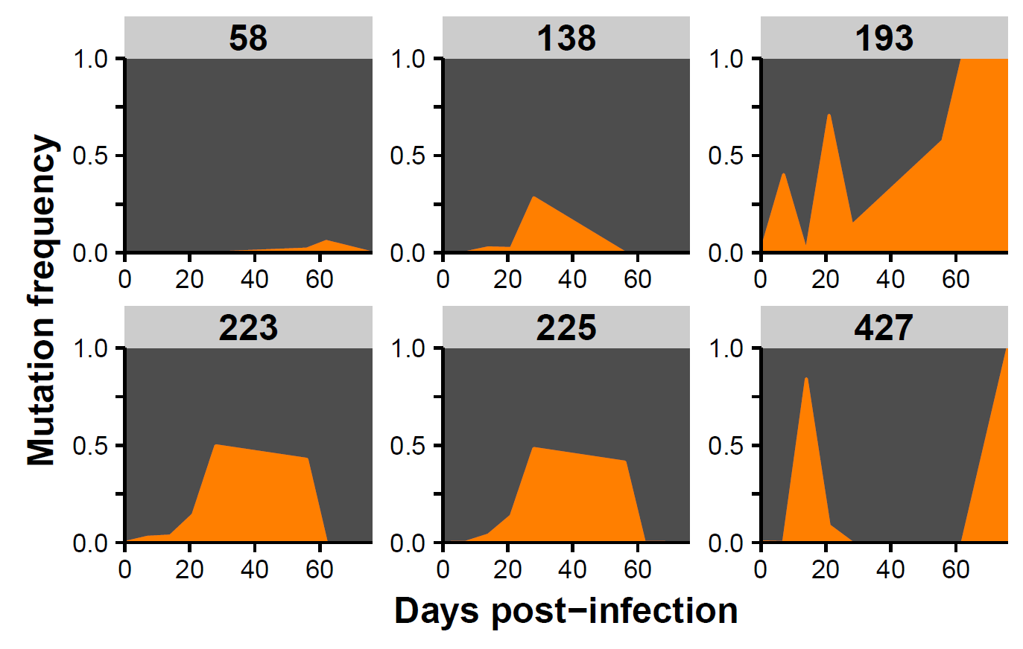
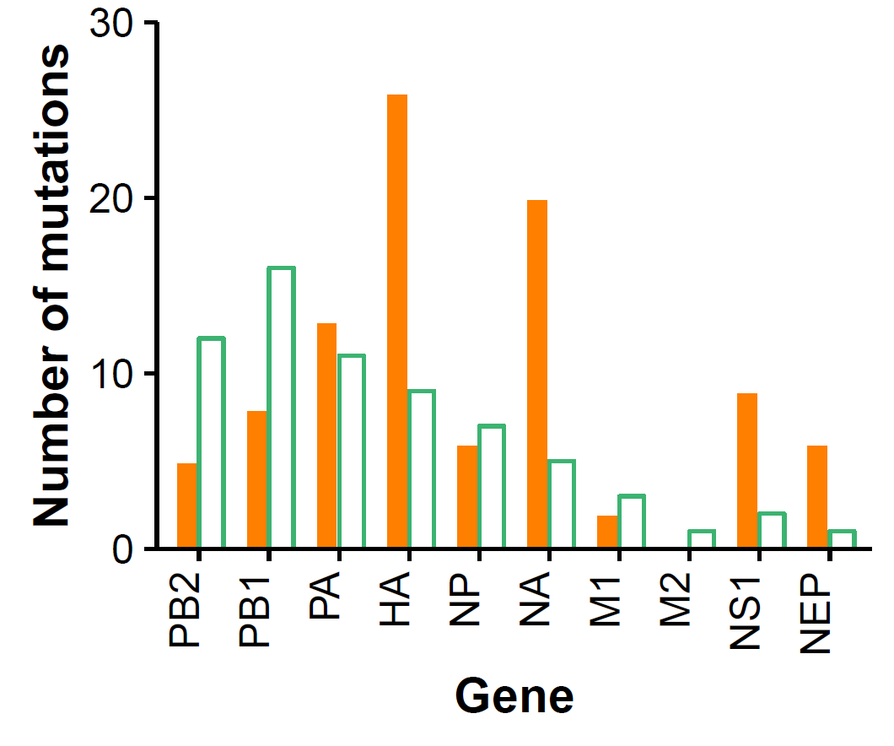
What genetic variation is present within hosts?
variant calling criteria: >5% in both sequencing replicates
■ nonsynonymous □ synonymous
I
A
F
T
S
Y
V
N
L
I
D
F

Slide 11
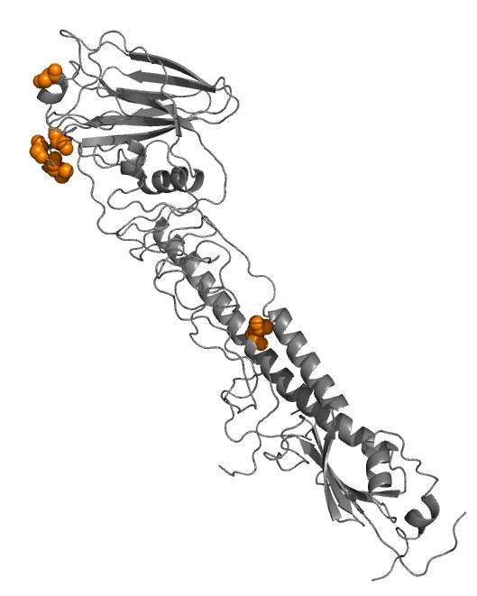
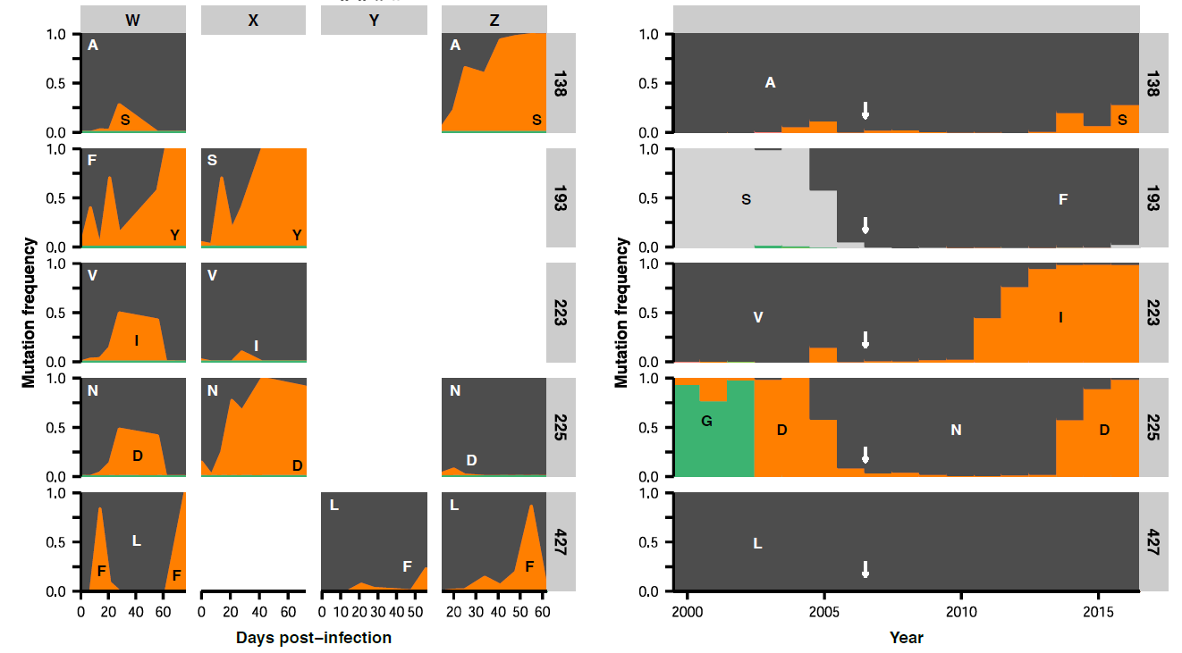
Certain mutations arise independently in multiple patients.
193
225
138
hemagglutinin
223
427

Slide 12
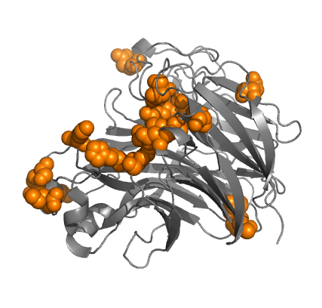
Oseltamivir resistance drives the emergence of many parallel mutations in neuraminidase.
W X Y Z
R150H
neuraminidase
*R152K
1. Mutations arise in parallel in multiple patients in our study in response to antigenic or antiviral selection.
*I222N
*T242I
*R292K
*N294S
E431K
* known oseltamivir-resistance mutation

Slide 13
Competition between variants can slow the fixation of beneficial mutations in the absence of recombination.
time

Slide 14
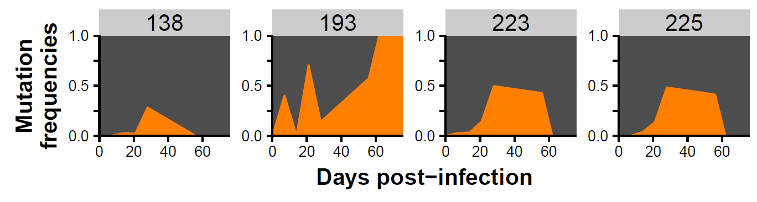
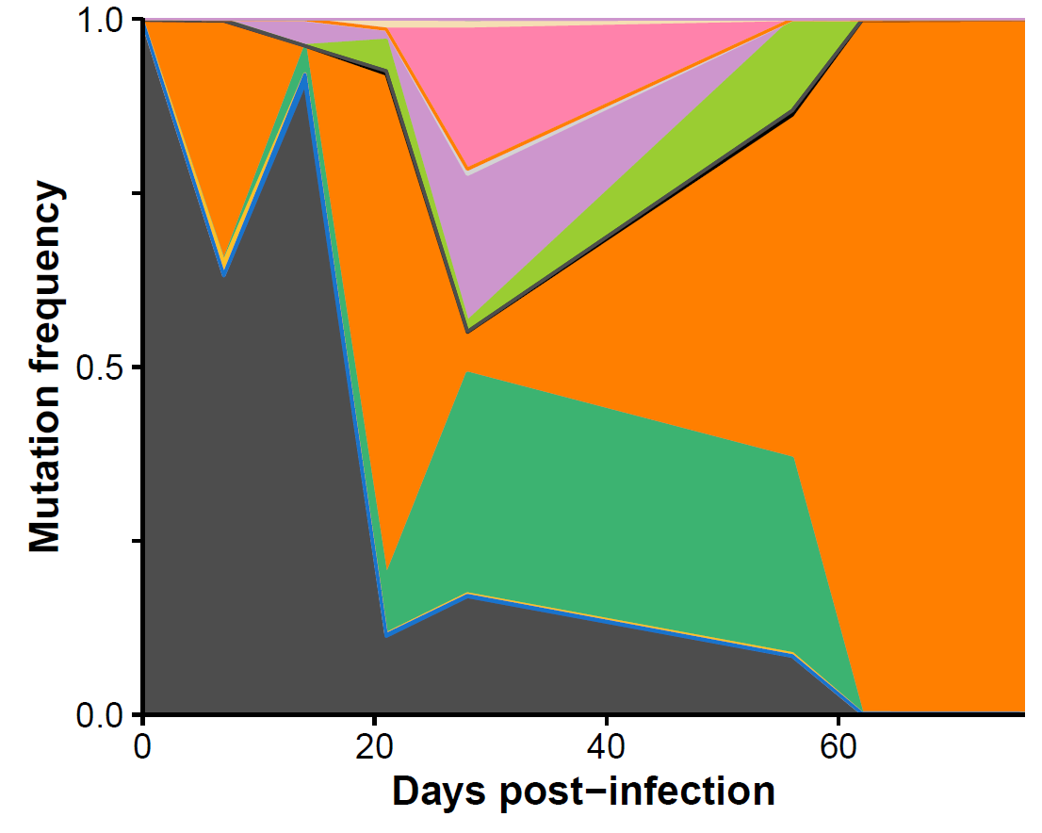
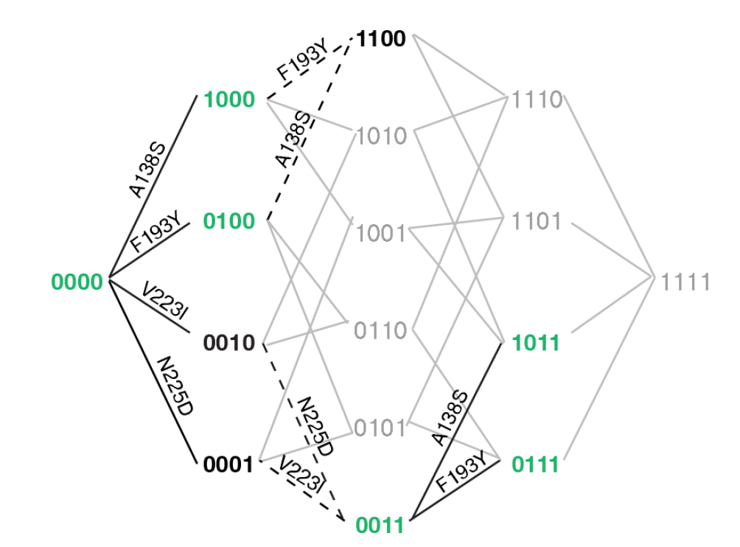
Multiple mutant lineages compete within a single patient.
patient W
2. Mutations arise in parallel within single patients.
1011
0111
1000
0010
0100
0011
0000

Slide 15
Recurrent within-host mutations also emerge in the global influenza population.
within-host
between-host
patient infections
3. Mutations arise in parallel in hemagglutinin at the within-host and global scales.

Slide 16
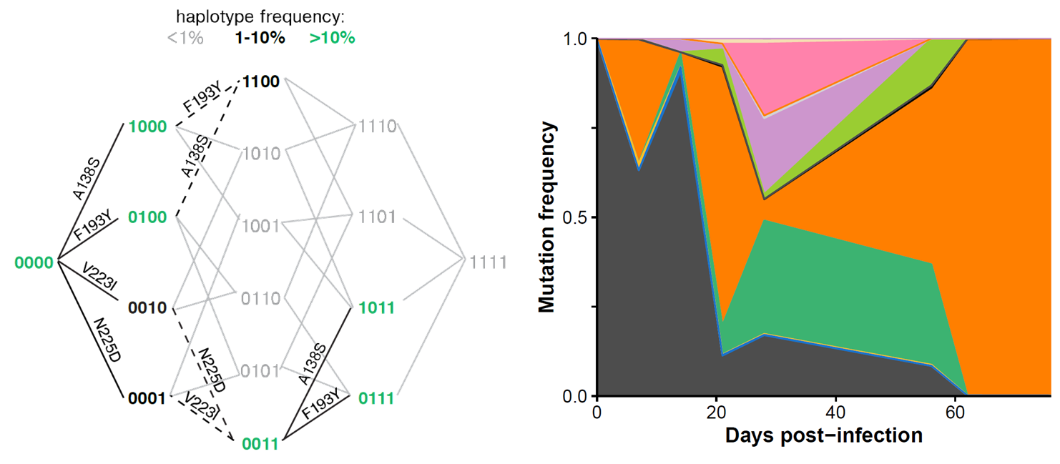
Influenza displays parallelism at multiple spatiotemporal scales.
within hosts
multiple
hosts
between hosts

Slide 17



Acknowledgements
Jesse Bloom
Terry Stevens-Ayers
Angela Campbell
Janet Englund
Steve Pergam
Michael Boeckh

Slide 18
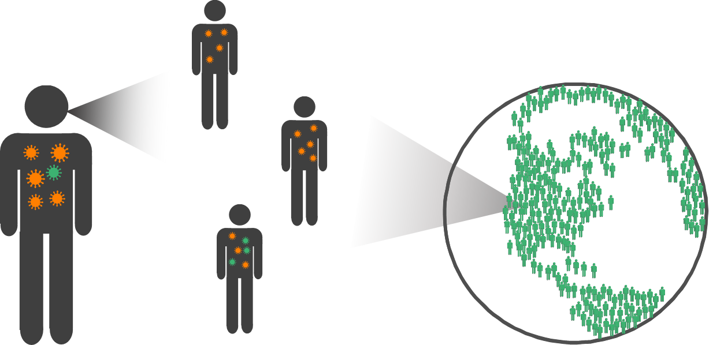
thank you! (any questions?)

Slide 19
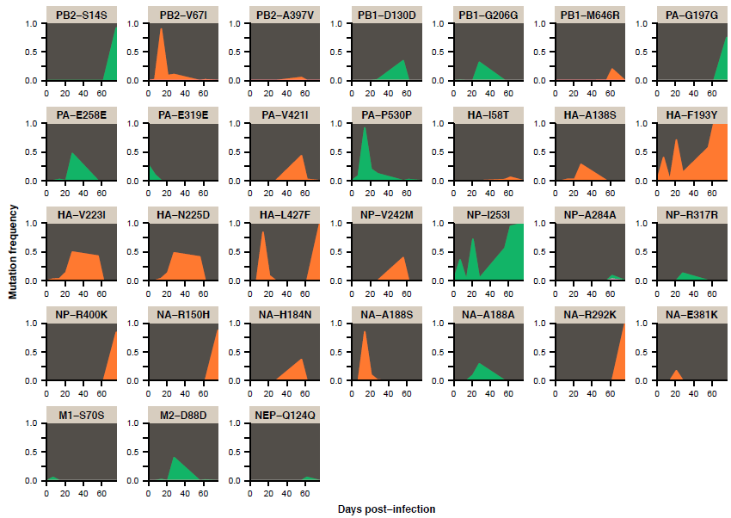
De novo evolution occurs at many sites in the flu genome.
■ nonsynonymous
■ synonymous

Slide 20
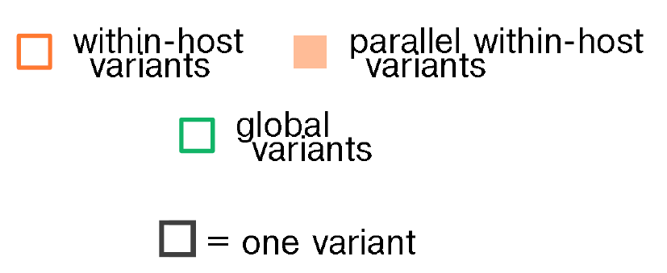

A large proportion of within-host mutations in hemagglutinin also emerge globally.
hemagglutinin
19
p<0.01
5
other influenza genes
47
79
not significant
2
neuraminidase
17
not significant
3
67
176

Slide 21
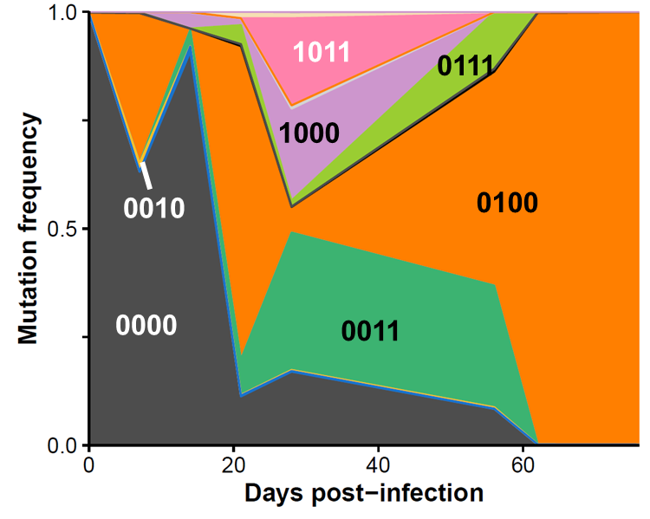
How does influenza evolve within typical, acute infections?
chronic infections
acute infections
 | Genes | H3N2 | pdmH1N1
Dinis et al. 2016 | HA | 68 | 46
Poon et al. 2016 | all | 47 | 55
Debbink et al. 2017 | all | 120
McCrone et al. bioRxiv | all | 200

Slide 22
Recent studies have measured influenza’s within-host genetic diversity.
 | Genes | H3N2 | pdmH1N1
Dinis et al. 2016 | HA | 68 | 46
Poon et al. 2016 | all | 47 | 55
Debbink et al. 2017 | all | 120
McCrone et al. bioRxiv | all | 200

Slide 23

How does influenza evolve within acute infections?
acute infections
 | Genes | H3N2 | pdmH1N1
Dinis et al. 2016 | HA | 68 | 46
Poon et al. 2016 | all | 47 | 55
Debbink et al. 2017 | all | 120
McCrone et al. bioRxiv | all | 200
chronic infections
substantial viral evolution, seemingly in response to antigenic selection

Slide 24
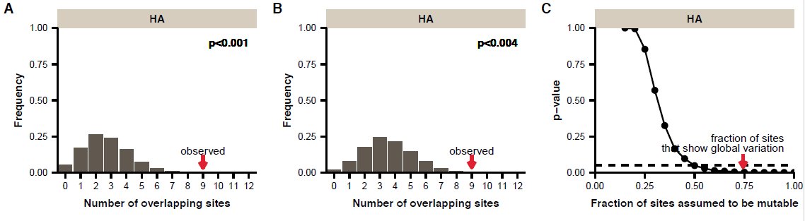
Is this parallelism statistically significant?
HA gene
75% of sites show any global variation
X
X
X
X
X
X
X
5 within-host
7 global
within-host
global
*
*
*
3 overlapping sites
567 total sites

