Slide 1
Installing a verbal autopsy system (EasyVA) in your own country
David Kong
david.kong@gatesfoundation.org
10/2/2024

Slide 2



What is EasyVA?
EasyVA is a web-based tool designed to help streamline the process of certifying cause of death (CoD). Key features include support for:
Physician-Certified Verbal Autopsy
(PCVA)
Computer-Coded Verbal Autopsy
(CCVA)
Provides structured and efficient workflow for clinicians and supervisors to enter CoD
Integrated the following software packages to determine the CoD
InterVA
InsilicoVA
SmartVA

Slide 3
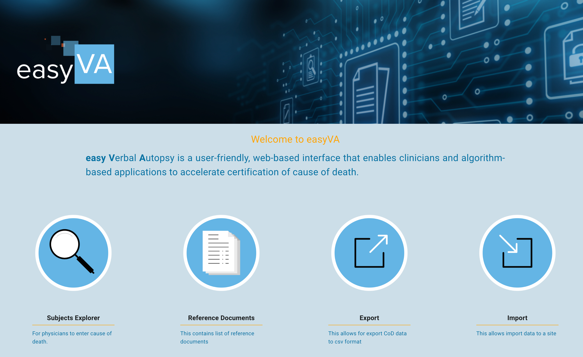
What’s new?
Open Source Availability: EasyVA is going to open source very soon (days), allowing for broader accessibility and collaboration
Partner Installation: Partners can independently install and manage the application
Identity and Access Management (IAM): The previous IAM has been replaced with an open-source solution, Keycloak, improving security and flexibility. Users can also opt for other IAM.

Slide 4
Software perquisites
Github desktop
Install Git and GUI for downloading source from source repository
Allow developers to share / collaborate on code projects
Docker desktop
Tool for building and running docker images. EasyVA is designed to run using docker containers

Slide 5
Building and running the application
Download the source from github. In a terminal, run the following commands.
Start the build
Run the containers
Run a python script to do initial setup in Keycloak ( IAM )
Restart VAService
In the browser, navigate to http://localhost:3000 to see the webapp
git clone https://github.com/institutefordiseasemodeling/easyVA
cd easyVA docker compose –f docker-compose.local.yml build
docker compose –f docker-compose.local.yml up -d
docker compose -f docker-compose.local.yml exec -it vaservice python /app/bootstrap_keycloak_client.py
docker compose -f docker-compose.local.yml restart vaservice

Slide 6
Demo 1: Import a WHO questionnaire file and view algorithm results
For this demo, let’s first learn about different user roles in EasyVA and what their permissions are:
Staff
Import / Export
Access to all sites
Site Representative
Import / Export
Access to single site
Supervisor
Assign CoD
Assign final CoD
Clinician
Assign CoD
View algorithm results
View algorithm results
Create site/user

Slide 7
Demo 2: Clinicians review questionnaire and assign CoDs
User permission needed for this demo: Supervisor or Clinician
Staff
Import / Export
Access to all sites
Site Representative
Import / Export
Access to single site
Supervisor
Assign CoD
Assign final CoD
Clinician
Assign CoD
View algorithm results
View algorithm results
Create site/user
Notes:
-

Slide 8
More on Physician certified VA (PCVA)
Clinician Access to Questionnaires: Clinicians can review a subject’s questionnaire and assign a cause of death (CoD).
Automatic CoD Finalization: If two independent clinicians assign the same CoD, it is automatically accepted as the final CoD.
Consensus Process for Discrepancies: If three different CoDs are assigned on the same subject, a consensus must be reached.
Supervisor Authority: Only supervisors are authorized to set the final CoD when consensus is required

Slide 9
Demo 3: Create a new user in both Keycloak and EasyVA
User permission needed for this demo: Staff - to create a new supervisor account
Staff
Import / Export
Access to all sites
Site Representative
Import / Export
Access to single site
Supervisor
Assign CoD
Assign final CoD
Clinician
Assign CoD
View algorithm results
View algorithm results
Create site/user

Slide 10
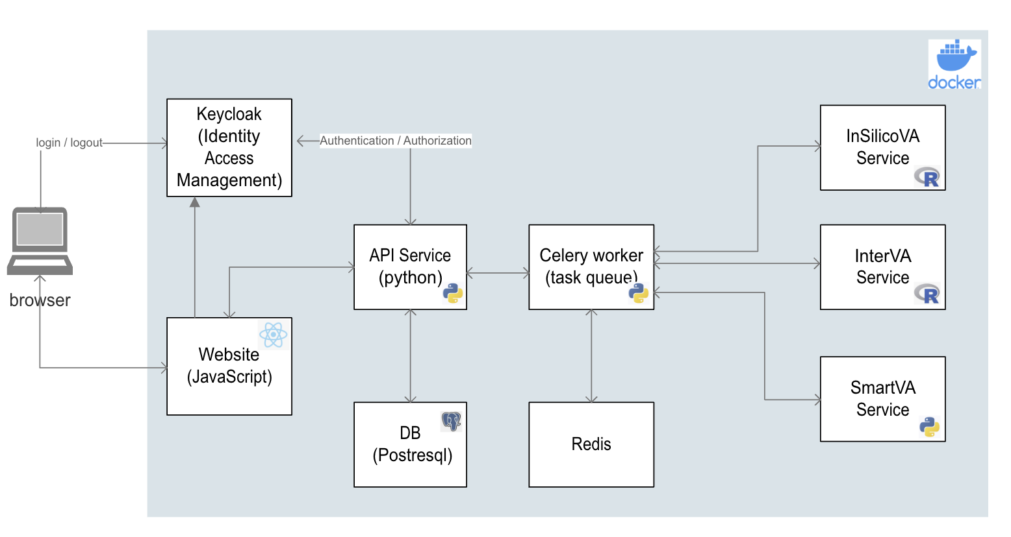
Architecture

Slide 11
Comments or Questions?

Slide 12
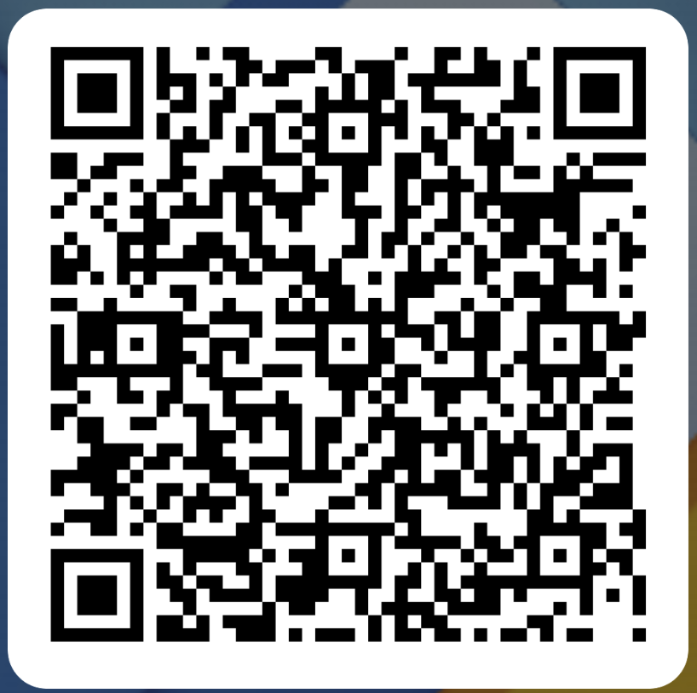
Thank you
EasyVA slack signup
Please contact us for all your EasyVA questions:
David Kong (David.kong@gatesfoundation.org)
Tony Ting (tony.ting@gatesfoundation.org)
Mandy Izzo (mandy.izzo@gatesfoundation.org)
Joy Lee (Joy.lee@gatesfoundation.org)

